Slide 1
Module 2

Slide 2
Outline
Agenda
Today
Project information
Sample project organization & timeline

Slide 3
Today’s agenda
9:00 - 9:30 Get settled
9:30 - 10:00 Welcome & example project walkthrough
10:00 - 11:15 Intro to SQL and PostgreSQL
11:15 - 11:30 Break
11:30 - 12:30 Using databases
12:30 - 1:30 Lunch (all on own)
1:30 - 2:15 Guest speaker (Tom Herzog)
2:15 - 3:00 Database exercises / project work
3:00 - 3:15 Break
3:15 - 5:15 Project work
5:15 - 5:30 Closing discussion
5:30 Written informal feedback for program course correction

Slide 4
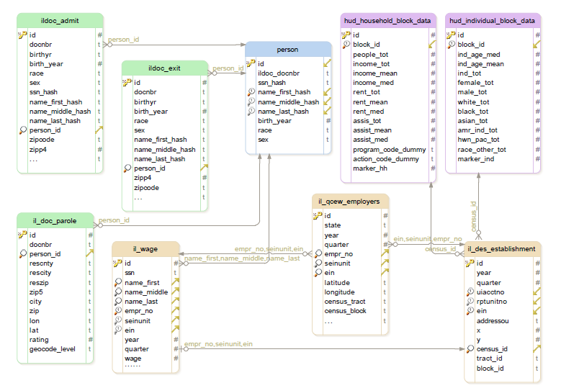
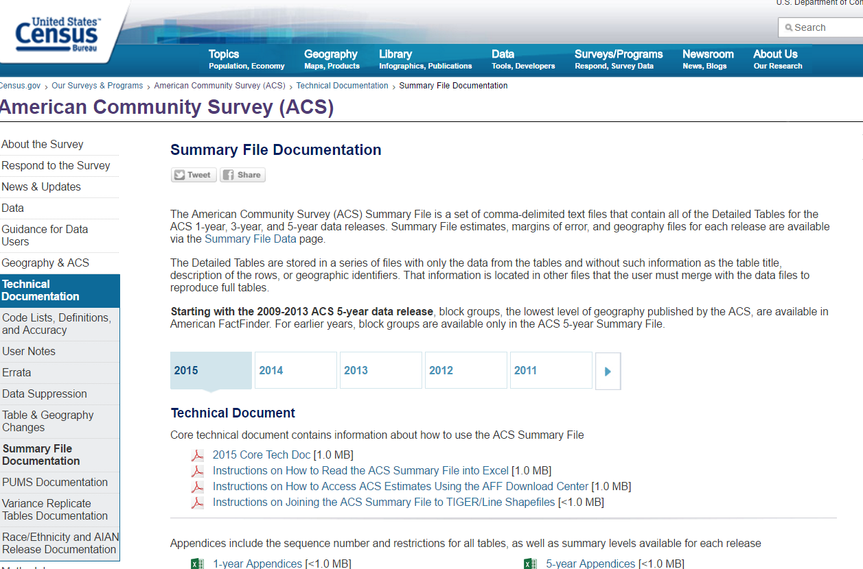
Why today is important

Slide 5

https://www.brookings.edu/wp-content/uploads/2016/06/200310_Holzer.pdf

Slide 6



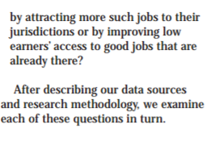
Questions

Slide 7
Module 2: example project structure & timeline

Slide 8
Overview
Project activity
Timeline
Definition & Scoping: Rayid’s tutorial from Module 1
Execution
Organization & workflows
Data exploration & analysis
Frequently revisit scope and assess risks to success
Closing: output review
Module 1
Modules 2, 3, 4
Module 4 / early May

Slide 9
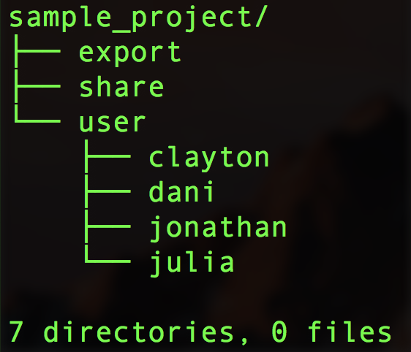
Project space organization
Initial setup
Only each user has access to their user directory
All members of the project can read and write in share
BUT, there can be problems if 2+ teammates try to edit a file at the same time
AND, Jupyter notebooks create temporary files when the notebook is in use (ie: not recommended to run notebooks from the “share” space)
Export is where to put things you would like reviewed for export

Slide 10
Suggested use of directories and how git fits
Directories
Share: working data subsets
User directories: exploration and distinct tasks / analyses; all analysis done from within user directories
Export: only use when ready for review and export process
Git
Team members push cleaned notebooks (or scripts etc) to master
Master has a complete workflow from start

Slide 11
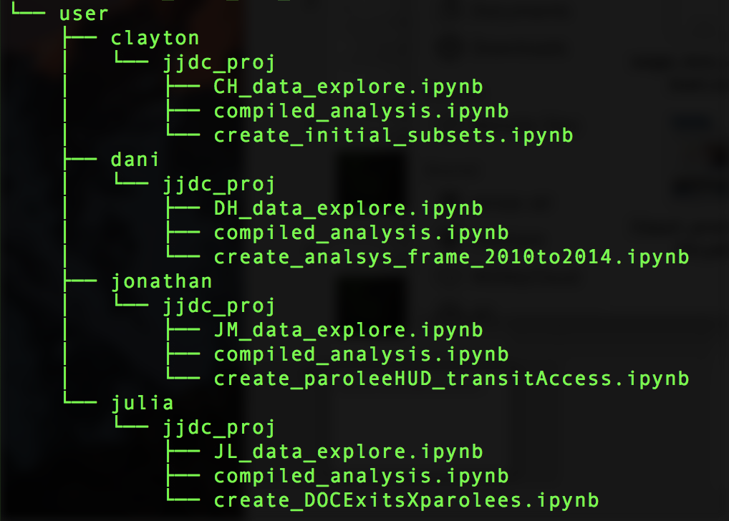
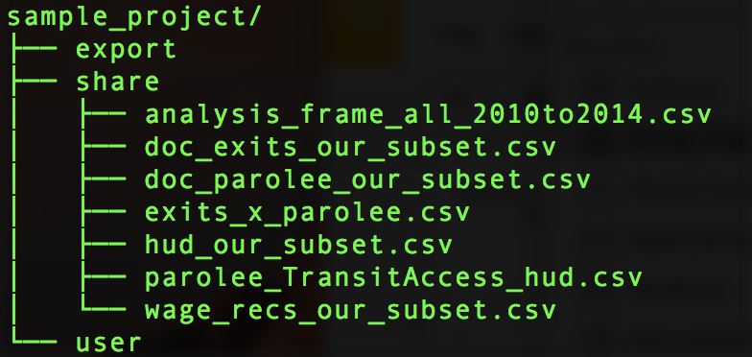
What could a working project space look like?
Share directory as interim data storage
User’s have the “jjdc_proj” directory as the local copy of git repository

Slide 12
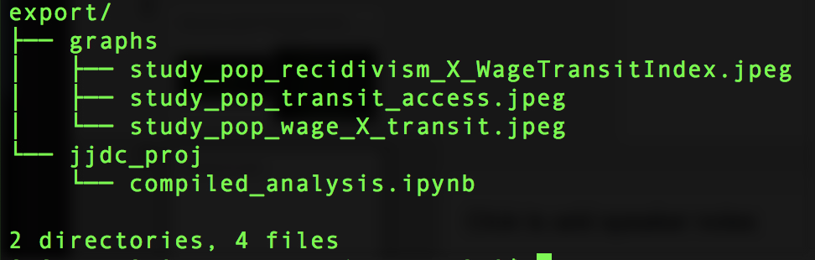
Completing the project
Include
Images to be output
Code used to create images (or other outputs like aggregated data)
More comprehensive export guidelines will be provided later in the program

Slide 13
Recommended project activities during Module 2
Session 1 - Wednesday
Revisit and clarify project goal(s) and scope
Data exploration
Session 2 - Thursday
Data exploration
Project planning: reassess scope, risks to success, and plans B - D
Data exploration
Session 3 - Friday
Discuss any interesting learnings from data exploration
Data exploration
Next steps & roles

Slide 14
When a “git pull” goes wrong
Sometimes when you “git pull”, git will refuse to merge because you have local changes that will be overwritten. For a given file with local changes that will be overwritten, you have the following options:
Stash, or set aside the changes, pull, then put the changes back:
Run “git stash” to set aside the changes in your repository.
Run “git stash list” to see all sets of changes you have pushed aside, just to make sure they got saved.
Run “git pull”. It should complete successfully now.
Run “git stash pop” to put the most recent set of changes back into your repository. If there are merge problems, you’ll be prompted to resolve the conflicts.
Wipe your changes. For each file:
Run “git checkout <file_path>”. This retrieves the most recent version from the master repository and puts it in place of your changed file.
Run “git pull”.
You could also “make a copy” of a jupyter notebook you want to edit, but this gets confusing fast.
You should not have to make an entirely new clone of your repository.
For more on using git, see the “git_basics.ipynb” Jupyter notebook in session 2’s notebooks.

