Slide 1
Data and Databases

Slide 2
Data and Databases - Overview
Data storage and organization methods
Which is good for what? – including truly big data
Overview of class data sets and how they relate
How and why we put the class data in a relational database
Examples of derived data

Slide 3
Data storage – types of storage
File system data files including delimited text and spreadsheets
Native data files for your statistical package of choice
Database management systems (DBMS)
Relational databases
“NoSQL” databases

Slide 4
Data storage – Text files
Text data files can come in many formats:
Excel, Comma-separated values (CSV), tab-delimited, fixed-width, etc.
Pros:
Platform independent
Relatively easy to make, use, and share (though complex text data can be painful).
Fine for small data sets and simple analysis.
Cons:
Analysis can be made repeatable, but substantial overhead related to preparing files for analysis.
Large files become unwieldy.
As analysis and data become more complex, harder to keep track of different files and tie data together.

Slide 5
Data storage – Native data files
Files in the native format for your statistical package of choice:
Stata, SAS, R, SPSS, etc.
Pros:
Good for modest-sized, relatively simple data sets (often limited by amount of memory).
Data is parsed and ready to analyze.
Statistical packages provide some of the features of full-on databases – indexing, filtering, etc.
Cons:
Can be difficult to migrate data from one statistical package to another.
As data increases in size and complexity, more difficult to share and collaborate, and statistical package eventually can’t easily keep up.
Notes:
More cons related to large data sets:
For large data sets, can be really painful to work around memory limits, even if the statistical package supports loading data larger than memory.
Data must be loaded each time the application is started, which is a reliable process, but can still take a long time for a large data set.

Slide 6
Data storage – DBMS
A database is a collection of data about entities. It can be more or less structured, depending on the type of database, and can include information about the relationships between entities.
A database management system (DBMS) is system that provides infrastructure for storing, managing, and interacting with databases. This includes:
The way the system stores data.
A query language, which specifies how users interact with data.
Support for transactions and crash recovery.
There are hundreds of different DBMS, but the two main types we’ll discuss are relational and NoSQL.

Slide 7
Data storage – Relational DBMS
Relational DBMS (RDBMS) data model:
Relational databases store data records in tables, each of which:
Has a predefined set of columns - the pieces of information captured for each record in a table
Stores data records as rows in the table, where a row has a place for a value for each column.
Tables and their columns and relationships are defined in a schema.
RDBMS-es use the Structured Query Language (SQL, pronounced “sequel”) to allow user interaction with data.
Allows for concurrent reads and the clustering of writes into transactions that can be committed or rolled back and that are processed in the order they are received.
Notes:
- Primary key can be a single unique integer (your traditional numeric ID), or can be a set of fields where a unique combination of values identifies a given record.

Slide 8
Data storage – RDBMS – pros and cons
Relational DBMS pros:
Well-suited for tabular data.
Relations provide good support for normalization (more on this later).
Logical representation of data (tables and rows) separate from how data is stored.
Easily integrable - Most programming languages and statistical packages can use SQL to load data from and write to common RDBMSes.
Relational DBMS cons:
Requires initial investment setting up schema and populating tables (data cleaning and loading can be substantial work if data files don’t fit the schema).
Hasn’t always been a good fit for unstructured data (how to define schema?)
Can be difficult to scale up to truly “big” amounts of data and/or numbers of users.

Slide 9
Aside – Database scaling – CAP theorem
As a data store becomes extremely large and used by millions of concurrent users, you must either partition (split up) or replicate your data across multiple computers, so you can distribute the load of your application.
CAP theorem outlines the tradeoffs inherent in design of distributed databases.
CAP – in context of scaling data storage across multiple computers:
Consistency – all computers see the same data at the same time.
Availability – every request gets a response whether it succeeds or fails.
Partition tolerance – system continues to work even if network failure.
A given system can’t have a high level of all three.

Slide 10
Aside – Database scaling - RDBMS and CAP
RDBMS designers valued Consistency and Availability over Partition tolerance in designing RDBMS transactions.
This lead to a set of transaction design principles known as ACID:
Atomic – all work in a transaction completes or none of it does.
Consistent – a transaction transforms the database from one consistent state to another.
Isolated – results of changes made in a transaction are not visible until the transaction has committed.
Durable – results of committed transactions survive failures.
As volume of data and number of users increased during the Internet boom, database designers needed to relax these rules to allow their data stores to scale up.

Slide 11
Data Storage - NoSQL
NoSQL = a wide variety of databases (see table on next slide) that relax consistency (and so ACID properties) in order to increase scalability and/or availability.
NoSQL initially stood for “No SQL”, now stands for “Not Only SQL” (Relational databases and NoSQL databases have started to converge).
Generally do not require a fixed table schema nor do they support JOINs or other relational database features.
Designed to process extremely large amounts of data and handle many concurrent users.
Sometimes referred to as BASE:
Basically Available – system at least seems to work all the time.
Soft state – does not have to be consistent all the time.
Eventually consistent – if not consistent now, it becomes consistent at some later time.

Slide 12
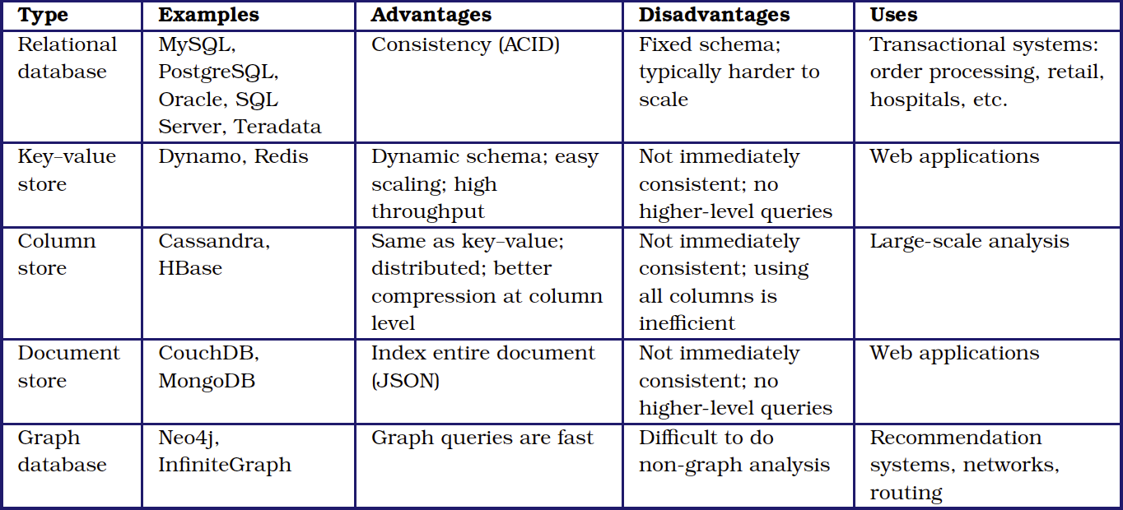
Data Storage – NoSQL types
Notes:
- Key-value store – a single table with two columns: name and value. No records, no types, have to keep an eye out for name collisions,

Slide 13
Data Storage – NoSQL types
Basic key-value store
a single table with two columns: name and value.
No records, column types, schema, or query language.
Can create structure via naming conventions, but beware name collisions.
Document-based databases
Key can relate to a structured document (JSON)
Still no schema or query language – you are responsible for consistency within documents.
database has the ability to index and filter based on values within document.
Graph-based databases
Two types of records – nodes and ties.
Each record is a name-value pair store so nodes and ties can have attributes.
Have specialized query languages that make relational queries quick (give me all the friends of my friends)

Slide 14
Data Storage – what to use?
Each of these data storage options is useful in certain circumstances.
Relational DBMS:
This should be your default for projects that involve tabular data, especially if you tie data sets together.
RDBMS maintains the integrity of your data, but can also do much of what NoSQL databases can.
Flat files and statistics package data files:
Simple projects (small data, basic analysis) with no need for re-use.
Contexts in which you have limited access to technology or rights to install programs.
Data transfers.
NoSQL databases:
High volume of unstructured data you need to capture in real-time (twitter fire hose).
Specialized use cases where RDBMS isn’t appropriate.

Slide 15
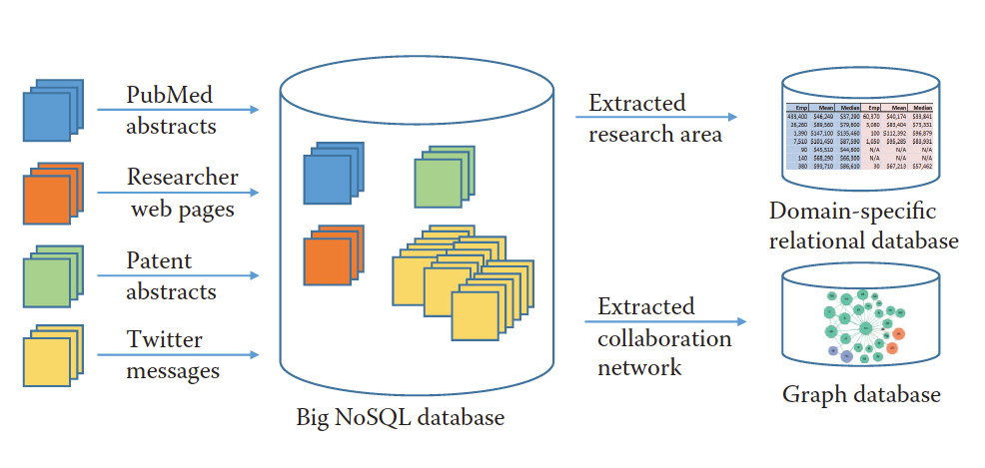
Data Storage – what to use? – hybrid
Statistics Package
if RDBMS - SQL-based integration
Python
Data hub –
or RDBMS
Notes:
For class, our hub is an RDBMS:
Flat files cleaned and transformed so they can be inputs to database.
PostgreSQL as data hub.
Python for working with data and facilitating extracts and imports.
Other database systems and analytical programs as needed.

Slide 16
Data Storage – what to use? - examples
10,000 records describing research grants, each specifying the principal investigator, institution, research area, proposal title, award date, and funding amount in comma-separated value (CSV) format.
10 million records in a variety of formats from funding agencies, web APIs, and institutional sources describing people, grants, funding agencies, and patents.
10 billion Twitter messages and associated metadata—around 10 terabytes (1013 bytes) in total, and increasing at a terabyte a month.

Slide 17
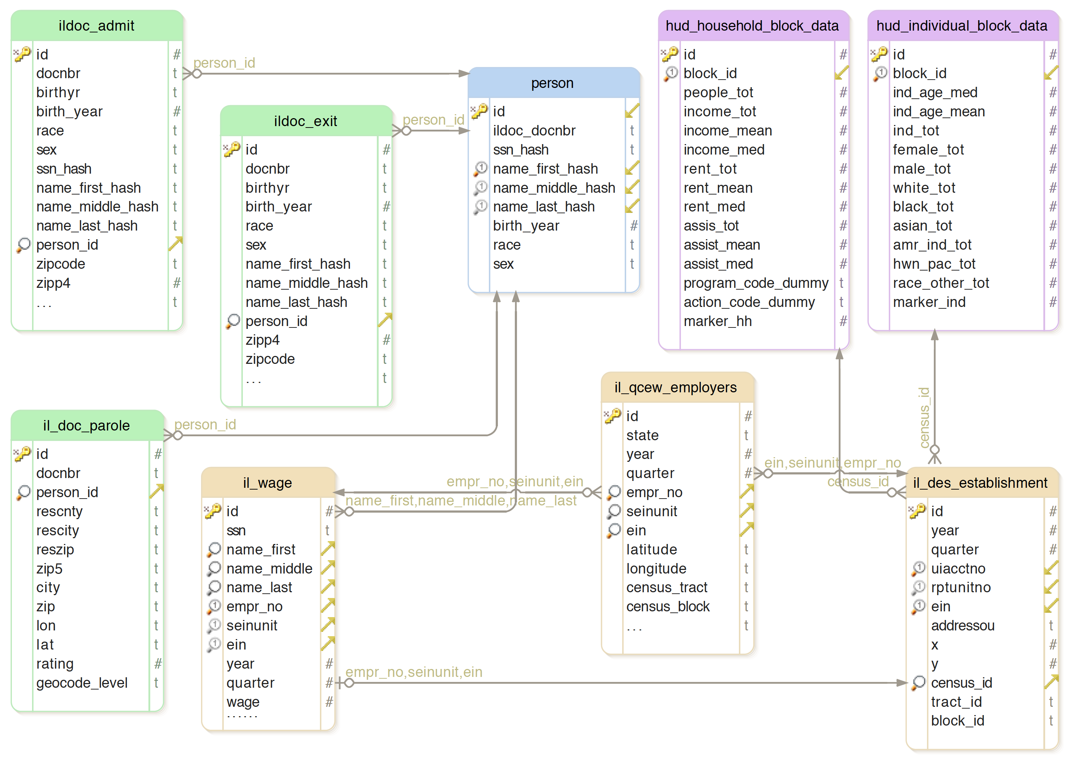
Data Storage – example – class data
Notes:
For class, our hub is an RDBMS:
Class data ingest process:
Received flat files, mostly CSVs, from data providers. Moved them straight to air-gapped red environment.
In red environment:
Parsed files.
For person-level data, hashed SSN and name parts, removed original values
For data we were required to aggregate, aggregated.
Converted back to CSV files for ease of export and moving files.
In yellow environment:
Loaded into pandas, checked auto-typed columns, converted as needed but avoid loss of information.
Stored data in database table.
Added unique integer auto-increment ID.
If related to person:
populate foreign key to person.
See if any information needs to be normalized up to person
optimize database tables – mostly creating indexes.

Slide 18
Normalizing data
Normalization – process of designing a schema where:
tables match the entities in your data (people, employers, wage records, etc.).
A given piece of information is only stored once, and…
Don’t have name string in every wage record, just the person table.
…stored in the table where the information belongs.
And any information that could be applied to an entity more than once gets its own table, rather than a set of columns in a row
email address – if there are 3 columns for email addresses in person, what do you do with the fourth?
Important for complex and/or ongoing projects.
Sometimes not necessary for small or one-time projects.
BUT - Easier to start with a normalized schema in an RDBMS and grow than to retro-fit later.

Slide 19
Normalizing Data - Forms
Increasing levels of normalization are called “forms”.
There are 4 or 5 theoretical forms. The first three are generally agreed to be the most useful:
1st Normal Form:
Create separate tables for each set of related data.
One and only one value per column.
No comma-delimited lists.
Tables should have a primary key
one or more columns you can use to uniquely and unambiguously identify each row in the table.

Slide 20
Normalizing Data – Forms continued
2nd Normal Form:
Create separate tables for entities that can apply to multiple records.
Each table should have a single-column primary key.
Record relations between tables using foreign keys.
3rd Normal Form:
Within each table, remove information that is not exclusively an element of that entity.
Any employer information in a wage record should be removed, employer referenced by foreign key.
So how did we do?

Slide 21
Normalizing Data – example – class data

Slide 22
What next? – Deriving data
Normalized data in an RDBMS makes it much easier to quickly derive data to test a range of hypotheses or research questions. For example:
Lets build a data file to help us understand effect of interventions on recidivism:
Define re-offending: prison admission within two years of exit.
Include history, but also as large a sample as possible – amount of history? 2 years to start.
Who do we include to start? Start with people in exit table who left jail between 1992 and 2013.
Admit and exit data start in 1990, so jump ahead to 1992 so everyone has 2 years of history.
They end in 2015, so come back two years to 2013 so we can look for recidivism with all in our sample.
If you want to integrate other data sets, adjust time frame filter to include their data, as well.
Il_wage – from 2005 to 2015, so start in 2007 rather than 1992.
Once population is selected, create row per person in data table, then create columns for interesting data and write code to populate the columns.

Slide 23
Conclusion
Once you have data from different sources normalized and related in an RDBMS, it becomes much easier to derive data to test a range of hypotheses or research questions.
The data table pattern can be adapted to many scenarios:
For machine learning, might want to maximize number of observations, and so pull in older records at the expense of data derived from wage table.
For geospatial analysis, might want to tie it into parole addresses (2009-2015), then to services and jobs available near ex-offenders’ residences.
Code re-use: If you build your code to generate column values carefully, you can re-use it in many different scenarios as well, making subsequent analysis increasingly more efficient to implement.
All of this is comparatively straightforward because you use a database.

Slide 24
Questions?

Slide 25
Addendums
Normalizing data – example – Twitter stream
Class data ingest process overview.

Slide 26
Normalizing Data – example – Twitter
When you capture tweets, you get a whole bunch of information wrapped up in a JSON document:
Information on tweet content
Full text of tweet
Hash tags
Referenced URLs
Information on user who tweeted
Demographic information
Information on friends and followers
How to deal with this data?

Slide 27
Normalizing Data – example – Twitter, continued
Raw tweet table for collection – either dump JSON in a text field, or parse and make a column per field in the tweet JSON.
Tweet stream can be high volume - just parse, write and move on.
Similar to a NoSQL strategy.
Then, have follow-on processor that breaks up data into the following tables/entities:
Tweet
User information, joined from tweet by foreign key.
Hash tags and URLs in separate tables, joined from tweet by foreign keys.
What do you do when a user’s information changes?

Slide 28
Class data – ingest process overview
Statistics Package
if RDBMS - SQL-based integration
Python
Data hub –
or RDBMS
Notes:
For class, our hub is an RDBMS:
Class data ingest process:
Received flat files, mostly CSVs, from data providers. Moved them straight to air-gapped red environment.
In red environment:
Parsed files.
For person-level data, hashed SSN and name parts, removed original values
For data we were required to aggregate, aggregated.
Converted back to CSV files for ease of export and moving files.
In yellow environment:
Loaded into pandas, checked auto-typed columns, converted as needed but avoid loss of information.
Stored data in database table.
Added unique integer auto-increment ID.
If related to person:
populate foreign key to person.
See if any information needs to be normalized up to person
optimize database tables – mostly creating indexes.

Slide 29
Class Data – ingest process
Class data ingest process:
Received flat files, mostly CSVs, from data providers. Moved them straight to air-gapped red environment.
In red environment:
Parsed files.
For person-level data, hashed SSN and name parts, removed original values
For data we were required to aggregate, aggregated.
Converted back to CSV files for ease of export and moving files.
In yellow environment:
Loaded into pandas, checked auto-typed columns, converted as needed but avoid loss of information.
Stored data in database table.
Added unique integer auto-increment ID.
If related to person:
populate foreign key to person.
See if any information needs to be normalized up to person
optimize database tables – mostly creating indexes.

