Slide 1
Introduction to Data Science Techniques (MAT 339)

Slide 2
Plan for Today
Course Overview
Introduction to GitHub
Introduction to LaTeX

Slide 3
1. Course Overview
Origins of this course
Review Course Description
“ADMIN/S26 DST Course Description.docx”
Preview of some course topics

Slide 4
1c. Preview of course topics
Week 2 - the terminal (command-line basics and commands)
Weeks 3-4 - data wrangling and processing in the terminal
Weeks 5-6 - automation (turning workflows into commands using shell scripts, data pipelines, etc.)
Weeks 7-8 - interactive command-line interfaces (CLIs) (e.g., Textual, Rich)
Weeks 9-10 - images as data (OpenCV, PIL, etc.)
Week 11 - dashboarding (in Jupyter)
Week 12-14 - Python APIs and other intermediate Python topics
I will show a few quick demos of these.

Slide 5
GitHub – a very short introduction
GitHub is a system for collaborating on developing code, allows for:
tracking of changes,
maintaining history of code versions,
testing new ideas on “branches”,
and much more…
You should have already:
set up a GitHub account at https://www.github.com, and
installed GitHub Desktop from https://desktop.github.com/download/ and/or have Git from the terminal up and running (see course GitHub guide “Accessing Course Content using GitHub.docx”)

Slide 6
GitHub
Learning objectives for today’s lesson
git clone
git add
git commit
git push
git pull
resolving one simple merge conflict

Slide 7
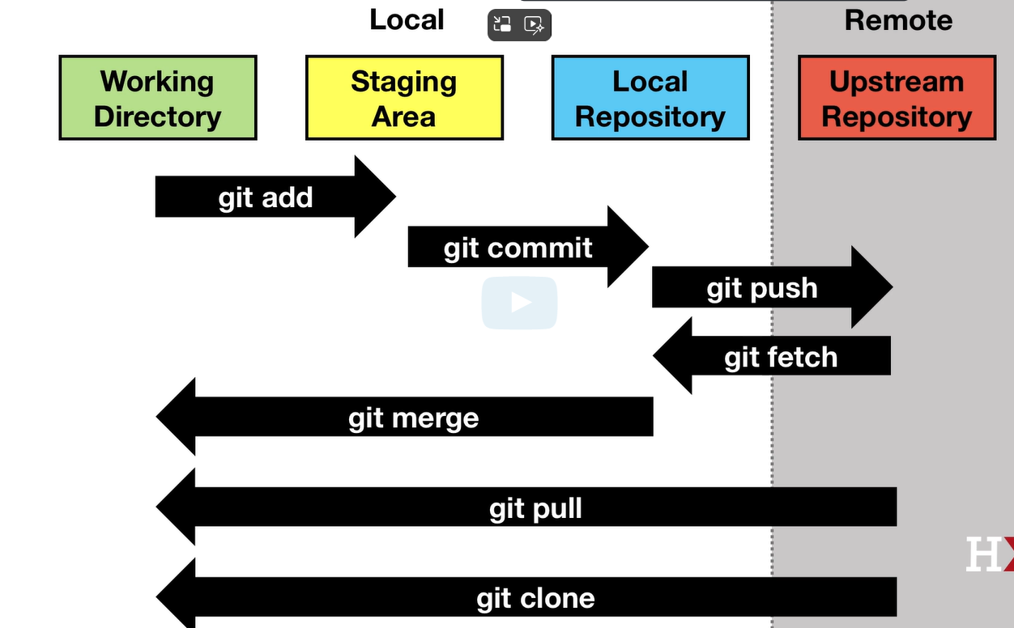
How Git is Organized
Files in your working directory are not necessarily in the local repo.
They must be added to the staging area, causing git to track them, then committed to the repo.
source: Harvard EdX Data Science: Productivity Tools course
https://courses.edx.org/courses/course-v1:HarvardX+PH125.5x+1T2025/

Slide 8
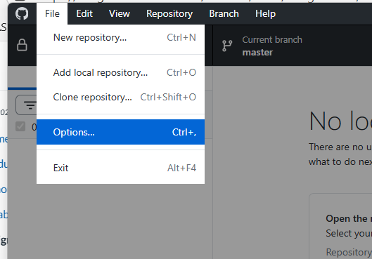
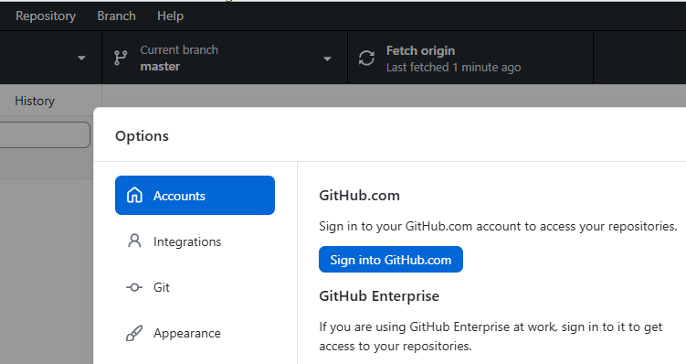
On to the lesson:
I will be using GitHub desktop and I recommend you do as well for this lesson, but you could use Git from the terminal instead.
If not already logged in to your account within GitHub Desktop, sign into your GitHub account by going to File:Options:Accounts.

Slide 9
Part of HW 1 was to be completed before today’s class, so you should have already cloned my github_basics_A (or _B or _C) repository depending on your last name.
If not, do so now. See the course GitHub document for more info on how to clone.
Note:
You can make changes to this repo since you were invited to be a “collaborator” by the repo owner.
You can not make changes to the course content repo.
On future teams you will be on, you would each want to be collaborators.

Slide 10
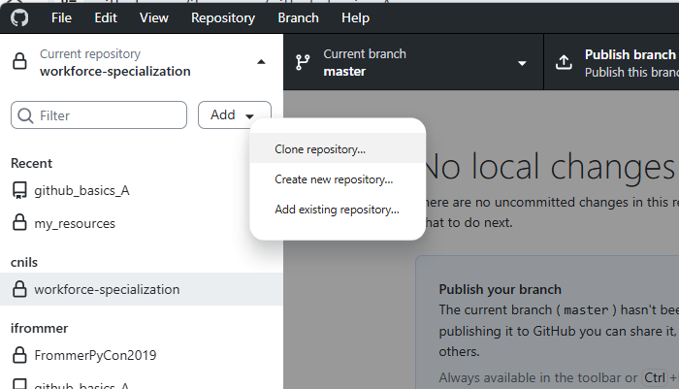
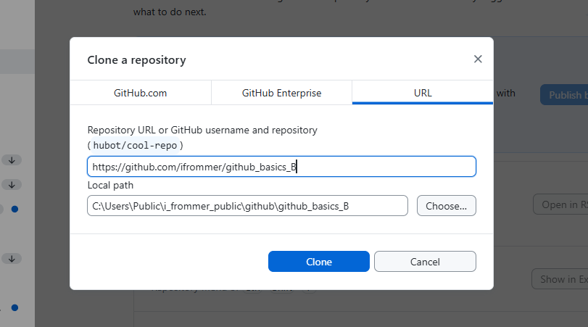
Cloning a Repo – in pictures

Slide 11
Collaborating on Files
Work flow
work on files locally
when done, “Commit” your changes (“Commit” button in GitHub Desktop)
then click “Push origin” – this uploads your files to the repo on github.com
If you take turns working on files, no conflicts will arise.
let’s demonstrate this – add 1 comment under the divider, then commit, then push
Sometimes your work on a file may overlap – leads to conflicts that you have to “merge” – a very common situation.
let’s try to demonstrate this – see next slides

Slide 12
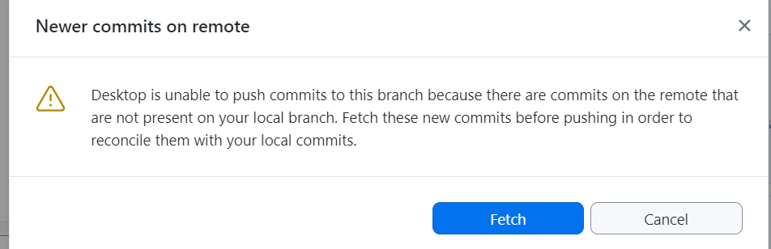
What a conflict looks like
Here’s the original file:
recipes = {
"apple pie": ["apples", "flour", "sugar"],
"pancakes": ["flour", "milk", "eggs"]}
Ava and Ben each independently download the file (by “pulling” the repo).
Each updates the file with a recipe. Ben add’s egg salad. Ava adds hummus; her recipe.py now looks like this:
recipes = {
"apple pie": ["apples", "flour", "sugar"],
"pancakes": ["flour", "milk", "eggs"],
"hummus": ["chickpeas","olive oil","garlic"]}
Ava commits her changes and pushes (uploads) the changed file to the repo.
Ben commits his changes, but when he goes to push he encounters a merge message.
Ben clicks Fetch

Slide 13
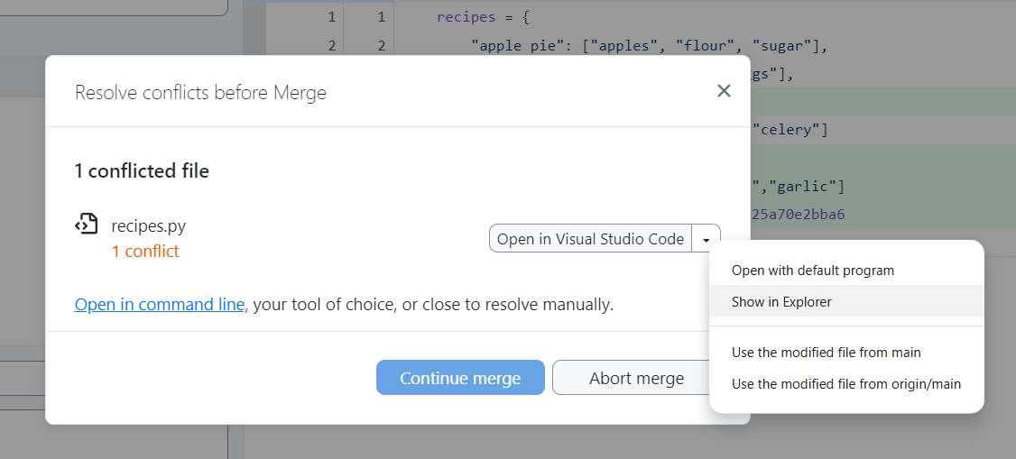
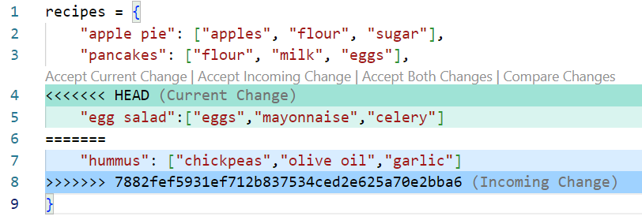
Conflicted file (cont)
After clicking Fetch, Ben sees this:
Next, he and his collaborators:
decide how to resolve this (possibly using GitHub Issues) and
edit the file accordingly (e.g. in Spyder, VS Code, etc. ); here’s what it looks like in VS Code:
<- what’s in both versions
<- what’s only in Ben’s version
<- what’s only in the remote version (on the repo online, i.e. what Ava uploaded first)
They agree to edit to include both recipes.
<<< and >>> signify start and end of conflict
======= separate the different versions.

Slide 14
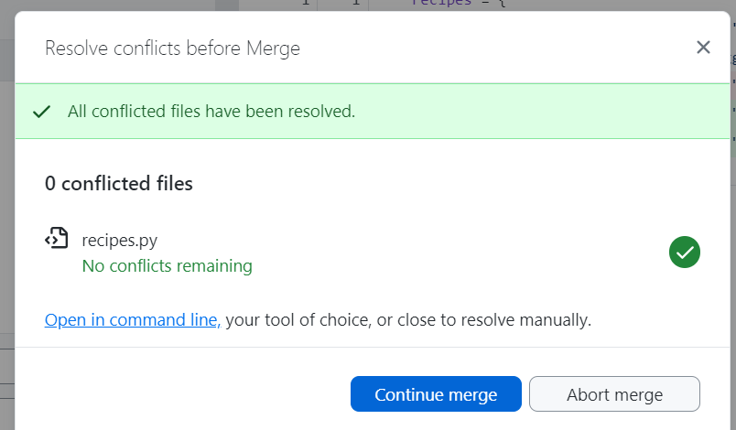
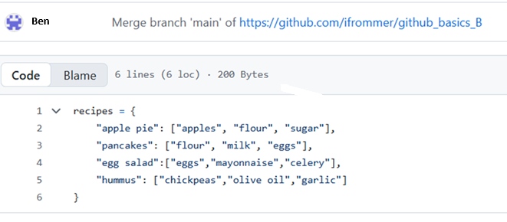
Merging
After editing the file, back in GitHub Desktop Ben now sees:
He clicks “Continue merge”
The conflict is now resolved.
Up on the repo, the file is now:

Slide 15
GitHub questions on the homework
Questions 1-4 – setting up account, tools and cloning
Question 5 – screen shots of your set-up
Question 6 – based on what we just covered:
6. Choose one or more students who were assigned to your github basics repo. This was based on last name: B-H in github_basics_A J-P in github_basics_B R-W in github_basics_C Following the script demonstrated in class, make changes to the repo rst by taking turns and then overlapping. When overlapping, resolve the conflict and merge the changes. Write up a brief recap of these activities as your answer to this question.

Slide 16
Creating Your Own GitHub Repo
1st create the repo on GitHub.com (the "upstream repo")
Next make the local repo:
Set up a local directory with files you want in the repo
In Git Bash (or similar) from the top level of this directory type:
git init (turns it into a local repo)
Add the files in the folder to the local repo¹. For example to add the file README.txt, type:
git add README.txt ²
git commit -m "First commit…"
Connect to the GitHub repo by typing:
git remote add origin <repo's_url>
4. Type git push -u origin main - pushes local files upstream
¹ Files can be in the folder without being in the repo
² Use: git add . to add all new, modified, and deleted files and their contents within the current directory and all of its subdirectories to the Git staging area

Slide 17
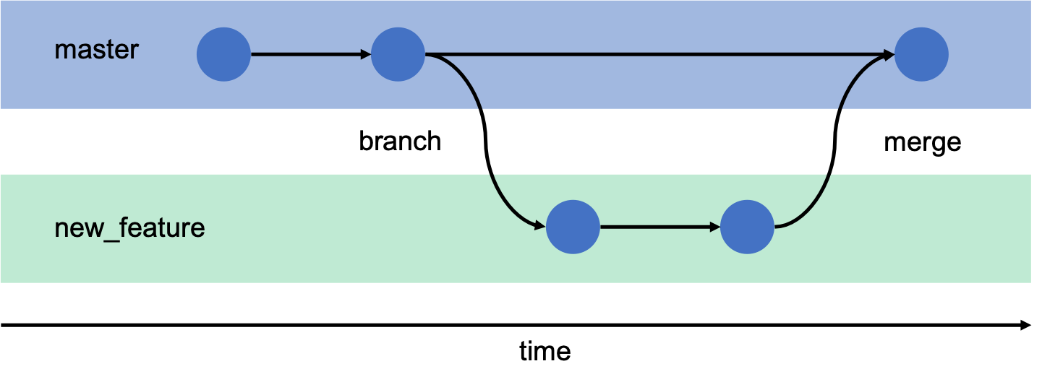
Git Branches and Merges
Scenario
Chuck and Dina are collaborating on a coding project.
Dina wants to add a new feature to one of the .py modules but doesn’t want to break what is already in the repo in the process.
Dina creates a branch, committing changes to the branch, as she works -
git checkout -b new_feature
git commit -m "Refactoring complete“
Once she is satisfied the refactoring is successful, she then merges the branch with main
git checkout main
git merge new_feature
and can delete the branch
git branch -d new_feature
src: https://gitbookdown.dallasdatascience.com/branching-git-branch.html

Slide 18
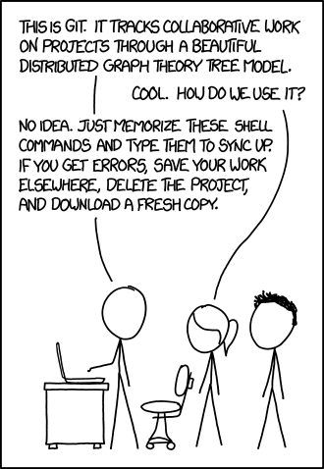
There is much, much more to GitHub
this is only 1% of it
tight integration with Visual Studio Code (programming IDE) and R-Studio
massive amount of repos online you can clone and use, take in your own direction,e tc.
how collaboratove coding is done
Additional Git and GitHub resources:
GitHub Guides
Try Git tutorial
Codecademy
MIT missing semester version control chapter (for deeper insight into what Git does / how it works; scroll down for “Basics”, “Resources”, and other good stuff)
Happy Git and GitHub for the user
Cody Bellamy’s guide (in our repo at dst_course\LEC\lec01-intro-github-latex)
XKCD comic

Slide 19
LaTeX
Our Agenda
Quick introduction
Overleaf
a sample homework template
Note:
you are required to use LaTeX on HW 1,
but after that it is encouraged but optional in this course

Slide 20
Quick Intro to LaTeX
LaTeX is a tool for type-setting technical, mathematical documents
Example documents
multi problem set; calc I activities: hyperbolic, assorted review; CML exam
References
Books!
Trefor Bazett ’s YouTube LaTeX tutorials
Overleaf – see next slide
Communicating Mathematics Through Homework | Mathematics | Harvey Mudd College

Slide 21
Overleaf
Free online LaTeX editor
we’ll check out multi HW in Overleaf
let’s do a hello-world.tex and showcase the Overleaf’s visual editor
Loads of help documentation, templates, etc., e.g.
Learn LaTeX - Overleaf, Online LaTeX Editor
https://www.overleaf.com/about/why-latex
Templates - Journals, CVs, Presentations, Reports and More
Many alternatives to Overleaf exist – I use TeXstudio, a Windows desktop application

Slide 22
LaTeX on HW 1
HW 1 asks you to compile all of your answers in one LaTeX (.tex) document.
Turn in a printed copy (the pdf) and upload the .tex file to Canvas.
Feel free to use an existing homework or problem set template from Overleaf.
I will share the snippet with the checkboxes in the course repo, you can paste this into your LaTeX file.
Hint: to include the images, use the graphicx LaTeX package (include with \usepackage{graphicx}).

Slide 23
What a conflict looks like
the conflicts are between the <<< and >>>
recipes.py
recipes = {
<<<<<<< HEAD
"apple_pie": ["apples", "sugar", "butter"],
"brownies": ["chocolate", "sugar", "butter"],
"pancakes": ["flour", "milk", "egg"]
=======
"pancakes": ["flour", "milk", "egg"],
"apple_pie": ["apples", "sugar", "butter"],
"brownies": ["chocolate", "sugar", "butter"]
>>>>>>> main
}
your local version (alphabetized)
the remote version (what’s on the repo online)
You and your collaborators decide how to resolve this (possibly using GitHub Issues) and edit this to one single file that you commit and push.

