Slide 1
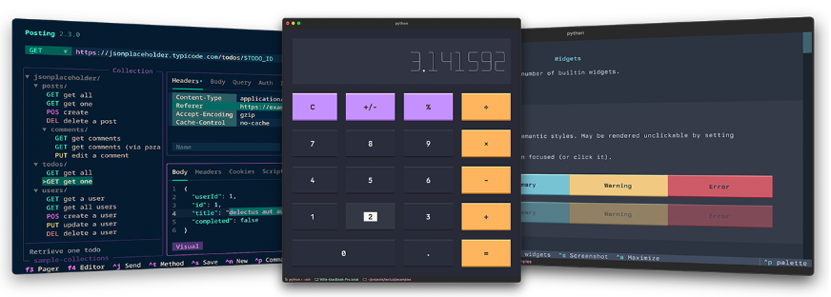
Terminal User Interfaces (TUIs)
image source: https://github.com/Textualize/textual

Slide 2
Background Information on TUIs
What are they?
Demonstrations: slow stochastics python –m textual
Created in Python using libraries like textual, rich, and typer. We will focus on textual.
Why textual?
TUIs are low bandwidth
The terminal is a far simpler platform than the web
textual apps work over SSH
Easier to manage state than more web oriented frameworks
Easier to build bespoke components
source: textual creator Will McGugan, https://www.reddit.com/r/Python/s/RpcWZnFP49

Slide 3
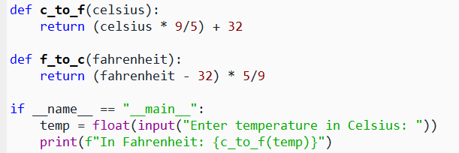
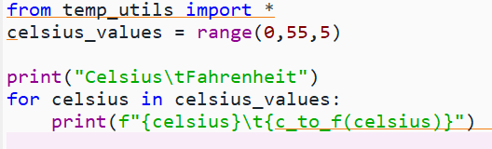
Some Python Preliminaries
to run a Python script in the terminal, simply type:
python filename.py
replacing filename.py with the name of the script you want to run
let’s try this – make a quick hello_world.py and run it
Using: if __name__ == “__main__”
Example: temp_utils.py
only run this block if this .py file is run directly as opposed to being imported
This script imports temp_utils.py.
So the code in temp_utils.py’s if __name__ block does not run.
Let’s try it…

Slide 4
Developing TUIs with textual
write TUI code in Python using the textual library
run the Python code in the terminal
be sure you are in the conda environment within which you installed textual
run the Python script in the terminal by typing: python filename.py as shown earlier

Slide 5
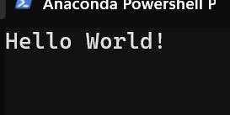
Hello World Example
App is the main object that runs your TUI program, manages the interface, and handles user input.
from textual.app import App
from textual.widgets import Label
class MyLabelApp(App):
def compose(self):
yield Label( 'Hello World!')
if __name__ == "__main__":
MyLabelApp().run()
The interface consists of widgets like buttons, labels, etc. (think “Controls” in VBA).
These are imported from textual.widgets.
You create your TUI program as a child of textual’s App object, inheriting App ’s attributes and methods.
App widgets are initialized with the compose method using a yield statement.
Widget properties are passed to it as arguments.
Call App’s run method to launch your TUI program when this script is run.

Slide 6
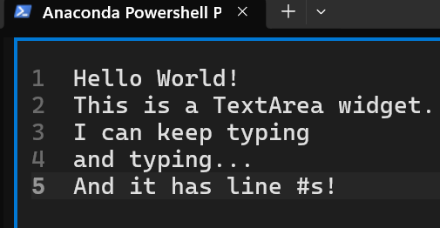
Some textual Widgets
Static – general-purpose text-display, very basic, dynamic, often used for messages and output
Label – also very basic, for displaying text, often used for field names and captions
TextArea – scrollable, editable textbox
takes ‘text=‘ as an input, among many others
can make it read-only, show line #s, ...
Select – choose from a pull-down list, more on this soon

Slide 7
TextArea Widget Example
from textual.app import App
from textual.widgets import TextArea
class MyTextBoxApp(App):
def compose(self):
yield TextArea( 'Hello World!',
id = 'main_text_area',
show_line_numbers = True)
if __name__ == "__main__":
MyTextBoxApp().run()
Compare this code with the prior example.
Some of the differences are highlighted. Note the setting of some widget parameters.

Slide 8
Select Widget Example
from textual.app import App
from textual.widgets import Select
MENU_ITEMS = ['Hello','World!','DST']
class MyApp(App):
def compose(self):
yield Select( [(item, item) for item in MENU_ITEMS],
prompt = 'Choose your item:',
id = 'select_menu',
)
if __name__ == "__main__":
MyApp().run()
The Select widget takes a list of tuples representing:
(display text – what the user sees,
value – what the code receives)
in this example, display text = value
But how do we capture what was selected?

Slide 9
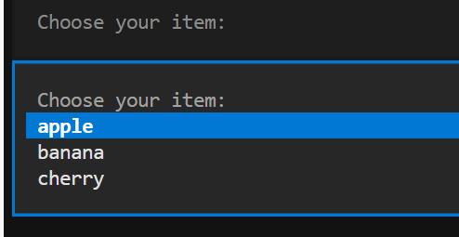
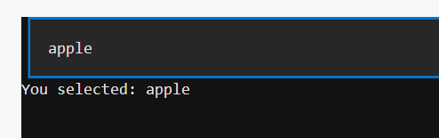
Capture selection from Select widget
Select widget
Let’s display the selection
in a Static widget.
When a selection occurs, an event is triggered.

Slide 10
Capture selection from Select widget
Let’s build this up together from a skeleton.
from textual.app import App
from textual.widgets import # YOUR CODE HERE
MENU_ITEMS = ["apple", "banana", "cherry"]
class MyApp(App):
def compose(self):
yield Select([(item, item) for item in MENU_ITEMS],
prompt="Choose your item:",
id="select_menu",
)
yield # YOUR CODE HERE
def on_select_changed(self, # YOUR CODE HERE ):
result = f"You selected: {# YOUR CODE HERE}"
output_widget = self.query_one(# YOUR CODE HERE
# YOUR CODE HERE
if __name__ == "__main__":
MyApp().run()
Note new method:
on_select_changed
Its name references the widget (Select) and the event type (“changed”)
self.query_one – find one widget that matches a specified widget type, e.g.
self.query_one("#output", Static)

Slide 11
More Widgets!
Header
Button
ListView – can use for a simple menu
Custom widgets - as subclasses of class `Widget`, see https://textual.textualize.io/guide/widgets/#custom-widgets.
SparkLine - looks like a bar chart / histogram
Understand these items:
Be sure to import the widgets your using – from textual.widgets import TextArea, Label, …
What are the basic parameters most widgets need?
What are specific ones some specific widgets need?
How do we capture information in the widgets – e.g. that they were clicked, what text was input into them, etc.?
See the Widget Gallery

Slide 12
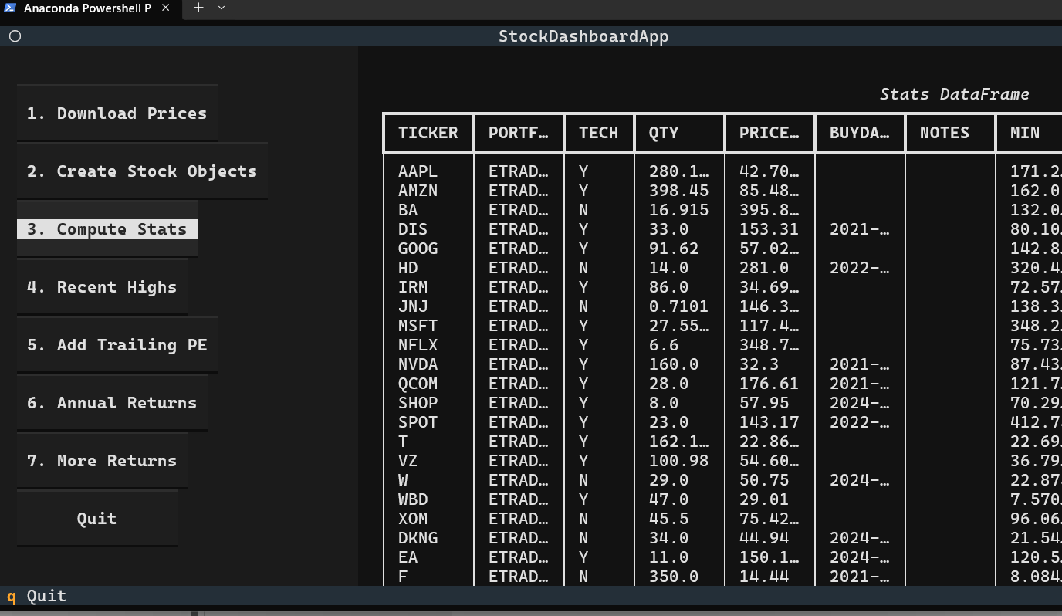
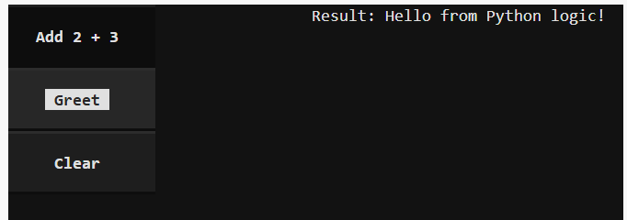
Organizing Widgets in Panels
We will start with this much simpler example -
some of the code –
with Horizontal():
with Vertical(id="menu"):
yield Button("1. Download Prices", id="download_prices")
yield Button("2. Create Stock Objects", id="create_stock_objs")
…
yield Button("Quit", id="quit")
yield OutputPanel(id="output") # a Static class instance
…

Slide 13
Simple Panels Example
from textual.app import App
from textual.widgets import Button, Static
from textual.containers import Horizontal, Vertical
class MyApp(App):
def compose(self):
# Create a horizontal layout with two panels
with Horizontal():
# Left panel: buttons stacked vertically
with Vertical(id="left_panel"):
yield Button("Add 2 + 3", id="btn_add")
yield Button("Greet", id="btn_greet")
yield Button("Clear", id="btn_clear")
# Right panel: output area
with Vertical(id="right_panel"):
yield Static("Click a button, output will appear here", id="output")
if __name__ == "__main__":
MyApp().run()

Slide 14
Calling other Python Code from a TUI
Let’s add Python functions to handle actions of button clicks
and logic to call these when buttons are pressed:
def add(a, b):
return a + b
def greet():
return "Hello from Python logic!"
def on_button_pressed(self, event):
button_id = event.button.id
output = self.query_one("#output", Static)
if button_id == "btn_add":
result = add(2, 3)
elif button_id == "btn_greet":
result = greet()
elif button_id == "btn_clear":
result = ""
output.update("")
output.update(f"Result: {result}")

Slide 15
The Full Code – see ex06_panels_plus.py
from textual.app import App
from textual.widgets import Button, Static
from textual.containers import Horizontal, Vertical
# --- "application logic" (non-Textual code) ---
def add(a, b):
return a + b
def greet():
return "Hello from Python logic!"
class MyApp(App):
def compose(self):
# Create a horizontal layout with two panels
with Horizontal():
# Left panel: buttons stacked vertically
with Vertical(id="left_panel"):
yield Button("Add 2 + 3", id="btn_add")
yield Button("Greet", id="btn_greet")
yield Button("Clear", id="btn_clear")
# Right panel: output area
with Vertical(id="right_panel"):
yield Static("Click a button, output will appear here", id="output")
def on_button_pressed(self, event):
button_id = event.button.id
output = self.query_one("#output", Static)
if button_id == "btn_add":
result = add(2, 3)
elif button_id == "btn_greet":
result = greet()
elif button_id == "btn_clear":
result = ""
output.update("")
output.update(f"Result: {result}")
if __name__ == "__main__":
MyApp().run()

Slide 16
Next time
passing values from TUI to other Python code
more elaborate layout using CSS files
more complicated examples

Slide 17
Rebind or disable Ctrl+Q in VS Code
Ctrl+Q is used by default to quit a textual application. But VS Code catches the Ctrl+Q first. This is a workaround. You don’t need admin rights for this—user keybindings are allowed.
Steps:
Press: Ctrl+K then Ctrl+S (opens Keyboard Shortcuts)
Search for: Ctrl+Q
You’ll likely see something like:
“Quit” or “Close Window”
Right-click → Remove Keybinding (or reassign it to something else)

