Slide 1
Introduction to the Terminal
command-line basics and commands

Slide 2
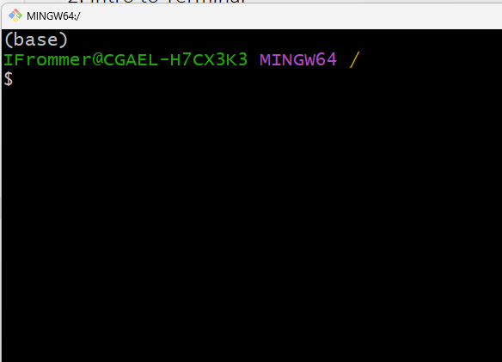
Introduction
Lecture 1: Course Overview + Introduction to the Shell - motivation of course including coverage of terminal, 1:19 - 1:49
What?
the terminal is a text-based interace to the computer
it preceded all GUIs, software applications, etc. (see history of Unix, Linux, …)
the “program” that runs within the terminal – accepts commands, returns output, etc. is known as the shell (it's essentially a programming language)
we have worked with shells in the Anaconda prompt and Spyder iPython console
Why use the terminal?
much faster
can automate repetitive tasks, combine output of 1 program and pass it to another program,
much in open source community for building, installing, using often in the shell (pip install, conda envs, pytest, yolo…),
How?
we type a program name then arguments, e.g.
echo "hello world"

Slide 3
Terminal we will use
Git Bash
Alterntively you could use the more powerful Windows Subsystem for Linux (I have it set up on an HP laptop I will show.)
Other options include: VS Code and R-Studio (but mainly for using shells already on your machine), mac os z shell (like bash shell)
We're not going to use/cover PowerShell or the "Command Prompt" (cmd, Windows).

Slide 4
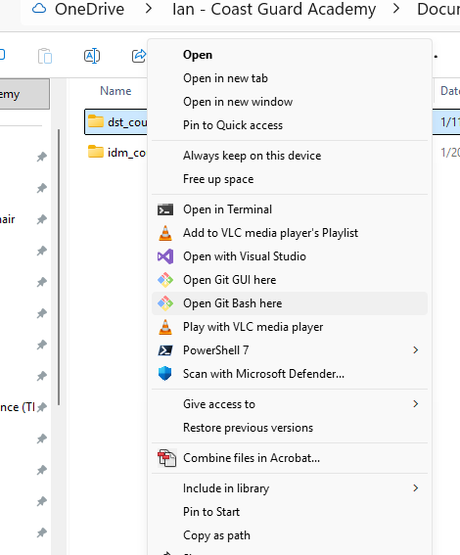
Basic Commands
Open Git Bash. You can launch it from Windows, or within a specific folder through Windows Explorer –
right-click on folder, choose more options, then
“Open Git Bash here”
Try typing the following, trying to figure out what they do:
ls ls -l ls –a ls –C ls –S ls –lh ls –lt ls -R
cd cd - cd ~ cd ..
pwd

Slide 5
Basic Commands (continued)
ls – lists files, with various settings:
ls –l show details
ls -a show all files (even hidden ones, like .gitignore)
ls -C show in columns
ls -S sort by size
ls -lh show human readable file sizes
ls –lt sort by time newest first, -tr to reverse),
ls -R recursive down through subfolders
Note you can combine them and use wildcards like ? and * to stand for character(s)
cd change directory
cd - to go back to previous dir
cd ~ go to home directory
cd .. go up one level
pwd output present working directory

Slide 6
Basic Commands (continued)
mkdir and rmdir
mv and cp
cp -r - copy directories recursively
rm and rm -r
Let’s demo these in the terminal…

Slide 7
Basic Commands (continued)
less and cat – show a file
less - page at a time - in less type h for help; try typing e,f,y,b
cat - whole thing
touch fname creates empty file named fname
date
echo “Hello world!”
<command> > filename - pipe command output to a file
e.g. date > today.txt
echo "# My First Repo" > README.md
<command name> --help (man <command name> in Linux and Unix)
; Divide multiple commands on 1 line.
e.g., cd .. ; ls

Slide 8
Basic Commands (continued)
tr translate, squeeze or delete chars from the standard input
echo "hello world" | tr 'a-z' 'A-Z'
echo "hello 123" | tr -d '0-9' deletes
echo "hello world" | tr ' ' ‘_’
echo $PATH | tr ':' '\n' # puts each on its own line
tee - outputs to file and standard output (T-junction) -
echo "Hello, World!" | tee hello.txt
\ is escape character - don't treat next char as special
environment variables - $PATH - do echo $PATH
also $HOME, $SHELL, … env to see all
using files like .bashrc, .bash_profile, .bash_login, .profile you can have certain values for env variables loaded on starting the shell
start <filename> - opens the file on the system, e.g if a .txt opens in notepad on Windows

Slide 9
Example - rename some files
for file in *.txt; do mv "$file" "PREFIX_$file"; done
we plan to get more into idea of for loops and variables later

Slide 10
Example – find files of a certain type, display details and in order of date
find . -name "*.md"
. specifies root directory to start search, alternatively could use / to search from top level root directory
find . -name "*.md" –print0
print0 puts a null character between results, so that we can do…
find . -name "*.md" -print0 | xargs -0 ls -lht
now pipe those results into another command
xargs takes the output from before the pipe and makes that the args to the command after (file names separated by null chars in this case)
so each the search results are passed to ls -lht

Slide 11
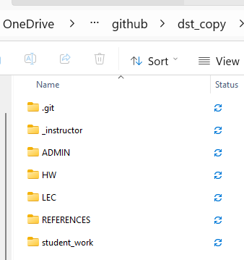
Example - reconstruct a folder structure in a parallel folder
find . -type d
find all directories within current directory
find . -type d -exec mkdir -p ../dst_copy/{} \;
-exec is a find option to run a command on each file found
{} is the placeholder for the current file found (like for i in my_list…)
dst_copy is our name for the parallel folder
\; so the shell doesn't think it's the ; separating 2 commands. find needs ; to terminate its exec part

Slide 12
Demos using CyberNet Server
logging in
ssh into the cyber server from the HP laptop
Secure file copy -
Example: Copy a file named file.txt from your Windows machine to the /home/user/ directory on a remote Linux server.
scp C:\path\to\file.txt user@remote_host:/home/user/
scp from CyberServer to HP
scp orda@10.233.107.2:/home/orda/Frommer/README.txt README.txt
scp -r orda@10.233.107.2:/home/orda/Frommer/* CyberServer
(See also WinSCP – GUI-based not terminal-based)
find the yolo weights files - *.pt
orda@cybernetml:~$ find . -name "*.pt" -print0 | xargs -0 ls -lht

Slide 13
More commands
top (not in bash) lists current processes
ln -s src dest creates symbolic link from src file to dest name
ssh - let’s check out on HP
scp C:\path\to\file.txt user@192.168.1.100:/home/user/
securely copy file from host to server, where server IP address (192.168…) or server name (cfara1) is used.
I'll demo this on the HP
sudo …
which <command name> - tells where it is
next time - grep, awk, sed

Slide 14
Editors in the Terminal
nano - we will use
vim – power users like it, :q to quit
emacs – old-school, still used, can be installed on git bash

Slide 15
References
https://ubuntu.com/tutorials/command-line-for-beginners
https://www.geeksforgeeks.org/linux-unix/basic-linux-commands/
https://linuxcommand.org/tlcl.php (see my downloads folder)
Missing Semester - YouTube

