Slide 1
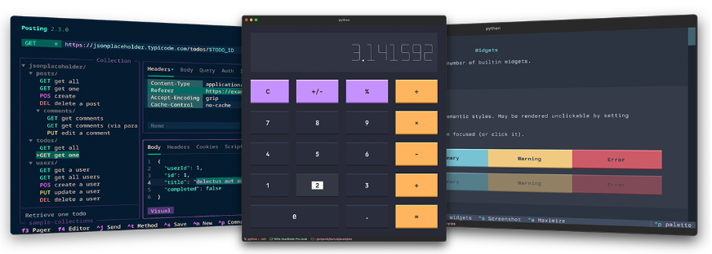
Terminal User Interfaces (TUIs)
with textual (continued)

Slide 2
More background info about textual
OS-independent
does depend on terminal – colors you can get will depend on what terminal can offer
CTL-Q to quit, but you can change this
much styling of widgets, layout, panels, etc. is possible – we will explore some of this today

Slide 3

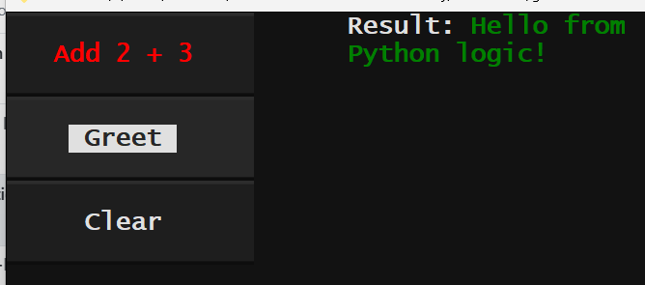
Basic Formatting of Text Widgets
Text widgets support markup of content, such as:
“[bold red]Hello[/] World!”
[/] signifies end all format tags
this is actually utilizing the Python library named rich – see next slide
works on Static, Label, Button widgets (not Input, TextArea)
Some formatting you can do this way:
[bold] [italic] [underline]
[red] [green] [blue]
[white on blue]
[#ff0000] or [rgb(21,23,200)] (other ways to specify colors)
[bold red on yellow]
See:
ex07_label_with_formatting.py
ex08_panels_plus_formatted.py
https://textual.textualize.io/guide/content/
https://rich.readthedocs.io/en/stable/markup.html

Slide 4
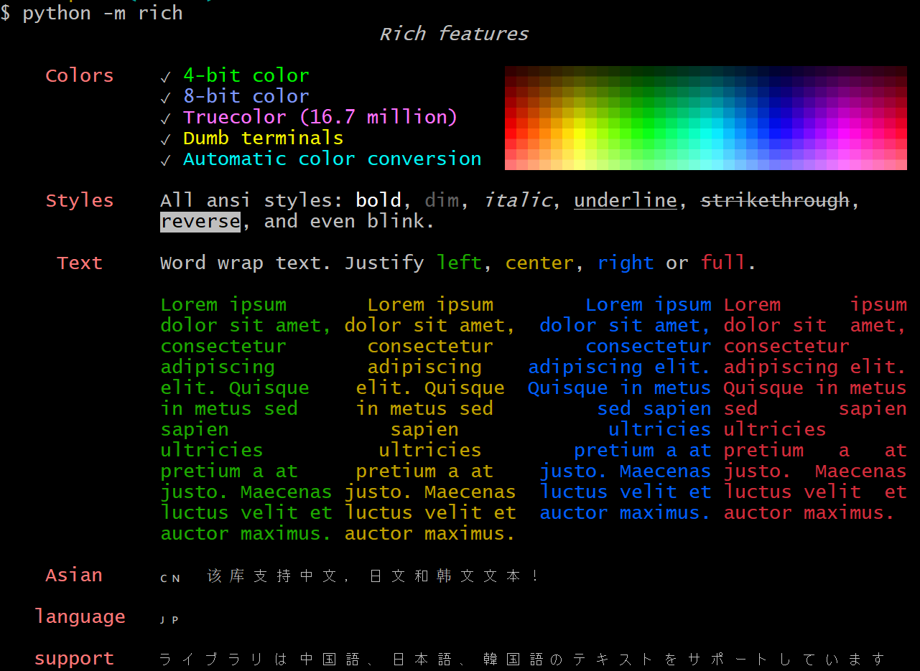
the rich library
Python library for writing text with color and style to the terminal, and for displaying advanced content such as tables, markdown, and syntax highlighted code.
rich came with textual – you already have it. Type:
python –m rich
See: https://realpython.com/python-rich-package/

Slide 5
For increased format control use: textual .styles property of widgets
Examples (append these to a widget instance, we will do)
.styles.background = 'orange'
.styles.width=45
.styles.text_align = “center”
.styles.padding = 1, 1
.styles.margin = 4, 4
.styles.height=“2fr” # means gives this widget 2 parts of the available space
Set these in the on_mount method – more on that soon
Let’s build an example out of ex09_styled_buttons_skeleton.py
See for reference:
Styles: https://textual.textualize.io/guide/styles/
Colors: https://textual.textualize.io/api/color/#textual.color--named-colors

Slide 6
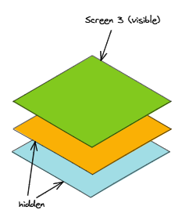
Textual Screens
containers for widgets that occupy the dimensions of your
terminal
can be many screens in a given app, but only one screen is
active at a time
our examples have only had one screen but see the textual demo
for an example with many
Can control screen styles with .screen.styles, e.g.
def compose(self):
self.screen.styles.background = "antiquewhite"
self.screen.styles.border = ("heavy", "silver")
https://textual.textualize.io/guide/screens/

Slide 7
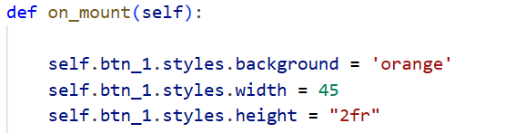
the on_mount method
we saw this in ex09 :
it’s a method of textual’s App class
runs after compose() builds the UI structure
allows us to:
set styles of widgets
set global properties of the UI (e.g. theme)
set focus on a widget
start a background task (e.g. timer)
initialize data or state
update a widget after layout has been created
See
https://textual.textualize.io/guide/design/
https://github.com/Textualize/textual/blob/main/src/textual/theme.py
def on_mount(self):
self.theme = "solarized-light"

Slide 8
textual themes
def on_mount(self):
self.theme = "solarized-light"
from textual.theme import BUILTIN_THEMES
print(list(BUILTIN_THEMES.keys()))
['textual-dark', 'textual-light', 'nord', 'gruvbox', 'catppuccin-mocha', 'textual-ansi', 'dracula', 'tokyo-night', 'monokai', 'flexoki', 'catppuccin-latte', 'catppuccin-frappe', 'catppuccin-macchiato', 'solarized-light', 'solarized-dark', 'rose-pine', 'rose-pine-moon', 'rose-pine-dawn', 'atom-one-dark', 'atom-one-light']

Slide 9
Styling with TCSS in textual
Cascading Style Sheets (CSS)
a language for specifying presentation and styling of an HTML (or XML) document
cornerstone technology of the World Wide Web
TCSS
textual version of CSS
offers even more style control and in manner consistent with web design standards and with less code than using .styles
e.g. can style entire class of widgets in one shot
uses .tcss files

Slide 10
TCSS (continued)
/* Example .tcss file */
#menu {
width: 30%;
min-width: 24;
padding: 2 0 2 2;
background: $boost;
}
#output {
min-width: 60;
padding: 2;
}
/* comments in CSS look like this */
Static {
background: blue;
padding: 1 1;
}
#static_with_id {
border: solid white
}
.static_cls1 {
background: green;
}
.static_cls2 {
border: dashed yellow;
}
Can apply styling based on widget (or container) type, id, or class
In the code, menu and output are the id's of a textual Container and Widget, respectively.
classes is a space-separated list of style names attached to a widget, e.g
yield Static("Second class", classes="static_cls1 static_cls2")

Slide 11
TCSS Example
from textual.widgets import Static
class TCSSApp(App):
# DEFINE tcss file name and path here
CSS_PATH = "ex10.tcss"
def compose(self):
yield Static("A static widget")
yield Static("Using an id", id="static_with_id")
yield Static("First class", classes="static_cls1")
yield Static("Second class", classes="static_cls1 static_cls2")
if __name__ == "__main__":
TCSSApp().run()
Let’s fill in
ex10_tcss_1_skeleton.py
and
ex10_skeleton.tcss

Slide 12
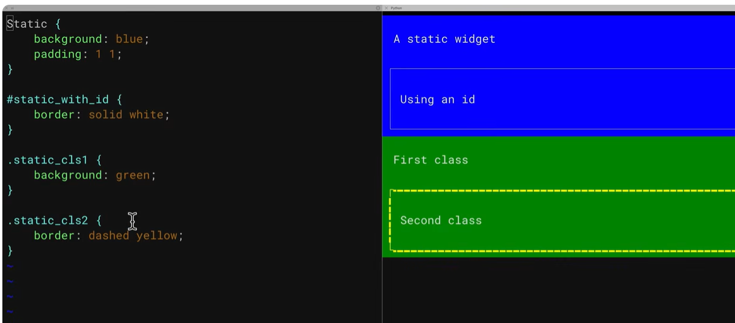
Using textual dev mode
Aids development by allowing for real-time updates of .tcss style changes
First do
pip install textual-dev
then
textual run --dev filename.py
See:
https://youtu.be/dpJrM2_NOT8?si=fUKR3FXGLGx1NHFa&t=1223

Slide 13
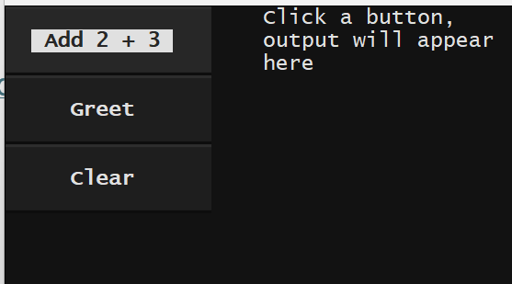
Layout using Containers
Containers are reusable arrangements of widgets with preset styles
Recall earlier we saw the code below
See https://textual.textualize.io/how-to/work-with-containers/ and question 3 on hw08
from textual.containers import Horizontal, Vertical
...
class MyApp(App):
def compose(self):
# Create a horizontal layout with two panels
with Horizontal():
# Left panel: buttons stacked vertically
with Vertical(id="left_panel"):
yield Button("Add 2 + 3", id="btn_add")
yield Button("Greet", id="btn_greet")
yield Button("Clear", id="btn_clear")
# Right panel: output area
with Vertical(id="right_panel"):
yield Static("Click a button, output will appear here", id="output")

Slide 14
Events and Actions
We saw examples of this in: ex06_panels_plus.py:
def on_button_pressed(self, event):
button_id = event.button.id
output = self.query_one("#output", Static)
if button_id == "btn_add":
result = add(2, 3)
...
See: https://textual.textualize.io/guide/events/ and https://youtu.be/dpJrM2_NOT8?si=3zS834a9RG6b_5TL&t=517
Handler naming (e.g. on_button_pressed) –
Start with "on_".
then the message's namespace (if any, converted from CamelCase to snake_case) plus an underscore "_"
then the name of the class (converted from CamelCase to snake_case)

Slide 15
Another simple event example
Exercise – read over this code and figure out what it is doing.
What is in this TUI?
Where is the event handler?
What triggers it?
What action does it take?
from textual.app import App, ComposeResult
from textual.widgets import Input, Static
# --- "application logic" ---
def process_name(name: str) -> str:
return f"Hello, {name}!"
# --- TUI ---
class MyApp(App):
def compose(self) -> ComposeResult:
yield Input(placeholder="Enter your name")
yield Static("", id="output")
def on_input_submitted(self, event: Input.Submitted) -> None:
name = event.value # get value from TUI
result = process_name(name) # pass to function
output = self.query_one("#output", Static)
output.update(result) # show result in UI
if __name__ == "__main__":
MyApp().run()

Slide 16
And another simple event example
Let’s rewrite our first example ex01_label.py so that it quits when we type “q” (as opposed to having to type “CTL-Q”)
Hints:
The event handler for a key press is: on_key
The value of the event’s message (i.e. the key) is stored in event.key
The textual App class has an exit() method to shut itself down (i.e. quit)
Start by editing the file ex01_label.py
answer in ex11_label_qquit.py
Now you can handle any key press…

Slide 17
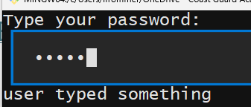
Powerful: passing TUI input to a calling program
ex_12_password.py
from textual.app import App
from textual.widgets import Input, Label, Static
class PwdApp(App):
def compose(self):
yield Label("Type your password:")
yield Input(password=True, id="input")
yield Static("status...", id="output")
def on_input_changed(self, event):
msg = self.query_one("#input", Input).value
output = self.query_one("#output", Static)
output.update('user typed something')
def on_input_submitted(self, event):
msg = self.query_one("#input", Input).value
output = self.query_one("#output", Static)
# output.update(msg)
self.exit(msg)
if __name__ == "__main__":
PwdApp().run()
call_password.py
from ex12_password import PwdApp
user_pwd = PwdApp().run()
print(f"The password is {user_pwd}")
$ python call_password.py
call_password calls ex12_password.py
ex12_password.py passes the input it received back to call_password
Let’s see...
See https://www.youtube.com/watch?v=Y2-c22nCE4E&t=135s

