Slide 1
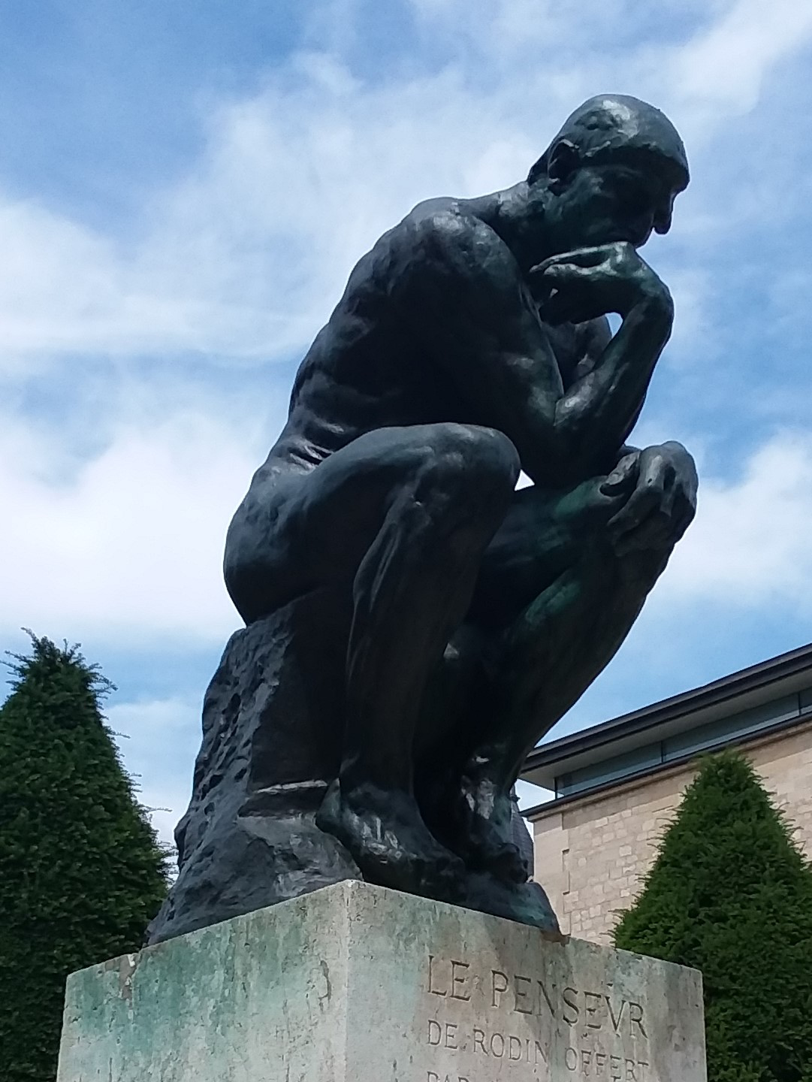
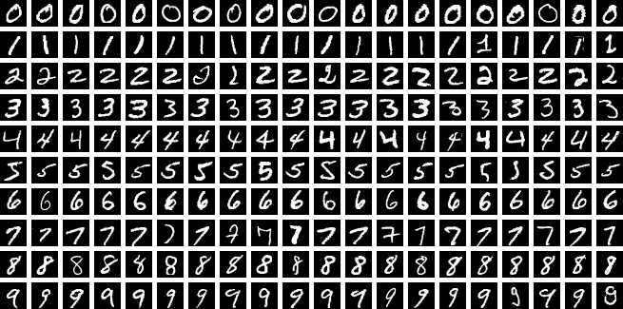
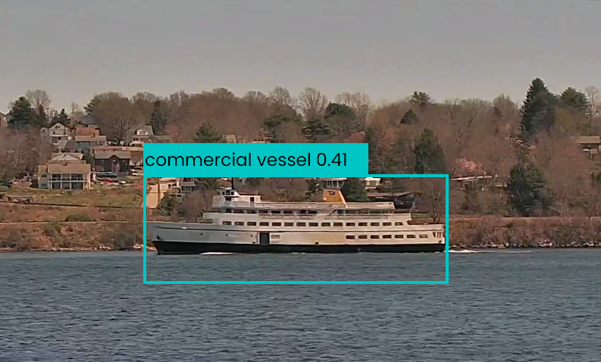
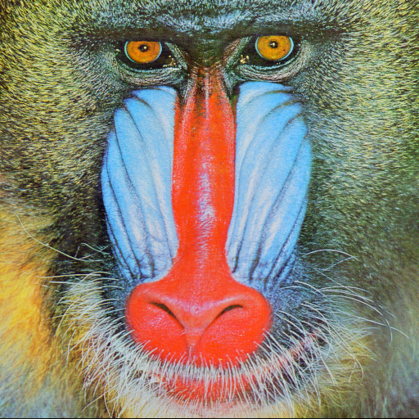
images as data
Notes:
By Suvanjanprasai - Own work, CC BY-SA 4.0, https://commons.wikimedia.org/w/index.php?curid=156115980

Slide 2
images as data - agenda
Today
quick preliminaries with VS Code
the pillow Python library
Next time
(tentatively) the OpenCV Python library

Slide 3
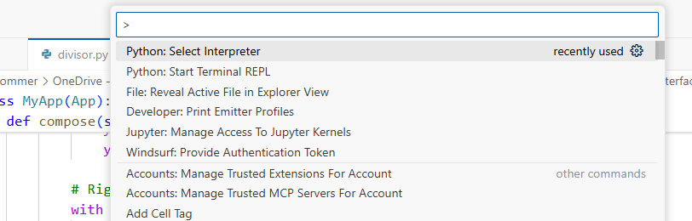
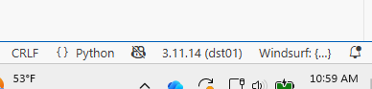

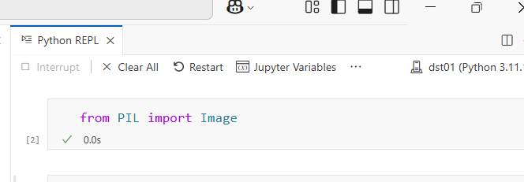
VS Code Tips
Comand palette
CTL-Shift-P or from View menu
Access a lot of useful commands from here
Change conda environment
Command palette → Python: Select Interpreter , or
with editor window selected bottom right corner, click to change
Open a Python terminal
Command palette → type REPL , or
from a line of code in a py file in the editor type shift-enter
note: then can control-click where it says “Ctrl click to launch VS Code Native REPL” to launch a Jupyter-like terminal
will be in whatever environment you selected

Slide 4
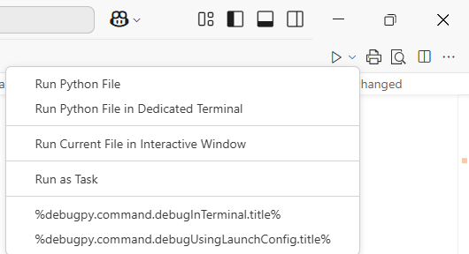
VS Code Tips (continued)
also: triangle above editor
can lead to either of those Python terminals
code cells (like in Spyder)
in editor type “# %%” to create cell
then can run these cells in the VS Code Native REPL (~Jupyter)
can add breakpoints in editor and use debugger – same triangle pull-down or “Run and Debug” triangle on LHS of VS Code
note Jupyter must exist in the selected Python environment for this Jupyter-like REPL to work
if you switch environments you may see: “Kernel not found” or “Jupyter not installed”
if so, activate this environment (e.g. in PowerShell) and pip install jupyter

Slide 5
Helpful Videos on VS Code
https://youtu.be/lWEKiak0WVU?si=5kGQ4QuYivKq2iDc
https://www.youtube.com/watch?v=F60iJ3xxgtg

Slide 6
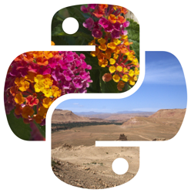
The pillow Python library
Use for:
Opening and saving images
Basic edits:
resize
crop
rotate
Drawing text or shapes
Simple filters
Example use cases:
Generating images (thumbnails, reports)
Adding watermarks
Preparing images for display
Install/usage
pip install pillow # likely already installed due to matplotlib
from PIL import Image # historical reasons
https://pillow.readthedocs.io/en/stable/handbook/index.html
https://pypi.org/project/pillow/

Slide 7
Pillow Commands Reference
We will work through a number of these in a Jupyter notebook.
Command | What it does
img = Image.open("baboon.png") | Loads an image file into a Pillow image object
img.format | Returns the file format (e.g., 'PNG')
img.format_description | Returns a human-readable description of the format
img.crop((x1, y1, x2, y2)) | Crops a rectangular region from the image
img.copy() | Creates a copy of the image
img.resize((w, h)) | Resizes the image to width w and height h
img.paste(other_img, (x, y)) | Pastes another image onto this one at position (x, y)
Image.new("RGB", size) | Creates a new blank image with given mode and size
img.rotate(angle) | Rotates the image by a given angle (degrees)

Slide 8
Pillow Commands Reference (continued)
Command | What it does
img.transpose(Image.FLIP_LEFT_RIGHT) | Flips the image horizontally
img.transpose(Image.FLIP_TOP_BOTTOM) | Flips the image vertically
img.transpose(Image.ROTATE_90) | Rotates the image 90° counterclockwise
img.transpose(Image.ROTATE_180) | Rotates the image 180°
img.transpose(Image.ROTATE_270) | Rotates the image 270°
img.size | Returns (width, height) of the image
img.mode | Returns the color mode (e.g., 'RGB')
img.load() | Gives access to pixel data for reading/modifying
pixels[x, y] | Accesses the pixel at position (x, y)
img.save("file.png") | Saves the image to a file
Check out: https://drivendata.co/blog/fish-winners

Slide 9
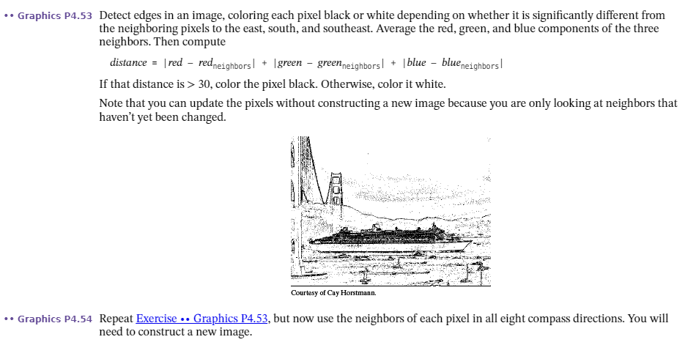
Edge Detection – maybe more on this later
from Python for Everyone by Horstmann and Necaise

Slide 10
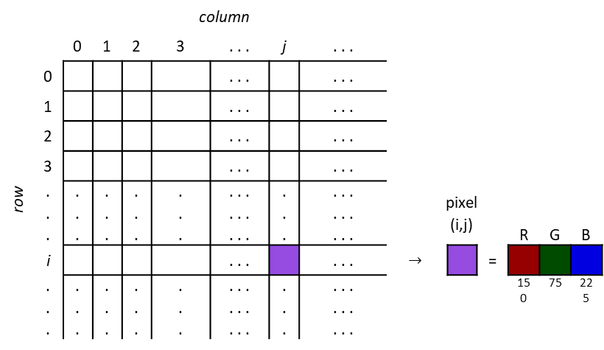
Image application using pillow: Steganography
Steganography: hiding secret information in non-secret data
Background
images are m x n matrices of pixels
pixels typically contain 3 color components: red, blue green
amount of each color in pixel can represented with an 8-bit value (0-255)
 |  | column
 |  | 0 | 1 | 2 | 3 | . . . | j | . . .
row | 0 |  |  |  |  | . . . |  | . . .
 | 1 |  |  |  |  | . . . |  | . . .
 | 2 |  |  |  |  | . . . |  | . . .
 | 3 |  |  |  |  | . . . |  | . . .
 | . . . | . . . | . . . | . . . | . . . | . . . . . . . . . | . . . | . . . . . . . . . |  | pixel (i,j) |  |  | R | G | B
 | i |  |  |  |  | . . . |  | . . . | $$→$$ |  |  | =
 | . . . | . . . | . . . | . . . | . . . | . . . . . . . . . | . . . | . . . . . . . . . |  |  |  |  | 150 | 75 | 225
 | pixel (R,G,B)
 | (255,0,0)
 | (0,255,0)
 | (0,0,255)
 | pixel (R,G,B)
 | (0,0,0)
 | (255,255,255)
 | (128,128,128)

Slide 11
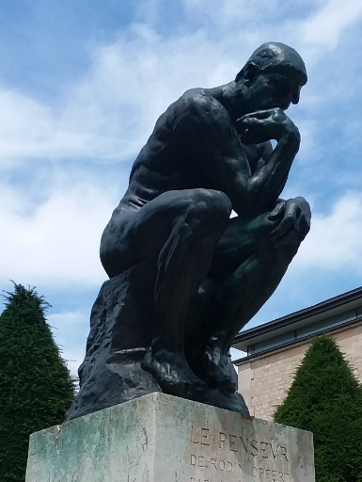

replace the “least significant bit”
original image
image with bit 0 cleared
can you
see any
difference?
132 1000 0100 | 35 0010 0011 | 81 0101 0001
pixel at
row i and
column j
132 1000 0100 | 34 0010 0010 | 80 0101 0000

Slide 12

replace the least 2 significant bits
original image
image with bits 0,1,2 cleared
can you
see any
difference?
132 1000 0100 | 35 0010 0011 | 81 0101 0001
pixel at
row i and
column j
128 1000 0000 | 32 0010 0000 | 80 0101 0000

Slide 13
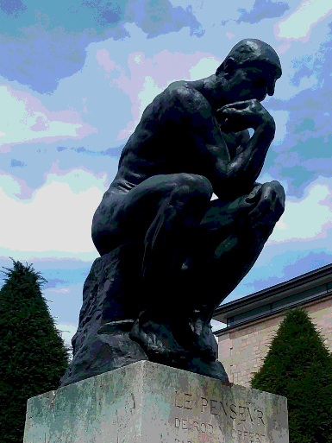
replace the least 5 significant bits
original image
image with bits 0,1,2,3,4 cleared
can you
see any
difference?
132 1000 0100 | 35 0010 0011 | 81 0101 0001
pixel at
row i and
column j
128 1000 0000 | 32 0010 0000 | 64 0101 0000

Slide 14


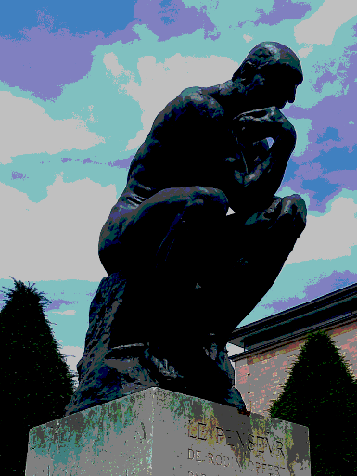
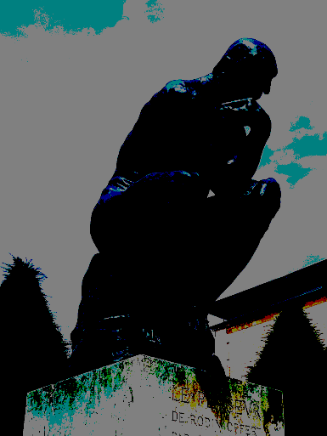
As lower order bits are removed, the image has little degradation
As more higher order bits are removed, the image has huge degradation

Slide 15
Steganography: our approach
we will hide our message (“hello”) in the red channel of pixels
Each letter has an ASCII code which we will convert to a binary number
h = 104 = 01101000
e = 101 = 01100101
l = 108 = 01101100
o = 111 = 01101111
hello = 01101000 01100101 01101100 01101111
Loop through the image pixels starting at (0,0), replacing the least significant bit of the red channel with the next bit from our message.
Later we can read the message from the red channel of the image’s pixels
See Jupyter notebook
** many other ways to do this

