Slide 1
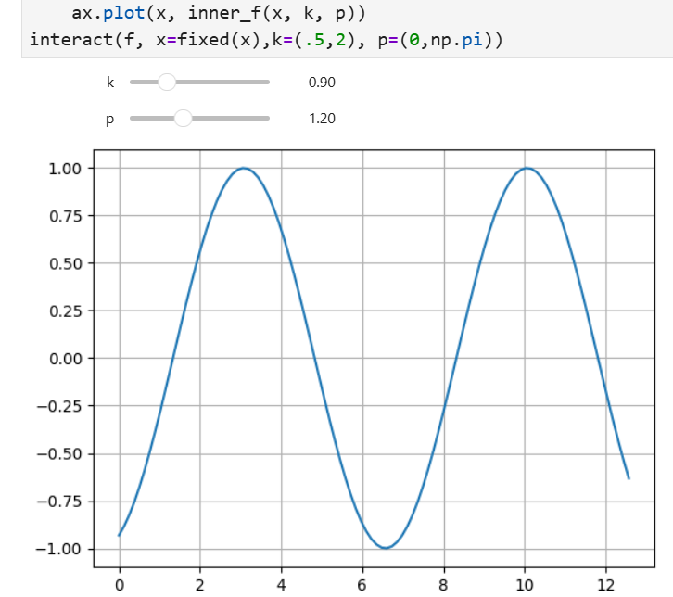
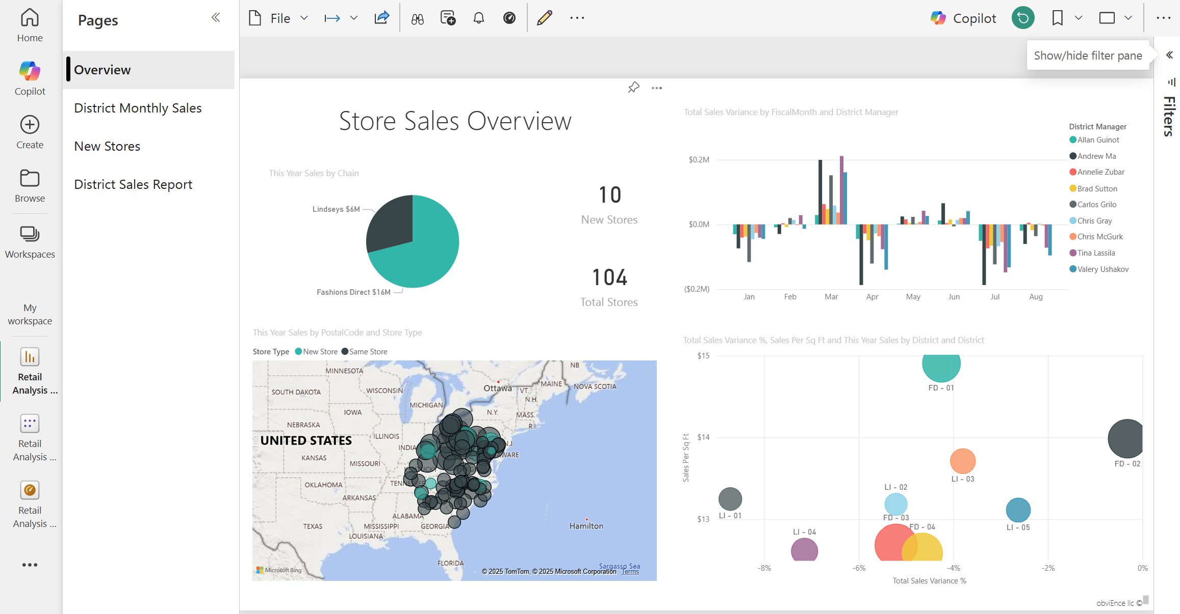
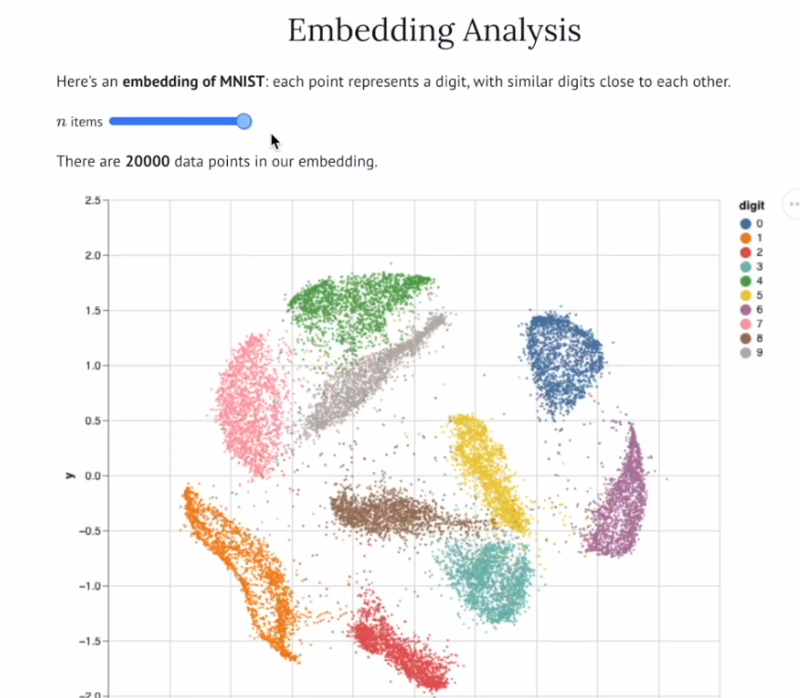
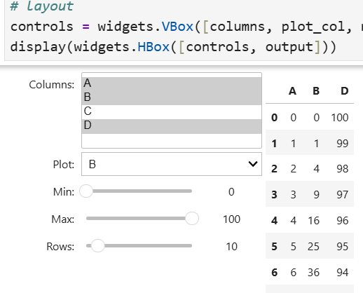
Widgets and Dashboards

Slide 2
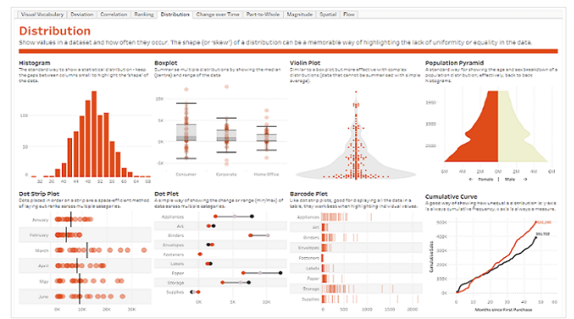
Dashboards
interactive interface combining data visualizations, tables, and controls to let users explore and monitor data by changing inputs and immediately seeing updated outputs.
Outputs
plots (histograms, scatter plots, time series)
tables
summary statistics
Controls
sliders (filter ranges, thresholds)
dropdowns (choose column/category)
checkboxes (toggle options)
dashboard are also becoming ai-driven
https://www.tableau.com/blog/dashboards-arent-dead-theyre-evolving-and-so-is-tableau

Slide 3
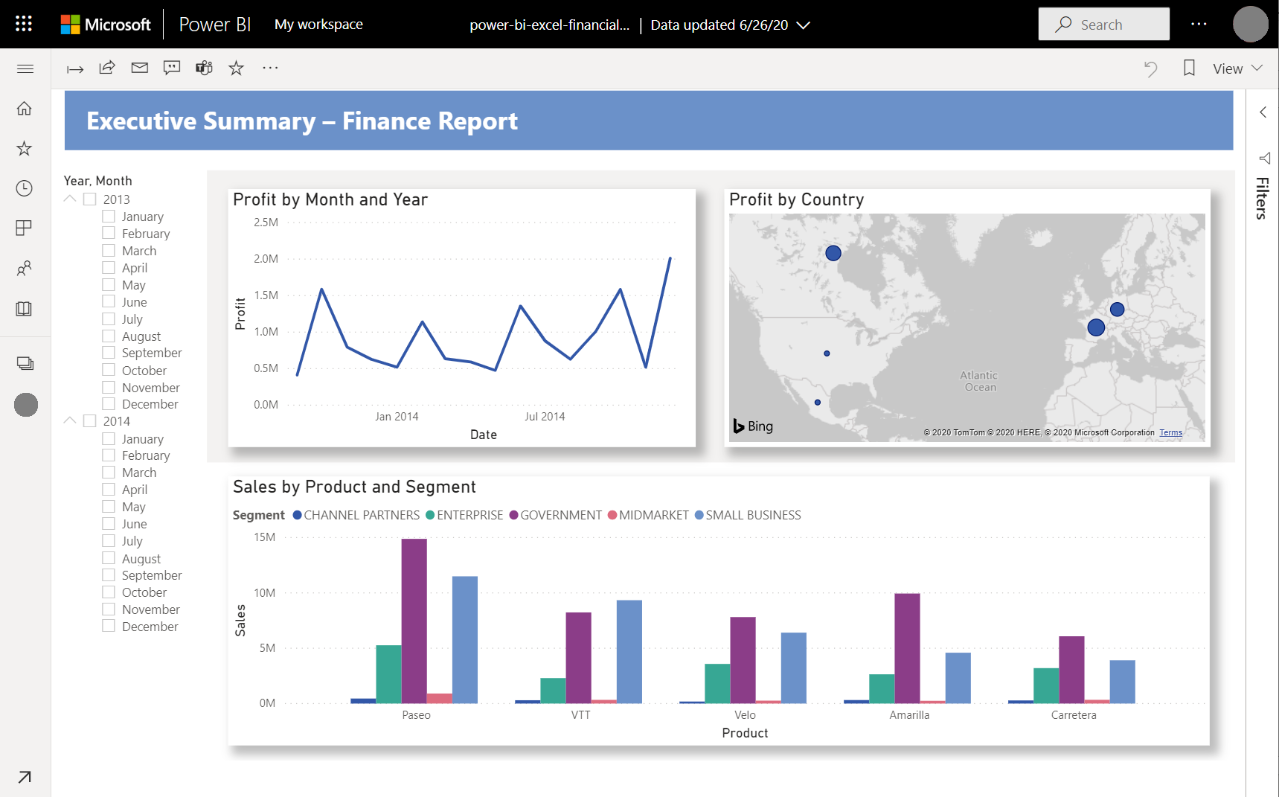
Some examples
https://oil-gas-demo.plotly.app/
https://hot-100-songs.plotly.app/
https://spotify-listening-habits.plotly.app/
https://plotly.com/examples/
https://dash.gallery/dash-uber-rides-demo/
https://demo-seattle-weather.streamlit.app/?ref=streamlit-io-gallery-favorites
https://juancab.github.io/AstroInteractives/ (click the Launch Binder button)
https://github.com/JuanCab/COVID_DataViz
Notes:
https://www.tableau.com/trial/visualize-your-data
https://learn.microsoft.com/en-us/power-bi/create-reports/sample-tutorial-connect-to-the-samples
Tutorial: Create a report from an Excel workbook in Power BI - Power BI | Microsoft Learn

Slide 4
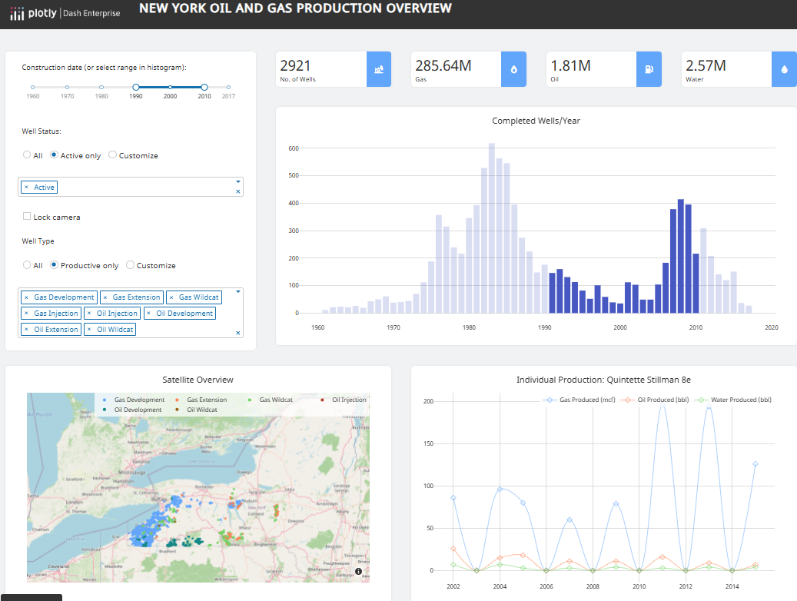
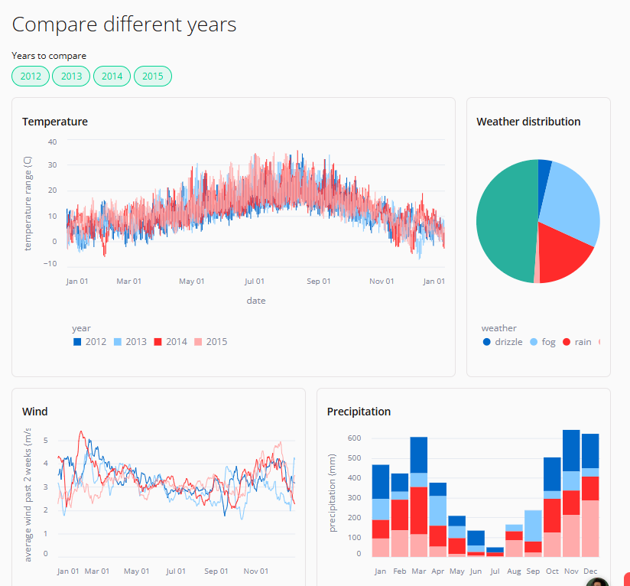
Overview of platforms/tools
jupyter widgets – add-on to support interactivity, lets you build dashboards manually inside notebooks
marimo – reactive notebook with built-in widgets, entire notebook can behave like a dashboard
panel – for turning notebooks into dashboards
dash (plotly) – real dashboarding, full web apps, more complex
streamlit - turn Python scripts into standalone dashboards
commercial software - Tableau, PowerBI (on edu machine), … easier for non-technical users
https://oil-gas-demo.plotly.app/
https://demo-seattle-weather.streamlit.app/?ref=streamlit-io-gallery-science-technology

Slide 5
jupyter widgets
implemented with the Python library ipywidgets
likely already installed if you’ve installed jupyter in your dst environment
if not or you have issues, run the following then restart jupyter lab:
pip install --upgrade jupyterlab ipywidgets jupyterlab_widgets
We will demo this through an example – ipywidgets_basics.ipynb
See also:
https://ipywidgets.readthedocs.io/en/latest/ - Jupyter widgets documentation
https://github.com/jupyter-widgets/tutorial/tree/main/notebooks – useful, tutorials
https://youtu.be/1vuI22MkkrY?si=TqsYFTmTY5hqM_74 scipy tutorial I attended
https://github.com/JuanCab/COVID_DataViz - COVID dashboard
https://github.com/jupyter-widgets/ipydatagrid add-on for data frame viewing

Slide 6
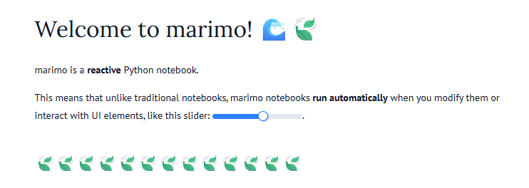
marimo
Python notebook with built-in reactivity
Cells update automatically when inputs change -> No “run order” or hidden state issues
Has built-in UI elements (sliders, dropdowns) that are linked to functions in the notebook
Version-control friendly (e.g. git)
Human-readable source code (it’s Python)
Built-in sql support
…
See: marimo | a next-generation Python notebook

Slide 7
Using marimo
To create notebooks:
marimo edit
To run your notebook as a web app, with Python code hidden and uneditable:
marimo run your_notebook.py
See our example marimo notebook in the repo: my_marimo_nb.py

Slide 8
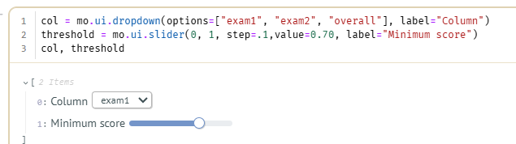
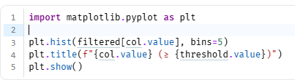
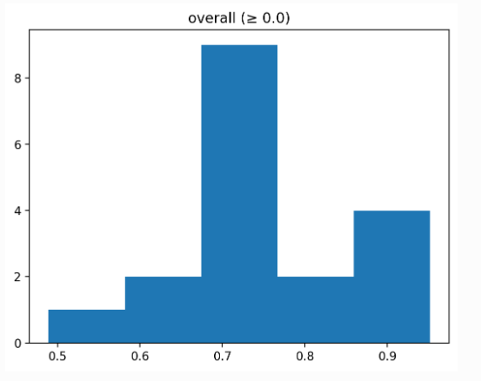
marimo (cont)
slider example
xx = mo.ui.slider(0, 10, value=2, label="Choose a number", show_value=True)
def square(n):
return n**2
square(xx.value)
dataframe example
after importing calc1.csv into df …
filtering - create dropdown for column,
slider for threshold
then
filtered = df0[df0[col.value] >= threshold.value]
plot histogram

Slide 9
marimo (cont)
Column selection
df = pd.read_csv('trans-atlantic1599.csv’)
cols = mo.ui.dropdown(options=df.columns, label="Category")
then
counts = df[cols.value].value_counts()
plt.figure()counts.plot(kind="bar")
plt.title(f"Counts of {col.value}")
plt.ylabel("Count")
plt.show()
we get a dynamically updating bar chart for categorical variables

Slide 10
More info on marimo…
https://marimo.io/
https://realpython.com/marimo-notebook/ - good tutorial
https://talkpython.fm/episodes/show/501/marimo-reactive-notebooks-for-python - good Python podcast

