Slide 1
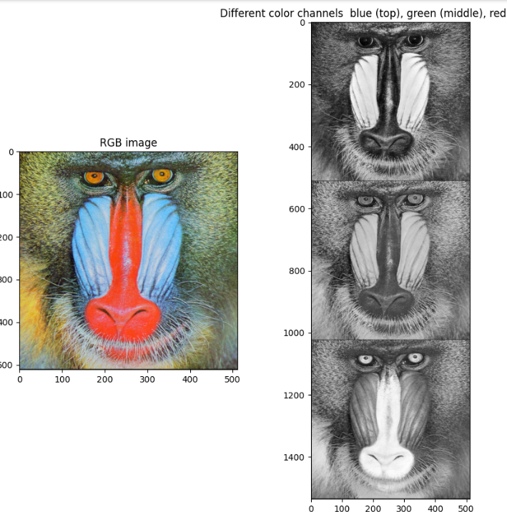
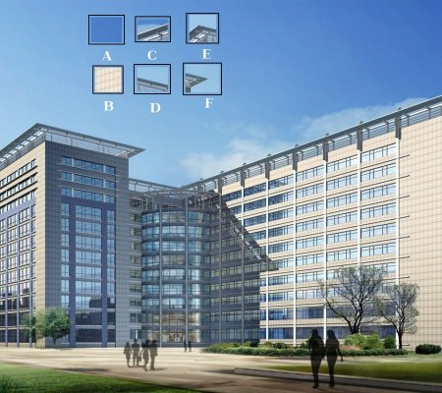
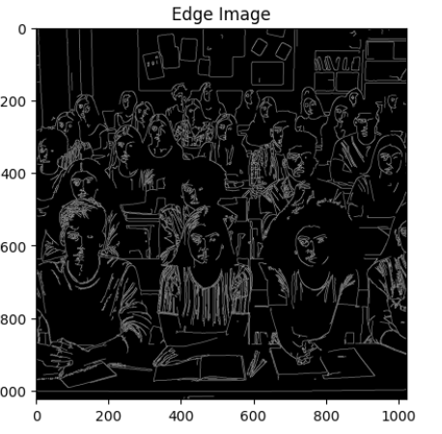

OpenCV

Slide 2
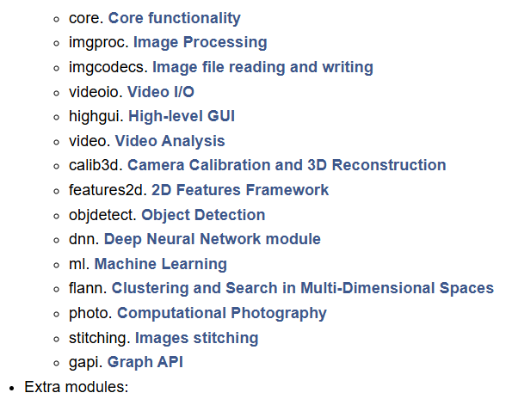
OpenCV
open-source library for real-time computer vision processing
main modules (from https://docs.opencv.org/4.x/):

Slide 3
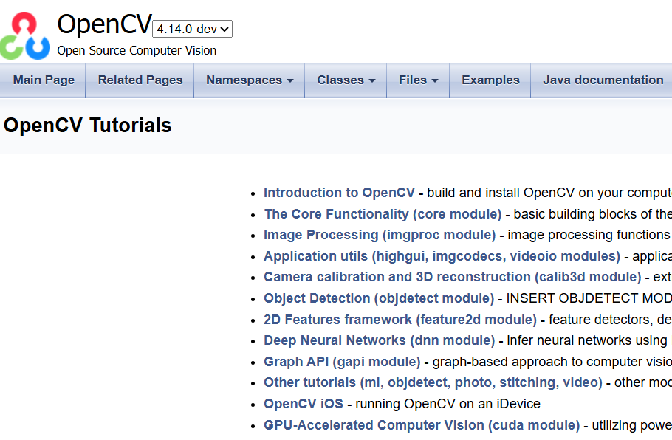
Loads of tutorials are available from opencv.org –
https://docs.opencv.org/4.x/d9/df8/tutorial_root.html

Slide 4
OpenCV vs PIL (Pillow)
Library | Best for | Mindset
PIL (Pillow) | simple image manipulation and I/O | operate on images
OpenCV | advanced computer vision and image processing | "understand" images
There is overlap, each library can do some of what the other is known for (e.g. OpenCV can also do simple image manipulation).

Slide 5

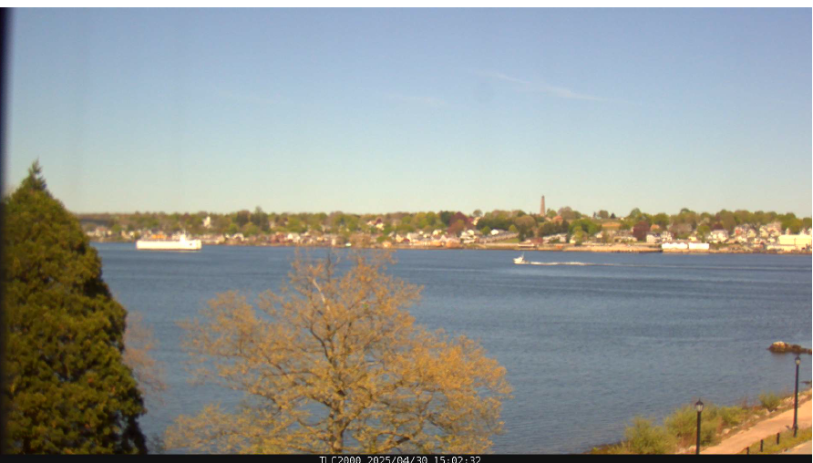
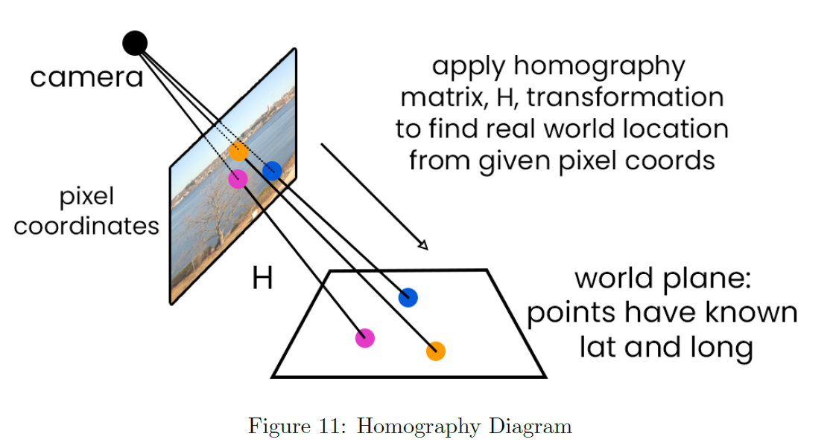
Some OpenCV Capabilities
These are some of the things OpenCV can do (or do better) than Pillow:
Detection of edges, contours, objects and other features
Image segmentation / thresholding
Separate foreground/background
Turn images into regions e.g. this is the sky, don’t look for boats here
Geometric transformations (perspective,
homography)
from 2025 Computer Vision Capstone
Notes:
and more: Camera calibration
Stereo vision / depth estimation
Image filtering (advanced kernels)
Morphological operations
Template matching

Slide 6
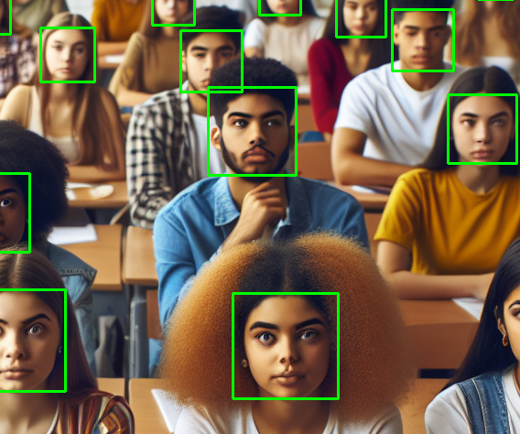
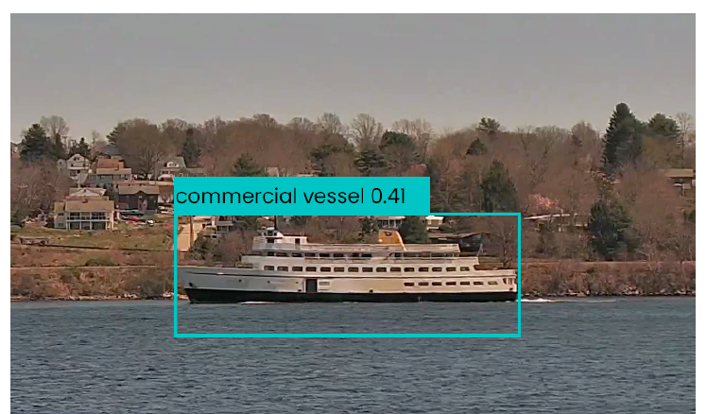
More OpenCV Capabilities
Drawing onto images of lines, rectangles, circles, text, etc.
Motion detection / optical flow
Video capture and processing (e.g., webcam input , Frame-by-frame processing, real-time image processing )
Camera calibration
Stereo vision / depth estimation
Notes:
and more: Image filtering (advanced kernels)
Morphological operations
Template matching

Slide 7
Using OpenCV
See using_opencv.ipynb Jupyter notebook which covers:
OpenCV basics
Intro to Feature Engineering with OpenCV
We will start with the OpenCV basics.

Slide 8
Features in Images (including still images from videos)
specific visual patterns, which are unique, can be tracked and can be compared
allow us to undertake image classification, object detection, tracking, comparison, etc.
found by:
OpenCV (and other tools), extracted from the raw image data and transformed into numerical features that machine learning algorithms can work with, or
modern vision-related machine learning approaches such as convolutional neutral networks (CNNs) without human guidance
Notes:
based in part on the following, see them for more information:
https://docs.opencv.org/4.x/df/d54/tutorial_py_features_meaning.html
https://www.geeksforgeeks.org/computer-vision/feature-extraction-and-image-classification-using-opencv/
https://docs.opencv.org/4.x/db/d27/tutorial_py_table_of_contents_feature2d.html

Slide 9

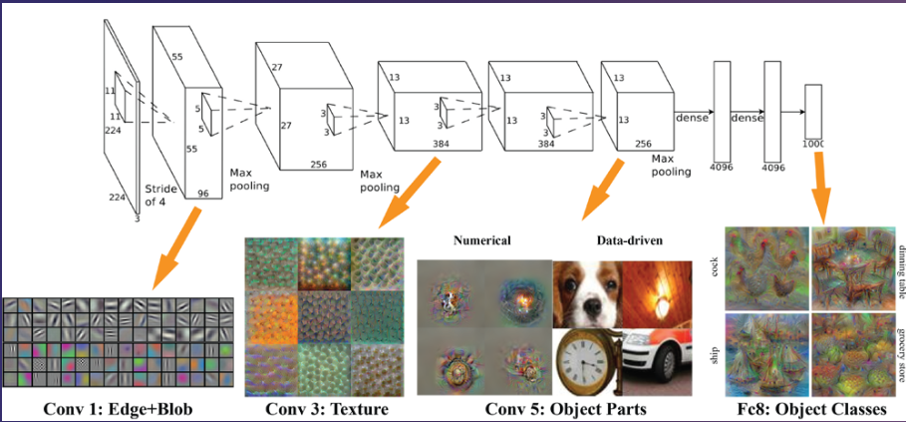
Feature Engineering
(image)
↓
[edges, contours, brightness, etc.]
↓
(feature vector)
↓
(model)
↓
(label)

Slide 10
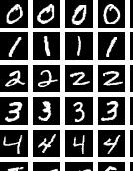
Feature “engineering” – simple example
Proose a feature that could help distinguish between two types of images in this image data set
Examples :
number of edges
size of largest contour
presence of corners
etc.
OpenCV can find these for us…

Slide 11
OpenCV Edge Detection
can detect vertical, horizontal, of varying thickness, orientation, numbers of edges, by region etc.
common feature extraction technique used by OpenCV is the Canny algorithm
See using_opencv.ipynb Jupyter notebook “Image Features” section

Slide 12
Convolutional Neural Network (CNN) and Feature Discovery
Has multiple layers, learning higher order constructs as you move up:
Early layers learn:
edges
gradients
Middle layers learn:
textures
patterns
Later layers learn:
parts of objects (eyes, wheels, etc.)
https://cs.brown.edu/courses/csci1430/2024_Spring/hw5_cnns/

Slide 13
Why Manual Feature Extraction Could Matter
Limited data– not enough data for the model to learn from it
Very specific and strong domain knowledge – e.g. a specific shape matters a lot
Interpretability – one can explain what the model is using as features, becoming increasingly important – “trustworthy AI”
Preprocessing – can speed the model up

Slide 14
for more on OpenCV and Feature Engineering check out
https://docs.opencv.org/4.x/
https://docs.opencv.org/4.x/d9/df8/tutorial_root.html
https://docs.opencv.org/4.x/df/d54/tutorial_py_features_meaning.html
https://www.geeksforgeeks.org/computer-vision/feature-extraction-and-image-classification-using-opencv/
https://docs.opencv.org/4.x/db/d27/tutorial_py_table_of_contents_feature2d.html

