Slide 1
Automation using shell scripts and makefiles

Slide 2
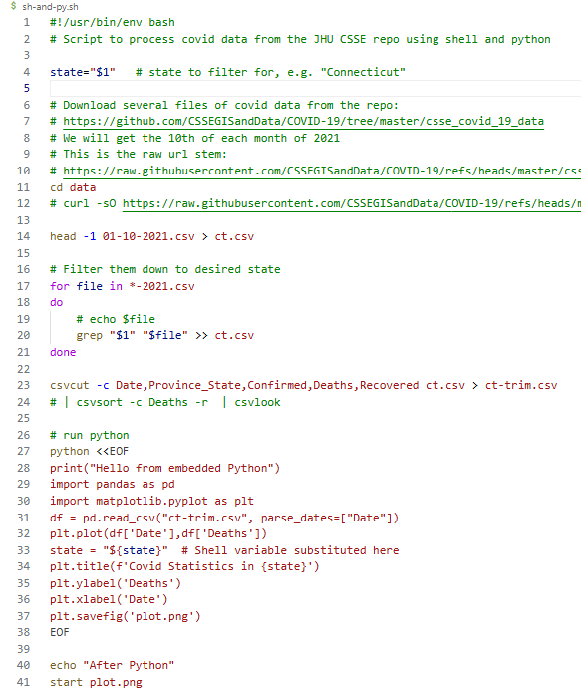
Automation
So far in this course –
we’ve learned many tools to accomplish tasks in the terminal
we’ve run them manually by typing them one after another in a “work flow”
Automation –
put these commands together in scripts or using other tools to execute tasks automatically instead of manually
allows the workflow to be run
repeatedly,
consistently, and
with minimal human intervention

Slide 3
Automation using Shell Scripts
shell scripts = programs consisting of commands that can be run from the terminal
they can utilize:
properties from your environment (e.g. $HOME, $PATH, …)
many programming language structures (variables, loops, conditionals, etc.)
commands and tools you can access from the terminal (shell commands like cd, ls, etc.; programs like python, sqlite3; and more)

Slide 4
Creating Scripts
Create in a text editor or IDE (nano, Notepad, Spyder, Visual Studio Code, etc.)
Put the scripts in any folder of yours you would like, and name them what you would like.
Running scripts (suppose your script is named myscript.sh)
in Linux or Unix (usually)
type sh myscript.sh or bash myscript.sh
or of you chmod privileges, just type myscript
in Git Bash
./myscript.sh
no need to change privileges

Slide 5

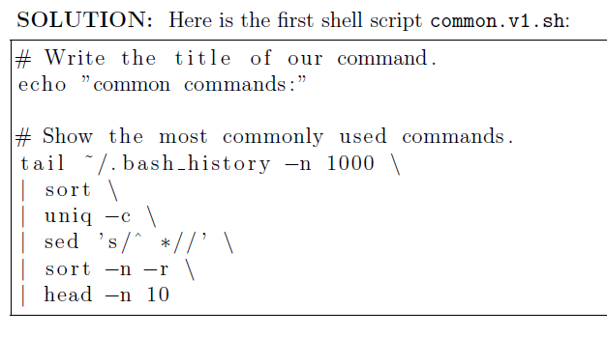
Example Shell Script
from HW 5, you should have had practice writing and running shell scripts
hello-world.sh
common.v1.sh

Slide 6
Shebangs #!
1st line of the shell script
tells terminal what program to use to interpret your script:
shells (bash, csh, zsh, etc.)
programming languages (Python, Perl, Ruby, etc.)
other executable programs (e.g. awk, sed, sqlite3, etc.)
A shebang can use any executable program that is capable of interpreting the file as a script of instructions.
To find the shell interpreter (to put in the shebang line), type: echo $SHELL
mine returned - /usr/bin/bash
# is sometimes known as a “sharp” (think: music). ! sometimes pronounced “bang!”. So #! is sharp-bang or she-bang for short.

Slide 7
shebang for Python
a shell script can consist entirely of Python
if so, you may need to alter the shebang path in your script to get it to work (assuming you set up Python within Git Bash), as follows:
type: conda activate
type: which python
now set the path in the shebang (#!) line of your script to the path from step 2, no space in between
For example:
#!/c/Users/ifrommer/.conda/envs/dst01/python
we will also see Python mixed with bash commands in a script

Slide 8
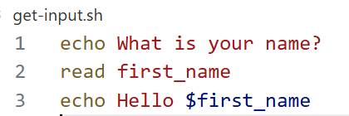
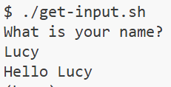
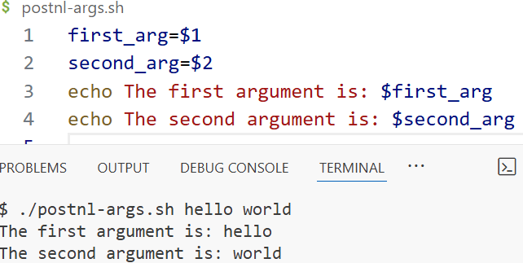
More basic shell script examples
Get input from the user:
Pass in positional arguments:
$ ./myscript.sh CT 2025
argument #: 0 1 2

Slide 9
sqlite3 shell script
#!/usr/bin/env sqlite3
CREATE TABLE test(x INT);
INSERT INTO test VALUES (1);
SELECT * FROM test;

Slide 10
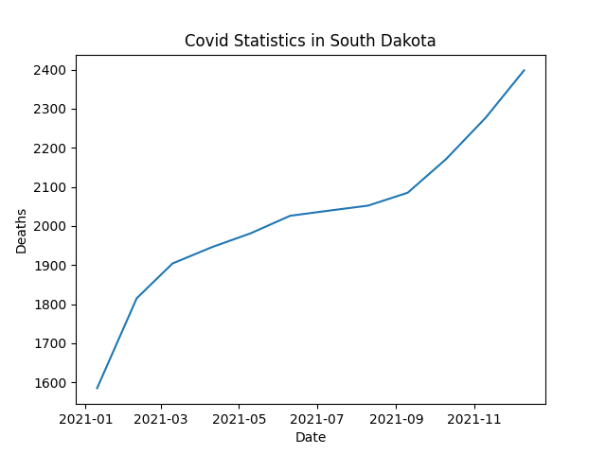
A More Complex Shell Script
Download several days of US COVID-19 data
Extract a particular state from each file
Combine in a new file
Plot the state’s data using Python
Save the figure to a file
Send a text when it’s done using twilio
We will build this up in stages.

Slide 11
Stage 1
#!/usr/bin/env bash
# Script to process covid data from the JHU CSSE repo using shell and python
# v1 - download the data to a data folder
# Download several files of covid data from the repo:
# https://github.com/CSSEGISandData/COVID-19/tree/master/csse_covid_19_data
# We will get the 10th of each month of 2021
# This is the raw url stem:
# https://raw.githubusercontent.com/CSSEGISandData/COVID-19/refs/heads/master/csse_covid_19_data/csse_covid_19_daily_reports_us
# Store them in a data/ subdirectory
cd data
curl -sO https://raw.githubusercontent.com/CSSEGISandData/COVID-19/refs/heads/master/csse_covid_19_data/csse_covid_19_daily_reports_us/[01-12]-10-2021.csv
cd ..
Create a data directory
The shell script will
change into /data/
download the files
change out of /data/
Let’s run this.

Slide 12
Stage 2
… beginning of the script the same as in Stage 1 …
# curl -sO https://raw.githubusercontent.com/CSSEGISandData/COVID-19/refs/heads/master/csse_covid_19_data/csse_covid_19_daily_reports_us/[01-12]-10-2021.csv
state="Connecticut" # state to filter for, e.g. "Connecticut"
# Grab the first line of one of the files to get the header, and write it to the output file we will use
head -1 01-10-2021.csv > state.csv
# Filter them down to desired state
for file in *-2021.csv
do
# echo $file
grep "$state" "$file" >> state.csv
done
csvcut -c Date,Province_State,Confirmed,Deaths,Recovered state.csv > state-trim.csv
cd ..
add
collect one state’s data in a state.csv file
csvcut it
next time we will cover shell
variables
for loops and other structures
Let’s run this.

Slide 13
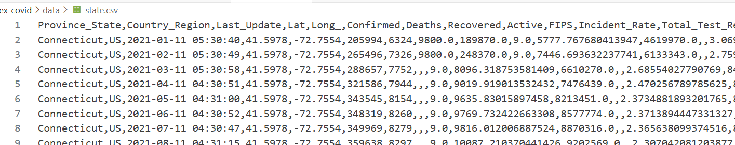
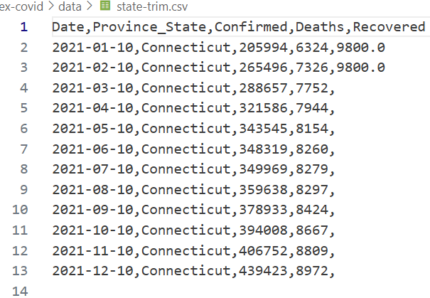
Results from Stage 2

Slide 14
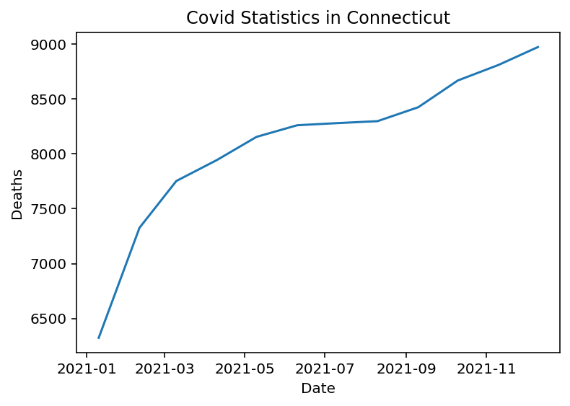
Stage 3 – add some Python to plot the data
We can develop this in Spyder if we prefer -
state = 'Connecticut'
import pandas as pd
import matplotlib.pyplot as plt
df = pd.read_csv("data/state-trim.csv", parse_dates=["Date"])
plt.plot(df['Date'],df['Deaths'])
plt.title(f'Covid Statistics in {state}')
plt.ylabel('Deaths')
plt.xlabel('Date')
plt.savefig('plot.png')
Note – we are pointing to the state-trim.csv file we created earlier in the shell script.

Slide 15
Stage 3 – Python in the shell script
… beginning of the script the same as in Stage 1 …
csvcut -c Date,Province_State,Confirmed,Deaths,Recovered state.csv > state-trim.csv
# run python
python <<EOF
print("Hello from embedded Python")
import pandas as pd
import matplotlib.pyplot as plt
df = pd.read_csv("state-trim.csv", parse_dates=["Date"])
plt.plot(df['Date'],df['Deaths'])
state = "${state}" # Shell variable substituted here
plt.title(f'Covid Statistics in {state}')
plt.ylabel('Deaths')
plt.xlabel('Date')
plt.savefig('plot.png')
EOF
echo "After Python"
start plot.png
cd ..
the shell calls Python
all lines between <<EOF and EOF are executed by Python
no need for a Python shebang in this script

Slide 16
One last change – use for any state
We will change this line:
state="Connecticut"
to this:
state=$1
Recall from earlier example $1 means first argument passed in.
Now we can run this script for any state. (Use “” for multi-word state names, e.g. ./covid-3.sh “New York”.)
Let’s run this.

