Slide 1
Using “make”

Slide 2
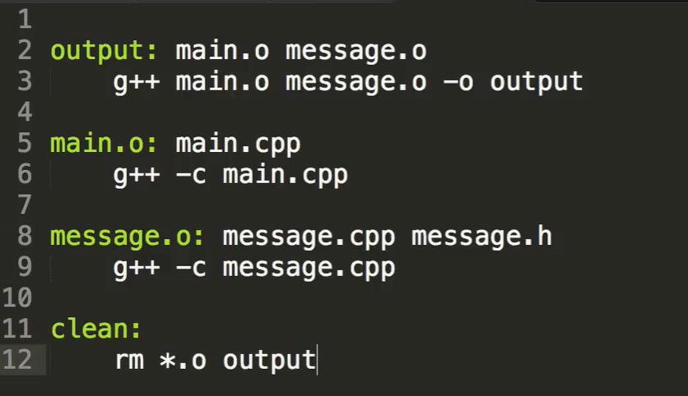
What is make?
output.txt: data01.dat square.py
python square.py > output.txt
command-line automation tool
manages a sequence of commands to create a final product (e.g. output file, program, database)
works through the use of a file known as a “makefile”
builds up target files based on dependent files (“dependencies”)
key aspect: examines the timestamps of the dependencies to determine if its commands need to be run
Notes:
src: https://www.youtube.com/watch?v=_r7i5X0rXJk

Slide 3
Where makefiles are used
C/C++ code compilation
Python scripts / Data pipelines
LaTeX / document compilation (.tex, .bib)
Website generation (make html out of md, etc.)
Automating testing
output.txt: data01.dat square.py
python square.py > output.txt
paper.pdf: paper.tex plot-data.png
pdflatex paper.tex
plot-%.png: %.dat plot.py
./plot.py -i $*.dat -o $@

Slide 4
make vs shell scripts
Feature | Shell Script (.sh) | Makefile
Main purpose | Running a sequence of commands | Building/updating files
Mindset | Top-down, linear, runs everything without checking whether files have been updated | Rule-based (Target: Dependency). Skips work that is already up-to-date
Error Handling | Keeps going unless you add set -e | Stops immediately if a command fails
Best For... | File processing, data pipelines, system tasks, automation with logic | Compiling code, data pipelines, or complex builds

Slide 5
Using makefiles
make is built into many terminals
needs to be installed into Git Bash
See "Installing make for Git Bash.docx" in the Admin folder of the course repo.

Slide 6
structure of a makefile
target: dependencies <TAB>command
Note – you must include the TAB before commands. Spaces will not work.
output.txt: data01.dat square.py python square.py > output.txt
Some optional but conventional targets:
all: indicates default build target
clean: commands to remove generated files
all: output.txt output.txt: data01.dat square.py python square.py > output.txt clean: rm –r data01.dat

Slide 7
Simple Python make example
# A simple Makefile – Makefile.print-numbers
all: output.txt
output.txt: data01.dat square.py
python square.py > output.txt
dependencies – files
the build depends on; make automatically rebuilds if these have changed
target file to be built
command to actual build the target from the dependencies

Slide 8
Simple Python make example
square.py contents:
fileobj = open("data01.dat", "r")
line = fileobj.readline()
line = line.strip()
y = [int(i) for i in line.split()]
for n in y:
print(n * n)
fileobj.close()
# A simple Makefile – Makefile.print-numbers
all: output.txt
output.txt: data01.dat square.py
python square.py > output.txt
data01.dat contents:
10 14 9 16 25 36 49
$ cat output.txt
100
196
81
256
625
1296
2401
To run, type:
make –f Makefile.print-numbers
To get a feel for how make works, make changes to the data file and re-run make.
See lec05-automation-shell-scripts/makefiles/ example folders for files.

Slide 9
LaTeX example
You need pdflatex installed in your terminal for this to work
See optional problem on HW 6 Part I
See MIT Missing Semester – Lecture 8 Metaprogramming
https://missing.csail.mit.edu/2020/metaprogramming/
https://www.youtube.com/watch?v=_Ms1Z4xfqv4&t=604s
paper.pdf: paper.tex plot-data.png
pdflatex paper.tex
plot-%.png: %.dat plot.py
./plot.py -i $*.dat -o $@

