Slide 1

CS1010: Programming Methodology

Slide 2
Week 1 Part I: Introduction
Objectives
High-level programming languages.
Useful problem-solving strategies.
Writing algorithms in pseudo-codes.
References
Chapter 1: Computers and Computing Fundamentals
Week1 - 2
Notes:
Instructors: Please spend about 1 hour 15 minutes on Part I.

Slide 3
Computers
Computer = Hardware + Software
Hardware: physical components for computation/processing; should be simple, fast, reliable.
Software: set of instructions to perform tasks to specifications; should be flexible, user-friendly, sophisticated.
Program is a kind of software.
Week1 - 3

Slide 4
Computers are Information Processors
Raw data
Computer system
Processed information
Data units
Internal representation in machine
1 bit (binary digit): 0 or 1
1 byte = 8 bits
Floating-point representation, etc.
Data types in programs
int, double, float, char, etc.
Week1 - 4

Slide 5
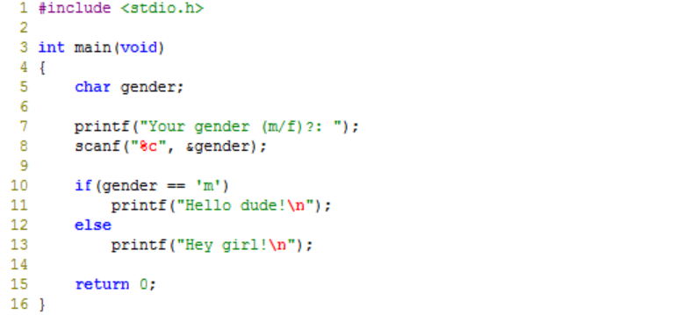
Program (1/4)
Program
A sequence of instructions telling a computer what to do.
Execution of a program
Computer performs the instruction sequence.
Programming language
Language for writing instructions to a computer.
Week1 - 5
Notes:
Program is a sequence of instructions that a computer can interpret and execute. The instructions follow the rules of the programming language chosen.

Slide 6
Program (2/4)
Program
A sequence of instructions telling a computer what to do.
Execution of a program
Computer performs the instruction sequence.
Programming language
Language for writing instructions to a computer.
Major flavors of programming language
Machine language or object code
Program to which computer can respond directly. Each instruction is a binary code that corresponds to a native instruction.
Example: 0001001101101110
Week1 - 6

Slide 7
Program (3/4)
Program
A sequence of instructions telling a computer what to do.
Execution of a program
Computer performs the instruction sequence.
Programming language
Language for writing instructions to a computer.
Major flavors of programming language
Machine language or object code
Assembly language
Symbolic language for coding machine language instructions.
Example: ADD A, B, C
Week1 - 7

Slide 8
Program (4/4)
Program
A sequence of instructions telling a computer what to do.
Execution of a program
Computer performs the instruction sequence.
Programming language
Language for writing instructions to a computer.
Major flavors of programming language
Machine language or object code
Assembly language
High-level
Detailed knowledge of the machine is not required. Uses a vocabulary and structure closer to the problem being solved.
Examples: Java, C, C++, Scheme...
Week1 - 8

Slide 9
Programs: Edit, Compile and Execute
Compiler
Translate a program written in a high-level language to a program in a target (low-level) language.
Source code
Editor
produces
welcome.c
eg: vim welcome.c
Executable code
Compiler
produces
a.out
eg: gcc welcome.c
Output
Execute
produces
Hello, welcome to CS1010!
eg: a.out
Week1 - 9

Slide 10
Problem Solving Process
Determine problem features
Analysis
Rethink as appropriate
Write algorithm
Design
Produce code
Implementation
Check for correctness (and efficiency)
Testing
Week1 - 10

Slide 11
Algorithmic Problem Solving
An algorithm is a well-defined set of steps to solve a complex task effectively.
An algorithm is commonly presented in pseudo-code.
Week1 - 11

Slide 12
Algorithm: Example #1
Find maximum value of a list of numbers.
Begin of algorithm
Declare a variable max.
First, you initialise max to zero.
Then, you enter the input numbers, one by one:
For each number that you have entered, compare it with max.
If number is larger than max, let max be number instead.
After all the numbers have been entered, print max.
End of algorithm
A more succinct version in shown in next slide…
Week1 - 12
Notes:
An example of a pseudo-code. This algorithm is too verbose.

Slide 13
Algorithm: Example #1
Find maximum value of a list of numbers.
Begin of algorithm
max ← 0 // max to hold the largest value eventually
for each num entered,
if num > max
then max ← num
print max
End of algorithm
Is there any error in this algorithm?
Week1 - 13
Notes:
This is a better version. It conveys the same information as version 1, but more concise.

Slide 14
Algorithm: Example #2
Compute the average of three integers.
A possible algorithm:
enter values for num1, num2, num3
ave ← ( num1 + num2 + num3 ) / 3
print ave
Variables used:
num1
num2
num3
ave
Another possible algorithm:
enter values for num1, num2, num3
total ← ( num1 + num2 + num3 )
ave ← total / 3
print ave
Variables used:
num1
num2
num3
total
ave
Week1 - 14
Notes:
The boxes tells the important information that we must hold data in some memory location. Each box has a name (the variable name) and content (the data it contains).

Slide 15
Algorithm: Example #3
Print two integers in increasing order.
Algorithm:
enter values for num1, num2
// swap the values in the variables if necessary
if (num2 < num1)
then temp ← num1
num1 ← num2
num2 ← temp
// display sorted integers
print num1, num2
Variables used:
num1
num2
temp
Week1 - 15
Notes:
This is an example using condition check

Slide 16
Problem Solving: Coin Change
Given this list of coin denominations: 1¢, 5¢, 10¢, 20¢, 50¢, and $1, find the minimum number of coins needed for a given amount. You do not need to list out what coins are used.
Example 1: For $3.75, coins are needed.
Example 2: For $5.43, coins are needed.
For simplicity, we assume that the input data is in cents.
6
10
Week1 - 16
Notes:
A possible algorithm (without using list or loop):
Enter amt
coins ← 0
coins = coins + (amt / 100)
amt = amt mod 100
coins = coins + (amt/50)
amt = amt mod 50
coins = coins + (amt/20)
amt = amt mod 20
coins = coins + (amt/10)
amt = amt mod 10
coins = coins + (amt/5)
amt = amt mod 5
coins = coins + amt
Print coins
The important idea here is students figure out themselves that they should start with the highest denomination (i.e. $1 coin).
But does this algorithm always work for other denominations, such as: 50-cent, 40-cent, 30-cent, 10-cent coins? No. Example: amount = 70 cents.
Students may not use modulo or % as they may not be aware of this. Some students may use repeated subtraction instead.
We will re-visit this problem when we cover arrays in week 8.

Slide 17
Design Algorithm Before Coding!
Preceding examples show that we can discuss problems and their solutions (algorithms) without writing out the codes.
A sample program development process for the Coin Change problem:
Understanding the problem (if in doubt, ask questions!): 2-5 minutes
Designing the algorithm: 10-20 minutes
Verifying the algorithm: 10-20 minutes
Writing the program: 10 minutes
Testing and debugging the program: 10 minutes to 1 hour
For more complex problems, time spent in thinking about the algorithm could far exceed time spent in writing the program.
The more time you invest in writing a good algorithm, the more time you will save in debugging your program.
Week1 - 17

Slide 18

Summary for Part I
Part I’s most important lessons
Program
Edit -> Compile -> Run
Problem-solving
a systematic, logical process
Algorithms
How to write pseudo-codes
Week1 - 18
Notes:
Instructors: at this point, we should be 1.5 hours into the lecture. You may give a short break here.

Slide 19
Part II: Overview of C Programming
Objectives
Able to write your first program with an editor
Able to execute your first program
Understand basic C constructs and arithmetic operations
Understand basic programming style
References
Chapter 2, Getting Started
Chapter 3, The Basics of C
Vim Quick Tutorial (hand-out)
Getting started with UNIX
Week1 - 19

Slide 20
1. General
There are many programming languages (A to Z):
A+, APL, Ada | Basic | C, C#, C++ | D, Delphi | E, Eiffel
F, Fortran, F# | G, | Haskell | IDL, Io, ICI | Java, JASS
K, | Lisp | M, Maple | Nimrod | Oz
Pascal, Python | Q, | R, RPG, Ruby | Smalltalk, Shakespeare | Tcl, Today
uniPaaS | Vimscript, VBA | Winbatch | X++, XL | Y, Z++
C is a general-purpose computer programming language developed in 1972 by Dennis Ritchie at the Bell Telephone Lab for use with the UNIX operating system.
Week1 - 20

Slide 21
2. Our First Program (1/5)
Week1_MileToKm.c
/*
* Week1_MileToKm.c: Converts distance in miles to kilometers.
*/
#include <stdio.h> // printf, scanf definitions
#define KMS_PER_MILE 1.609 // conversion constant
int main(void) {
float miles, // input - distance in miles
kms; // output - distance in kilometers
printf("Enter the distance in miles> ");
scanf("%f", &miles); // input distance in unit miles
kms = KMS_PER_MILE * miles; // convert distance to kilometers
/* Display the distance in kilometers */
printf("That equals %9.2f kilometers.\n", kms);
return 0;
}
Sample Run
$ gcc –Wall Week1_MileToKm.c
$ a.out
Enter the distance in miles> 10.5
That equals 16.89 kilometers.
Week1 - 21

Slide 22
2. Our First Program (2/5)
General form of a C program:
preprocessor directives followed by functions
preprocessor directives
function heading
{
variable declarations
executable statements
}
Week1 - 22

Slide 23
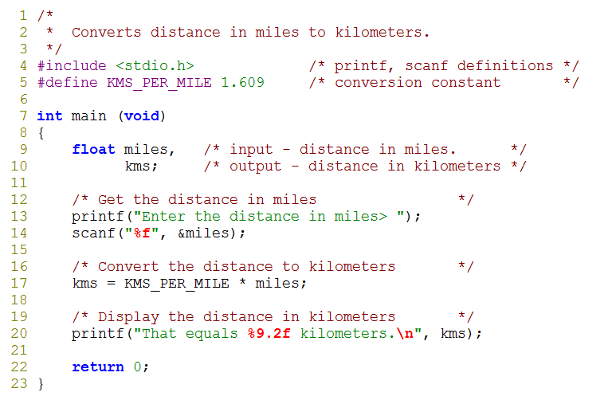
2. Our First Program (3/5)
standard header file
preprocessor directives
constant
reserved words
comments
variables
standard identifiers
Week1 - 23

Slide 24
2. Our First Program (4/5)
Week1 - 24

Slide 25
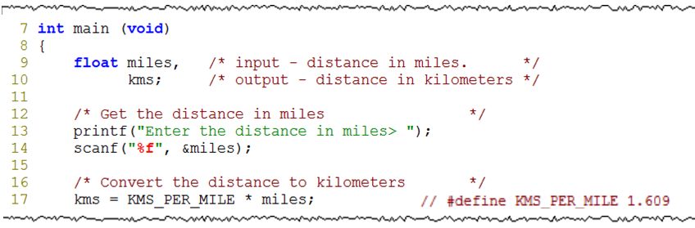
2. Our First Program (5/5)
memory
memory
memory
machine language Week1_MileToKm conversion program
machine language Week1_MileToKm conversion program
machine language Week1_MileToKm conversion program
miles
miles
miles
?
10.5
10.5
kms
kms
kms
?
?
16.89
Week1 - 25

Slide 26
3. Logging into UNIX System (1/4)
To login to sunfire server, you need your SoC UNIX account user-name and password.
If you don’t have it yet, create your account here:
https://mysoc.nus.edu.sg/~newacct
Week1 - 26
Notes:
Students can refer to https://mysoc.nus.edu.sg/~newacct to create their SoC UNIX account. For students who forgot their UNIX password, they can go to https://mysoc.nus.edu.sg/~myacct/iforgot.cgi to reset their password.

Slide 27

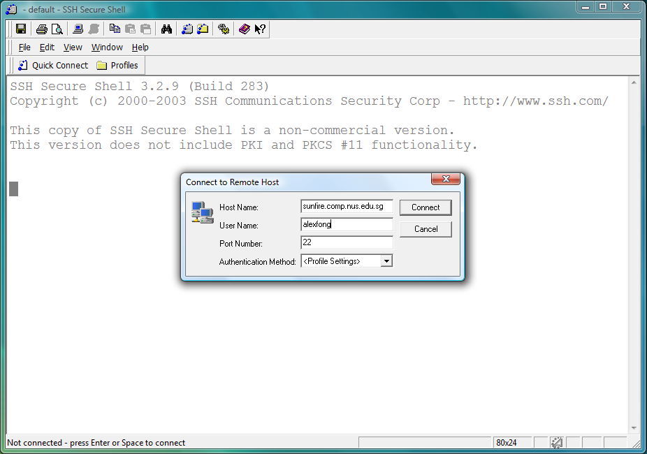
3. Logging into UNIX System (2/4)
1. Look for the SSH Secure Shell Client icon on your desktop, and double click on it.
2. Click on “Quick Connect” to get the pop-up window. Enter “sunfire” for Host Name and your UNIX id as User Name.
Week1 - 27

Slide 28
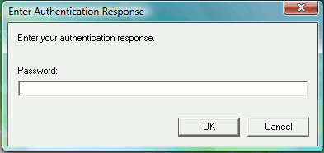
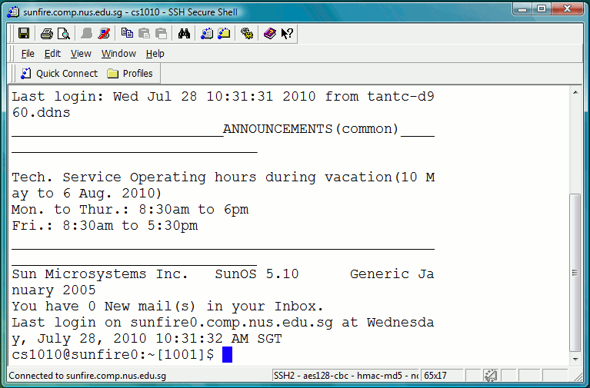
3. Logging into UNIX System (3/4)
3. Enter your UNIX password.
4. Once you log in successfully into your UNIX account, you will see this screen (actual display may vary).
Week1 - 28

Slide 29
3. Logging into UNIX System (4/4)
If this is your first time logging in
Run the following setup script:
~cs1010/lab0/setup source .bash_profile
Basic UNIX commands
ls
mkdir
rmdir
cd
(more to come in later weeks)
Week1 - 29

Slide 30
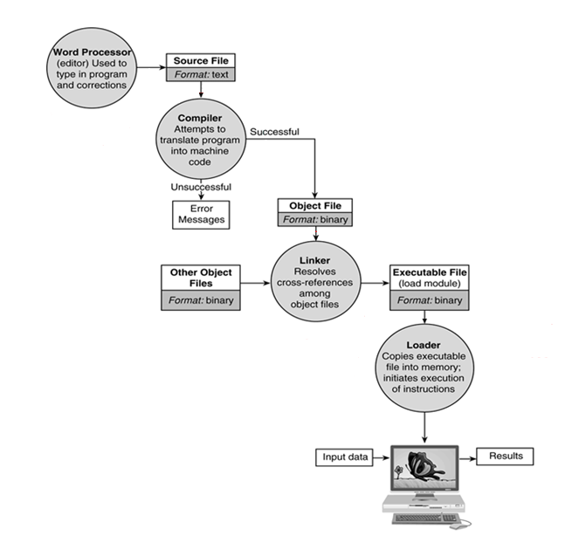
vim
gcc
execute program
Week1 - 30
Notes:
C is an example of a compiled language. Compiled languages are languages typically processed by compilers.

Slide 31
4. Programs: Edit, Compile and Execute
Write a new program or edit an existing program: vim
insert vs. command mode
i, <Esc>, :w, :wq
Compile C source code into executable code: gcc
gcc -Wall filename.c -o filename
Execute a program:
filename
Week1 - 31

Slide 32
5. Ex1: Execute an Program (1/2)
Use vim to type the program: Week1_MileToKm.c
/*
* Week1_MileToKm.c: Converts distance in miles to kilometers.
*/
#include <stdio.h> // for printf, scanf definitions
#define KMS_PER_MILE 1.609 // conversion constant
int main(void)
{
float miles, kms;
printf("Enter the distance in miles> ");
scanf("%f", &miles); // input distance in unit miles
kms = KMS_PER_MILE * miles; // convert distance to kilometers
/* Display the distance in kilometers */
printf("That equals %9.2f kilometers.\n", kms);
return 0;
}
When finish:
Save and quit vim
Check next page of the slides
Week1 - 32

Slide 33
5. Ex1: Execute an Program (2/2)
Compile your program using gcc
gcc -Wall Week1_MileToKm.c -o MileToKm
Hint: use <tab> wisely
gcc may report compilation error to you. Correct your program till it is free of (syntax) errors.
Execute your program and check against the following sample output:
Enter the distance in miles> 15
That equals 24.14 kilometers.
Week1 - 33

Slide 34
Summary for Part II
Part II’s most important lessons
Worked in a UNIX system and used the vim editor
Learned about simple features and style in C
Wrote the first program to do arithmetic operations correctly
Week1 - 34

Slide 35
End of File

