Slide 1

CS1010: Programming Methodology

Slide 2
Week 13: I/O and File Processing
Objectives:
Understand the concepts of file I/O.
Learn how to use standard functions for formatted I/O.
References:
Chapter 3, Chapter 7
Lessons 3.6, 3.8, 7.4
Week13 - 2

Slide 3
1. Introduction: Input / Output
In C language, input/output is done based on the concept of stream.
There are two types of streams: text and binary
Binary stream is beyond of the scope of CS1010.
Text stream
Consists of a sequence of characters organized into lines.
Each line ends with a newline character '\n'.
Example: source code of C program
Week13 - 3

Slide 4
1. Introduction: Standard Streams
Three streams are predefined for each C program: stdin, stdout, stderr
stdin points to a default input stream (keyboard)
stdout points to a default output stream (screen)
stderr points to a default output stream for error messages (screen)
A stream is accessed using a pointer of type FILE *.
Declare a stream -> open the stream -> read / write data -> close the stream
The 3 standard streams do not need above procedure.
All I/O functions are defined in header file <stdio.h>
Week13 - 4

Slide 5
2. Opening a File and File Modes (1/2)
FILE *infile, *outfile;
infile = fopen("demo1.in", "r");
outfile = fopen("demo1.out", "w");
open file "demo1.in" for reading
define FILE pointers
"w" for writing mode
fopen() function returns NULL pointer if an error is encountered; otherwise, returns a pointer of FILE type.
Error can happen, e.g., when you try to open a file for reading, but the file doesn’t exist in current directory, or you don’t have permission to open this file.
Week13 - 5
Notes:
CS1010 Programming Methodology
©The McGraw-Hill Companies, Inc.
5
I found that some students have been using NULL as the null character ('\0'), but their program works. This is not correct.
The reason the program works is that NULL is defined as 0L in many header files, but there is no rule saying that it must be defined as 0. [Actually it should be (void *) 0]. Since the null character '\0' has an ASCII value of 0, it is a mere coincidence that using NULL works, but this should be discouraged.
Hence when working on strings, students should stick to the null character '\0' instead of NULL. NULL is used where a null pointer is intended.

Slide 6
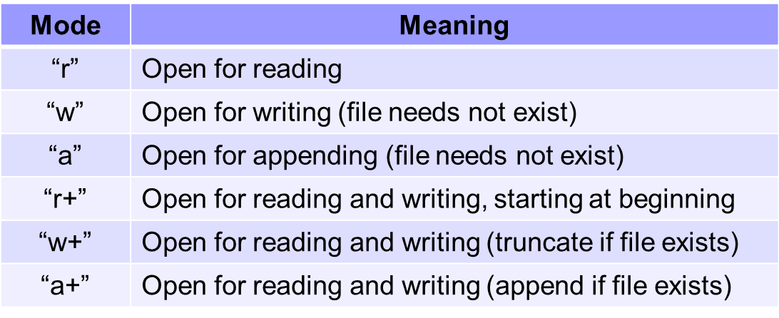
2. Opening a File and File Modes (2/2)
File modes for text files:
We will focus on "r" and "w" only.
Note that
In "r" mode, file must already exist
In "w" mode, new data will overwrite existing file data (if any)
Week13 - 6
Notes:
CS1010 Programming Methodology
©The McGraw-Hill Companies, Inc.
6

Slide 7
3. Closing a File
#include <stdio.h>
int main(void)
{
FILE *infile, *outfile;
infile = fopen("demo1.in", "r");
outfile = fopen("demo1.out", "w");
// data reading and writing skipped here
fclose(infile);
fclose(outfile);
return 0;
}
close the stream represented by this pointer variable
It is good practice to close a file after use.
Week13 - 7
Notes:
CS1010 Programming Methodology
©The McGraw-Hill Companies, Inc.
7

Slide 8
4. I/O Functions
We will only focus on the first category
Formatted I/O: fprintf(), fscanf()
Use format specifier to read data (int, double, char, string…)
Character I/O: putchar(), getchar(), fputc(), fgetc(), ungetc()
Reads and writes single characters
Line I/O: fputs(), fgets(), puts(), gets()
Reads and writes lines (as string)
Block I/O: fread(), fwrite()
Used mostly for binary streams
Week13 - 8

Slide 9
5. Formatted I/O (1/3)
float weight, height;
FILE *fp1, *fp2;
fp1 = fopen("demo1.in", "r");
fp2 = fopen("demo1.out", "w");
fscanf (fp1, "%f %f", &weight, &height);
fprintf(fp2, "Wt: %f, Ht: %f\n", weight, height);
The use of fscanf and fprintf is similar to scanf and printf.
Difference: refer to a particular stream vs. to stdin / stdout
fprintf(stdout, "out");
is equivalent to
printf("out");
fscanf(stdin, "%d", &var);
is equivalent to
scanf("%d", &var);
Week13 - 9

Slide 10
5. Formatted I/O (2/3)
With error checking routine
Week13_Demo1.c
#include <stdio.h>
#include <stdlib.h>
int main(void)
{
FILE *infile, *outfile;
// process data and close streams finally...
return 0;
}
to use exit()
check whether file is opened successfully
if ( (infile = fopen("demo1.in", "r")) == NULL ) {
printf("Cannot open file demo1.in\n");
exit(1); // terminate program with error code
}
if ( (outfile = fopen("demo1.out", "w")) == NULL ) {
printf("Cannot open file demo1.out\n");
exit(2); // terminate program with error code
}
Week13 - 10
Notes:
When the program terminates with exit(...), immediate enter echo $? in UNIX to find the exit code the program terminated with. It should show 1 or 2 in this example.
$? in UNIX refers to the exit status of the last executed program/command.

Slide 11
5. Formatted I/O (3/3)
fscanf returns EOF if an input failure occurs before any data items can be read; otherwise, returns the number of data items that were read and stored.
Assuming that file contains no error, then a return value of EOF means you have reached the end of the file.
Input file:
10 20 30 40
FILE *fp;
int var;
// open file using pointer fp
while ( fscanf(fp, "%d", &var) != EOF )
{
printf("%d\n", var);
}
10
20
30
40
//while (fscanf(fp, "%d", &val) == 1)
Week13 - 11

Slide 12
7. Exercise #1: Counting Lines (1/2)
Write a function countLines that takes as input the name of a text file and returns the number of lines in the input file.
Skeleton:
Sample run:
cp ~cs1010/lecture/Week13_CountLines.c .
(Input file: "ex1.in")
10 20
30 40
50 60
What is the input filename? ex1.in
Number of lines = 3
Week13 - 12

Slide 13
7. Exercise #1: Counting Lines (2/2)
int countLines(char *filename)
{
int count = 0;
FILE *fp;
char ch;
if ( (fp = fopen(filename, "r")) == NULL )
exit(1);
while ( fscanf(fp, "%c", &ch) != EOF )
if (ch == '\n')
count++;
fclose(fp);
return count;
}
Week13_CountLines.c
Week13 - 13
Notes:
You may also use fget() to achieve this, but is out of scope – google it if interested.

Slide 14
8. Exercise #2: Trimming Blanks (1/2)
Complete the following function in Week13_TrimBlanks.c
int trimBlanks (char *infile, char *outfile)
that takes an input text file and produces a new text file that is a duplicate copy of the input file except that each sequence of consecutive space characters is replaced by a single space character.
The function returns the number of space characters been trimmed.
Skeleton:
cp ~cs1010/lecture/Week13_TrimBlanks.c .
("ex2.in")
10 20
30 40
What is the input filename? ex2.in
What is the output filename? ex2.out
7 blanks are trimmed.
("ex2.out")
10 20
30 40
Week13 - 14

Slide 15
8. Exercise #2: Trimming Blanks (2/2)
Week13_TrimBlanks.c
int trimBlanks (char *infile, char *outfile)
{
char ch, prevCh = 'A'; // prevCh can be initial to any value
int count = 0;
FILE *ifp, *ofp;
if ( (ifp = fopen(infile, "r")) == NULL ) exit(1);
if ( (ofp = fopen(outfile, "w")) == NULL ) exit(2);
while ( fscanf(ifp, "%c", &ch) != EOF )
{ // only output the first blank to output file
if (ch == ' ' && prevCh == ' ') // not first blank
count++; // one more blank trimmed
else
fprintf(ofp, "%c", ch);
prevCh = ch;
}
fclose(ifp); fclose(ofp);
return count; // return the number of blanks trimmed
}
Week13 - 15

Slide 16

Summary for Today (1/2)
Today’s most important lessons
File processing
I/O on text files
fopen, fclose
I/O functions
Formatted I/O: fprintf, fscanf
Error checking on opening a file and detecting end-of-file (EOF) is essential
Week13 - 16

Slide 17
Summary for Today (2/2)
#include <stdio.h>
#include <stdlib.h>
int main(void)
{
FILE *infile, *outfile;
int num;
if ((infile = fopen("demo2.in", "r")) == NULL) {
printf("Cannot open file demo2.in\n");
exit(1);
}
if ((outfile = fopen("demo2.out", "w")) == NULL) {
printf("Cannot open file demo2.out\n");
exit(2);
}
while ( fscanf(infile, "%d", &num) != EOF )
fprintf(outfile, "Value read: %d\n", num);
fclose(infile); fclose(outfile);
return 0;
}
define pointers for I/O streams
open files with error checking
read data while detecting end of file
write data to output file
close files after processing
Week13 - 17
Notes:
CS1010 Programming Methodology

Slide 18

Announcement: Final Exam
CS1010 exam
23 Apr. 2012 (Monday), 9am
Venue: PRINCE GEORGE'S PARK RESIDENCES, MULTI-PURPOSE HALL, BASEMENT 1
Open book
Format
5 MCQ questions
3 tracing questions
5 programming questions
Grading of CS1010 is not bell-curve based!
Week12 - 18

