Slide 1

CS1010: Programming Methodology

Slide 2
Week 1 Outline Review
Overview of programming:
What is programming
Various programming languages
Demo: Getting our first program to execute.
write -> compile -> run
Week2 - 2

Slide 3
Week 2 Part I: Outline
We will continue with the following topics on Overview of C programming.
Program structure
Data input using scanf
Data compute: variable, data type, constant, precedence rules
Data output using printf
Coding style: naming, presentation, simplicity and efficiency.
Errors: syntax, run-time and logic error.
Week2 - 3
Notes:
Instructors: Please spend about 1 hour 30 minutes on Part I.

Slide 4
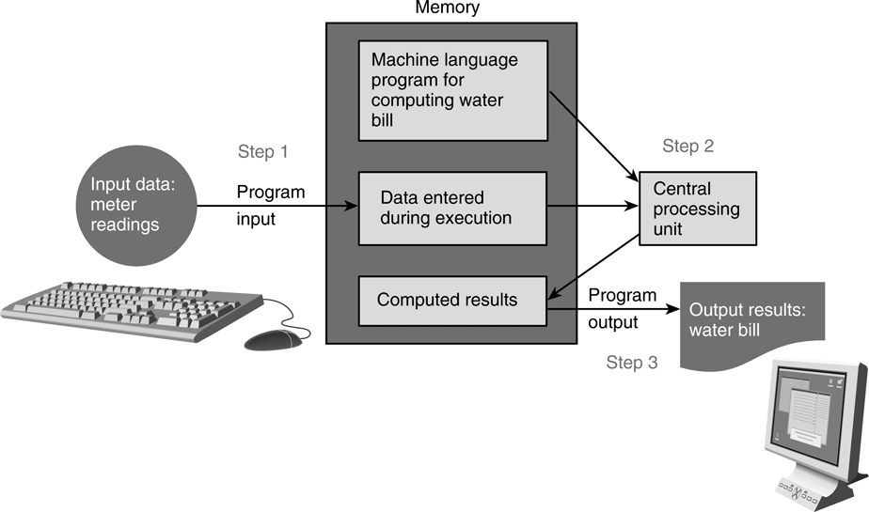
6. Program Structure
In general, a C program has 3 logical parts:
Input : through scanf (std input) or fscanf (file input)
Compute: through arithmetic / logic operations
Output: through printf (std output) or fprintf (file output)
Week2 - 4
Notes:
In C language, scanf is used to read data from standard input channel (keyboard); printf is used to print out data to standard output channel (monitor).

Slide 5
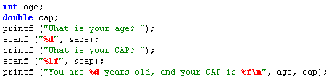

6. Program Structure: Input/Output (1/3)
Input/output statements:
printf (string constant);
printf (format string, print list);
scanf (format string, input list);
age
20
One version:
“age” refers to value in the variable age.
“&age” refers to (address of) the memory cell corresponds to the variable age.
Another version:
Week2 - 5
Notes:
Side notes: address of variable "age" varies each time a program is run.

Slide 6
6. Program Structure: Input/Output (2/3)
%d, %f, %lf etc. are placeholder (a.k.a format specifier)
Placeholder | Variable Type | Function Use
%c | char | scanf / printf
%d | int | scanf / printf
%f | float | scanf
%lf | double | scanf
%f | float or double | printf
%e | float or double | printf (for scientific notation)
More complex use in output: e.g., %5d, %8.2f, %.2f
minimum field width
precision
See Table 3.3 (next slide) for more example outputs.
Week2 - 6

Slide 7
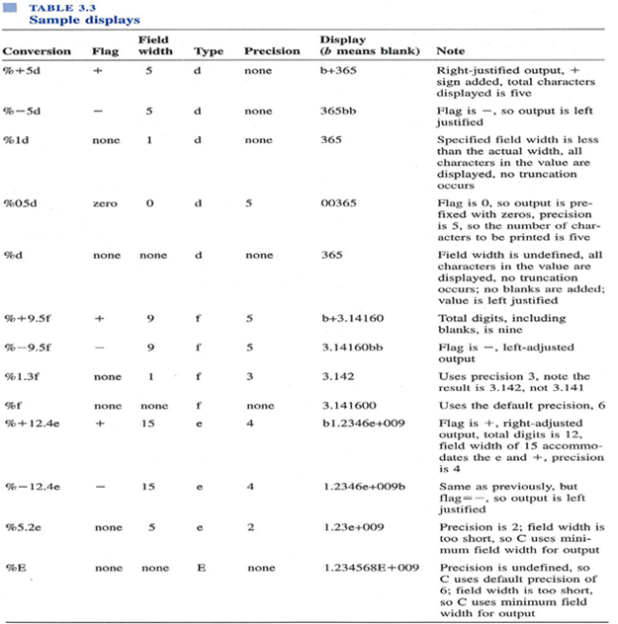
From:
C Programming for Engineering & Computer Science, by Tan and D’Orazio, page 56.
Week2 - 7

Slide 8
6. Program Structure: Input/Output (3/3)
\n is another format string – “newline escape sequence”
Backslash character is used to indicate escape sequence.
See Table 2.1 (next slide) for other interesting escape sequences.
Week2 - 8
Notes:
Demo using Week1_MileToKm.c:
with / with out '\n'
open two SSH windows
Use <tab> for auto-completion

Slide 9
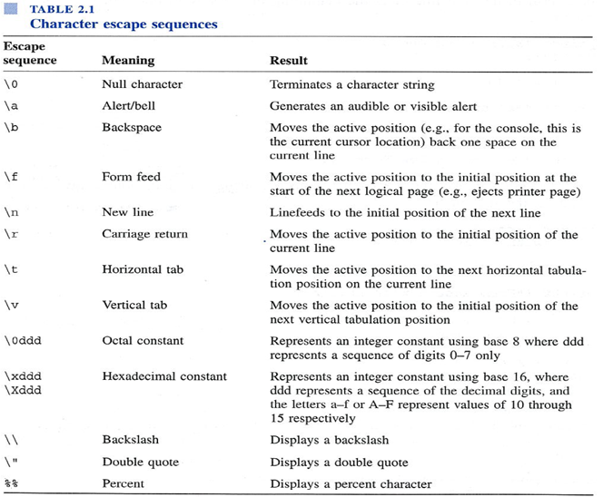
From:
C Programming for Engineering & Computer Science, by Tan and D’Orazio, page 56.
Week2 - 9

Slide 10
6. Program Structure: Compute (1/9)
Computation is done inside function(s)
int main (void)
is a special function where execution starts.
A function body has two major parts:
declarations: tell compiler what type of memory cells needed
executable: describe the processing on the memory cells
int main(void)
{
declaration statements
executable statements
return 0;
}
Week2 - 10
Notes:
For the int main(void) function, theoretically we can return any integer value, but we usually return 0 because the exit code 0 usually means a successful run (esp. when run in UNIX environment).
We can have the function return different values on different conditions (eg. in an 'if' statement) to indicate under what circumstance did the program end.
Exit code is useful if we need to check the termination status of a program after the program is run (for some follow-up action), though we don’t make use of it in this course.

Slide 11

6. Program Structure: Compute (2/9)
Declaration Statements
Part 1: Standard Data Types
data type: tells computer how to store a particular value in memory and what operations can be performed on the value.
int
32 bits, hence value between -2,147,483,648 (-2³¹) through +2,147,483,647 (2³¹ – 1)
float (and also double)
an abstraction for real numbers
3.14159
15.0e-4 or 15.0E-4 (value is 0.0015)
char
a character, which is a letter, a digit, or a special symbol
'A' 'z' '2' '9' '*' '?' ' '
Week2 - 11
Notes:
Date type decides how data is stored in computer, as an integer or a real number? If is a real number, is it encoded in double or float?

Slide 12
6. Program Structure: Compute (3/9)
Declaration Statements
Part 2: Identifier
Identifier: to be used as a variable name or a function name.
Reserved words (or keywords)
e.g. int, void, double, return
Standard identifier
e.g. printf, scanf
User-defined identifier
avoid reserved words and standard identifiers
consist only of letters, digits and underscores
must not begin with a digit
case-sensitive
e.g. invalid: 1Letter, double, int, TWO*FOUR, joe’s
valid: maxEntries, _X1234, this_IS_a_long_name
Week2 - 12

Slide 13
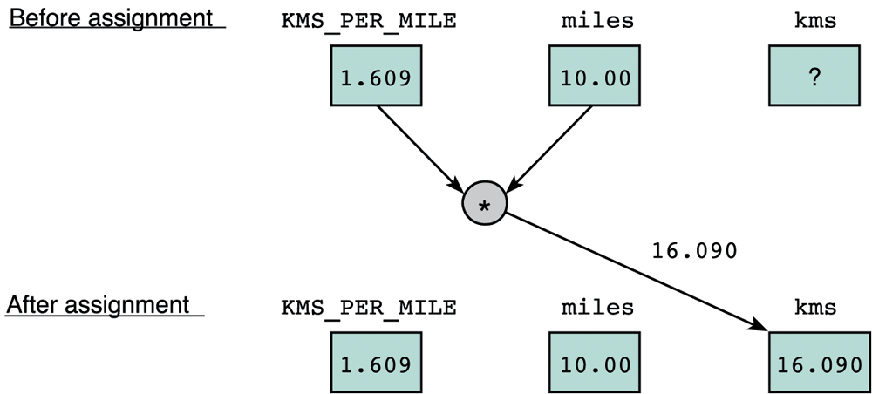
6. Program Structure: Compute (4/9)
Executable Statements
I/O statements (e.g. printf, scanf)
Assignment statements
stores a value or a computational result in a variable
kms = KMS_PER_MILE * miles;
= is not equality, but assignment
Week2 - 13
Notes:
Executable statements are the instructions where we process data.

Slide 14
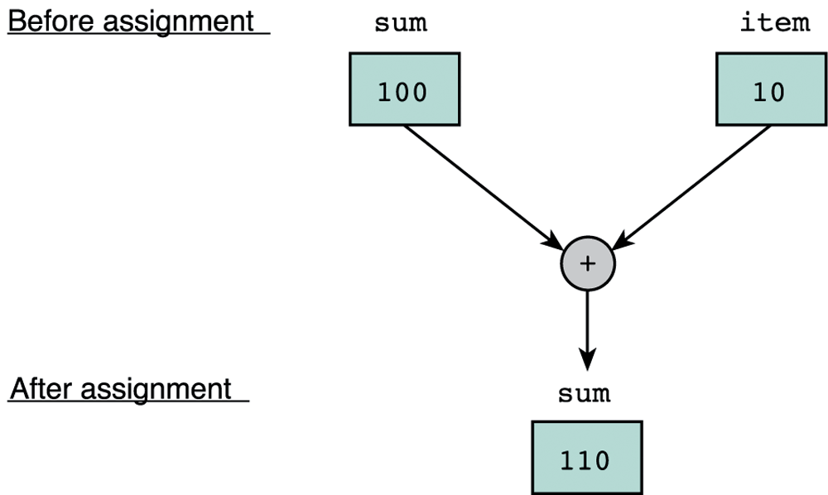
6. Program Structure: Compute (5/9)
Executable Statements
I/O statements (e.g. printf, scanf)
Assignment statements
stores a value or a computational result in a variable
sum = sum + item;
Week2 - 14

Slide 15
6. Program Structure: Compute (6/9)
Assignment statements involve arithmetic operations.
Unary operators: +, –
int y = -4; int x = -y;
Binary operators: +, –, *, /, % (modulo or remainder)
Left Associative (from left to right)
45 / 15 / 3 → 3 / 3 → 1
19 % 7 % 3 → 5 % 3 → 2
4 + 3 * 5 →
(4 + 3) * 5 →
General rule to evaluate an arithmetic operation: execute from left to right, respecting parentheses rule, and then precedence rule, and then associative rule (next page)
+, – are lower in precedence than *, /, %
= is lower in precedence than arithmetic operations.
19
35
Week2 - 15
Notes:
19 = 2 * 7 + 5

Slide 16
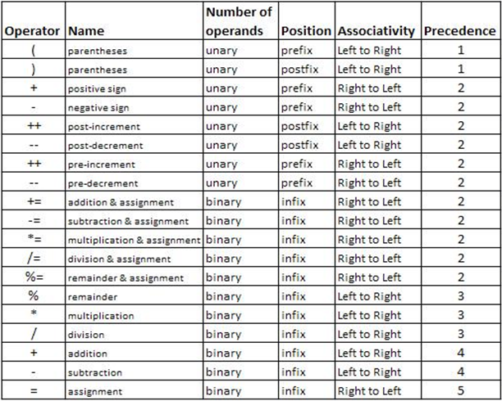
6. Program Structure: Compute (7/9)
Arithmetic operators: Associativity & Precedence
Week2 - 16

Slide 17
6. Program Structure: Compute (8/9)
Some interesting rules on arithmetic operations
Integer division
If both operands are integers, then the result of their division is also an integer.
5 / 2
Truncated result if result can’t be stored
int n; n = 9 * 0.5;
Data type promotion in mixed-type operation
If an operation is specified between a low precision data type and a high precision data type, the result of calculation would of high precision data type.
2 * 2.0
2
4 will be stored in n.
4.0
Week2 - 17
Notes:
Integer division and truncation can sometimes produce unexpected results, because any decimal portion of the integer division is dropped.

Slide 18
6. Program Structure: Compute (9/9)
Mixed-Type Arithmetic Operations
int m = 10/4; means
float p = 10/4; means
float q = 10/4.0; means
int n = 10/4.0; means
m = 2;
p = 2.0;
q = 2.5;
n = 2;
Type Casting
Use a cast operator to change the type of an expression
syntax: (type) expression
int aa = 6; float ff = 15.8;
float pp = (float) aa / 4; means
int nn = (int) ff / aa; means
float qq = (float) (aa / 4); means
pp = 1.5;
nn = 2;
qq = 1.0;
Week2 - 18
Notes:
Abbreviated Assignment and increment operator will be introduced in next week’s discussion session.

Slide 19
7. Demo #1 Fahrenheit to Celsius (1/2)
We are to write a program to convert a temperature in degrees Fahrenheit to degrees Celsius
Celsius = 5 / 9 * (Fahrenheit – 32)
We use the vim editor to write: Week2_FtoC.c
We Compile it using gcc.
We execute the program and is supposed to observe the following sample runs:
Enter temperature in Fahrenheit: 32.5
That equals 0.277778 Celsius.
Enter temperature in Fahrenheit: 0
That equals -17.777778 Celsius.
Week2 - 19

Slide 20
7. Demo #1 Fahrenheit to Celsius (2/2)
/* convert temperature from Fahrenheit to Celsius */
#include <stdio.h>
int main(void) {
double celsius, fahrenheit;
printf("Enter temperature in Fahrenheit: ");
scanf("%lf", &fahrenheit);
celsius = 5.0 / 9 * (fahrenheit - 32);
printf("That equals %lf Celsius\n", celsius);
return 0;
}
// celsius = 5 / 9.0 * (fahrenheit - 32);
// celsius = (fahrenheit - 32) * 5 / 9;
Week2_FtoC.c
Week2 - 20
Notes:
Here listed three common ways to bypass integer division.

Slide 21
8. Coding Style
Identifier naming for variables and functions
User-defined identifiers: use lower-case (with underscore if necessary)
User-defined constants: use all upper-cases
Use names that are descriptive, meaningful
Consistent indentation, and spacing to emphasize block structure
int main (void)
{
statements
}
Comment major code segments or complex logic:
// one line comment
/* block comment */
Header comment: your name, NUSNET id, program’s purpose, etc.
Week2 - 21
Notes:
Demo gg=G using Week2_FtoC.c
In lab assignments, marks will be deducted for bad style (bad naming of variables, poor indentation, no name and program description, etc.)
Internet resource on coding style: http://www.cs.swarthmore.edu/~newhall/unixhelp/c_codestyle.html

Slide 22
9. Errors
Syntax Error (and warning)
Program does not obey C grammar such as invalid choice of identifier name, invalid expression, missing semi-colon, etc.
Warning happens, for example, due to incomparable use of types for output
Run-time Error
Program terminates unexpectedly due to illegal operation, such as dividing a number by zero
Logic Error
Program produces result as opposed to what is expected (wrong algorithm)
The process of correcting errors in programs is called debugging.
Debugging can be very time-consuming.
Week2 - 22

Slide 23
10. Ex #1: Temperature Estimate (1/3)
Write a program Week2_Freezer.c that estimates the temperature in a freezer (in ºC) given the elapsed time (hours) since a power failure. Assume this temperature (T) is given by:
where t is the time (in unit hour) since the power failure.
Your program should prompt the user to enter how long it has been since the start of the power failure in hours and minutes, both values in integers.
Note that you need to convert the elapsed time into hours in real number (use type float).
For example, if the user entered 2 30 (2 hours 30 minutes), you need to convert it to 2.5 hours before applying the above formula.
Week2 - 23

Slide 24
10. Ex #1: Temperature Estimate (2/3)
Download the skeleton program:
Refer to the sample runs below. Follow the input / output format.
cp ~cs1010/lecture/Week2_Freezer.c .
Enter hours and minutes since power failure: 2 45
Temperature in freezer = -13.63
Enter hours and minutes since power failure: 1 0
Temperature in freezer = -18.67
Week2 - 24
Notes:
Instructors: You may give a short break after this exercise. There should remain 1 hour after finishing this exercise.

Slide 25
10. Ex #1: Temperature Estimate (3/3)
Week2_Freezer.c
// Estimates the temperature in a freezer (in C)
// given the elapsed time (hours) since a power failure.
#include <stdio.h>
int main(void)
{
int hours, minutes;
float time, temperature;
printf("Enter hours and minutes since power failure: ");
scanf("%d %d", &hours, &minutes);
time = hours + minutes/60.0; // convert hour & minutes to hours
temperature = 4 * time * time / (time + 2) - 20;
printf("Temperature in freezer = %.2f\n", temperature);
return 0;
}
Week2 - 25
Notes:
Instructors: You may give a short break after this exercise.

Slide 26
Week 2 Part II: Outline
Next, we will start a new topic called Top Down Design.
Objectives:
Able to analyse, design, and implement a program.
Able to structure a program into various functions.
Understand working with functions
References:
Chapter 5, Functions (Lessons 5.1 – 5.3)
Chapter 3, Lesson 3.7: Math Library Functions
Week2 - 26

Slide 27
1. General
Given a problem, how to proceed to reach a working program?
Determine problem features
Analysis
Rethink as appropriate
Design algorithm
Design
Write code
Implementation
Check for correctness (and efficiency)
Testing
Week2 - 27

Slide 28
1. General
Analysis and Design
stepwise
refinement
NO
( hierarchy of )
sub-problems
problem
statement
sub-problems can
be implemented ?
YES
Implementation
& Testing
Knowledge in C
and its libraries
Knowledge in
data structure
(mostly CS1020)
Knowledge in
algorithms
Week2 - 28
Notes:
When implementation and testing did not give the expected outcome, go back to the analysis and design again.

Slide 29
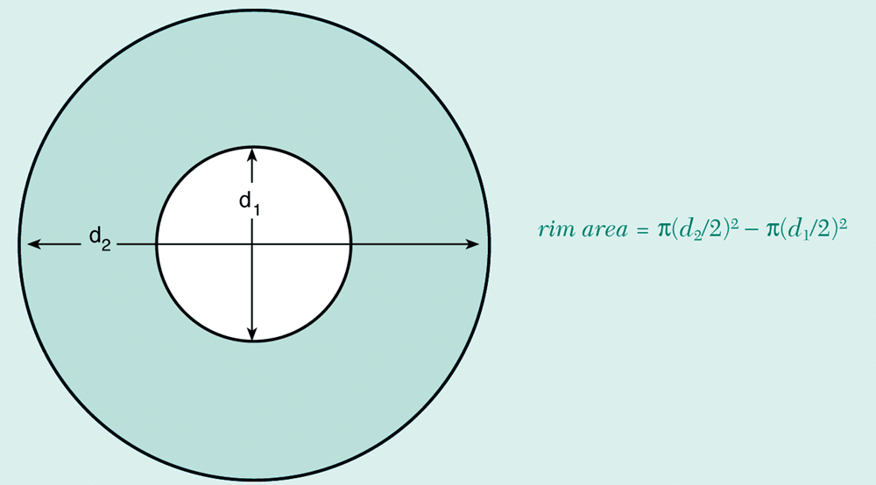
2. Demo: Top-down Design (1/6)
You work for a hardware company that manufactures flat washers. To estimate shipping costs, your company needs a program that computes the weight of a specified quantity of flat washers.
rim area = π(d₂/2)² – π(d₁/2)²
Week2 - 29

Slide 30
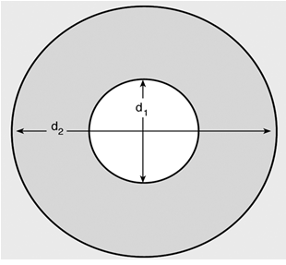
2. Demo: Top-down Design (2/6)
Analysis:
To get the weight of a specified qty of washer, we need to know the weight of each washer
To get the weight of a washer, we need its volume × density
To get volume, we need its rim area × thickness
To get the rim area, we need d2 and d1
qty, density, thickness, d2, d1 should be given as inputs.
Answer
qty
weight
volume
density
rim area
thickness
rim area = π(d₂/2)² – π(d₁/2)²
d2
d1
Week2 - 30

Slide 31
2. Demo: Top-down Design (3/6)
Analysis:
We define what the inputs and outputs are
Design:
Algorithm (expressed in words):
Read in all the necessary inputs (qty, density, thickness, d2, d1)
Compute weight of a single washer
2.1 Compute the area of the (small) hole using d1
2.2 Compute the area of the (big) circle using d2
2.3 Subtract the big area from the small area to get the rim_area
2.4 Compute volume = rim_area × thickness
2.5 Compute weight = volume × density
Compute the weight of a specified number of washer = weight × qty
Output the calculated weight
Week2 - 31

Slide 32
2. Demo: Top-down Design (4/6)
Design:
Algorithm (expressed in Structure Chart)
Compute Total Weight
Input: qty, density, thickness, d1, d2
Compute Weight of a single washer
Output total weight
Compute total Weight
Compute circle area
divide and conquer strategy
Week2 - 32

Slide 33
2. Demo: Top-down Design (5/6)
#include <stdio.h>
#include <math.h>
#define PI 3.14159
int main(void)
{
double d1; // input hole circle diameter
double d2; // input big circle diameter
double thickness; // thickness of a washer
double density; // density of a washer
int qty; // how many washers?
double unit_weight; // single washer's weight
double total_weight; // a batch of washers' total weight
double inner_area; // area of inner hole
double outter_area; // area of outter circle
double rim_area; // single washer's rim area
// ask for all the inputs
printf("Inner diameter in centimeters: ");
scanf ("%lf", &d1);
we will use library function pow later
Week2_WashersWeight_v1.c
Week2 - 33

Slide 34
2. Demo: Top-down Design (6/6)
printf("Outer diameter in centimeters: ");
scanf ("%lf", &d2);
printf("Thickness in centimeters: ");
scanf ("%lf", &thickness);
printf("Material density in grams per cubic centimeter: ");
scanf ("%lf", &density);
printf("Quantity in batch: ");
scanf ("%d", &qty);
// compute weight of a single washer
inner_area = pow(d1/2, 2) * PI;
outter_area = pow(d2/2, 2) * PI;
rim_area = outter_area - inner_area;
unit_weight = rim_area * thickness * density;
// compute weight of a batch of washers
total_weight = unit_weight * qty;
printf("The total weight of the batch of %d washers is %.2f grams\n",
qty, total_weight);
return 0;
}
Week2_WashersWeight_v1.c
To compile this program:
gcc -Wall Week2_WashersWeightV1.c -lm
Week2 - 34
Notes:
If you use any math library function in your program, you need to include <math.h> at the preprocessor directives; also you need to include flag '-lm' during compilation.

Slide 35
3. Functions (1/8)
printf("Thickness in centimeters: ");
scanf ("%lf", &thickness);
printf("Material density in grams per cubic centimeter: ");
scanf ("%lf", &density);
printf("Quantity in batch: ");
scanf ("%d", &qty);
inner_area = pow(d1/2, 2) * PI;
outter_area = pow(d2/2, 2) * PI;
rim_area = outter_area - inner_area;
unit_weight = rim_area * thickness * density;
// compute weight of a batch of washers
total_weight = unit_weight * qty;
printf("The total weight of the batch of %d washers "
"is %.2f grams\n", qty, total_weight);
return 0;
}
Week2_WashersWeight_v1.c
A bit duplicated
Week2 - 35
Notes:
Here we repeat the formula twice, each time with different diameter. It’s still ok because the duplicated code is just one line. But there could be other cases where your duplicated code is a big trunk. Then you would need to think about a better design to avoid duplication.

Slide 36
3. Functions (2/8)
// user defined function
// to calculate area of a circle
double circle_area(double diameter)
{
return pow(diameter/2, 2) * PI;
}
int main(void)
{
double d1;
double d2;
....
rim_area = circle_area(d2) - circle_area(d1);
unit_weight = rim_area * thickness * density;
// compute weight of a batch of washers
total_weight = unit_weight * qty;
....
return 0;
}
This is the first function call
This is the second function call
Week2_WashersWeight_v2.c
Week2 - 36
Notes:
Assuming that d2 = 4, d1 = 2, first function call will return value 12.56636; second function call will return value 3.14159
Return value will replace the function call for further calculation. So caller will continue doing 12.56636 – 3.14159 and assign result to variable rim_area.

Slide 37
3. Functions (3/8)
// return square root of (x^2 + y^2)
double sqrt_sum_square(double x, double y)
{
double sum_square; // local variable
sum_square = pow(x, 2) + pow(y, 2);
return sqrt(sum_square);
}
Arrows indicate flow of control between main and a function been called.
int main(void)
{
double a = 1.23;
double b = 4.56;
double c = sqrt_sum_square(a, b);
printf("The distance of (%.2f, %.2f) ", a, b);
printf("to origin is: %.2f\n", c);
return 0;
}
The distance of (1.23, 4.56) to origin is: 4.72
Week2 - 37
Notes:
To understand function, you need to understand
syntax to define and invoke function
workflow: when a program contains multiple functions, what is the sequence of execution.
Function header specifies whether a function receive input values (through parameter list) and return values to the caller (through return type). By looking at the function header, caller will know how to invoke that function and what is the expected return (if any).
Caller must provide exactly the same number of parameters to correctly invoke a function call; otherwise compiler will not be able to match parameter list and will report compilation error.
When caller make a function call, caller will be suspended; system will begin to execute the function been called line by line until it finish; then return to the caller, meaning that caller will resume execution.

Slide 38
3. Functions (4/8)
formal parameters
double sqrt_sum_square(double x, double y)
{
double sum_square; // local variable
sum_square = pow(x, 2) + pow(y, 2);
return sqrt(sum_square);
}
int main(void)
{
double a = 1.23;
double b = 4.56;
double c = sqrt_sum_square(a, b);
printf("The distance of (%.2f, %.2f) ", a, b);
printf("to origin is: %.2f\n", c);
return 0;
}
a, b are actual parameters
Week2_Distance.c
Values of actual parameters are copied to function for computation.
Formal parameters are placeholders to receive values.
Matching of actual and formal parameters from left to right
Scope of formal parameters, local variables is within the function only
Week2 - 38
Notes:
The scope of variables / parameters is the function in which they are defined.
Formal parameter and actual parameter are different variables, belonging to callee and caller respectively.
Normally we give them different names, but even with the same names (e.g., replace 'x' with 'a' and 'y' with 'b'), they are still different memory slots (with different memory addresses). Compiler will be able to differentiate them.

Slide 39
3. Functions (5/8)
#include <stdio.h>
#include <math.h>
double sqrt_sum_square(double, double);
int main(void)
{
double a = 1.23;
double b = 4.56;
double c = sqrt_sum_square(a, b);
printf("The distance of (%.2f, %.2f) ", a, b);
printf("to original is: %.2f\n", c);
return 0;
}
// return square root of (x^2 + y^2)
double sqrt_sum_square(double x, double y)
{
double sum_square;
sum_square = pow(x, 2) + pow(y, 2);
return sqrt(sum_square);
}
The complete program of Week2_Distance.c:
Week2_Distance.c
Function prototype is needed if the caller is defined before the function been called
these a, b, c are local to main function
such x, y, sum_square are local to this function
Week2 - 39
Notes:
In function prototype, you may just give the type of parameters and skip their names. You may even put parameter names there, but will be ignored by the compiler.

Slide 40
3. Functions (6/8)
preprocessor directives
function prototypes
main function
{
variable declarations
executable statements
}
function1 heading
{
variable declarations
executable statements
}
function2 heading
{
variable declarations
executable statements
}
more function definitions..
A function is a block of code solving a task / sub-task.
A function takes zero or more input parameters, and returns zero or one return value.
Return value (if any) from function call may be used (or be skipped) by the caller.
Week2 - 40

Slide 41
3. Functions (7/8)
General format of 4 kinds of functions
// takes no parameter
// returns nothing
void funcA (void)
{
printf("Welcome on board!\n");
return;
}
// takes no parameter
// returns a double value
double funcB ()
{
return 3.1415926;
}
// takes a parameter
// returns nothing
void funcC (double par)
{
printf("%f\n", par);
}
// takes two parameters
// returns a double value
double funcD (double a, double b)
{
return a + b;
}
Week2 - 41
Notes:
If a function takes no parameter, then parameter list can be empty or "void".
When all statements are executed, a function returns to caller naturally. Or if a "return" statement is met, control will also return to the caller instantly.
As a programmer, it’s your design how many parameters a function will take and whether it will return a value or not.

Slide 42
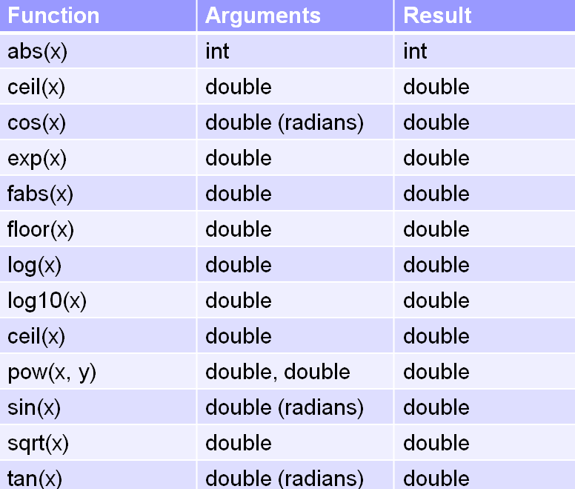
3. Functions (8/8)
Some useful Math functions
function abs(x) is from <stdlib.h>; the rest are from <math.h>
to compile with –lm option for using functions from <math.h>
Week2 - 42

Slide 43
4. Exercise #2: Speed of Sound
Write a program that calculates the speed of sound (a) in air of a given temperature T (ºF). Formula to compute the speed a in ft/sec:
(This is a true story) Being unable to correct compilation errors, one of the students sent me his code, which can be downloaded as follows:
Help your friend by trying to understand his code, and modifying it until it is error-free.
cp ~cs1010/lecture/Week2_SpeedOfSound.c .
Week2 - 43
Notes:
You may apply top-down design approach to see how you can solve the task step by step. Two major steps are implemented as two functions in the given skeleton file (but with minor errors).
Of course, you can have other designs. For example, treat the computation part as one major step only and define one function for it.

Slide 44

Summary for Today
Today’s most important lessons
Program structure
Arithmetic operations: integer division, mixed types, type casting
Top-down design for problem solving: divide and conquer
Modular programming: functions
Acquaintance with C language library functions
printf, scanf
pow, sqrt
Week2 - 44

Slide 45

Reminder
Our first discussion session is on this Friday
No attendance taken
You may join any group if haven’t fixed a group yet.
Trial lab (lab #0) has been released.
Questions: http://www.comp.nus.edu.sg/~cs1010/lab/lab0.html
Submit your programs to CodeCrunch https://codes.comp.nus.edu.sg/
This is an ungraded lab. The purpose is for you to familiar yourself with UNIX environment, vim editor and CodeCrunch submission.
Seek help from your discussion leader (DL) this Friday.
Week2 - 45

Slide 46
End of File

