Slide 1

CS1010: Programming Methodology

Slide 2
Week 5: Repetition Statements
Objectives:
Understand the program control structure called loops.
Compare the different types of repetition structure.
References:
Chapter 4 Lessons 4.7 – 4.11
Week5 - 2

Slide 3

1. What are Loops?
Control structures:
Sequence (done!)
Selection: if, if-else, switch (done!)
Repetition
Loop: allow us to specify the repetition of a groups of steps
When do you need to use loops?
Any steps repeated in the solution? If yes, which ones?
Do you know before-hand how many times to repeat the group of steps? If no, what is the condition to keep repeating?
Week5 - 3
Notes:
Selection statement allows us to choose different path of the program to execute.
Loop allows us to repeat certain steps of the program.

Slide 4
2. while Loops
while ( condition )
{
statements to execute
}
We call the number of times a loop repeats “the number of iterations”.
If condition is true, execute loop body, otherwise terminate loop.
Week5 - 4

Slide 5
3. Demo #1: Print Integers (1/2)
Write a program Week5_Integers.c to accept 2 integer a and b (assume a ≤ b) and print integers between a and b, both inclusive.
Your program should have a function
void print_integers(int, int)
to print out integers.
Sample run:
Enter two integers a and b (a<=b): -3 8
-3 -2 -1 0 1 2 3 4 5 6 7 8
Week5 - 5

Slide 6
3. Demo #1: Print Integers (2/2)
// List integers between a and b (a <= b)
#include <stdio.h>
void print_integers(int, int); // function prototype
int main(void)
{
int a, b;
printf("Enter two integers a and b (a<=b): ");
scanf("%d %d", &a, &b);
print_integers(a, b);
return 0;
}
// Print integers in range [x, y]
// Pre-cond: x <= y
void print_integers(int x, int y)
{
int i = x;
while (i <= y)
{
printf("%d ", i);
i++;
}
printf("\n"); // change line
}
Week5_Integers.c
Q: Any suggestion to improve print_integers() function?
Week5 - 6
Notes:
Changing variable x in print_integers function will not affect variable a in main function.

Slide 7
4. while Loops: Examples (1/3)
Example: Given a positive integer n, print positive odd integers up to n.
// Pre-cond: n > 0
void print_odd_integers(int n)
{
int i = 1;
while (i <= n)
{
if (i%2 != 0)
printf("%d ", i);
i++;
}
printf("\n");
}
Q: Any other way?
Week5 - 7
Notes:
Answer will be given in class.

Slide 8
4. while Loops: Examples (2/3)
Trace the following codes manually and write out their outputs.
(a)
int a = 1;
while (a*a < 1000)
{
printf("%d ", a);
a *= 2;
}
printf("\n");
1 2 4 8 16
b=0, c=99
b=1, c=98
b=2, c=97
:
:
b=48, c=51
b=49, c=50
(b)
int b = 0, c = 99;
while (b < c)
{
printf("b=%d, c=%d\n", b, c);
b++; c--;
}
Week5 - 8
Notes:
Use MI to solve (b)

Slide 9
4. while Loops: Examples (3/3)
Trace the following code manually and write out its output.
(c)
int d = 3;
while (d = 1)
{
printf("d=%d\n", d);
d = 99;
}
d=1
d=1
d=1
:
(Infinite loop!)
A compilation warning will be reported:
warning: suggest parentheses around assignment used as truth value
If you encounter an infinite loop, press control-c to stop it (in UNIX).
Week5 - 9
Notes:
The condition (d = 1) is an assignment statement, and it evaluates to 1 (which is true), hence an infinite loop.
Instructors: you may give such a demo: Week5_CommonError1.c

Slide 10
5. do-while Loops
do
{
statements to execute
} while ( condition );
Execute loop body at least once.
Example: Print positive odd integers up to n.
// pre-cond: n > 0
void print_odd_integers(int n) {
int i = 1;
do {
printf("%d ", i);
i += 2;
} while (i <= n);
printf("\n");
}
Week5 - 10
Notes:
Note that if n < 1, there will be an output of 1, which is incorrect. However, we have written a pre-condition of n > 0 in the documentation.
The capability of while, do-while and for loop is the same. Just which syntax is easier to write code, given a specific problem.

Slide 11
6. for Loops (1/2)
for ( initialization; condition; update )
{
statements to execute
}
Initialization: initialize the loop variable
Condition: repeat loop while the condition is true
Update: change value of loop variable
Week5 - 11
Notes:
Semicolon separates each of the 3 sections.
Each section may be empty, but semicolons must be present still.
If the condition is empty, it is evaluated as true and the loop will repeat until something else stops it.

Slide 12
6. for Loops (2/2)
for ( initialization; condition; update )
{
statements to execute
}
Example: Print numbers 1 to 10
int n;
for (n=1; n<=10; n++)
{
printf("%d ", n);
}
Steps:
n=1;
if (n<=10) { printf(…); n++; }
Go to step 2
Do initialization only once.
For each round:
check condition first
do body part
do update part
* Any round condition is false, skip 2) - 3)
Week5 - 12
Notes:
What we cover here is the most common/simplest format. Other formats such as empty initialization/update, multiple initialization/update, composite condition, etc, as well as ++n, etc. are left out here.

Slide 13
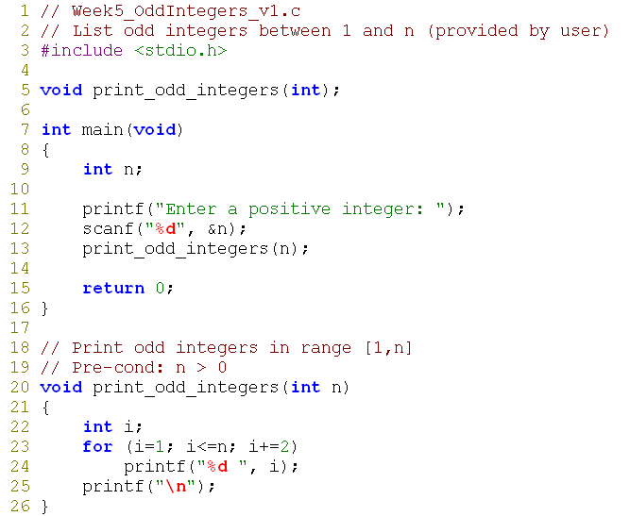
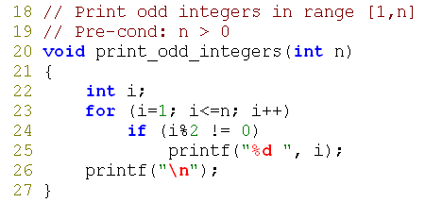
7. for Loops: Odd Integers
Version 4
Version 3
Week5 - 13

Slide 14
8. Exercise #1: Sum of Multiples of 3
Modify the program Week5_OddInteger.c to read a positive integer n and then compute the sum of all integers between 1 and n which are multiples of 3.
Rename this program as: Week5_SumMultiples3.c.
Your program should contain a function:
int sum_multiples_of_3(int)
to return sum of multiples of 3 in range [1, n].
cp ~cs1010/lecture/Week5_OddInteger.c Week5_SumMultiples3.c
Enter a positive integer: 10
Sum = 18
Enter a positive integer: 50
Sum = 408
Week5 - 14
Notes:
Instructors: pick up 1 exercise from Ex1 and Ex2 and let students try it on the spot. The other one will be their take-home exercise.
In the given solution, sum must be initialized to be 0 before increasing it value.
You must define a variable first before you use it.
You must initialize a variable before using its value.

Slide 15
9. Exercise #2: Asterisks
Write a program Week5_Asterisks.c to read an integer n (n > 0) and print certain number of asterisks on a single line.
Your program should contain a function:
void print_asterisks(int)
Think! What is the relationship between the number of * and the iteration number?
Enter n: 3
*****
Done!
Enter n: 6
***********
Done!
Enter n: 10
*******************
Done!
Enter n: -2
Done!
Week5 - 15
Notes:
figure out the formula 2*n – 1 first (design algorithm)

Slide 16
10. Common Errors (1/2)
Off-by-one error: make sure the loop repeats exactly the correct number of iterations.
Make sure your loop will eventually terminate.
Be cautious of using '=' where it should be '==' (as in slide 9).
for (n=1; n<=10; n++) {...}
for (n=1; n<10; n++) {...}
for (n=0; n<10; n++) {...}
for (n=0; n<=10; n++) {...}
Week5 - 16
Notes:
First loop will run 10 times, second: 9 times, third: 10 times; last: 11 times

Slide 17
10. Common Errors (2/2)
What are the outputs for the following programs?
int main(void)
{
int i;
for (i=0; i<10; i++);
printf("%d\n", i);
return 0;
}
10
int main(void)
{
int i=0;
while (i<10);
{
printf("%d\n", i);
i++;
}
return 0;
}
(infinite loop!)
Week5 - 17
Notes:
Good indentation can help to identify problems such as this.

Slide 18
11. Some Notes of Caution
Involving real numbers
double one_seventh = 1.0/7.0;
double f = 0.0;
while (f != 1.0)
{
printf("%f\n", f);
f += one_seventh;
}
0.000000
0.142857
0.285714
0.428571
0.571429
0.714286
0.857143
1.000000
1.132857
:
(infinite loop!)
Avoid using floating-point number in loop condition
Week5 - 18

Slide 19
12. Exercise #3: Nested Loops
Download the following three programs:
Hand trace them and write down the outputs.
Then verify your answers by running the programs.
cp ~cs1010/lecture/Week5_NestedLoopEx1.c .
cp ~cs1010/lecture/Week5_NestedLoopEx2.c .
cp ~cs1010/lecture/Week5_NestedLoopEx3.c .
Q: Can we download the three files in a batch?
Week5 - 19
Notes:
Instructors: let students try and understand this topic on their own.

Slide 20
13. Using break in loop (1/2)
break is used in in switch statement; break can also be used in a loop.
Test out Week5_BreakInLoop.c
break is to jump out of the enclosing loop immediately.
Use break sparingly, as it is likely to make your program harder to debug.
cp ~cs1010/lecture/Week5_BreakInLoop.c .
Week5 - 20
Notes:
Instructors: let students try and understand this topic on their own.

Slide 21
13. Using break in loop (2/2)
A loop with break can always be rewritten into another one without break.
// with 'break'
int n, i, sum;
sum = 0;
i = 1;
while (i <= 10)
{
scanf("%d", &n);
if (n < 0)
break;
sum += n;
i++;
}
// without 'break'
int n, i, sum;
int is_positive; // indicate if input n
// is positive
sum = 0; i = 1;
is_positive = 1;
while ((i <= 10) && is_positive)
{
scanf("%d", &n);
if (n < 0)
is_positive = 0;
else {
sum += n;
i++;
}
}
Week5 - 21
Notes:
If using break will greatly simplify your logic, then choose it.

Slide 22
14. Using continue in loop
Test out program Week5_ContinueInLoop.c
continue is to skip the rest body part of current round of loop and proceed to next round.
continue is even less often used than break.
cp ~cs1010/lecture/Week5_ContinueInLoop.c .
Week5 - 22
Notes:
Try not to use continue in your own programming as the logic could become confusing even for programmers themselves.

Slide 23
15. Exercise #4: Prime Number
Primality test is a classic programming problem.
Given a positive integer, determine whether it is a prime
A prime number has two distinct factors (divisors): 1 and itself. Examples: 2, 3, 5, 7, 11, ... (Note: 1 is not a prime!)
Write a program Week5_PrimeTest.c. You should include a function is_prime that takes a positive integer and check its primality. Return 1 if so, 0 otherwise.
This is your take-home exercise.
Enter a positive integer: 131
131 is a prime.
Enter a positive integer: 713
713 is not a prime.
Week5 - 23
Notes:
There are many algorithms for is_prime(int).

Slide 24

Summary for Today (1/3)
Today’s most important lessons
Repetition statements (loops)
while, do-while and for
Nested loops
break and continue
Week5 - 24

Slide 25
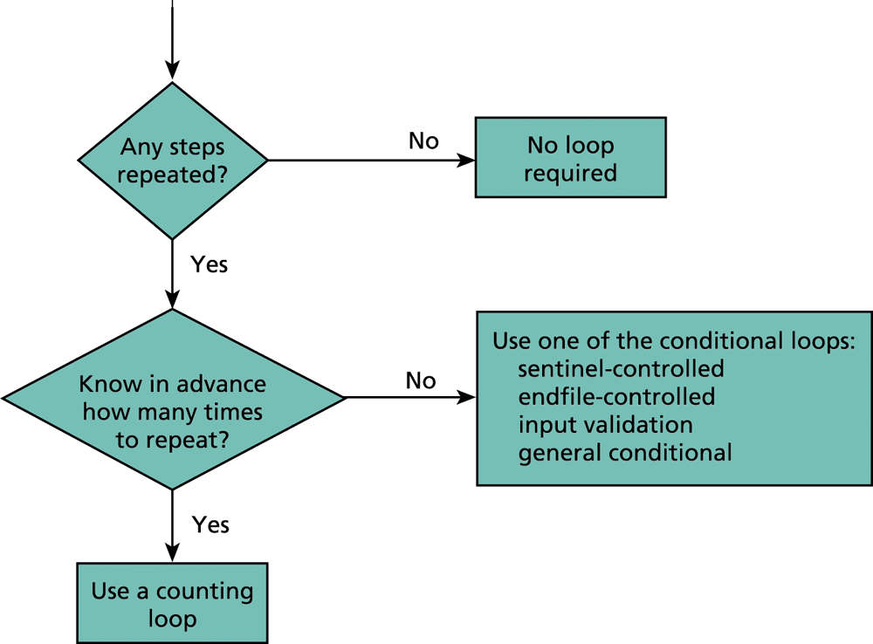
Summary for Today (2/3)
Week5 - 25
Notes:
'for' loop is a counting loop (counter based). 'while' and 'do-while' loops are conditional loops

Slide 26
Summary for Today (3/3)
Today’s most important lessons (II)
We have learned the 3 control structures:
Sequence, Selection, Repetition
With these, we are able to solve just any computing problem virtually!
However, writing good programs is more than just learning the syntax:
Variables should be descriptive
Logic should be clear
Algorithm should be efficient
Practice makes perfect!
Week5 - 26

Slide 27

Reminder
Take-home lab #2 has been released
Questions: http://www.comp.nus.edu.sg/~cs1010/lab/lab2.html
Submit your programs to CodeCrunch
https://codes.comp.nus.edu.sg/
Deadline: 12 February 2012, Sunday, 6pm
This is your 2nd graded lab and 1 attempt mark will be carried forward to your final mark.
Week5 - 27

Slide 28
End of File

