Slide 1
(Malloc) Debugging
CSCI 380: Operating Systems
Instructor:
William Killian

Slide 2
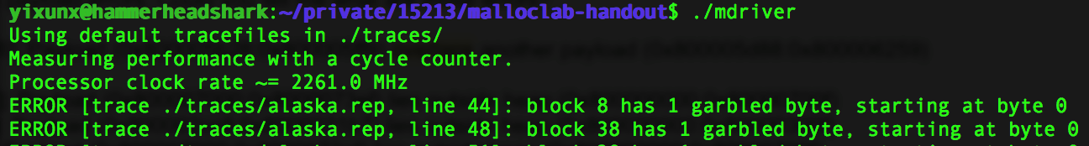
Errors
Some errors are identified by the driver
The error message is straightforward in most cases
“garbled byte” means part of the payload returned to the user has been overwritten by your allocator
“out of memory” occurs when the memory is used very inefficiently, or there are lost blocks

Slide 3
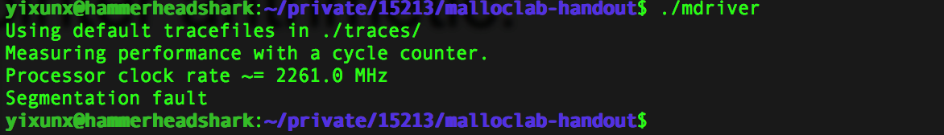
Errors
But most of the times…
Do “gdb mdriver” and “run” to find out which line segfaults
Note that a segfault occurring at line 200 could actually be caused by a bug on line 70

Slide 4
Segfault
To resolve a segfault, it is necessary to find the earliest time things went wrong.
One way to do this is to print the whole heap before/after relevant functions
Scroll up from the point of segfault and find the earliest operation that makes the heap look wrong
Sometimes this gives too much information, not all of which are useful
The heap checker can make this easier
Checks violation of invariants (corruption of the heap)

Slide 5
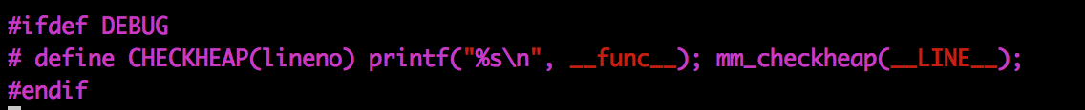
Heap Checker
Once you’ve settled on a design, write the heap checker that checks all the invariants of the particular design
The checking should be detailed enough that the heap check passes if and only if the heap is truly well-formed
Call the heap checker before/after the major operations whenever the heap should be well-formed
Define macros to enable/disable it conveniently
e.g.

Slide 6
Invariants (non-exhaustive)
Block level:
Header and footer match
Payload area is aligned
List level:
Next/prev pointers in consecutive free blocks are consistent
Free list contains no allocated blocks
All free blocks are in the free list
No contiguous free blocks in memory (unless you defer coalescing)
No cycles in the list (unless you use circular lists)
Segregated list contains only blocks that belong to the size class
Heap level:
Prologue/Epilogue blocks are at specific locations (e.g. heap boundaries) and have special size/alloc fields
All blocks stay in between the heap boundaries
And your own invariants (e.g. address order)

Slide 7
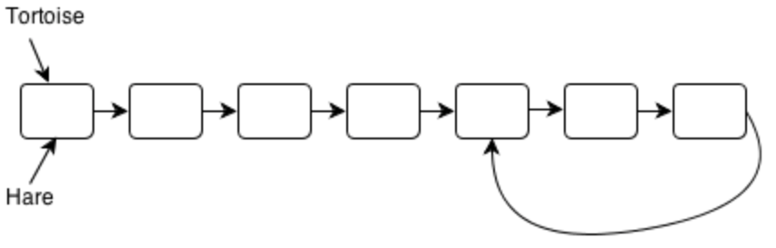
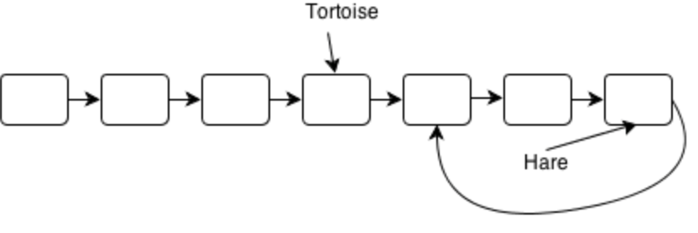
Hare and Tortoise Algorithm
Detects cycles in linked lists
Set two pointers “hare” and “tortoise” to the beginning of the list
During each iteration, move the hare pointer forward two nodes and move the tortoise forward one node. If they are pointing to the same node after this, the list has a cycle.
If the hare reaches the end of the list, there are no cycles.

Slide 8
Other things to watch for
Uninitialized pointers and/or memory
Make sure mm_init() initializes everything
It is called by the driver between each iteration of every trace
If something is overlooked, you might be able to pass every single trace file, but the complete driver test will fail

Slide 9
Valgrind
To check for Illegal accesses, uninitialized values…

Slide 10
Asking for help
It can be hard for me to debug your allocator, because this is a more open-ended lab
Before asking for help, ask yourself some questions:
What part of which trace file triggers the error?
Around the point of the error, what sequence of events do you expect?
What part of the sequence already happened?
If you can’t answer, it’s a good idea to gather more information…
How can you measure which step worked OK?
printf, breakpoints, heap checker…

Slide 11
Asking for help
Bring to us a detailed story, not just a “plot summary”
“Allocations of size blah corrupt my heap after coalescing the previous block at this line number...” is detailed
“It segfaults” is not
Most importantly: don’t hesitate to come to office hours if you really need help

Slide 12
Beyond Debugging: Error prevention
It is hard to write code that is completely correct the first time, but certain practices can make your code less error-prone
Plan what each function does before writing code
Draw pictures when linked list is involved
Consider edge cases when the block is at start/end of list
Write pseudocode first
Document your code as you write it

Slide 13
Beyond Debugging: Version control
“I had 60 util points just 5 minutes ago!”
Save the allocator after each major progress
Most basic: copy files around using the cp command
Alternatively: keep different versions in separate c files, and use “ln –s mm-version-x.c mm.c” to start using a particular version
Or use git/svn/cvs…
Make sure your repository is private if you use remote repos

Slide 14
Optimization
To achieve better performance, sometimes you would want to tweak certain parameters.
Number of size classes, the separation of size classes, the amount by which the heap is extended (CHUNKSIZE)…
It is better to write modular and encapsulated code so that changing the parameters only requires changing a few lines of code
Use inline functions and macros wisely

Slide 15
Optimization
When you hit a bottleneck, find which part is limiting your performance
A profiler is good for this kind of job
To use gprof:
Change the Makefile to add “-pg” to the compilation flag
Run the driver. This will generate a file called gmon.out
Run “gprof ./mdriver” to see the result
Don’t forget to change the Makefile back

Slide 16
Final Words
Start now, if not already
Come to office hours early
Write the heap checker well
Be prepared to start over several times
Though this shouldn’t be necessary since we have a path:
Explicit
Implicit
Segmented
Before handing in, check:
Does the header comment contain a detailed description of your approach?
Is the indentation correct? Any line over 80 chars? (go to autolab to verify these)

Slide 17
Questions?
Good luck!

