Slide 1
Filesystems
CSCI 380
Operating Systems
Prof. William Killian

Slide 2
Files and Directories

Slide 3
Remember the Fundamentals…
User Abstraction |  | Hardware Resource
Processes/Threads | <= OS => | CPU
Address Space | <= OS => | Memory
Files | <= OS => | Disk

Slide 4
File System Abstraction
Applications Daemons Servers Shell
------------- Application Programming Interface -------------
open() close() read() write() link() rename()
----------------- Device Independent Interface -----------------
Sectors Tracks seek() readBlock() writeBlock()
------------------------ Device Interface ------------------------
Hardware (SSD, HDD, SD-Card)

Slide 5
User Requirements on Data
Fast – we don’t want to wait
Vast – we should be able to store all the things
Persistent – data stays around (imagine data loss after rebooting)
Safe – users should be able to keep files to themselves (protec) or share data with other users (sharing)
Easy – searching/examining/modifying data should be simple

Slide 6
Hardware and OS Features
Fast Vast Persistent Safe Easy
Hardware Operating Systems

Slide 7
User Requirements on Data
Fast – Enabling random access means faster data access
Vast – Disk sizes are constantly increasing (8TB HDD, 2TB SSD)
Persistent
Disks provide magnetic storage. SSDs often use NVRAM.
Redundancy within OS allows recovery from certain types of failures
Safe – Unix provides Read Write eXecute privileges on all files
Easy
Names refer to files
Files can be logically organized into directories
Transparent (non-user-aware) mapping of files and directories onto hardware
Search facilities in OSes (Spotlight, Cortana, etc)

Slide 8
Files
File – Logical unit of data on a storage device
”A named collection of related information recorded on secondary storage”
Ex: test.c, a.out, /bin/ls
Files can contain programs (source, binary) or data
Files can be structured or unstructured
UNIX implements files as a sequence of bytes (unstructured)
File Attributes – additional information to store
Name
Type
Location
Size
Permissions
Creation Time, etc

Slide 9
User Interface to the File System
Data Operations:
create() delete()
open() close()
read() write()
seek()
Naming Operations:
hardLink() softLink()
setAttribute() getAttribute()
rename()

Slide 10
Creating a File
create(name)
Allocate necessary disk space (checks quotas, permissions, etc)
Create a file descriptor (include name, location, and attributes)
Add the file descriptor to the directory containing the file
Optionally add file type / other attributes

Slide 11
Deleting a File
deleting(name)
Find the directory containing the file
Free the disk blocks used by the file
Remove the file descriptor from the directory
Behavior is dependent on hard links

Slide 12
Open and Close
We have covered these previously…
fileID = open(name, mode)
close(fileID)
File permissions are checked
Remember: open counts get changed, file tables are updated

Slide 13
Read
read(fileID, from, size, buf)
OS reads “size” bytes from file position “from” into “buf”
for (i = from; i < from + size; i++) {
buf[i – from] = file[i];
read(fileID, size, buf)
OS reads “size” bytes from current file position fp into buf, then advances fp
for (i = 0; i < size; i++) {
buf[i] = file[fp + i];
fp += size;

Slide 14
Write, Seek, Memory Map
write operations are similar to reads, but copies the other direction
seek just updates fp stored within the file descriptor
Memory mapping a file
Maps part of the virtual address space to a file
Read/write operations to that portion of memory implies OS read/write from corresponding location in the file
File accesses are simplified (no read/write calls are necessary)

Slide 15
File Access Methods
Programmer’s View:
Sequential: data processed in order
Most programs use this method
Ex: compiler reading a source file
Direct: address a block based on a key value
Databases often do this
Ex: hash table, dictionary
Operating System’s View:
Sequential: keep a pointer to the next byte in the file; update pointer on each read/write operation
Direct: address any block in the file directly provided its offset within the file

Slide 16
Naming and Directories
We need a way to refer to files that are stored on disk
OS uses numbers for each file
Users prefer textual names to refer to files
Directory: OS data structure to map names to file descriptors
Naming Strategies:
Single-Level Directory: one name space for the entire space, every name unique
Use a special area of disk to hold directory (containing <name, index> pairs
Two-Level Directory: each user has a separate directory, but all of each user’s files must still have unique names
Multi-Level Directory: tree-structure name space (UNIX and all modern OSes)

Slide 17
Multi-Level Directories
Store directories on disk, just like files
Except file descriptor for directories have a special flag bit
User programs read directories just like any other file
But only special system calls can write directories
Each directory contains <name, fileDesc> pairs in arbitrary order
The file referred to by a name could be another directory
There is one special “root” directory
/

Slide 18
Referential Naming
Hard Links (UNIX: ln command)
A hard link adds a second (or more) connection to a file
Ex: creating a hard link from B to A
Before: A → file #100
After “ln A B”: A → file #100
B → file #100
OS maintains reference counts and deletes only when count == 0
Soft Links (UNIX: ln -s command)
A soft link only makes a symbolic pointer from one file to another
After “ln -s A B” A → file #100
B → A
Removing “A” leaves the name B in the directory, but its contents no longer exist

Slide 19
Directory Operations
Search – locate an entry for a file in the current directory
Create – adds a directory listing
Delete – removes a directory listing
List – list all files (ls command in UNIX)
Rename -- renames a file (mv command in UNIX)
Traverse (recursive?)

Slide 20
Protection
OS must allow users to control sharing of files
Grant or deny access to file operations depend on protection info.
Access Lists and Groups (Windows NT)
Keep an access list for each file with username and type of access
Lists can become large and tedious to maintain
Access Control Bits (UNIX)
Three categories of user: owner, group, world
Three types of access privileges: read, write, execute
Maintain a bit for each combination: 111101000 ➔ rwxr-x---

Slide 21
Summary of File System Functionality
Naming
Protection
Persistence
Fast

Slide 22
How Physical Disks Work

Slide 23
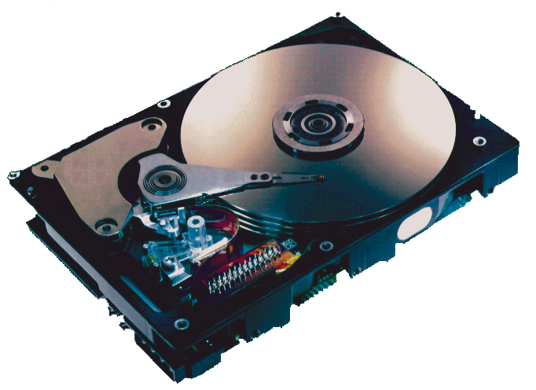
What’s Inside A Disk Drive?
Spindle
Arm
Platters
Actuator
Electronics
(including a
processor
and memory!)
SCSI
connector
Image courtesy of Seagate Technology

Slide 24
Disk Geometry
Disks consist of platters, each with two surfaces.
Each surface consists of concentric rings called tracks.
Each track consists of sectors separated by gaps.
Tracks
Surface
Track k
Gaps
Spindle
Sectors

Slide 25
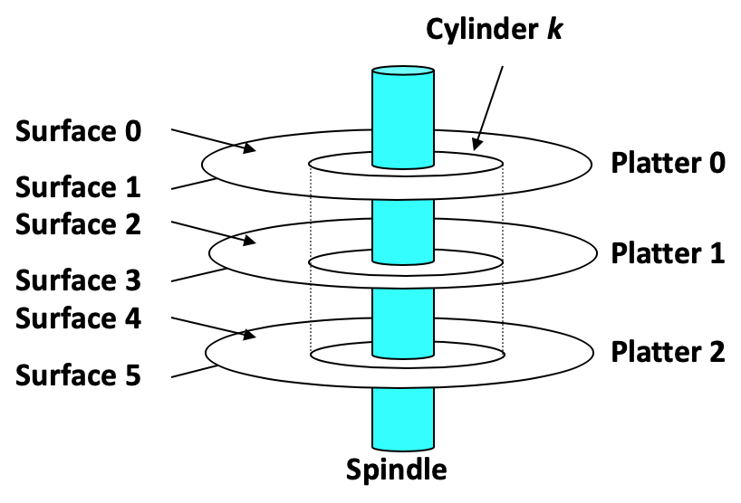
Disk Geometry (Multiple-Platter View)
Aligned tracks form a cylinder.

Slide 26
Disk Capacity
Capacity: maximum number of bits that can be stored.
Vendors express capacity in units of gigabytes (GB) or terabytes (TB), where 1 GB = 10⁹ Bytes and 1 TB = 10¹² Bytes
Capacity is determined by these technology factors:
Recording density (bits/in): number of bits that can be squeezed into a 1 inch segment of a track.
Track density (tracks/in): number of tracks that can be squeezed into a 1 inch radial segment.
Areal density (bits/in²): product of recording and track density.
Tracks

Slide 27
Computing Disk Capacity
Capacity = (# bytes/sector) x (avg. # sectors/track) x
(# tracks/surface) x (# surfaces/platter) x
(# platters/disk)
Example:
512 bytes/sector
300 sectors/track (on average)
20,000 tracks/surface
2 surfaces/platter
5 platters/disk
Capacity = 512 x 300 x 20,000 x 2 x 5
= 30,720,000,000
= 30.72 GB

Slide 28
Disk Operation (Single-Platter View)
The disk surface
spins at a fixed
rotational rate
The read/write head
is attached to the end
of the arm and flies over
the disk surface on
a thin cushion of air.
spindle
spindle
spindle
spindle
spindle
By moving radially, the arm can position the read/write head over any track.

Slide 29
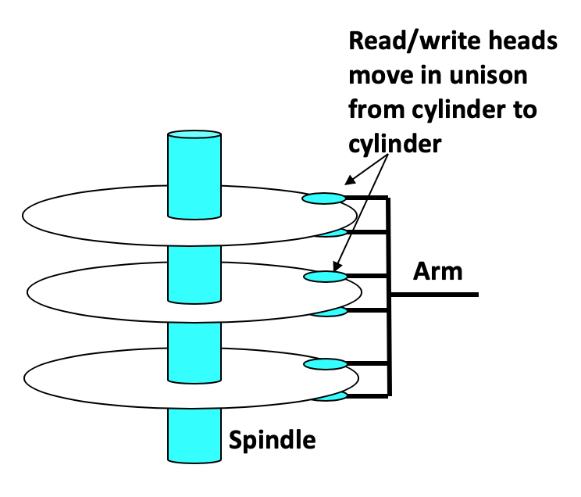
Disk Operation (Multi-Platter View)

Slide 30
Disk Structure - top view of single platter
Surface organized into tracks
Tracks divided into sectors
Notes:
Goal:
Show the inefficeincy of current disk requests.
Conveyed Ideas:
Rotational latency is wasted time that can be used to service tasks
Background Information:
None.
Slide Background:
None.
Kill text and arrows

Slide 31
Disk Access
Head in position above a track
Notes:
Goal:
Show the inefficeincy of current disk requests.
Conveyed Ideas:
Rotational latency is wasted time that can be used to service tasks
Background Information:
None.
Slide Background:
None.
Kill text and arrows

Slide 32
Disk Access
Rotation is counter-clockwise
Notes:
Goal:
Show the inefficeincy of current disk requests.
Conveyed Ideas:
Rotational latency is wasted time that can be used to service tasks
Background Information:
None.
Slide Background:
None.
Kill text and arrows

Slide 33
Disk Access – Read
About to read blue sector
Notes:
Goal:
Show the inefficeincy of current disk requests.
Conveyed Ideas:
Rotational latency is wasted time that can be used to service tasks
Background Information:
None.
Slide Background:
None.
Kill text and arrows

Slide 34
Disk Access – Read
After BLUE read
After reading blue sector
Notes:
Goal:
Show the inefficeincy of current disk requests.
Conveyed Ideas:
Rotational latency is wasted time that can be used to service tasks
Background Information:
None.
Slide Background:
None.
Kill text and arrows

Slide 35
Disk Access – Read
After BLUE read
Red request scheduled next
Notes:
Goal:
Show the inefficeincy of current disk requests.
Conveyed Ideas:
Rotational latency is wasted time that can be used to service tasks
Background Information:
None.
Slide Background:
None.
Kill text and arrows

Slide 36
Disk Access – Seek
After BLUE read
Seek for RED
Seek to red’s track
Notes:
Goal:
Show the inefficeincy of current disk requests.
Conveyed Ideas:
Rotational latency is wasted time that can be used to service tasks
Background Information:
None.
Slide Background:
None.
Kill text and arrows

Slide 37
Disk Access – Rotational Latency
After BLUE read
Seek for RED
Rotational latency
Wait for red sector to rotate around
Notes:
Goal:
Show the inefficeincy of current disk requests.
Conveyed Ideas:
Rotational latency is wasted time that can be used to service tasks
Background Information:
None.
Slide Background:
None.
Kill text and arrows

Slide 38
Disk Access – Read
After BLUE read
Seek for RED
Rotational latency
After RED read
Complete read of red
Notes:
Goal:
Show the inefficeincy of current disk requests.
Conveyed Ideas:
Rotational latency is wasted time that can be used to service tasks
Background Information:
None.
Slide Background:
None.
Kill text and arrows

Slide 39
Disk Access – Service Time Components
After BLUE read
Seek for RED
Rotational latency
After RED read
Data transfer
Seek
Rotational
latency
Data transfer
Notes:
Goal:
Show the inefficeincy of current disk requests.
Conveyed Ideas:
Rotational latency is wasted time that can be used to service tasks
Background Information:
None.
Slide Background:
None.
Kill text and arrows

Slide 40
Disk Access Time
Average time to access some target sector approximated by:
T_{access} = T_{avg seek} + T_{avg rotation} + T_{avg transfer}
Seek time (T_{avg seek})
Time to position heads over cylinder containing target sector.
Typical T_{avg seek} is 3—9 ms
Rotational latency (T_{avg rotation})
Time waiting for first bit of target sector to pass under r/w head.
T_{avg rotation} = 1/2 x 1/RPMs x 60 sec/1 min
Typical T_{avg rotation} = 7,200 RPMs
Transfer time (T_{avg transfer})
Time to read the bits in the target sector.
T_{avg transfer} = 1/RPM x 1/(avg # sectors/track) x 60 secs/1 min.

Slide 41
Disk Access Time Example
Given:
Rotational rate = 7,200 RPM
Average seek time = 9 ms.
Avg # sectors/track = 400.
Derived:
T_{avg rotation} = 1/2 x (60 secs/7200 RPM) x 1000 ms/sec = 4 ms.
T_{avg transfer} = 60/7200 RPM x 1/400 secs/track x 1000 ms/sec = 0.02 ms
T_{access} = 9 ms + 4 ms + 0.02 ms
Important points:
Access time dominated by seek time and rotational latency.
First bit in a sector is the most expensive, the rest are free.
SRAM access time is about 4 ns/doubleword, DRAM about 60 ns
Disk is about 40,000 times slower than SRAM,
2,500 times slower then DRAM.

Slide 42
Logical Disk Blocks
Modern disks present a simpler abstract view of the complex sector geometry:
The set of available sectors is modeled as a sequence of b-sized logical blocks (0, 1, 2, ...)
Mapping between logical blocks and actual (physical) sectors
Maintained by hardware/firmware device called disk controller.
Converts requests for logical blocks into (surface,track,sector) triples.
Allows controller to set aside spare cylinders for each zone.
Accounts for the difference in “formatted capacity” and “maximum capacity”.

Slide 43
I/O Bus
CPU chip
Register file
ALU
System bus
Memory bus
Main
memory
Bus interface
I/O
bridge
I/O bus
Expansion slots for
other devices such
as network adapters.
USB
controller
Graphics
adapter
Disk
controller
Mouse
Keyboard
Monitor
Disk

Slide 44
Reading a Disk Sector (1)
CPU chip
CPU initiates a disk read by writing a command, logical block number, and destination memory address to a port (address) associated with disk controller.
Register file
ALU
Main
memory
Bus interface
I/O bus
USB
controller
Graphics
adapter
Disk
controller
mouse
keyboard
Monitor
Disk

Slide 45
Reading a Disk Sector (2)
CPU chip
Register file
Disk controller reads the sector and performs a direct memory access (DMA) transfer into main memory.
ALU
Main
memory
Bus interface
I/O bus
USB
controller
Graphics
adapter
Disk
controller
Mouse
Keyboard
Monitor
Disk

Slide 46
Reading a Disk Sector (3)
CPU chip
When the DMA transfer completes, the disk controller notifies the CPU with an interrupt (i.e., asserts a special “interrupt” pin on the CPU).
Register file
ALU
Main
memory
Bus interface
I/O bus
USB
controller
Graphics
adapter
Disk
controller
Mouse
Keyboard
Monitor
Disk

Slide 47
Solid State Disks (SSDs)
I/O bus
Requests to read and
write logical disk blocks
Solid State Disk (SSD)
Flash
translation layer
Flash memory
Block 0
Block B-1
…
…
…
Page 0
Page 1
Page P-1
Page 0
Page 1
Page P-1
Pages: 512KB to 4KB, Blocks: 32 to 128 pages
Data read/written in units of pages.
Page can be written only after its block has been erased.
A block wears out after about 100,000 repeated writes.

Slide 48
SSD Performance Characteristics
Sequential read tput 550 MB/s Sequential write tput 470 MB/s
Random read tput 365 MB/s Random write tput 303 MB/s
Avg seq read time 50 us Avg seq write time 60 us
Sequential access faster than random access
Common theme in the memory hierarchy
Random writes are somewhat slower
Erasing a block takes a long time (~1 ms).
Modifying a block page requires all other pages to be copied to new block.
In earlier SSDs, the read/write gap was much larger. Fixed by flash translation layer.
Source: Intel SSD 730 product specification.

Slide 49
SSD Tradeoffs vs Rotating Disks
Advantages
No moving parts → faster, less power, more rugged
Disadvantages
Have the potential to wear out
Mitigated by “wear leveling logic” in flash translation layer
E.g. Intel SSD 730 guarantees 128 petabyte (128 x 10¹⁵ bytes) of writes before they wear out
In 2015, about 30 times more expensive per byte
Applications
MP3 players, smart phones, laptops
Increasingly common in desktops and servers

Slide 50
File System Implementation

Slide 51
File Organization on Disk
fileID 0, Block 0 ➔ Platter 0, Cylinder 0, Sector 0
fileID 0, Block 1 ➔ Platter 4, Cylinder 3, Sector 8
Performance Issues:
Support sequential and random access
How to structure data to maintain file location information
How do we physically lay out the files on the physical disk

Slide 52
On-Disk Data Structures
File Descriptor
The structure used to describe where the file is on the disk
Also maintains a list of attributes of the file
Must be stored on the disk just like all other files
Most Systems…
Have a majority of small files
Have the majority of disk space taken up by large files
Have I/O operations target both small and large files
The per-file cost must be low, but large files must also have good perf.

Slide 53
1. Contiguous Allocation
OS maintains an ordered list of free blocks
OS allocates a contiguous chunk of free blocks when it creates a file
Need to store only the start location and size in the file descriptor
Advantages:
Simple
Access Time, Number of Seeks
Disadvantages:
Changing file sizes
Fragmentation, Disk management
Examples:
IBM OS/360, write-once disks, early personal computers

Slide 54
2. Linked Files
Keep a list of all the free sectors/blocks
In the file descriptor, keep a pointer to the first sector/block
In each sector, keep a pointer to the next sector
data
data
data
data
data
link
link
link
link
link
P: 4
C: 20
S: 5
P: 2
C: 7
S: 1
P: 8
C: 12
S: 0
P: 1
C: 3
S: 9

Slide 55
2. Linked Files (continued)
Advantages
Fragmentation
File size changes
Efficient support of _______ access
Disadvantages
Does not support _______ access
Number of seeks?
Examples:
FAT, MS-DOS

Slide 56
3. Indexed Files
OS keeps an array of block pointers for each file
User (or OS) must declare maximum length of the file when created
OS allocates array to hold pointers to all blocks
but only allocates blocks on demand
OS fills in the pointers as it allocates blocks
Advantages:
Minimal wasted space for files
Sequential/Random access easy
Disadvantages:
Wasted space in FDs
Maximum file size
Lots of seeks due to non-contiguous data
FD Data
bp 0
bp 1
bp MAX

Slide 57
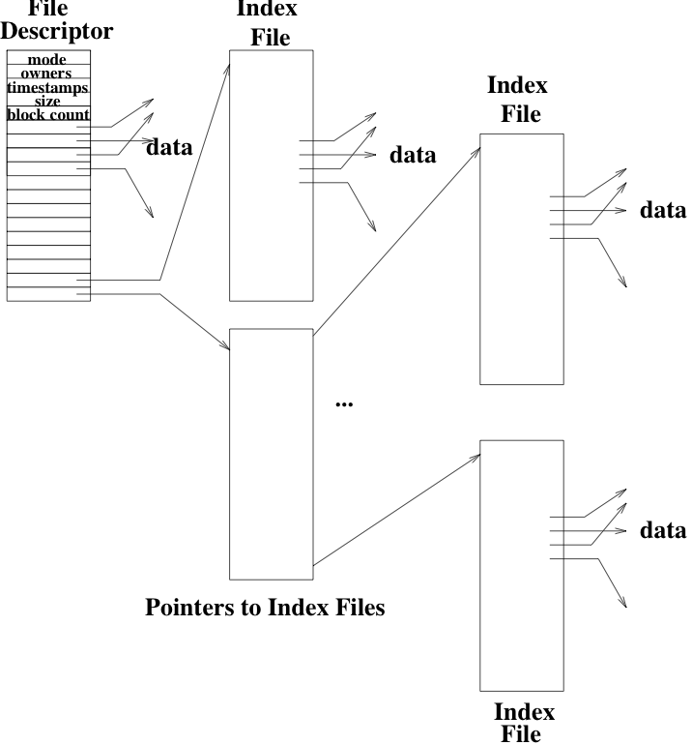
4. Multi-Level Indexed Files
Each FD contains k block pointers
First k-2 block pointers point to data
k-1th pointer points to a block of 2^{d} pointers to 2^{d} more data blocks
k^{th} pointer points to a block of pointers to indirect blocks
Advantages:
Incremental file growth
Small files
Disadvantages:
Indirect access is inefficient for Random Access
Lots of seeks because non-contiguous data
Example: BSD UNIX 4.3

Slide 58
Free Space Management
Need a way to keep track of which disk blocks are free
*cough* malloc lab? *cough*
Need to be able to find free space quickly and release space quickly
Solution? Use a bitmap?
The bitmap has one bit for each block on the disk.
If the bit is 1, the block is free, else the bit is 0 and block is allocated
Can quickly determin if any page in the next 32 is free (32-bit) but comparing to “word” 0
Marking a block as freed is as simple as toggling a bit

Slide 59
Free Space Management
Problem: bitmap might be too big to keep in memory for a large disk
2TB disk with 512byte sectors requires a bitmap with 4G (4 billion) entries
4Gb == 500MB
If most of the disk is in use, it will be expensive to find free blocks with a bitmap
An alternative implementation is to link together free blocks *cough*
The head of the list is cached in kernel memory
Each block contains a pointer to the next free block
Costs for allocating? Freeing? Allocate consecutive blocks?

Slide 60
Summary
Many of the concerns and implementations are similar to VM
Contiguous allocation is simple, but suffers from:
External fragmentation
Need for compaction
Need to move files as they grow
Indexed allocation is analogous to page tables
Table maps from logical file blocks to physical disk blocks
Free space can be managed using a bitmap or a linked list

Slide 61

Disk Head Scheduling (Antiquated)

Slide 62
Disk Head Scheduling
Idea
Permute the order of disk requests from the order they arrive to minimize number of length of seeks to perform
First-Come, First-Serve (FCFS)
Shortest Seek Time First (SSTF)
SCAN algorithm (0..N, N..0, 0..N, …)
If there is no request between current position and “extreme”, do not seek there
C-SCAN circular scan algorithm (0..N, 0..N, 0..N, …)

Slide 63
Disk Head Scheduling
FCFS
No overhead, works well for light loads; also for SSDs
SSTF
Always go to next closest request, maintain doubly linked sorted list
SCAN
Service requests as we pass them (akin to an elevator)
Requires sorted list of requests
C-SCAN
Like SCAN, but once it hits the bottom or top, it jumps to the other end and moves in the same direction

Slide 64
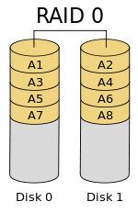
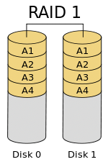
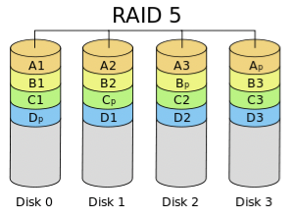
Bonus: RAID
Multiple disk drives can provide reliability through redundancy
Also performance?
Disk striping uses a group of disks as one storage unit
Disk mirroring uses a group of disks as a smaller storage unit
There are 6 different levels of RAID

