Slide 1
Virtual Memory
CSCI 380: Operating Systems
William Killian

Slide 2
I/O Basics
Four basic operations:
open
close
read
write
What’s a file descriptor?
Returned by open.
int fd = open(“/path/to/file”, O_RDONLY);
fd is some positive value or -1 to denote error
Every process starts with 3 open file descriptors that can be accessed macros like STDOUT_FILENO
0 - STDIN
1 - STDOUT
2 - STDERR

Slide 3
How the Unix Kernel Represents Open Files
Two descriptors referencing two distinct open files. Descriptor 1 (stdout) points to terminal, and descriptor 4 points to open disk file
Descriptor table
[one table per process]
Open file table
[shared by all processes]
v-node table
[shared by all processes]
File A (terminal)
stdin
fd 0
File access
stdout
fd 1
File pos
File size
Info in
stat struct
stderr
fd 2
fd 3
refcnt=1
File type
fd 4
...
...
File B (disk)
File access
File pos
File size
refcnt=1
File type
...
...

Slide 4
File Sharing
Two distinct descriptors sharing the same disk file through two distinct open file table entries
E.g., Calling open twice with the same filename argument
Descriptor table
[one table per process]
Open file table
[shared by all processes]
v-node table
[shared by all processes]
File A (disk)
stdin
fd 0
File access
stdout
fd 1
File pos
File size
stderr
fd 2
fd 3
refcnt=1
File type
fd 4
...
...
File B (disk)
File pos
refcnt=1
...

Slide 5
How Processes Share Files: fork
A child process inherits its parent’s open files
Note: situation unchanged by exec functions (use fcntl to change)
Before fork call:
Descriptor table
[one table per process]
Open file table
[shared by all processes]
v-node table
[shared by all processes]
File A (terminal)
stdin
fd 0
File access
stdout
fd 1
File pos
File size
stderr
fd 2
fd 3
refcnt=1
File type
fd 4
...
...
File B (disk)
File access
File pos
File size
refcnt=1
File type
...
...

Slide 6
How Processes Share Files: fork
A child process inherits its parent’s open files
After fork:
Child’s table same as parent’s, and +1 to each refcnt
Descriptor table
[one table per process]
Open file table
[shared by all processes]
v-node table
[shared by all processes]
Parent
File A (terminal)
fd 0
File access
fd 1
File pos
File size
fd 2
File type
fd 3
refcnt=2
fd 4
...
...
Child
File B (disk)
File access
fd 0
File size
fd 1
File pos
fd 2
refcnt=2
File type
fd 3
...
fd 4
...

Slide 7
I/O Redirection
Question: How does a shell implement I/O redirection?
linux> ls > foo.txt
Answer: By calling the dup2(oldfd, newfd) function
Copies (per-process) descriptor table entry oldfd to entry newfd
Descriptor table
before dup2(4,1)
Descriptor table
after dup2(4,1)
fd 0
fd 0
fd 1
a
fd 1
b
fd 2
fd 2
fd 3
fd 3
fd 4
b
fd 4
b

Slide 8
I/O Redirection Example
Step #1: open file to which stdout should be redirected
Happens in child executing shell code, before exec
Descriptor table
[one table per process]
Open file table
[shared by all processes]
v-node table
[shared by all processes]
File A
stdin
fd 0
File access
stdout
fd 1
File pos
File size
stderr
fd 2
fd 3
refcnt=1
File type
fd 4
...
...
File B
File access
File pos
File size
refcnt=1
File type
...
...

Slide 9
I/O Redirection Example (cont.)
Step #2: call dup2(4,1)
cause fd=1 (stdout) to refer to disk file pointed at by fd=4
Descriptor table
[one table per process]
Open file table
[shared by all processes]
v-node table
[shared by all processes]
File A
stdin
fd 0
File access
stdout
fd 1
File pos
File size
stderr
fd 2
fd 3
refcnt=0
File type
fd 4
...
...
File B
File access
File pos
File size
refcnt=2
File type
...
...

Slide 10
Malloc Lab Sneak Preview
You will write your own dynamic storage allocator – i.e., your own malloc, free, realloc, calloc.
This week in class, you will learn about different ways to keep track of free and allocated blocks of memory.
Implicit linked list of blocks.
Explicit linked list of free blocks.
Segregated lists of different size free blocks.
Other design decisions:
How will you look for free blocks? (First fit, next fit, best fit…)
Should the linked lists be doubly linked?
When do you coalesce blocks?
This is exactly what you’ll do in this lab, so pay lots of attention in class. ☺

Slide 11
Malloc Lab Sneak Preview
If you haven’t been using version control so far, this is a good time to start.
Workflow:
Implement indirect linked lists. Make sure it works.
Implement explicit linked lists. Make sure it still works.
Implement segregated lists. Make sure it still works.
You WILL break things and need to revert.
Barebones guide to using git:
git init starts a local repository.
git add foo.c adds foo.c to that repository.
git commit -a –m ‘Describe changes here’ updates your repository with the current state of all files you’ve added.

Slide 12
Agenda
Shell Lab FAQs
Malloc Lab Sneak Preview
Virtual Memory Concepts
Address Translation

Slide 13
Virtual Memory Concepts
Memory
invisible to
user code
We’ve been viewing memory as a linear array.
But wait! If you’re running 5 processes with stacks at 0xC0000000, don’t their addresses conflict?
Nope! Each process has its own address space.
How???
Kernel virtual memory
0xC0000000
User stack
(created at runtime)
%esp
(stack
pointer)
Memory-mapped region for
shared libraries
0x40000000
brk
Run-time heap
(created by malloc)
Read/write segment
(.data, .bss)
Loaded from the executable file
Read-only segment
(.init, .text, .rodata)
0x08048000
Unused

Slide 14
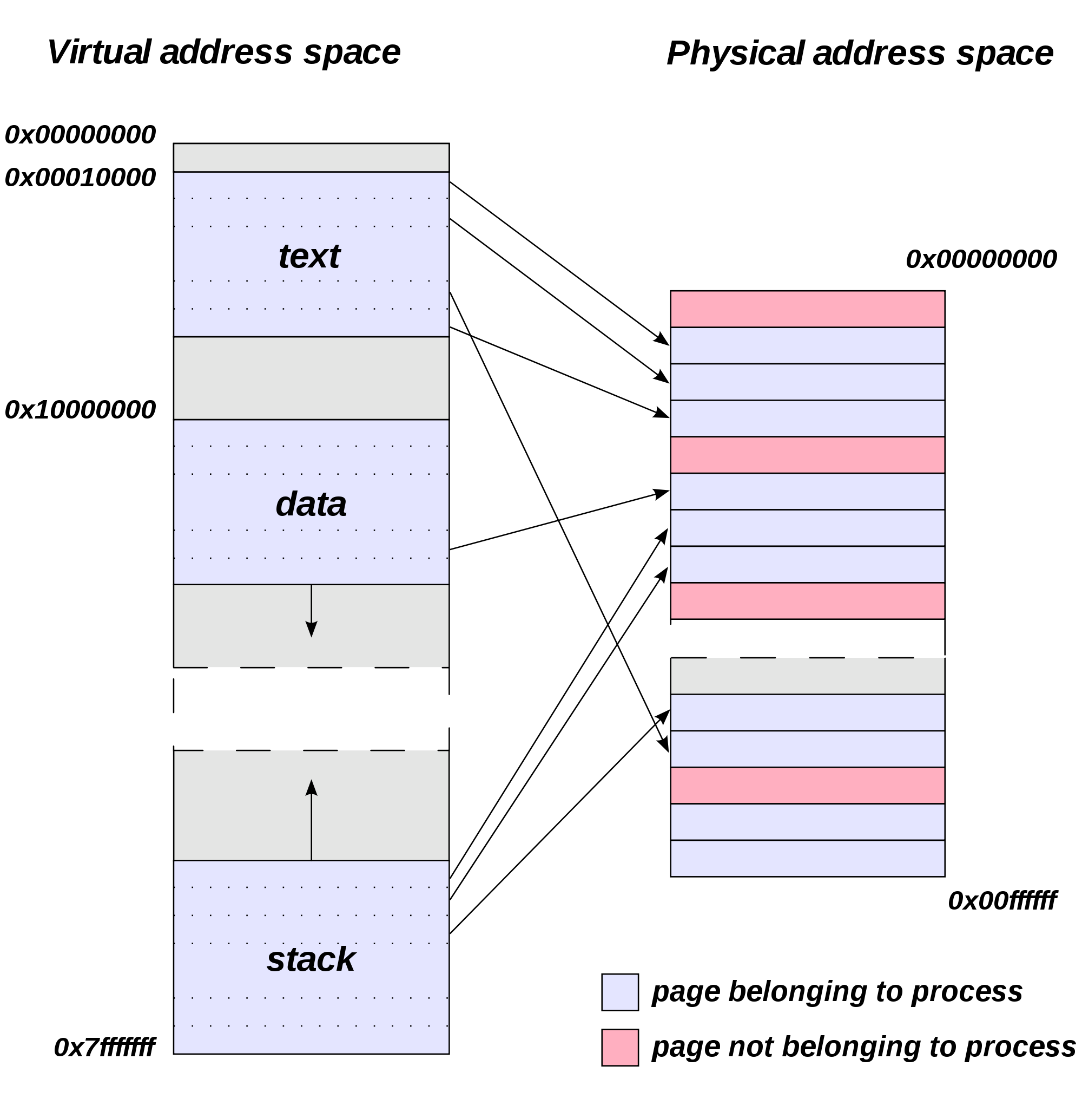
Virtual memory concepts
We define a mapping from the virtual address used by the process to the actual physical address of the data in memory.
Image: http://en.wikipedia.org/wiki/File:Virtual_address_space_and_physical_address_space_relationship.svg

Slide 15
Virtual memory concepts
This explains why two different processes can use the same address. It also lets them share data and protects their data from illegal accesses. Hooray for virtual memory!
0
Address
translation
0
Virtual Address Space for Process 1:
Physical
Address
Space (DRAM)
VP 1
VP 2
PP 2
...
N-1
PP 6
(e.g., read-only
library code)
Virtual Address Space for Process 2:
0
PP 8
VP 1
VP 2
...
...
N-1
M-1

Slide 16
Virtual memory concepts
Page table
Lets us look up the physical address corresponding to any virtual address. (Array of physical addresses, indexed by virtual address.)
TLB (Translation Lookaside Buffer)
A special tiny cache just for page table entries.
Speeds up translation.
Multi-level page tables
The address space is often sparse.
Use page directory to map large chunks of memory to a page table.
Mark large unmapped regions as non-present in page directory instead of storing page tables full of invalid entries.

Slide 17
Agenda
Shell Lab FAQs
Malloc Lab Sneak Preview
Virtual Memory Concepts
Address Translation

Slide 18
VM Address Translation
Virtual Address Space
V = {0, 1, …, N–1}
There are N possible virtual addresses.
Virtual addresses are n bits long; 2^{n} = N.
Physical Address Space
P = {0, 1, …, M–1}
There are M possible physical addresses.
Virtual addresses are m bits long; 2^{m} = M.
Memory is grouped into “pages.”
Page size is P bytes.
The address offset is p bytes; 2^{p} = P.
Since the virtual offset (VPO) and physical offset (PPO) are the same, the offset doesn’t need to be translated.

Slide 19
VM Address Translation
Virtual address
Page table base register
(PTBR)
n-1
p
p-1
0
Virtual page number (VPN)
Virtual page offset (VPO)
Page table address
for process
Page table
Valid
Physical page number (PPN)
Valid bit = 0:
page not in memory
(page fault)
m-1
p
p-1
0
Physical page number (PPN)
Physical page offset (PPO)
Physical address

Slide 20
VM Address Translation
Addressing
14-bit virtual addresses
12-bit physical address
Page size = 64 bytes
13
12
11
10
9
8
7
6
5
4
3
2
1
0
VPN
VPO
Virtual Page Number
Virtual Page Offset
11
10
9
8
7
6
5
4
3
2
1
0
PPN
PPO
Physical Page Number
Physical Page Offset

Slide 21
Example: Address Translation
Pages are 64 bytes. How many bits is the offset?
Find 0x03D4.
VPN: _____
PPN: ______
Physical address: ___________
13
12
11
10
9
8
7
6
5
4
3
2
1
0
VPN
VPO
VPN
PPN
Valid
VPN
PPN
Valid
00
28
1
08
13
1
01
–
0
09
17
1
02
33
1
0A
09
1
03
02
1
0B
–
0
04
–
0
0C
–
0
05
16
1
0D
2D
1
06
–
0
0E
11
1
07
–
0
0F
0D
1
PPN
PPO

Slide 22
Example: Address Translation
Pages are 64 bytes. How many bits is the offset?
Find 0x03D4.
VPN: _____
PPN: ______
Physical address: ___________
log₂ 64 = 6
13
12
11
10
9
8
7
6
5
4
3
2
1
0
0
0
0
0
1
1
1
1
0
1
0
1
0
0
VPN
VPO
VPN
PPN
Valid
VPN
PPN
Valid
0x0F
00
28
1
08
13
1
0x0D
01
–
0
09
17
1
02
33
1
0A
09
1
03
02
1
0B
–
0
0x0354
04
–
0
0C
–
0
05
16
1
0D
2D
1
06
–
0
0E
11
1
07
–
0
0F
0D
1
0
0
1
1
0
1
0
1
0
1
0
0
PPN
PPO

