Slide 1

New Joiner Introduction

Slide 2
Brief Intro
Name = “Rungoo Dunveerdev”
From = “Flacq”;
Highest Achievement so far = “Recent Graduate”;
Title = “Computer Scientist of the University of Mauritius”;
Part of = “New Associate Program”;
Current Training = “Development && Parametric Team”;
Exit();

Slide 3
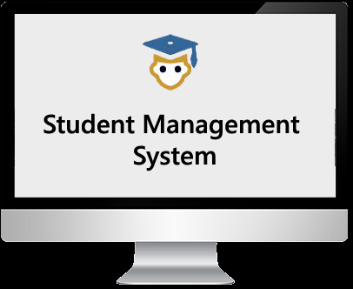
Final Year Project
Title: Student Management information System (SMIS).

Slide 4
SMIS
Single Page Application (SPA)
Built using Model View Controller (MVC) framework
Web Based Application
Implemented using AngularJS, HTML5, CSS3, Bootstrap, PHP, MySQL

Slide 5
Aims and Objectives of SMIS
1. Computerize the Manual and Daunting administrative task using a technological approach
2. Store data digitally
3. Provide Security, backup
4. Integrate ICT in the daily tasks
5. Share and Have access to resources online 24/7
6. Provide accurate, Real Time and up to date data/information
7. Enhanced decision making to enhance student and staff achievement and performance
8. Involve all stakeholders

Slide 6
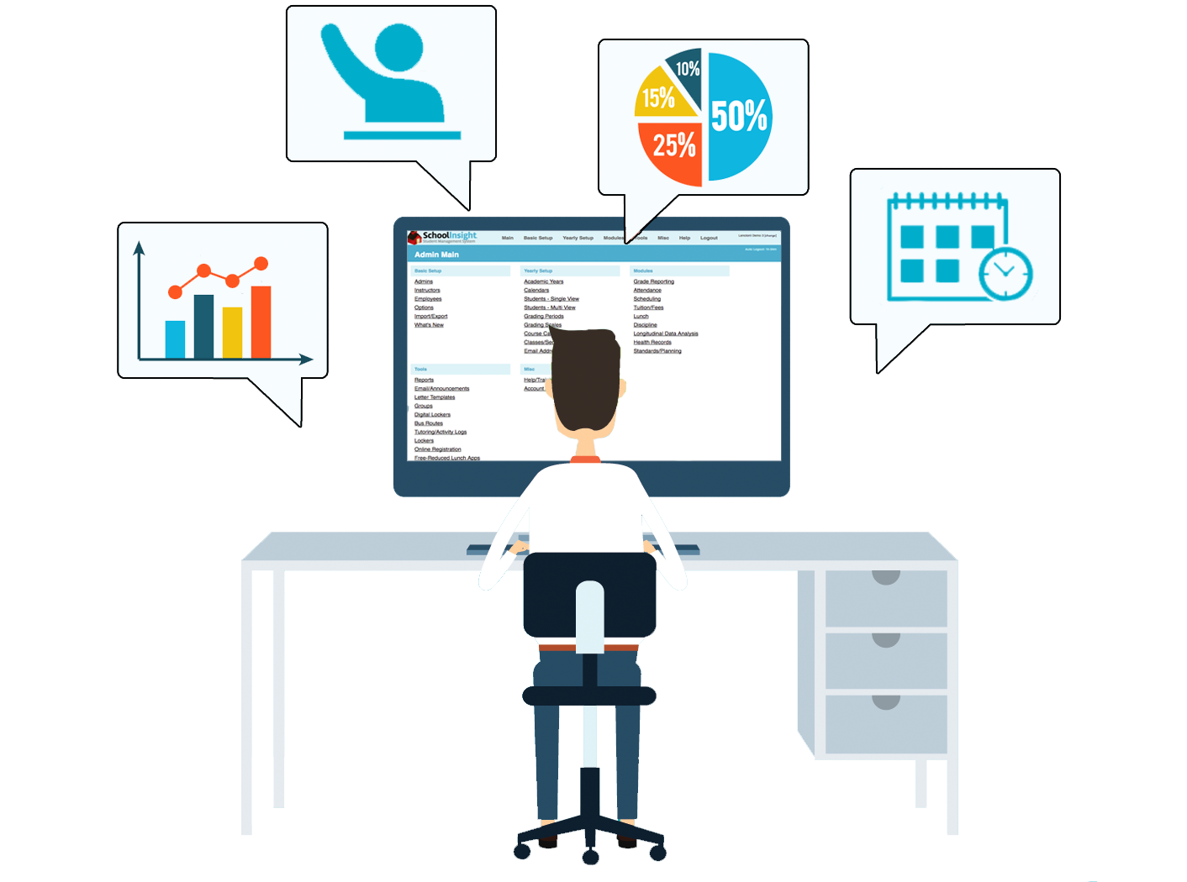

Administrator & Teachers

Slide 7

Students

Slide 8

Director/Upper Management

