Slide 1
2018
2019
凝心聚力
迎势起航
年终工作总结计划
汇报人：优品PPT
部 门：设计部

Slide 2
0CONTENTS
01
02
03
04
工作
总结
成果
展示
不足
之处
未来
规划
The user can demonstrate on a projector or computer, or print the presentation and make it into a film to be used in a wider field

Slide 3
01
工作总结
The user can demonstrate on a projector or computer, or print the presentation and make it into a film to be used in a wider field

Slide 4

今年工作总结
标题文字添加
标题文字添加
The user can demonstrate on a projector or computer, or presentation and make it film to be used in a wider field
The user can demonstrate on a projector or computer, or presentation and make it film to be used in a wider field
e
T
e
x
t
S
p
l
a
m
a
m
p
l
e
S
T
e
x
t
t
e
x
T
S
e
l
a
p
m
m
a
l
p
S
e
标题文字添加
e
T
标题文字添加
The user can demonstrate on a projector or computer, or presentation and make it film to be used in a wider field
t
t
x
The user can demonstrate on a projector or computer, or presentation and make it film to be used in a wider field
x
e
T
e
l
p
m
a
S

Slide 5

今年工作总结
标题文字添加
The user can demonstrate on a projector or computer, or presentation and make it film to be used in a wider field
标题文字添加
The user can demonstrate on a projector or computer, or presentation and make it film to be used in a wider field

Slide 6
今年工作总结
标题文字添加
标题文字添加
标题文字添加
标题文字添加
标题文字添加
标题文字添加
标题文字添加
标题文字添加
标题文字添加
标题文字添加
标题文字添加
标题文字添加
标题文字添加
标题文字添加
标题文字添加
标题文字添加
标题文字添加
标题文字添加
标题文字添加
标题文字添加
标题文字添加
标题文字添加
标题文字添加
标题文字添加

Slide 7
今年工作总结
1
标题文字添加
20%
The user can demonstrate on a projector or computer, or presentation
2
标题文字添加
60%
The user can demonstrate on a projector or computer, or presentation
3
标题文字添加
45%
The user can demonstrate on a projector or computer, or presentation
4
标题文字添加
40%
The user can demonstrate on a projector or computer, or presentation

Slide 8



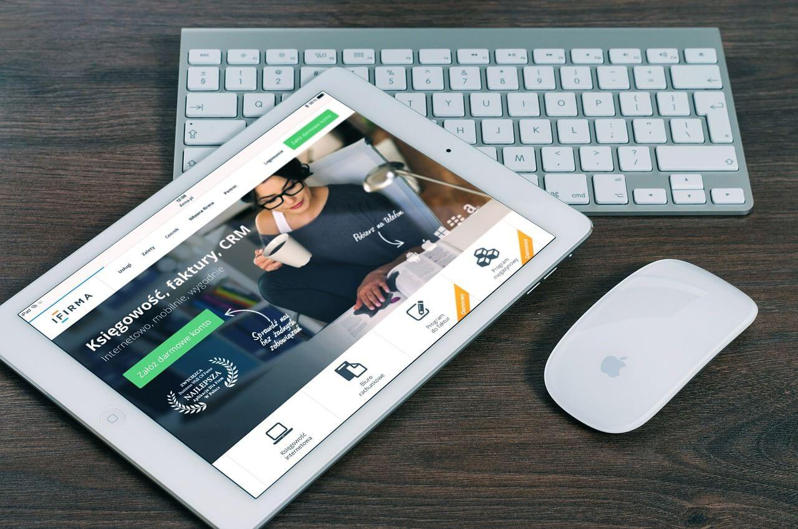
今年工作总结
The user can demonstrate on a projector or computer, or presentation and make it film to be used in a wider field
The user can demonstrate on a projector or computer, or presentation and make it film to be used in a wider field
The user can demonstrate on a projector or computer, or presentation and make it film to be used in a wider field
The user can demonstrate on a projector or computer, or presentation and make it film to be used in a wider field

Slide 9
02
成果展示
The user can demonstrate on a projector or computer, or print the presentation and make it into a film to be used in a wider field

Slide 10

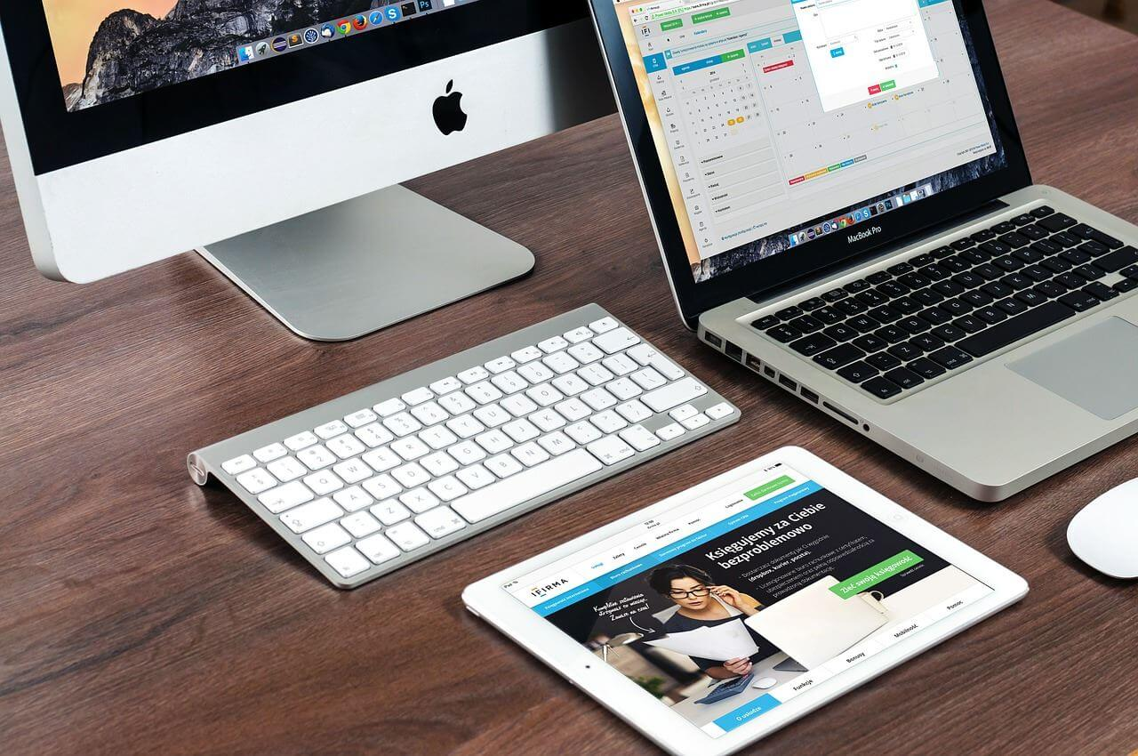

工作成果展示
标题文字添加
The user can demonstrate on a projector or computer, or presentation and make it film to be used in a wider field
标题文字添加
The user can demonstrate on a projector or computer, or presentation and make it film to be used in a wider field
标题文字添加
The user can demonstrate on a projector or computer, or presentation and make it film to be used in a wider field
标题文字添加
The user can demonstrate on a projector or computer, or presentation and make it film to be used in a wider field
标题文字添加
The user can demonstrate on a projector or computer, or presentation and make it film to be used in a wider field
01
05
02
04
03

Slide 11

工作成果展示
标题文字添加
标题文字添加
标题文字添加
标题文字添加
标题文字添加
标题文字添加
标题文字添加
标题文字添加
标题文字添加
标题文字添加

Slide 12
工作成果展示
标题文字添加
标题文字添加
The user can demonstrate on a projector or computer, or presentation and make it film to be used in a wider field
The user can demonstrate on a projector or computer, or presentation and make it film to be used in a wider field
标题文字添加
标题文字添加
The user can demonstrate on a projector or computer, or presentation and make it film to be used in a wider field
The user can demonstrate on a projector or computer, or presentation and make it film to be used in a wider field

Slide 13

工作成果展示
40%
25%
15%
10%
10%
标题文字添加
The user can demonstrate on a projector or computer, or presentation and make it film to be used in a wider field
标题文字添加
The user can demonstrate on a projector or computer, or presentation and make it film to be used in a wider field
标题文字添加
The user can demonstrate on a projector or computer, or presentation and make it film to be used in a wider field
标题文字添加
The user can demonstrate on a projector or computer, or presentation and make it film to be used in a wider field

Slide 14
工作成果展示
职务名称
职务名称
职务名称
职务名称
职务名称
职务名称
职务名称
职务名称
职务名称
职务名称
职务名称
职务名称
职务名称
职务名称
职务名称
职务名称
职务名称
职务名称
职务名称

Slide 15
03
不足之处
The user can demonstrate on a projector or computer, or print the presentation and make it into a film to be used in a wider field

Slide 16
工作不足之处
标题文字添加
标题文字添加
The user can demonstrate on a projector or computer, or presentation and make it film to be used in a wider field
The user can demonstrate on a projector or computer, or presentation and make it film to be used in a wider field
标题文字添加
标题文字添加
The user can demonstrate on a projector or computer, or presentation and make it film to be used in a wider field
The user can demonstrate on a projector or computer, or presentation and make it film to be used in a wider field

Slide 17
工作不足之处
标题文字添加
标题文字添加
The user can demonstrate on a projector or computer, or presentation and make it film to be used in a wider field
The user can demonstrate on a projector or computer, or presentation and make it film to be used in a wider field
标题文字添加
标题文字添加
标题文字添加
The user can demonstrate on a projector or computer, or presentation and make it film to be used in a wider field
The user can demonstrate on a projector or computer, or presentation and make it film to be used in a wider field
The user can demonstrate on a projector or computer, or presentation and make it film to be used in a wider field

Slide 18
工作不足之处
标题文字添加
标题文字添加
标题文字添加
标题文字添加
The user can demonstrate on a projector or computer, or presentation and make it film to be used in a wider field
The user can demonstrate on a projector or computer, or presentation and make it film to be used in a wider field
The user can demonstrate on a projector or computer, or presentation and make it film to be used in a wider field
The user can demonstrate on a projector or computer, or presentation and make it film to be used in a wider field

Slide 19
工作不足之处
标题文字添加
The user can demonstrate on a projector or computer, or presentation and make it film to be used in a wider field
标题文字添加
The user can demonstrate on a projector or computer, or presentation and make it film to be used in a wider field
标题文字添加
The user can demonstrate on a projector or computer, or presentation and make it film to be used in a wider field

Slide 20
04
未来规划
The user can demonstrate on a projector or computer, or print the presentation and make it into a film to be used in a wider field

Slide 21
来年工作规划
标题文字添加
标题文字添加
标题文字添加
The user can demonstrate on a projector or computer, or presentation
The user can demonstrate on a projector or computer
The user can demonstrate on a projector or computer
2015
2017
2013
2014
2016
标题文字添加
标题文字添加
The user can demonstrate on a projector or computer
The user can demonstrate on a projector or computer

Slide 22
来年工作规划
100
The user can demonstrate on a projector or computer, or presentation and make it film to be used in a wider field
80
78
The user can demonstrate on a projector or computer, or presentation and make it film to be used in a wider field
66
60
52
40
The user can demonstrate on a projector or computer, or presentation and make it film to be used in a wider field
35
20
The user can demonstrate on a projector or computer, or presentation and make it film to be used in a wider field
文字添加
文字添加
文字添加
文字添加

Slide 23
来年工作规划
标题文字添加
标题文字添加
标题文字添加
标题文字添加
The user can demonstrate on a projector or computer, or presentation and make it film to be used in a wider field
The user can demonstrate on a projector or computer, or presentation and make it film to be used in a wider field
The user can demonstrate on a projector or computer, or presentation and make it film to be used in a wider field
The user can demonstrate on a projector or computer, or presentation and make it film to be used in a wider field

Slide 24
来年工作规划
05
标题文字添加
标题文字添加
The user can demonstrate on a projector or computer, or presentation and make it film to be used in a wider field
The user can demonstrate on a projector or computer, or presentation and make it film to be used in a wider field
04
03
标题文字添加
标题文字添加
The user can demonstrate on a projector or computer, or presentation and make it film to be used in a wider field
The user can demonstrate on a projector or computer, or presentation and make it film to be used in a wider field
01
02
标题文字添加
The user can demonstrate on a projector or computer, or presentation and make it film to be used in a wider field

Slide 25
谢谢
观看
开展工作计划PPT
汇报人：优品PPT
部 门：设计部

Slide 26
更多精品PPT资源尽在—优品PPT！
www.ypppt.com
PPT模板下载：www.ypppt.com/moban/ 节日PPT模板：www.ypppt.com/jieri/
PPT背景图片：www.ypppt.com/beijing/ PPT图表下载：www.ypppt.com/tubiao/
PPT素材下载： www.ypppt.com/sucai/ PPT教程下载：www.ypppt.com/jiaocheng/
字体下载：http://www.ypppt.com/ziti/ 绘本故事PPT：http://www.ypppt.com/gushi/
Notes:
模板来自于 http://www.ypppt.com

