Slide 1
MotoStore
Class Name: PF08
Group Name: Group_5
Member: nde19071: Lê Văn Được
nde19036: Đồng Đức Lân
Instructor: Nguyễn Xuân Sinh

Slide 2
Objectives
The system describes the functions that employees can manage the products in the store on the console, helps employees create invoices according to customers' requirements and update information from the menu. This product will help employees to easily meet the needs of customers
Proposed System
- Insert product
- Update product
- Create order
- Update order
The scope of the project to be applied
- Applicable for large displacement vehicle dealers.
System name
- Product management and invoice management software.

Slide 3
Objectives
Deployment environment
- Desktop deployment environment (windows)
- Visual studio code
- IntelliJ Idea
- MySQL Workbenck 8.0.20
Development tools
- Development tools in the form of java
- Jdk8
- Apache maven
- Junit

Slide 4
Customer Requirements
Java application software to manage products and manage orders used by employees.
Product management includes: adding new products, updated exist product information
Orders management includes: creating new orders including customer and product information, store information, inputting orders information for created orders

Slide 5
Use Case
Login into the System
Insert product
Update product
Create order
Update order

Slide 6
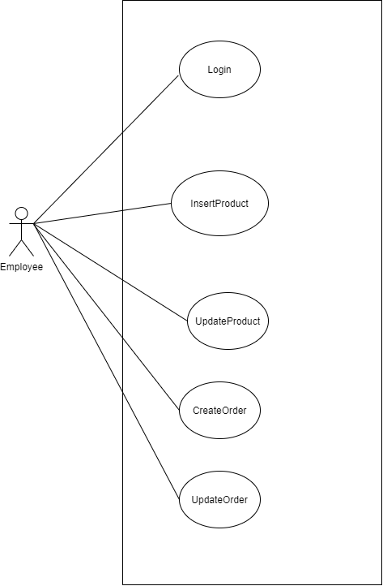
Use Case

Slide 7
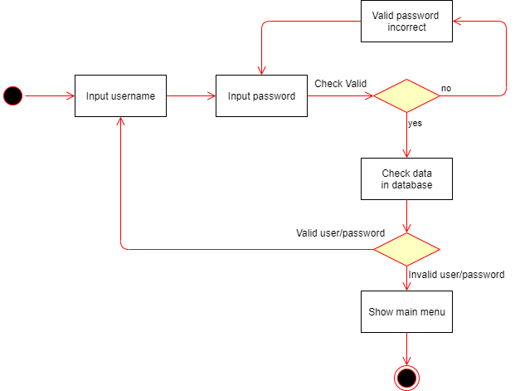
Activity Diagram
Login

Slide 8
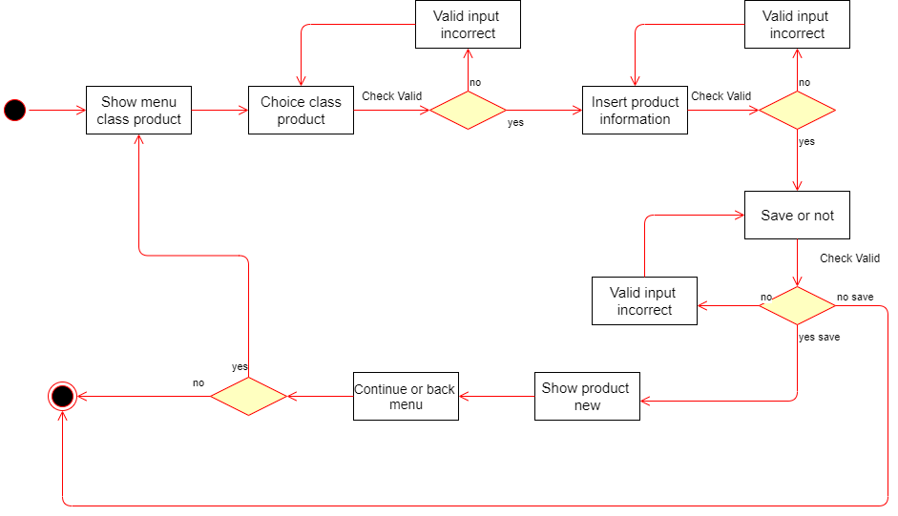
Activity Diagram
Insert products

Slide 9
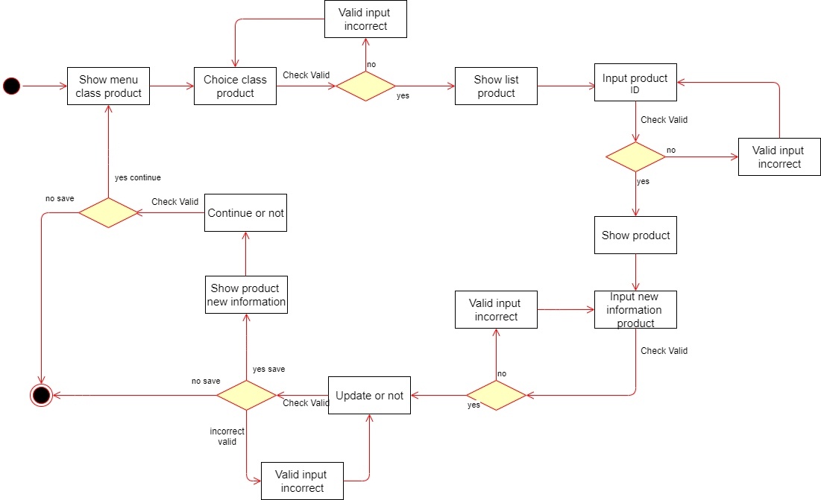
Activity Diagram
Update products

Slide 10
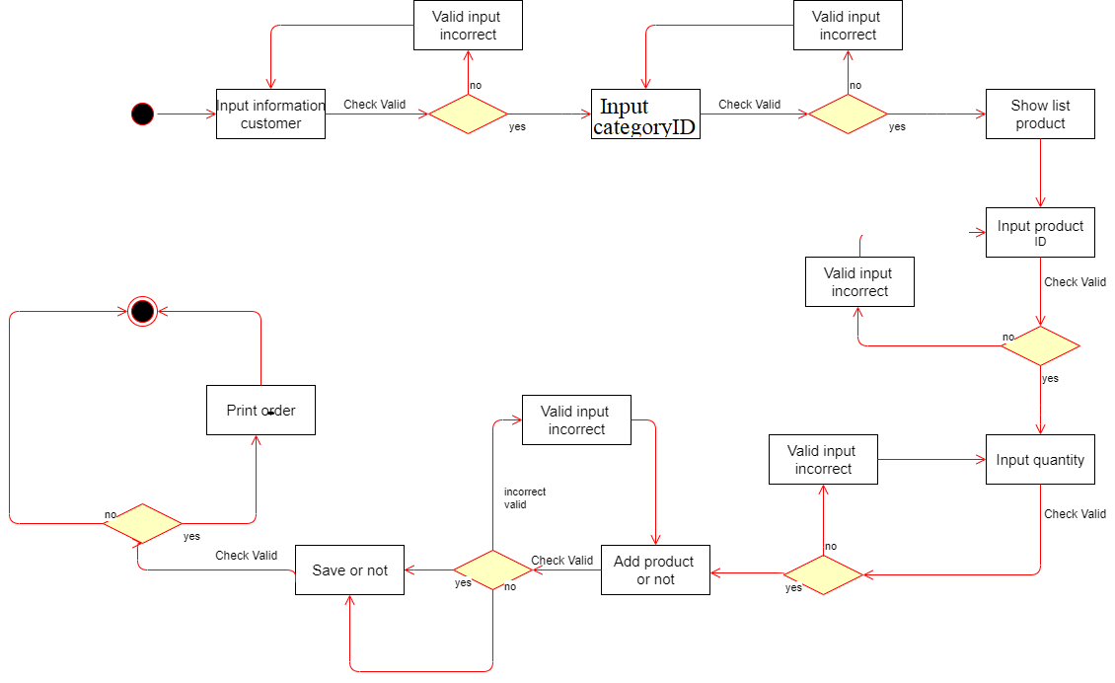
Activity Diagram
Create orders

Slide 11
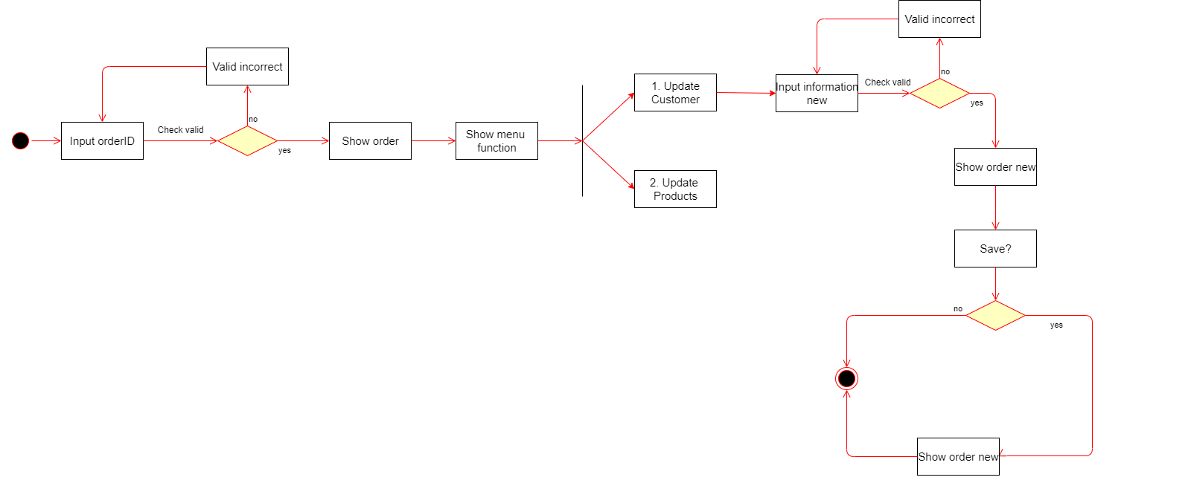
Activity Diagram
Update orders

Slide 12
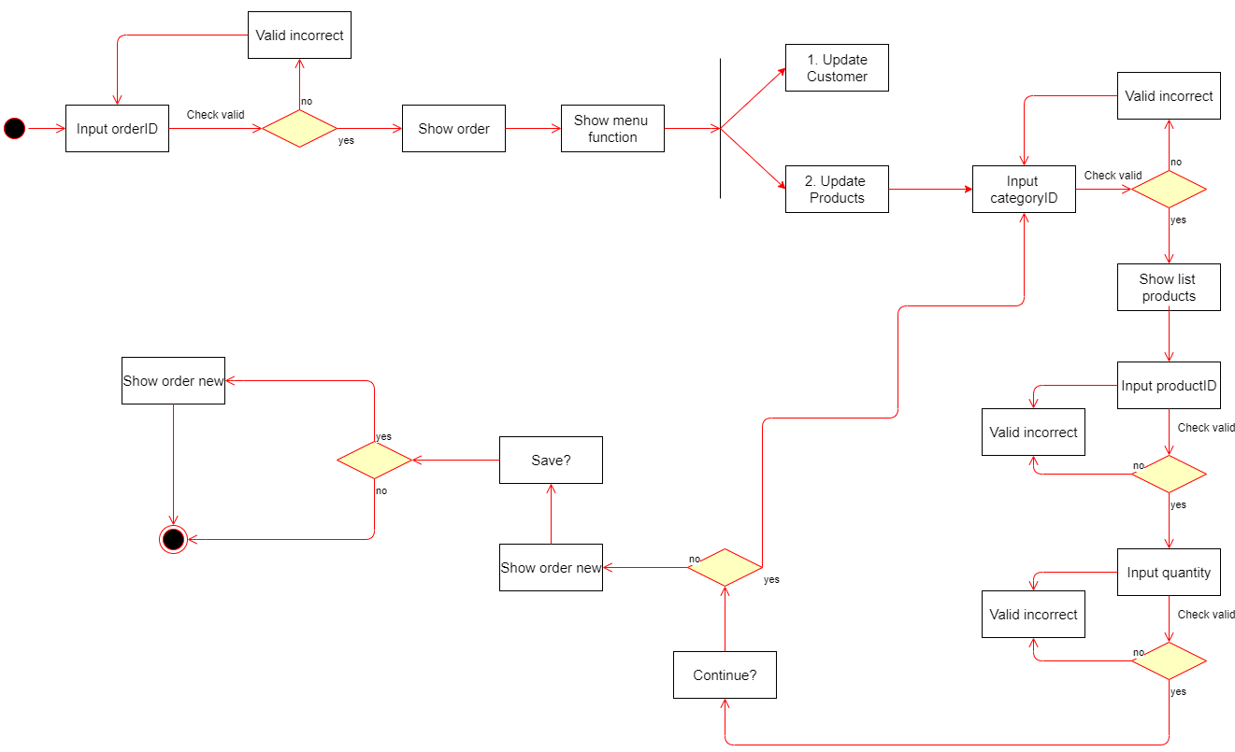
Activity Diagram
Update orders

Slide 13
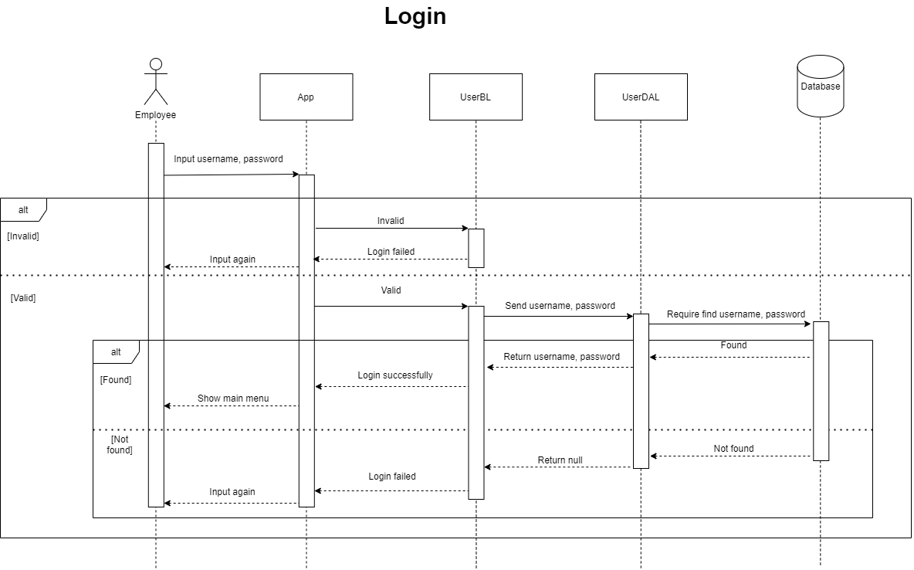
Sequence Diagram

Slide 14
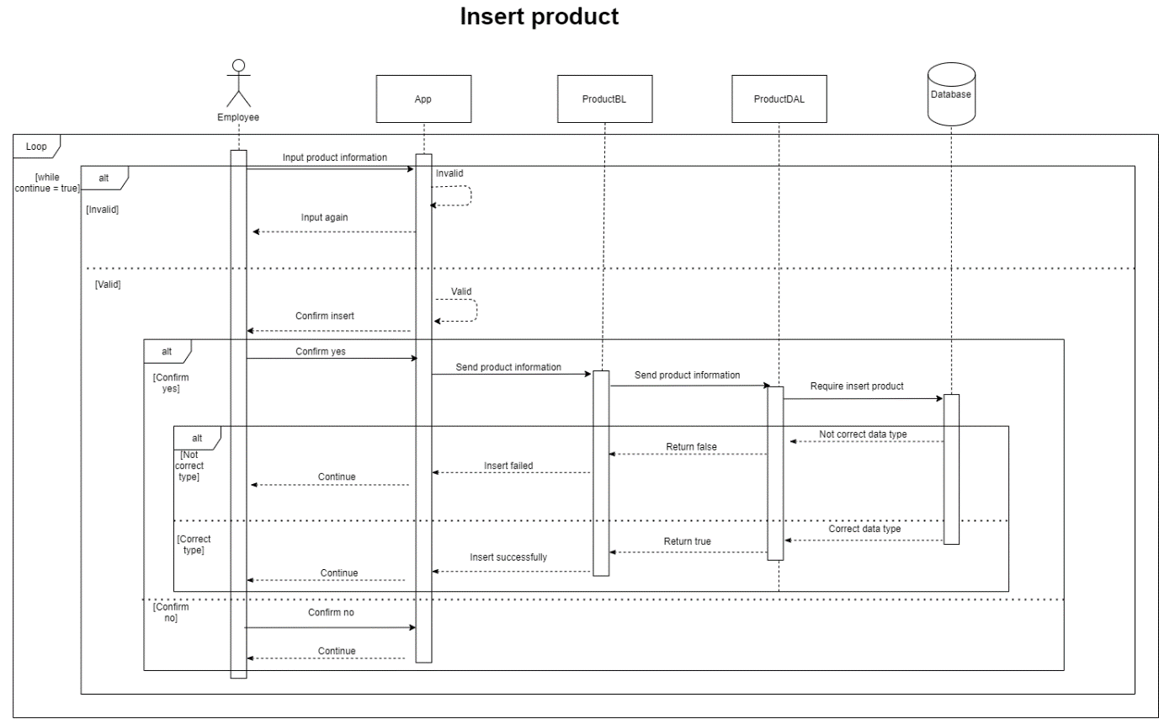
Sequence Diagram

Slide 15
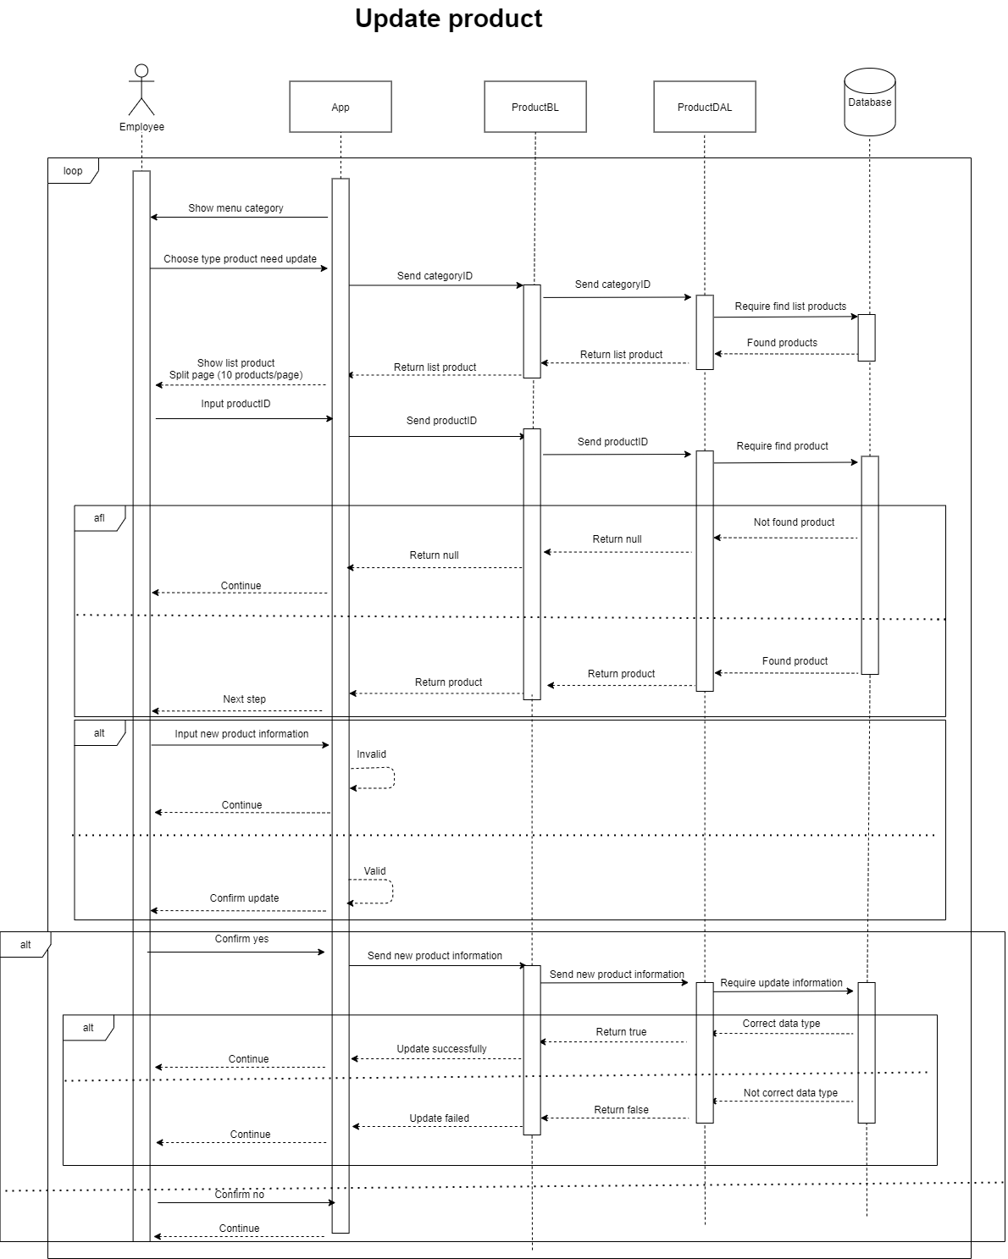
Sequence Diagram

Slide 16
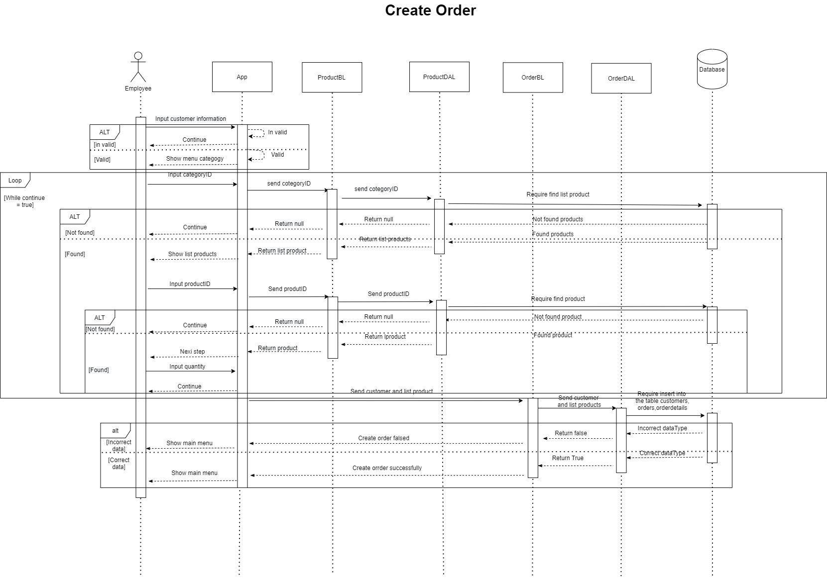
Sequence Diagram

Slide 17
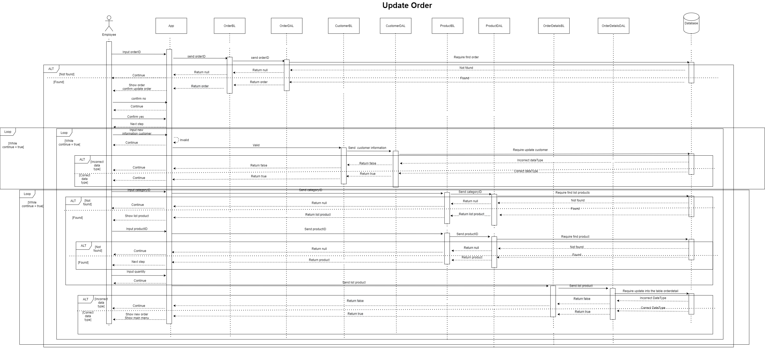
Sequence Diagram

Slide 18
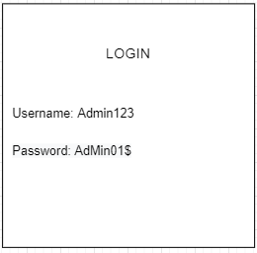
UI Design
Login

Slide 19
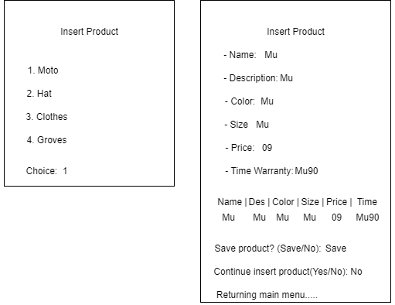
UI Design
Insert product

Slide 20
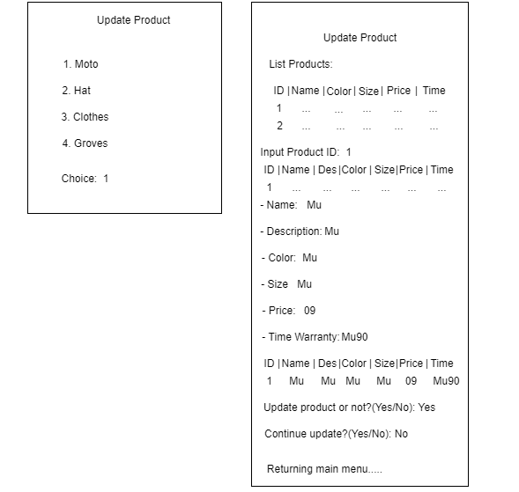
UI Design
Update product

Slide 21
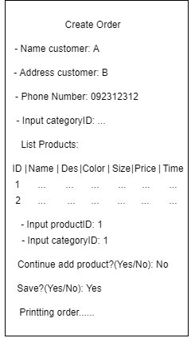
UI Design
Create order

Slide 22
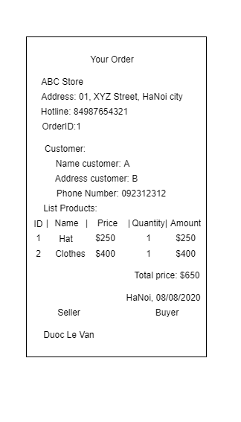
UI Design
Print order

Slide 23
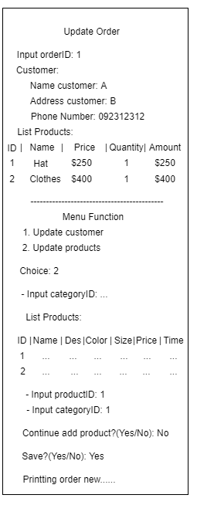
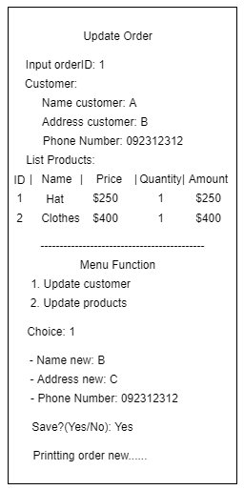
UI Design
Update Order

Slide 24
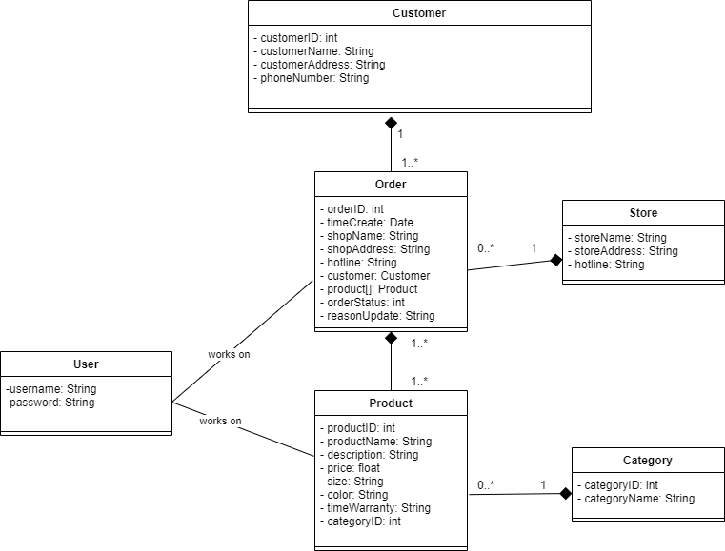
Class Diagram

Slide 25
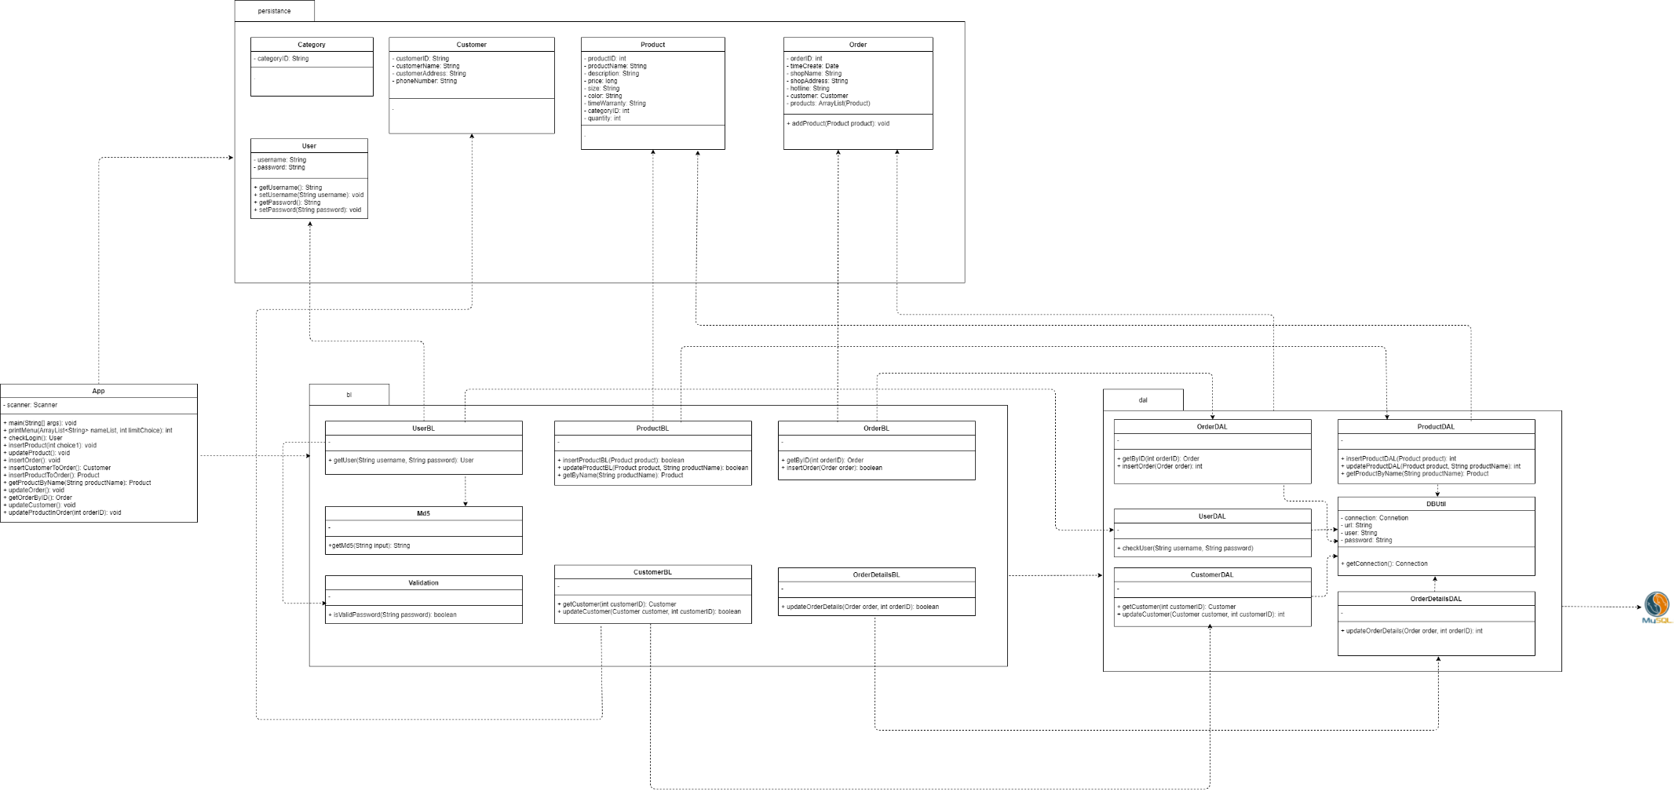
Class Diagram

Slide 26
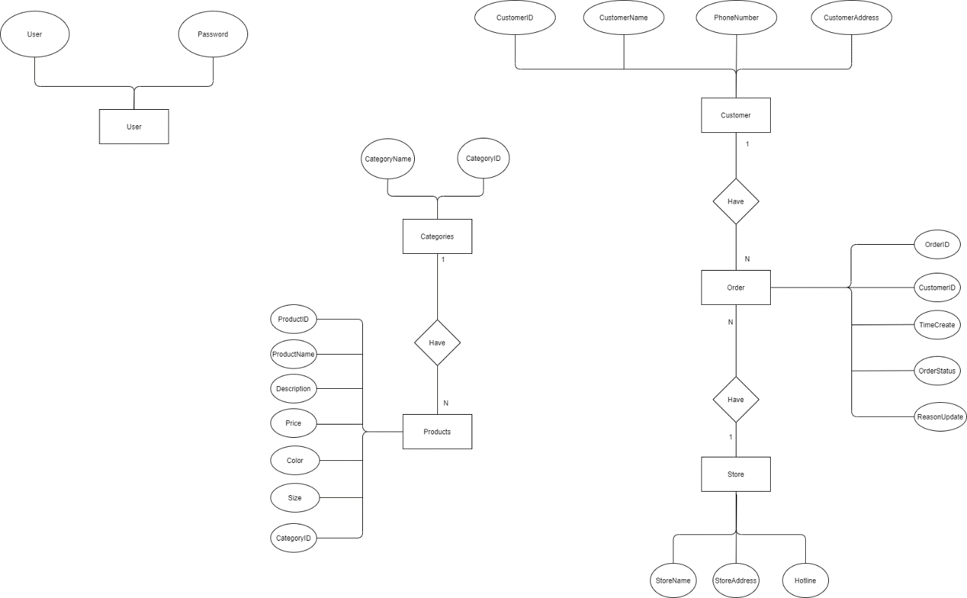
Entity Relationship Diagram

Slide 27
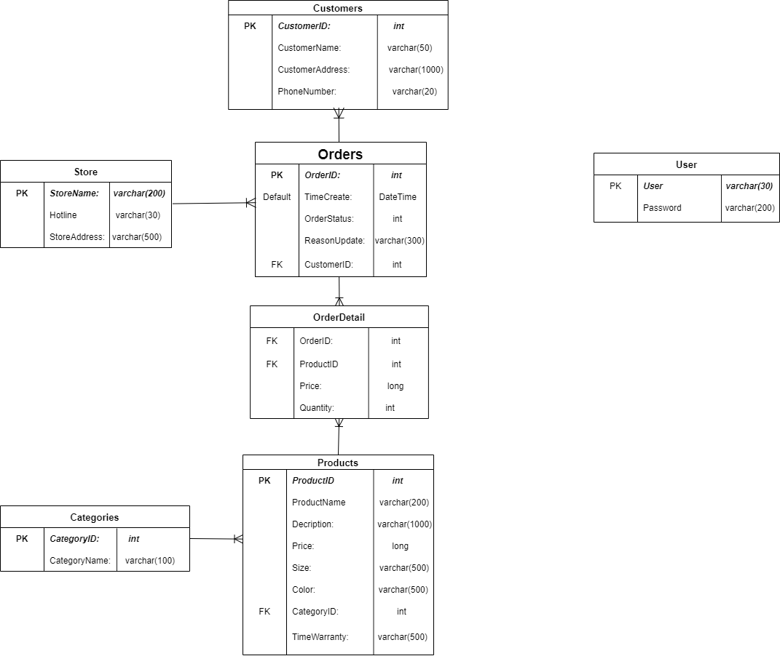
Entity Relationship Diagram

Slide 28
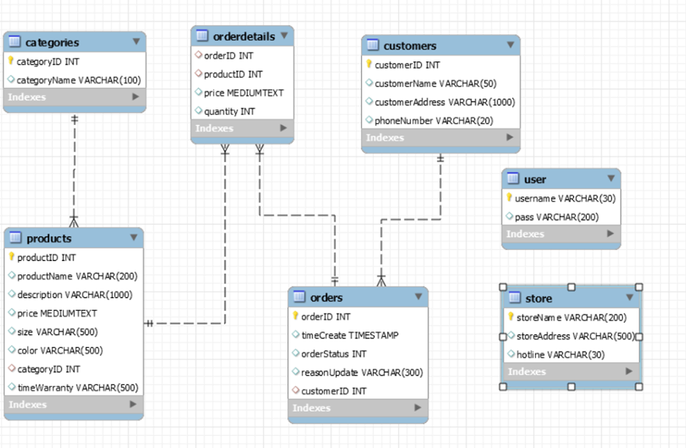
Entity Relationship Diagram

Slide 29
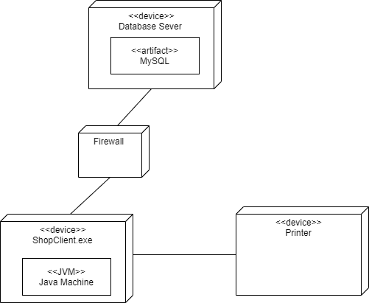
Deployment Diagram

Slide 30
Assign work to each team member
No | Task Name | Description | Start Date | End Date | Member | Self Assessment
1, | Draw ERD | Draw erdSQL, erdNoSQL | 3/8/20 | 8/8/20 | Lân | Done
2. | Draw Use Case | 5 use case | 3/8/20 | 8/8/20 | Được | Done
3. | Draw Class Diagram | Design details split layer | 3/8/20 | 8/8/20 | Được | Slow
4. | Write Document | Write by Word | 3/8/20 | 8/8/20 | Lân,Được | Finished in the end
5. | Draw Activity Diagrams | 5 activity diagrams | 3/8/20 | 8/8/20 | Lân | Slow
6. | Draw Deployment diagram | Deployment diagram | 3/8/20 | 8/8/20 | Lân | Slow
7. | Draw Sequence Diagrams | 5 sequence diagrams | 3/8/20 | 8/8/20 | Được | Very Slow

Slide 31
Assign work to each team member
No | Task name | Description | Start Date | End Date | Member | Self assessment
8. | Draw UI design | Design display for 5 use case, maybe 1 or more blueprints for each use case | 3/8/20 | 8/8/20 | Lân: Design Login function, Insert Product function, Update Product function. Được: Design Create Order function, Update Order function. | Done

Slide 32


Slide 33
Q & A

