Slide 1
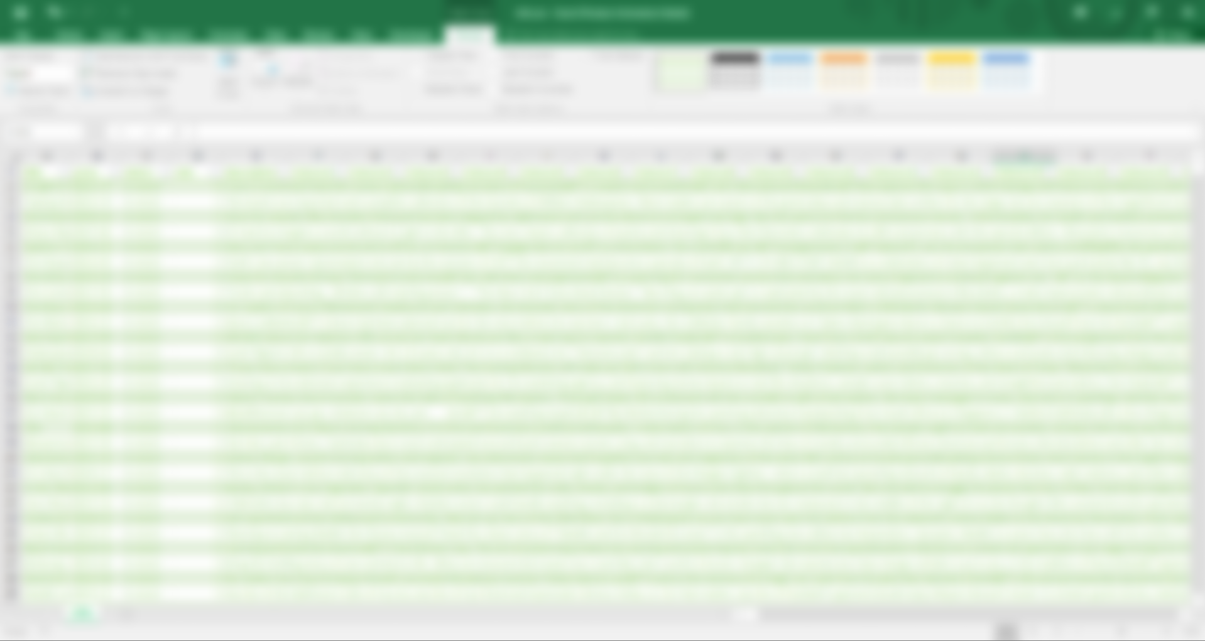
WEB SCRAPING

