Slide 1
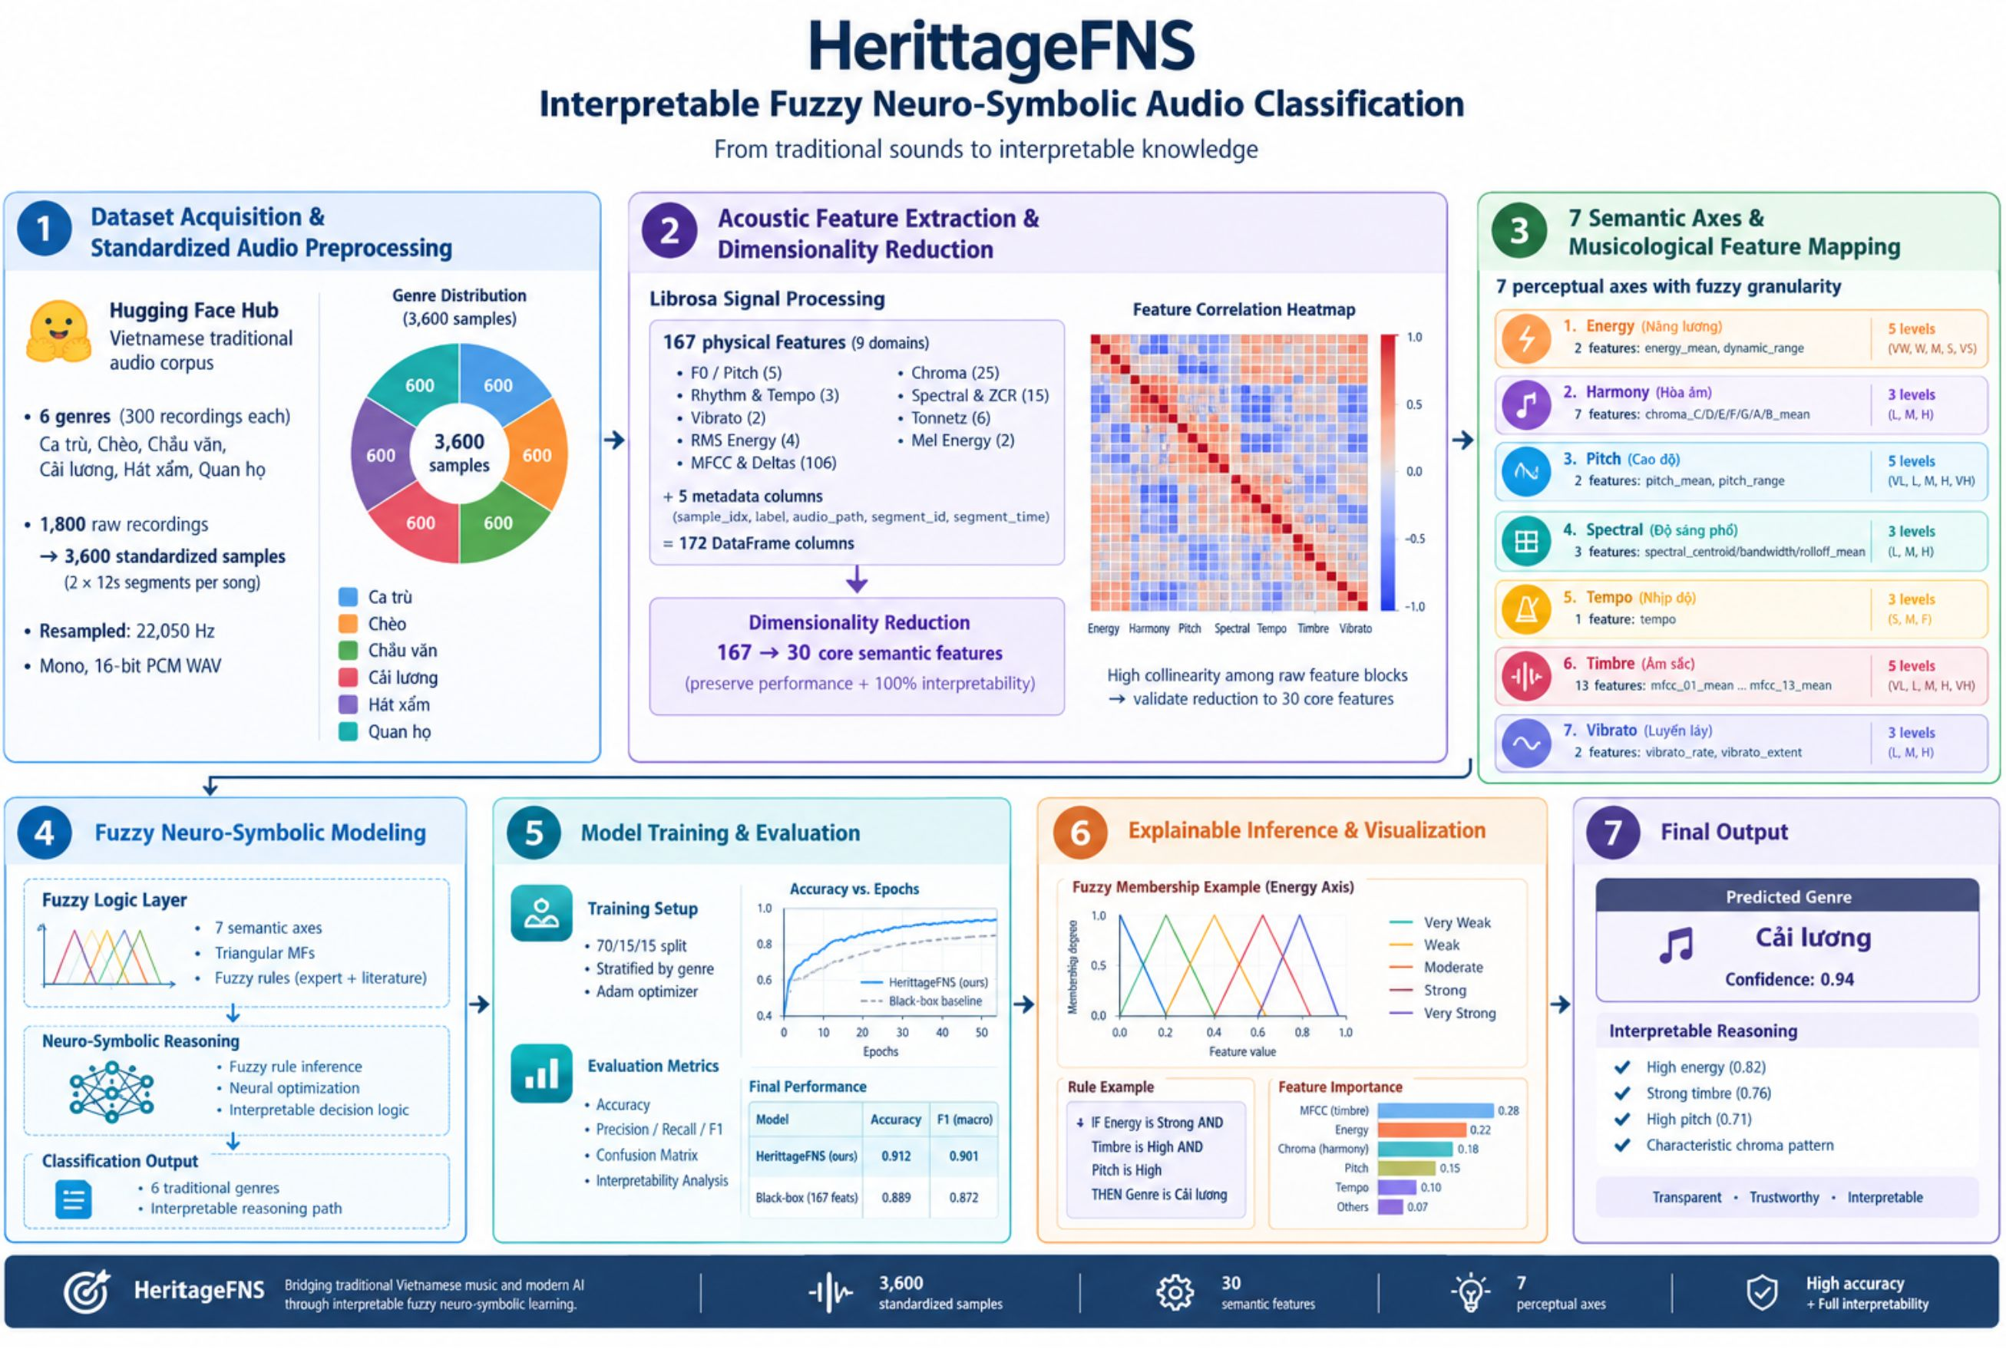
NEURO-SYMBOLIC MIR
HerittageFNS
Interpretable Fuzzy Neuro-Symbolic Audio Classification
End-to-end pipeline bridging traditional Vietnamese musical heritage to interpretable, rule-based symbolic knowledge.
Audio Signal Processing · Fuzzy C-Means · Symbolic Decision Trees
Notes:
Introduce HerittageFNS: an interpretable fuzzy neuro-symbolic framework designed specifically for traditional Vietnamese music genre classification. Highlight the full pipeline from raw acoustic signals to human-auditable IF-THEN rules.

Slide 2
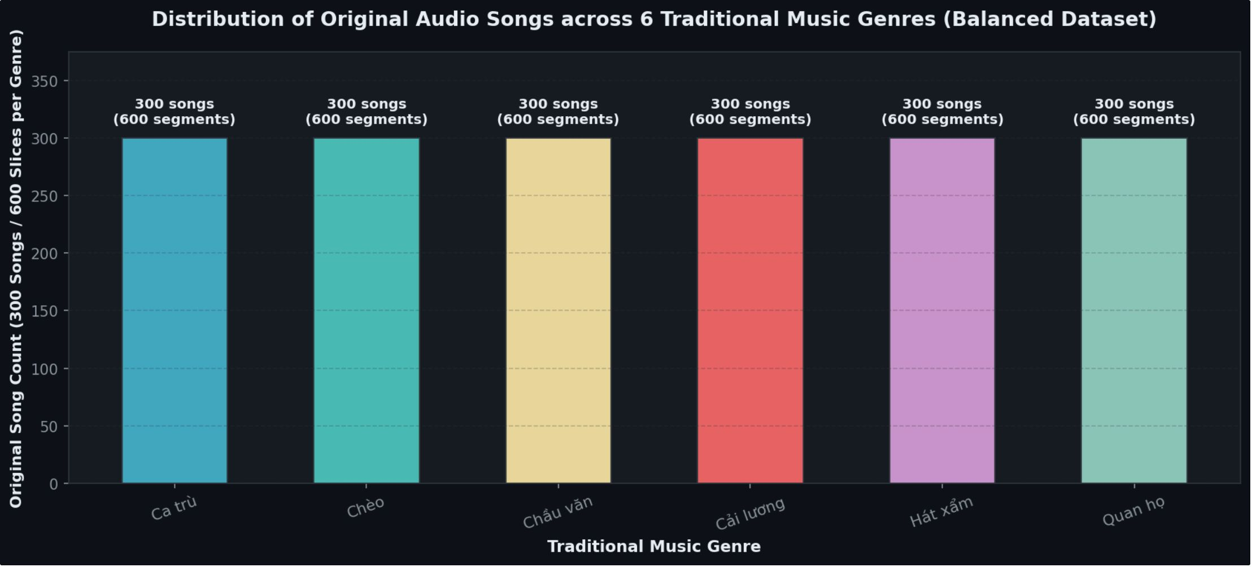
CORPUS STANDARDIZATION
1,800 recordings become 3,600 balanced, standardized samples
Source: Curated Vietnamese traditional audio corpus from Hugging Face Hub.
Genres: 6 genres: Ca trù, Chèo, Chầu văn, Cải lương, Hát xẩm, Quan họ.
Sampling: 1,800 raw recordings, 300 per genre; two 12-second non-overlapping segments per song: 3,600 samples, 600 per genre.
Format: Resampled to 22,050 Hz, mono, 16-bit PCM WAV.
02
Notes:
Describe the dataset preparation protocol: 1,800 raw songs spanning 6 traditional genres split systematically into 3,600 uniform 12-second clips at 22.05 kHz mono.

Slide 3

DIMENSIONALITY REDUCTION
167 physical features reduce to 30 semantic ones
Fuzzy rules over 167 dimensions explode combinatorially and destroy interpretability.
INPUT ACOUSTIC SPACE
SEMANTIC DISTILLATION
167 Librosa Features
30 Core Features
167 Librosa features across 9 domains:
Solution: 30 core features, with accuracy comparable to black-box models on all 167 and 100% human interpretability.
F0/Pitch (5) · Rhythm & Tempo (3) · Vibrato (2)
RMS Energy (4) · MFCC & Deltas (106)
Chroma (25) · Spectral & ZCR (15)
Tonnetz (6) · Mel Energy (2)
Plus 5 metadata columns (sample_idx, label, audio_path, segment_id, segment_time) = 172 DataFrame columns.
30 semantic features preserve interpretability.
03
Notes:
Explain the combinatorial bottleneck: fuzzy rules over 167 dimensions explode combinatorially and destroy interpretability. 30 core features retain accuracy comparable to black-box models on all 167 and 100% human interpretability.

Slide 4
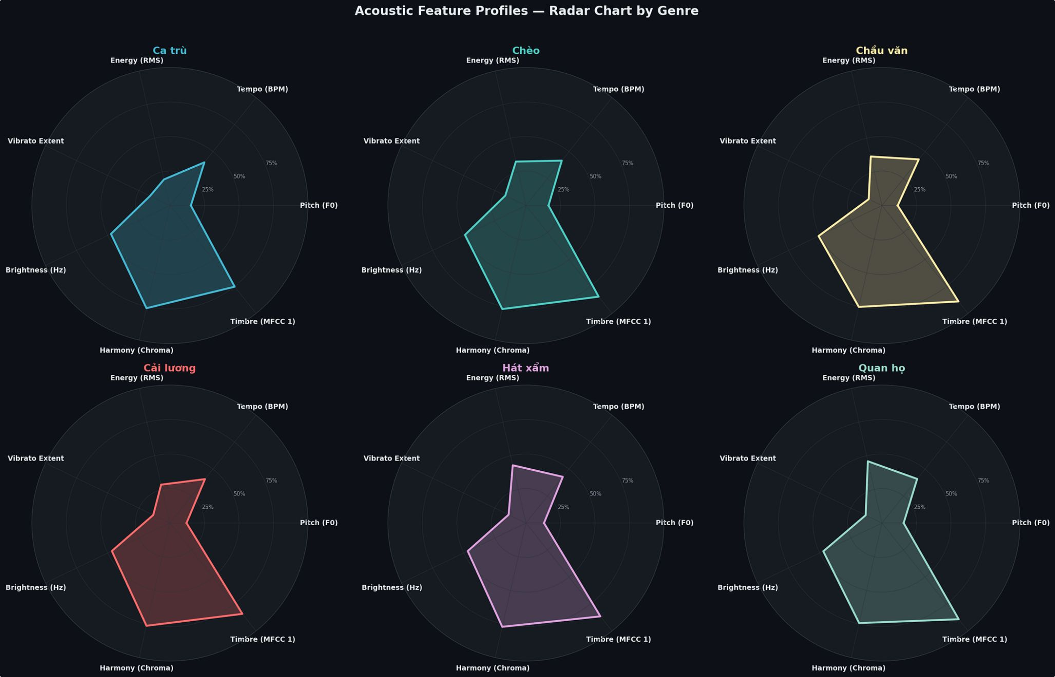
KNOWLEDGE MODELING
30 features form 7 musicological axes and 27 fuzzy sets
Energy (5 levels): energy_mean, dynamic_range
Harmony (3): 7 chroma means, C to B
Pitch (5): pitch_mean, pitch_range
Spectral (3): centroid, bandwidth, rolloff means
Tempo (3): tempo
Timbre (5): mfcc_01 to mfcc_13 means
Vibrato (3): vibrato_extent, vibrato_energy
04
Notes:
Walk through the 7 axes. Explain how 30 acoustic descriptors map directly to 27 linguistic fuzzy sets, providing an intuitive ethnomusicological profile shown on the radar chart.

Slide 5
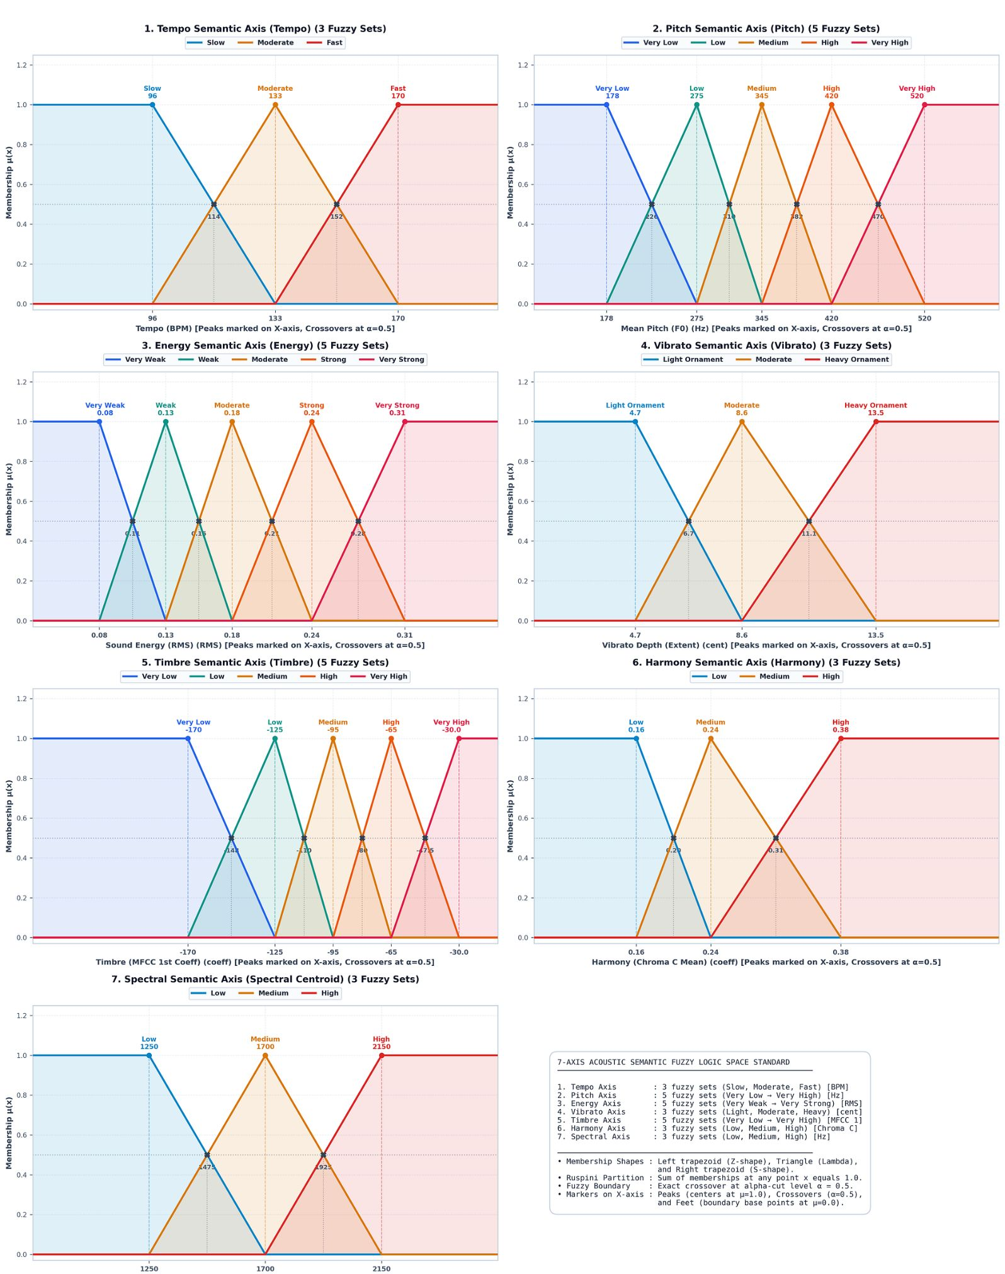

FUZZY PARTITIONING
Fuzzy C-Means builds the membership functions; four criteria pick each axis's representative feature
FCM with fuzzifier m = 2.0 forms Ruspini partitions ( ) per axis. Four rigorous criteria isolate the optimal scalar feature per axis:
1. Direct semantic definition of the axis.
2. Strictly increasing mean across fuzzy levels.
3. Highest between/within-cluster variance ratio (ANOVA F, Fisher).
4. Multi-dimensional axes: mfcc_01_mean for Timbre, mean pitch-class energy for Harmony.
05
Notes:
Highlight the mathematical rigor of Fuzzy C-Means (m=2.0) generating smooth Ruspini partitions, and explain the 4 selection criteria used to choose representative features for each axis.

Slide 6
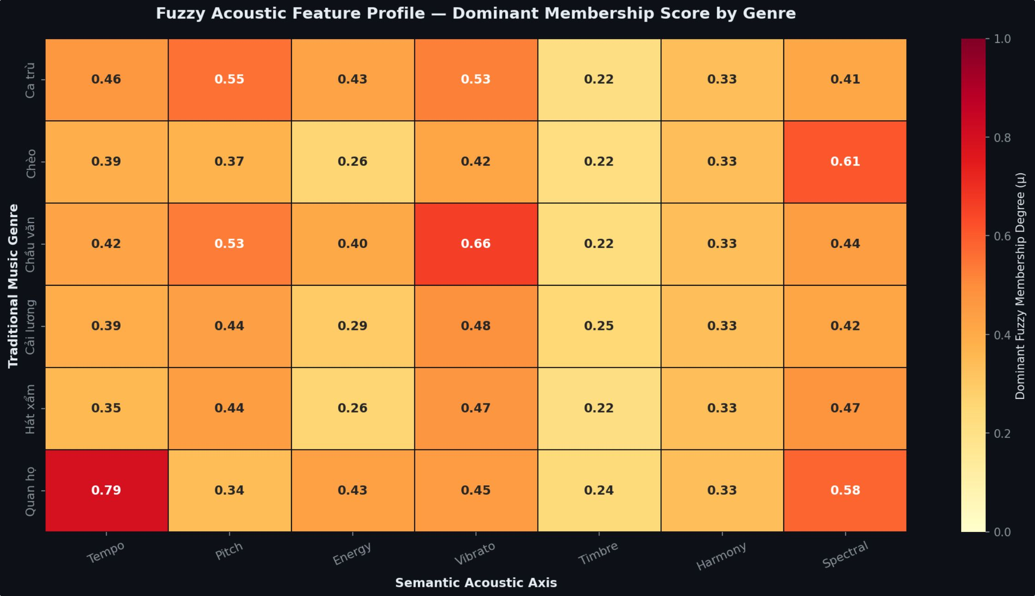


REPRESENTATION STRATEGY
Two new fuzzy datasets preserve gradient information
Crisp Linguistic Dataset
3,600 × 9 columns. Categorical axes assigned via (e.g. Tempo = Moderate). Discards boundary uncertainty.
Continuous Membership Dataset
3,600 × 29 columns. Retains all 27 continuous fuzzy membership degrees in .
Gradient Preservation
Continuous memberships eliminate artificial boundary bifurcations, capturing nuanced micro-variations across traditional singing styles.
06
Notes:
Contrast crisp argmax quantization against continuous fuzzy representations. Continuous memberships preserve vital borderline information that traditional discretization discards.

Slide 7
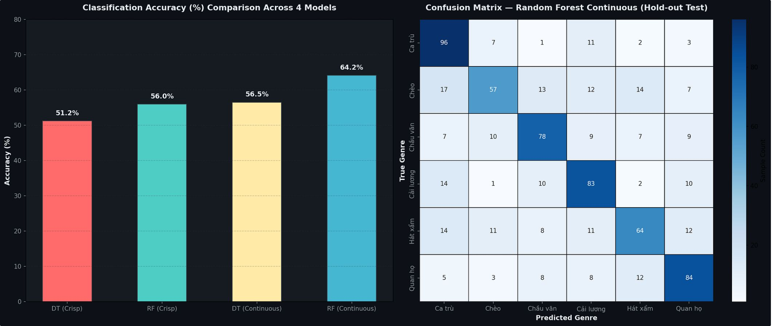
EXPERIMENTAL EVALUATION
Continuous fuzzy memberships lift Random Forest to 64.17% accuracy
DT and RF (50 trees), max_depth = 5, min_samples_leaf = 10; 80/20 stratified split, 720 test samples.
Decision Tree: crisp: 51.25% acc, 50.58% F1; continuous: 56.53% acc, 56.06% F1.
Random Forest: crisp: 55.97% acc, 55.04% F1; continuous: 64.17% acc, 63.71% F1.
Continuous over crisp: +8.20% for RF; RF over DT: +7.64%.
Genre Precision: Precision above 80% on Ca trù, Quan họ, Cải lương.
07
Notes:
Present the benchmark results: Continuous fuzzy features boost Random Forest from 55.97% to 64.17% (+8.20% gain), with high precision (>80%) on key traditional genres.

Slide 8
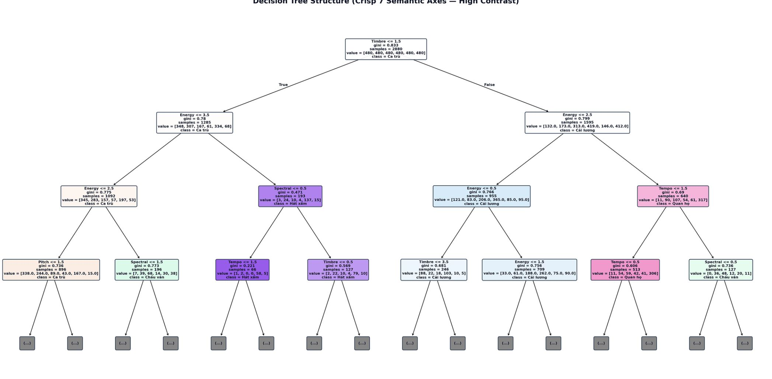
SYMBOLIC RULE EXTRACTION
All 50 trees convert into pruned IF-THEN rules
Every root-to-leaf path becomes a DNF rule: IF conditions THEN Genre [Confidence, Support, Frequency]. Pruning: confidence at least 50%, support at least 10 samples, tree voting frequency (e.g. 3/50).
Ca trù (Conf 75.0%, Supp 260):
IF Energy Very Weak AND Vibrato Moderate/Heavy AND Timbre Very Low/Low THEN Ca trù
Quan họ (Conf 84.0%, Supp 327):
IF Tempo Moderate AND Energy Strong/Very Strong AND Timbre High/Very High THEN Quan họ
Cải lương (Conf 78.4%, Supp 218):
IF Vibrato Heavy Ornament AND Timbre High/Very High AND Harmony High THEN Cải lương
08
Notes:
Show how tree ensembles transform into human-verifiable DNF rules. Point out that the extracted rules align directly with established ethnomusicological descriptions of vocal ornamentation and instrumental backing.

Slide 9
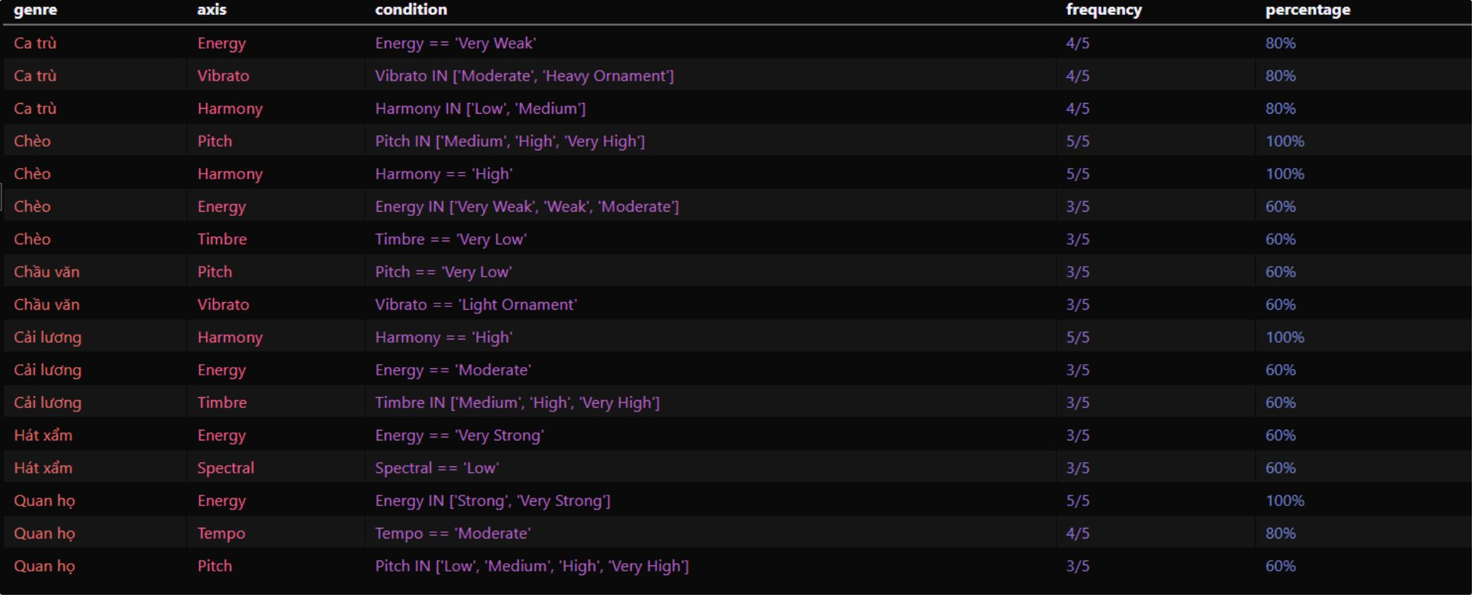
OUT-OF-SAMPLE VALIDATION
18 unseen recordings confirm invariant genre archetypes
Holdout: 3 songs per genre x 6 genres; 30 features, fuzzy membership, Top 5 matching rules per sample.
Ca trù (3/3): Energy Very Weak AND Timbre Very Low/Low
Quan họ (3/3): Energy Strong/Very Strong AND Timbre High/Very High
Cải lương (3/3): Vibrato Heavy Ornament AND Harmony High
Chầu văn (3/3): Pitch Very Low AND Harmony High
Takeaway: The model learns ethnomusicological archetypes, not sample noise.
09
Notes:
Conclude with the holdout verification: 18 completely independent songs validate that the learned rules reflect authentic genre invariants rather than memorized dataset quirks.

