Slide 1





















AI Programming Assistant
AI-Powered Code
with AI ChatBot
X-Eyes
1
Notes:
1

Slide 2










01
Overview
Contents
02
Core Features
03
Tech Stack Overview
04
Demo
05
Q&A
2
Notes:
2

Slide 3





















01
Overview
3
Notes:
3

Slide 4
Overview
AI Programming Assistant is a full-stack web application designed to empower developers with intelligent coding support.
It features an AI-powered chat for programming Q&A, code explanation, and quick action tools such as commenting, debugging, optimization, and test generation.
4

Slide 5
02
Core Features
5
Notes:
5

Slide 6
Quick Actions
Add Comments
Automatically add comments to code
Debug Code
Detect and fix bugs in code
Optimize Code
Improve performance and clean code
Generate Tests
Create unit tests for functions/methods
6

Slide 7
AI Chat Assistant
Programming Consultation
Q&A about algorithms, data structures, and best practices
Code Review
Evaluate and suggest code improvements
Learning Support
Explain concepts, patterns, and frameworks
7
Notes:
7

Slide 8
Knowledge Base
Document Upload
Upload and process documents in PDF, Markdown (.md), text (.txt), and Word formats.
Smart Search
Perform semantic search across all stored documents using advanced vector database (ChromaDB), enabling quick and relevant information retrieval.
AI-Powered Q&A
Ask questions and get answers based on the content of your uploaded documents.
8
Notes:
8

Slide 9
03
Tech Stack Overview
9
Notes:
9

Slide 10
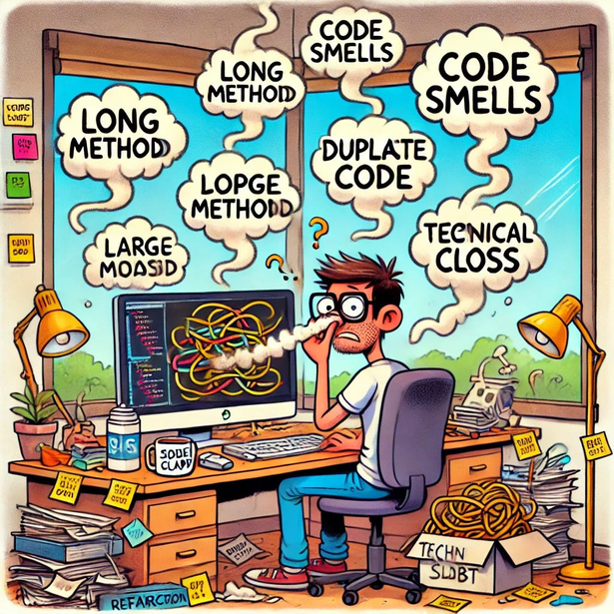

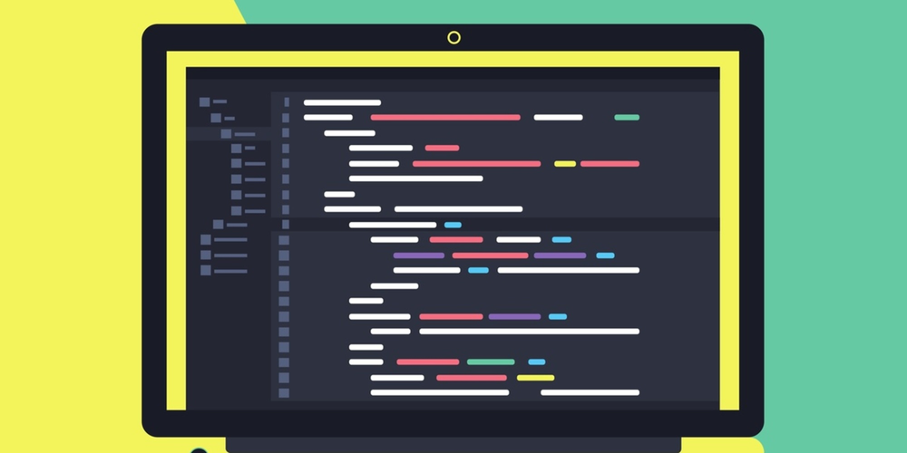
Tech Stack Overview
01
02
03
Identify code smells
Improve code readability
Optimize code structure
Detect and address technical debt in the codebase.
Enhance variable and function naming for better understanding.
Refactor complex logic into simpler, modular components.
10

Slide 11
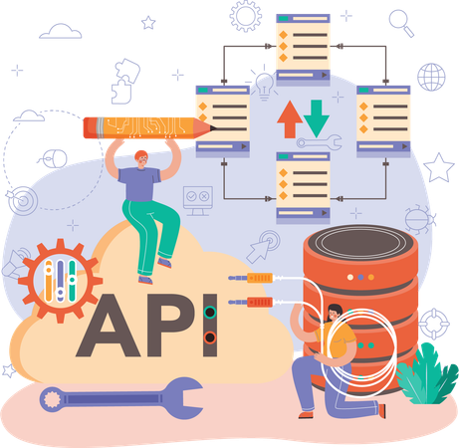
BackEnd
01
Flask
Python web framework
02
Azure OpenAI
AI integration for chat and code analysis
03
LangChain
Advanced prompt management and AI workflows
04
ChromaDB
Vector database for semantic search
05
Other
Flasgger, Flask-CORS, PyPDF2, pyttsx3
11

Slide 12
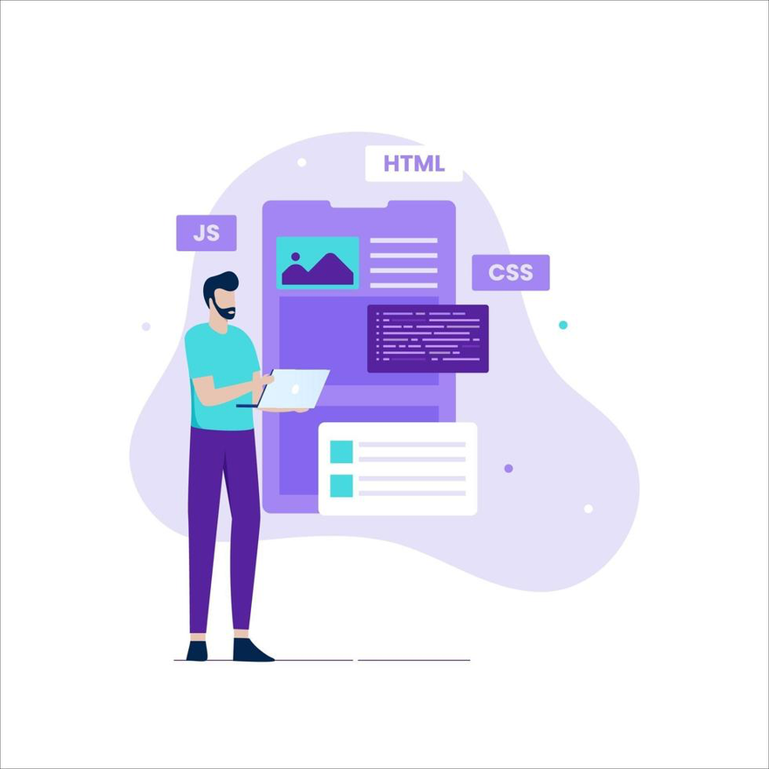
FrontEnd
01
React
Modern UI framework
02
Axios
HTTP client for API requests
12

Slide 13

Deployment
01
Docker & Docker Compose
Containerization and orchestration
02
Nginx
Load balancing and static file serving
03
AWS
EC2
13

Slide 14
04
Demo
14
Notes:
14

Slide 15
05
Q & A
15
Notes:
15

Slide 16































Thank You
16

