Slide 2
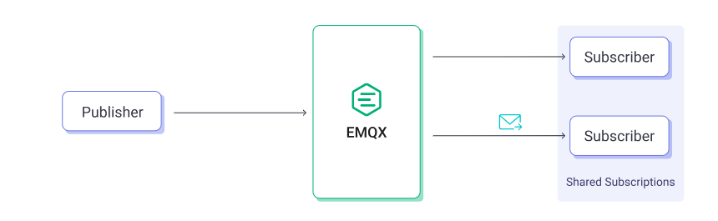
1.

Slide 3
1.
In pub/sub systems, messages are published and consumed asynchronously.
How do we identify messages belonging to the same flow and ensure they’re processed by the same instance?

Slide 4
2. Correlation ID
A Correlation ID is a unique identifier that is added to the very first interaction (incoming request) to identify the context and is passed to all components that are involved in the transaction flow.
Correlation ID becomes the glue that binds the transaction together and helps to draw an overall picture of events.
Enables tracing across multiple systems, allows grouping of related events,...

Slide 5
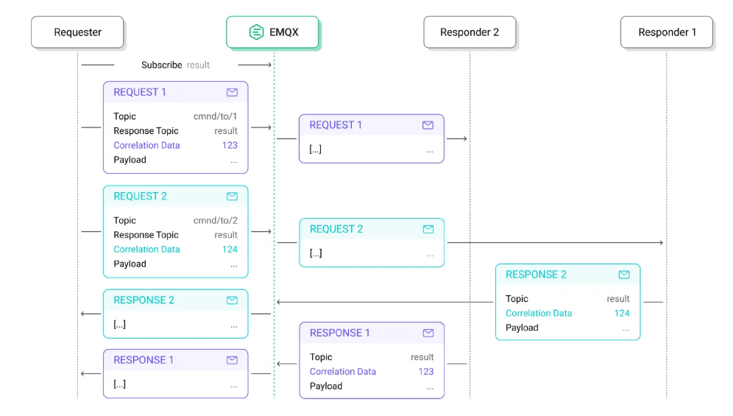
2. Correlation ID

Slide 6
3. Hash Load Balancing
With multiple instances consuming messages, we need consistent routing logic.
Use a deterministic mapping function:
target = hash(correlationId) mod N
where N = number of processing instances.

Slide 7
3. Hash Load Balancing
Apache Kafka
Kafka is a distributed event streaming platform designed for high-performance data pipelines, streaming analytics, and real-time applications.
It allows publish-subscribe (pub/sub) communication between systems with strong durability and scalability.

Slide 8
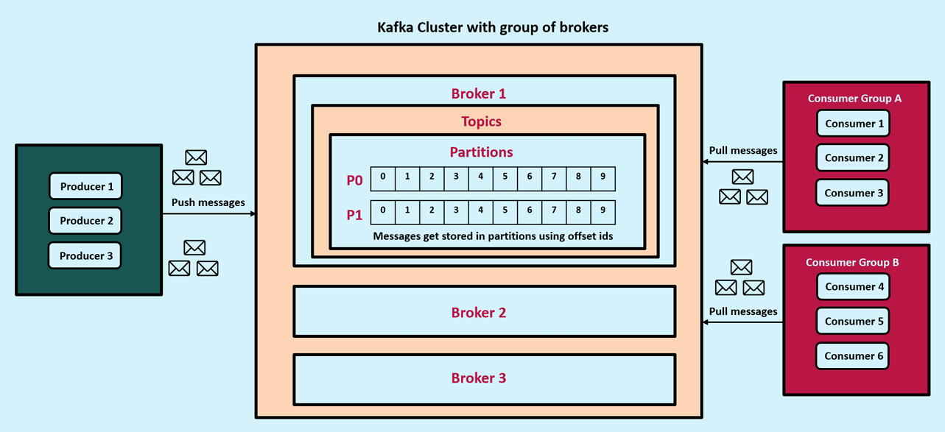
3. Hash Load Balancing
Notes:
Core Concepts
Producer: Publishes (sends) messages to topics.
Consumer: Subscribes to topics and processes messages.
Topic: A category or feed name to which messages are published.
Partition: A topic is split into partitions for parallelism and scalability.
Broker: A Kafka server that stores and serves messages.
Consumer Group: A group of consumers that share message processing for load balancing.

Slide 9
3. Hash Load Balancing
Apache Kafka integration
Kafka's topics are partitioned, events with the same event key are written to the same partition.
Each partition is consumed by exactly one consumer in the group.

Slide 10
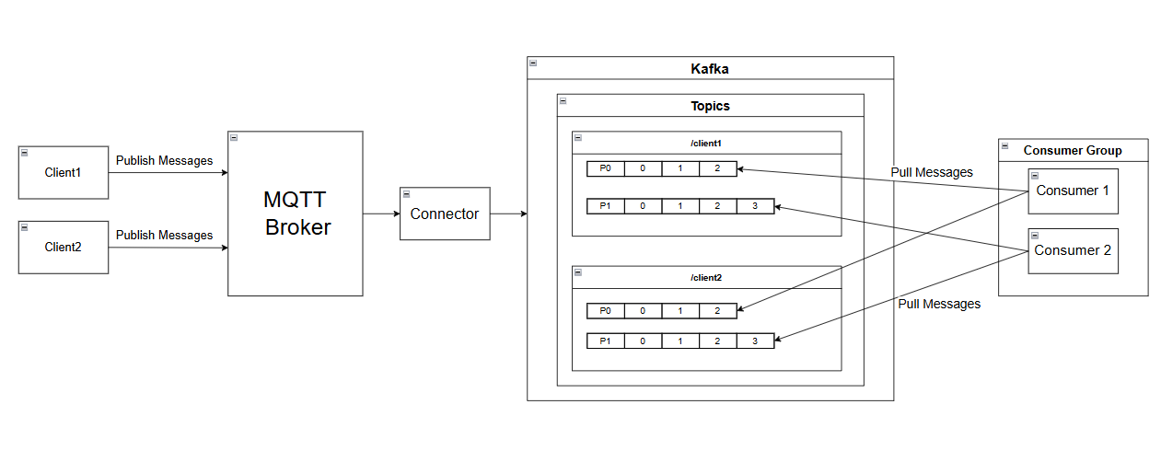
3. Hash Load Balancing

Slide 11
3. Hash Load Balancing

