Slide 1
Git
Quick, Clear, Practical

Slide 2
What is Version Control?
Tracks changes to files
Enables collaboration
Reverts to previous versions
Git is a *distributed* version control system

Slide 3
Git vs GitHub
Git: tool to manage version control locally
GitHub: platform to host/share Git repositories

Slide 4
Git Installation & Config
Install from https://git-scm.com
Setup config:
git config --global user.name "Your Name"
git config --global user.email "you@example.com"

Slide 5
Git Basics
git init, git clone

Slide 6
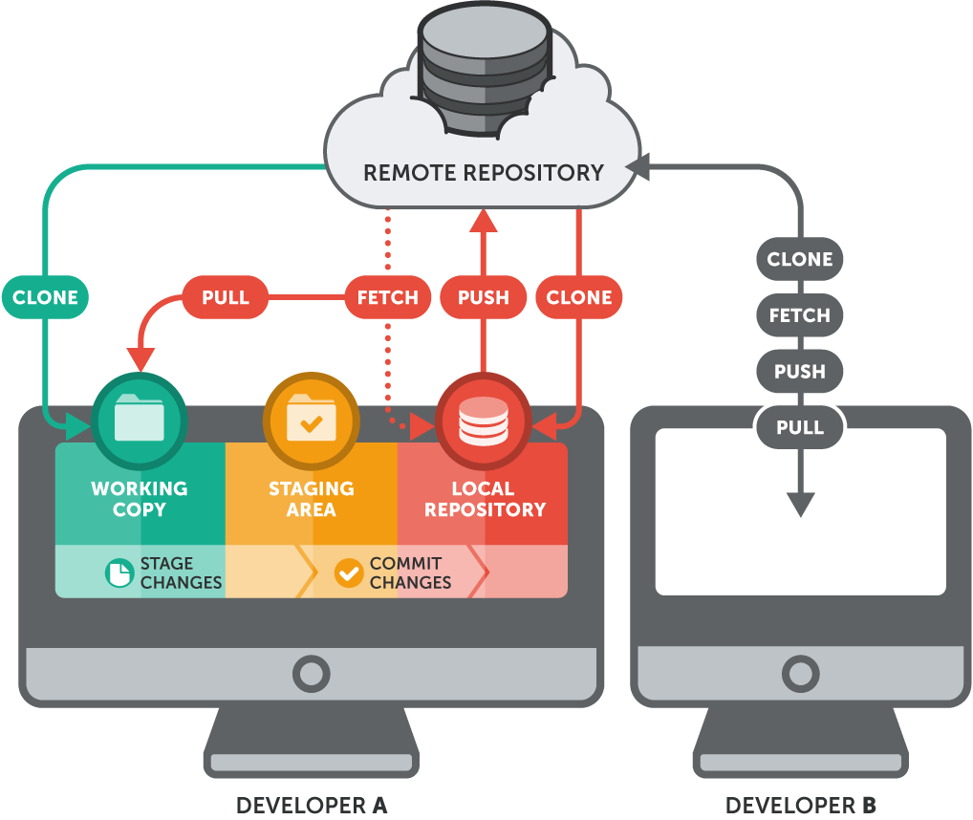
Git Basics

Slide 7
Git Basics
git add, git commit
git add . (add all file to staging)
git add hello.txt (add specific file)
git commit -m “message”
git commit -am “message” (add + commit)
git commit --amend --no-edit

Slide 8
Git Basics
git status, git log

Slide 9
Branching
git branch
git branch (show all branches)
git branch <branch-name> (create new branch)
git branch –d <branch-name>
git branch –D <branch-name>

Slide 10
Branching
git checkout
git checkout <branch-name> (create new branch)
git checkout –b <branch-name>
git checkout <commit>
git checkout <file>

Slide 11
Branching
git switch
git switch <branch-name> (create new branch)
git switch –c <branch-name>

Slide 12
Branching
git merge, git rebase conflict example shown

Slide 13
Remote Repos & GitHub
git remote, git push, git pull
git remote add <name> <url>
git fetch origin
git push -u origin feat/login
git pull

Slide 14
Remote Repos & GitHub
git remote, git push, git pull
Pull Request flow on GitHub
Use HTTPS/SSH

Slide 15
Best Practices
Clear commit messages
Proper branch naming
Use .gitignore
Prefer rebase in clean history

Slide 16
Workflow Types
Feature Branch
Git Flow
Fork & Pull Request

Slide 17
Advanced Git
git stash (stash your change)
git stash push -m “message“ (stash with mess)
git stash list (see your stash list)
git stash apply # applies latest stash
git stash apply stash@{0} (0)
git stash drop stash@{0}
git stash pop(apply + remove)
Notes:
When do you use git stash?
You’re working on something unfinished
Suddenly you need to:
Switch to another branch
Pull the latest code
Review someone else’s changes
But you don’t want to commit your half-done code yet

Slide 18
Advanced Git
git cherry-pick
git bisect, git tag

Slide 19
Troubleshooting
Reset vs Revert
git reset --soft HEAD~1 (git reset --soft HEAD~1)
git reset HEAD~1 (Keeps changes in working directory, but unstage them)
git reset --hard HEAD~1 (Deletes the last commit and all changes)
Notes:
When to Avoid Reset:
When working on shared branches
When changes are already pushed to remote

Slide 20
Troubleshooting
Merge conflict resolution
Detached HEAD explained
Reset vs Revert

Slide 21
Exercises
Init project, commit, and push
Branch, edit, conflict, resolve
Use stash, rebase, cherry-pick
Write 3 good commit messages

Slide 22
Real-World Scenarios
Handle force push safely
Rebase across multiple commits
Rewrite history using rebase -i

Slide 23
Resources & Q&A
Pro Git Book
GitHub Docs
Live Q&A

