Slide 1
Git
Quick, Clear, Practical

Slide 2
What is Version Control?
Tracks changes to files
Enables collaboration
Reverts to previous versions
Git is a *distributed* version control system

Slide 3
Git vs GitHub
Git: tool to manage version control locally
GitHub: platform to host/share Git repositories

Slide 4
Git Installation & Config
Install from https://git-scm.com
Setup config:
git config --global user.name "Your Name"
git config --global user.email "you@example.com"

Slide 5
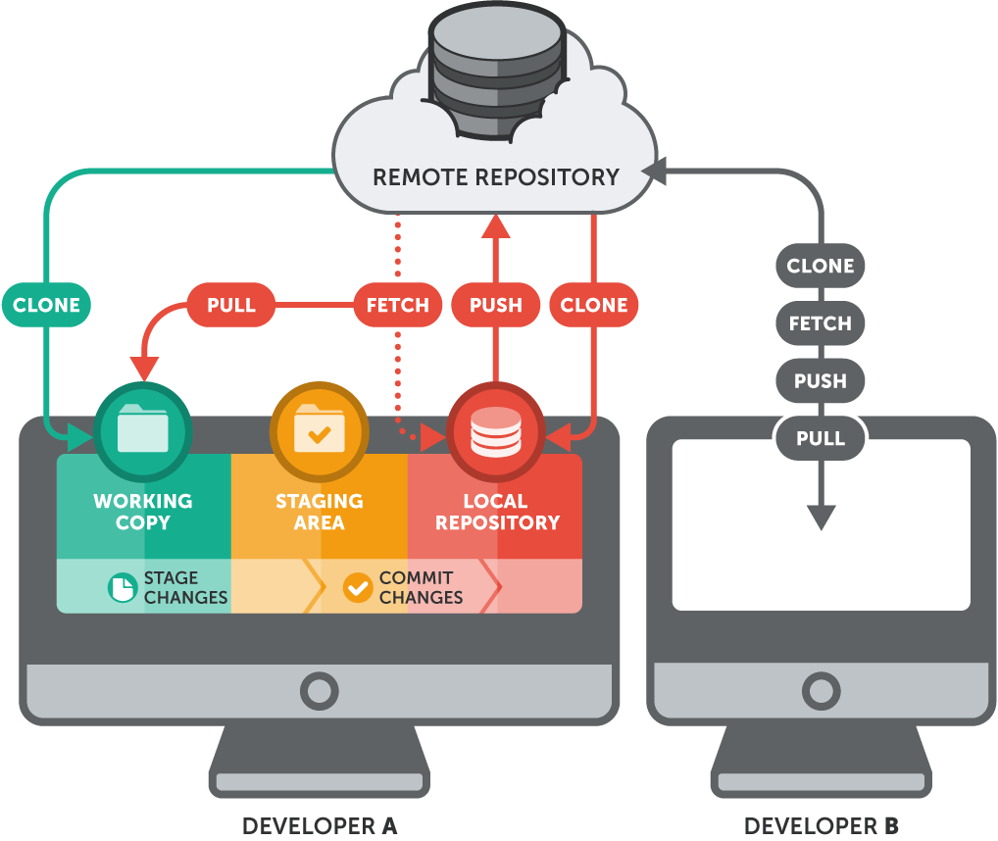
Git Basics

Slide 6
Getting and Creating Projects
git init
create an empty Git repository or reinitialize an existing one
git clone <url>
clone a repository into a new directory

Slide 7
Basic Snapshotting
git add .
add all files to staging
git add <file>
add specific file to staging
git restore .
Restore working tree files
git restore --staged .
Restore in staging files

Slide 8
Basic Snapshotting
git commit -m “message”
Record changes to the repository
git commit -am “message”
add + commit
git commit --amend --no-edit
keeps the old message but updates the content.
git commit --amend –m “msg”
Replace the tip of the current branch by creating a new commit

Slide 9
Git Basics
git status
Show the working tree status
git log
Show commit logs

Slide 10
Branching
List, create, or delete branches
git branch
list all branches
git branch <branch-name>
create new branch
git branch –d <branch-name>
soft delete
git branch –D <branch-name>
hard delete

Slide 11
Branching
git switch <branch-name>
switch to existed branch
git switch –c <new-branch-name>
Create and switch to new branch

Slide 12
Branching
git checkout <branch-name>
checkout branch
git checkout –b <branch-name>
create and checkout new branch
git checkout <commit>
detached HEAD
git checkout <file>

Slide 13
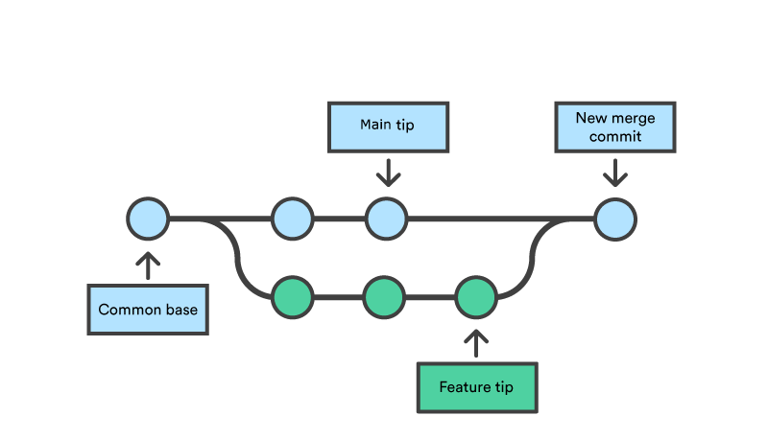
Branching
git merge
Join two or more development histories together

Slide 14
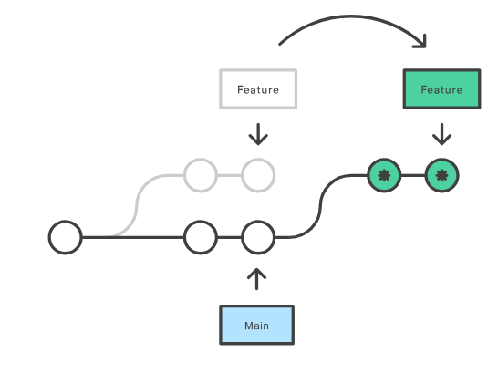
Branching
git rebase
Reapply commits on top of another base tip

Slide 15
Branching
Action Why
main ← merge feat ✅ To bring new feature into main
feat ← rebase main ✅ To keep up-to-date with main cleanly
So yes:
You rebase feature onto main (to avoid messy merge commits) You merge feature into main (to integrate your finished work)

Slide 16
Remote Repos & GitHub
git remote, git push, git pull
git remote add <name> <url>
git fetch origin
git push -u origin feat/login
git pull

Slide 17
Remote Repos & GitHub
git remote, git push, git pull
Pull Request flow on GitHub
Use HTTPS/SSH

Slide 18
Best Practices
Clear commit messages
Proper branch naming
Use .gitignore
Prefer rebase in clean history

Slide 19
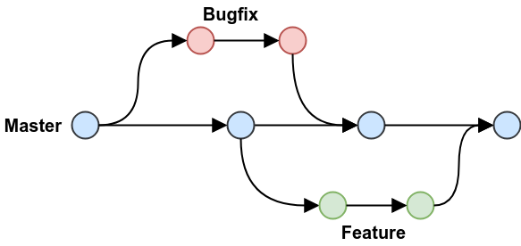
Workflow Types
Feature Branch
Git Flow
Fork & Pull Request

Slide 20
Advanced Git
git stash (stash your change)
git stash push -m “message“ (stash with mess)
git stash list (see your stash list)
git stash apply # applies latest stash
git stash apply stash@{0} (0)
git stash drop stash@{0}
git stash pop(apply + remove)
Notes:
When do you use git stash?
You’re working on something unfinished
Suddenly you need to:
Switch to another branch
Pull the latest code
Review someone else’s changes
But you don’t want to commit your half-done code yet

Slide 21
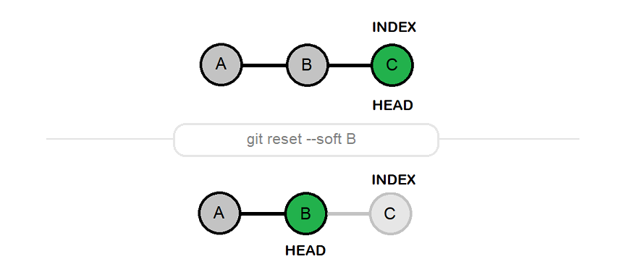
Troubleshooting
Reset vs Revert
git reset --soft HEAD~1
Keeps changes in the staging area
Notes:
When to Avoid Reset:
When working on shared branches
When changes are already pushed to remote

Slide 22
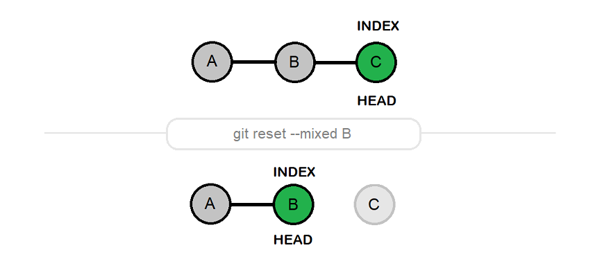
Troubleshooting
Reset vs Revert
git reset HEAD~1 ( default = --mixed)
Keeps changes in working directory, but unstage them
Notes:
When to Avoid Reset:
When working on shared branches
When changes are already pushed to remote

Slide 23
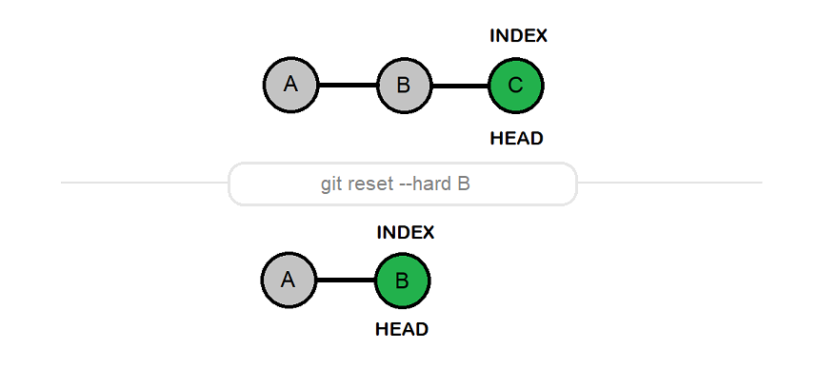
Troubleshooting
Reset vs Revert
git reset --hard HEAD~1
Deletes the last commit and all changes
Notes:
When to Avoid Reset:
When working on shared branches
When changes are already pushed to remote

Slide 24
Troubleshooting
When to Avoid Reset:
When working on shared branches
When changes are already pushed to remote
Use revert instead!
Notes:
When to Avoid Reset:
When working on shared branches
When changes are already pushed to remote

Slide 25
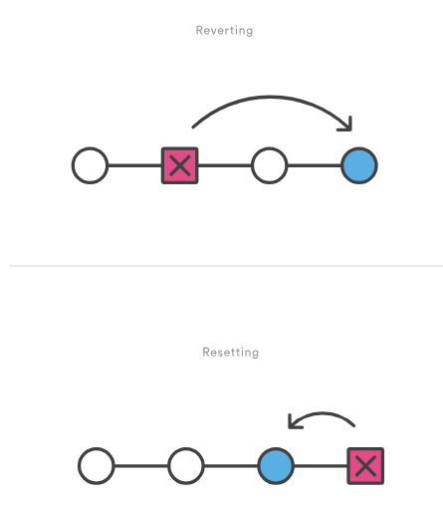
Troubleshooting
Revert
Undo a commit by creating
a new commit that reverses it
Notes:
When to Avoid Reset:
When working on shared branches
When changes are already pushed to remote

Slide 26
Troubleshooting
Merge conflict resolution
Detached HEAD explained
Reset vs Revert

Slide 27
Advanced Git
git cherry-pick
git bisect, git tag

Slide 28
Exercises
Init project, commit, and push
Branch, edit, conflict, resolve
Use stash, rebase, cherry-pick
Write 3 good commit messages

Slide 29
Real-World Scenarios
Handle force push safely
Rebase across multiple commits
Rewrite history using rebase -i

Slide 30
Resources & Q&A
Pro Git Book
GitHub Docs
Live Q&A

