Slide 1
IOT OfflineDebugSuite V0.1845.00
2018/03/27
Airoha

Slide 2
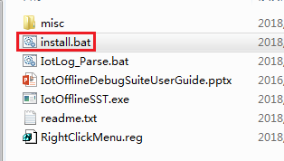
Install
Unzip tool packet to any folder
Run install.bat

Slide 3
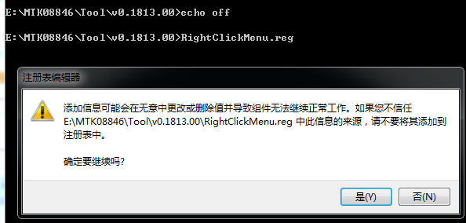
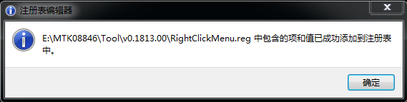
Install
Confirm to import reg file
Yes to finish install procedure

Slide 4
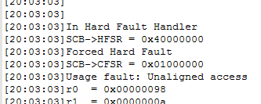
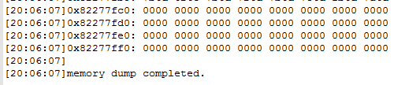
Usage
Make sure memory dump and symbol file (elf/axf/out) are in the same folder.
Make sure memory totally dump complete
Dump start
Dump complete

Slide 5
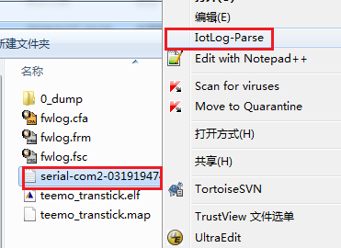
Usage
Right click memory dump file, choose context menu “IotLog-Parse”, running parser

Slide 6
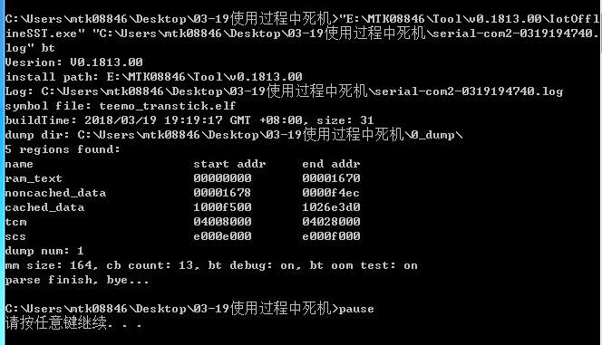
Usage
Parser running as below.

Slide 7
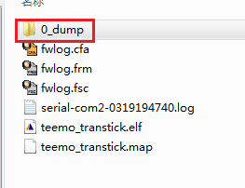
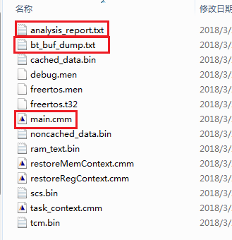
Usage
After parse finish, parse result locate at x_dump folder
Analysis report
TX/RX buffer and control block detail info
Use trace32 sim to analysis

Slide 8
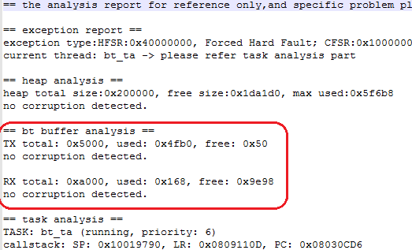
Usage
Add Tx/Rx buffer checker in analysis report

Slide 9
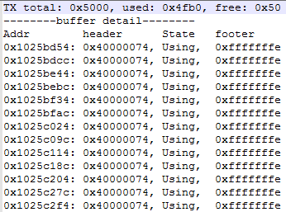
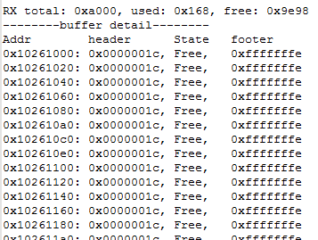
Usage
Add TX/RX buffer detail info

Slide 10
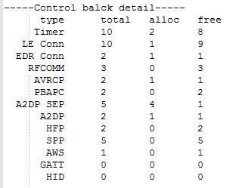
Usage
Add control block usage

Slide 11
appendix

Slide 12
Trace32 download
http://www.lauterbach.com/cgi-bin/download.pl?file=simarm.zip

