Slide 1
Threads synchronization
Thread basic
Thread mutex locking
Thread advance locking and condition variables
Hanoi, November 2018

Slide 2
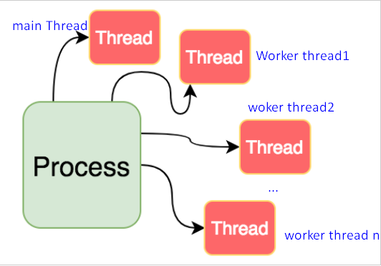
Threads
A thread is a path of execution within a process. A process can contain multiple threads.
Threads allow parallel execution of processes or distinct parts of a single process.
All threads within a process share:
The same address space
Process instructions
Most data
Open files (descriptors)
Signals and signal handlers
Current working directory
User and group id
Notes:
Why need thread
Thread in console & GUI
Cross thread

Slide 3
Threads
Each thread has a unique:
Thread ID (tid)
Set of registers, stack pointer
Stack for local variables, return addresses
Signal mask
Priority
Return value: errno
Basic thread operations:
Creation
Termination
Join
Detach
Swap
Notes:
Identify the function was called in which thread
ps –aux
ps -T -p 97947

Slide 4
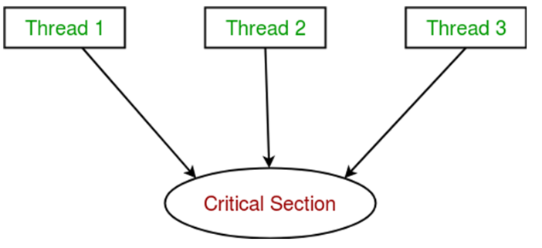
Problems
In the general case, you often use shared objects between the threads. And when you do it, you will face another problem: synchronization.
Solution: provide functions that will block one thread if another thread is trying to access data that it is currently using.
There are several ways to fix this problem:
Mutex
Condition variable
Semaphores
Future
…
Notes:
Nhất quán
crash

Slide 5
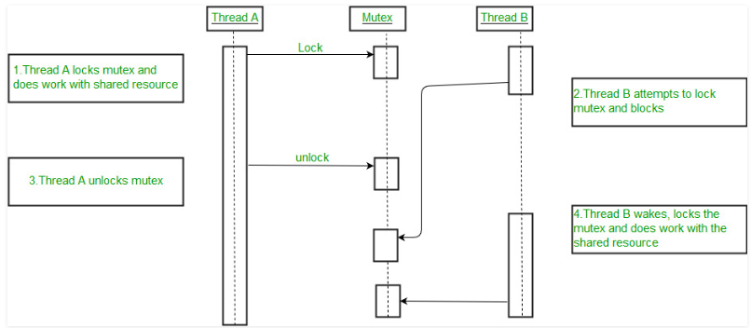
Use a mutex to make a thread-safe
There are two important methods on a mutex: lock() and unlock(). As their names indicate, the first one enable a thread to obtain the lock and the second releases the lock. The lock() method is blocking. The thread will only return from the lock() method when the lock has been obtained.
Notes:
Intent shared resource

Slide 6
Automatic management of locks
It exists a good solution to avoid forgetting to release the lock: std::lock_guard.
This class is a simple smart manager for a lock. When the std::lock_guard is created, it automatically calls lock() on the mutex. When the guard gets destructed, it also releases the lock.

Slide 7
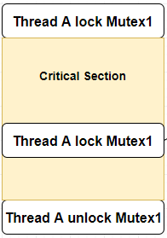
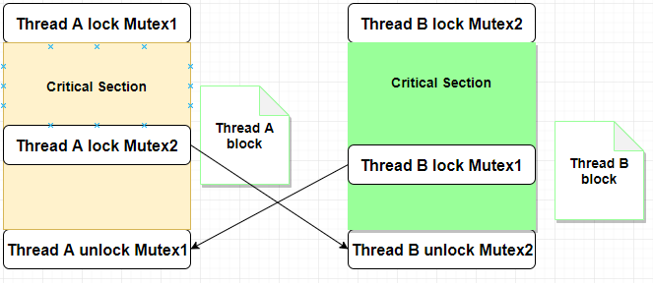
Dead lock - Recursive locking
The threads tries to acquire the lock again, but the lock is already locked. This is a case of deadlock. By default, a thread cannot acquire the same mutex twice.
Notes:
Try_lock

Slide 8
Timed locking
Sometimes, you doesn't want a thread to wait ad infinitum for a mutex. For example, if your thread can do something else when waiting for the thread.
the standard library has a solution: std::timed_mutex and std::recursive_timed_mutex
You have access to the same functions as a std::mutex: lock() and unlock(), but you have also two new functions: try_lock_for() and try_lock_until().

Slide 9
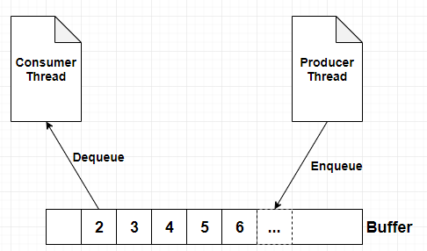
Condition variable
A condition variable is an object able to block the calling thread until notified to resume.
Producer & Consumer problem
Notes:
Signaling
Intent sync procedures

Slide 10
Thank you!

Slide 11
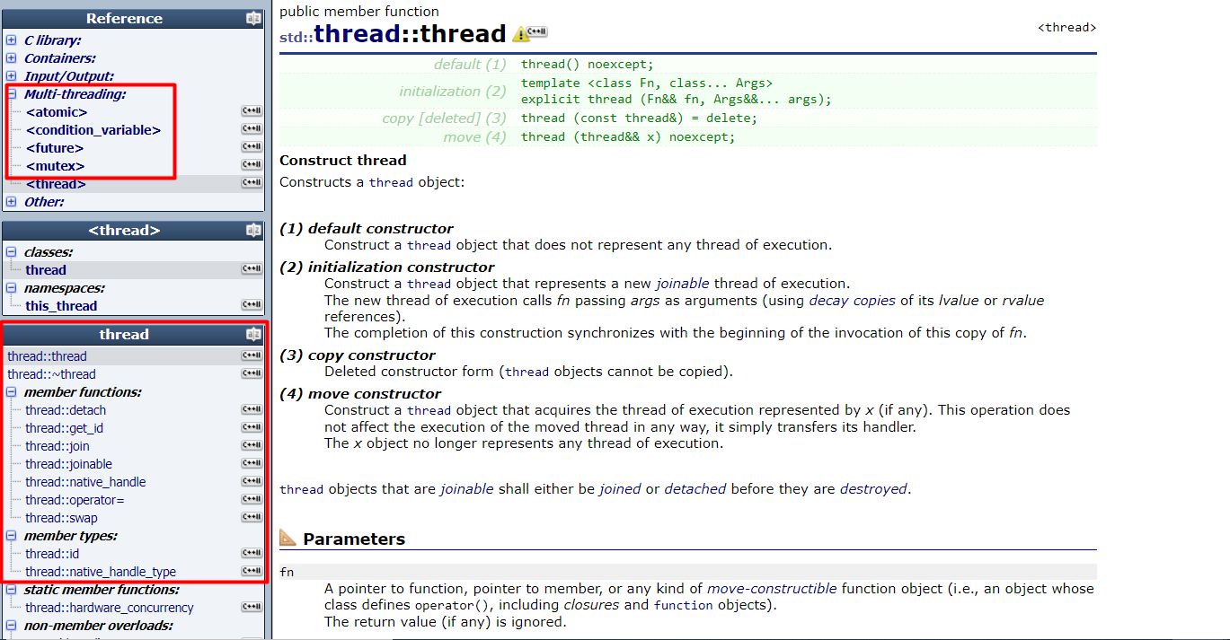
Appendix
http://www.cplusplus.com/reference/thread/thread/thread/

