Slide 1

Exploratory Data Analysis
G2M insight for Cab Investment firm
March 21th, 2025

Slide 2
Agenda
Executive Summary
Approach
EDA
EDA Summary
Recommendations

Slide 3
Executive Summary
XYZ is a private firm in the US who wants to join the Cab Industry seeing its immense growth in the past few years.
Objective: Provide actionable insights to help XYZ identify the right company to invest in.
Datasets:
- Cab_Data.csv – Transaction for 2 cab companies
- Customer_ID.csv - Indentifiers linking the customer’s demographic details
- Transaction_ID.csv – Mapping transaction to customer and payment method
- City.csv – List of US cities, their population and number of cab users

Slide 4
Approach
Deduplication and Validation:
Duplicates will be identified and removed based on Transaction ID and Customer ID.
Columns with missing values will be removed.
Outliers in Price_Charged and Cost_of_Trip will be flagged for further reviewed.
Assumptions:
Profit is calculated only using Priced_Charged and Cost_of_Trip to calculate profit.
Because there is no data on trip duration, we cannot pinpoint outliers in the Price_Charged feature.

Slide 5
Approach
Observe the Total Profit & Total Rides
Stratified profit analysis of both company (Yellow Cab and Pink Cab) explaining the difference in profit based on the following criteria:
- Customer Reach
- Customer Retention Rate
- Seasonality
- Custome demographics (Age and Income)

Slide 6
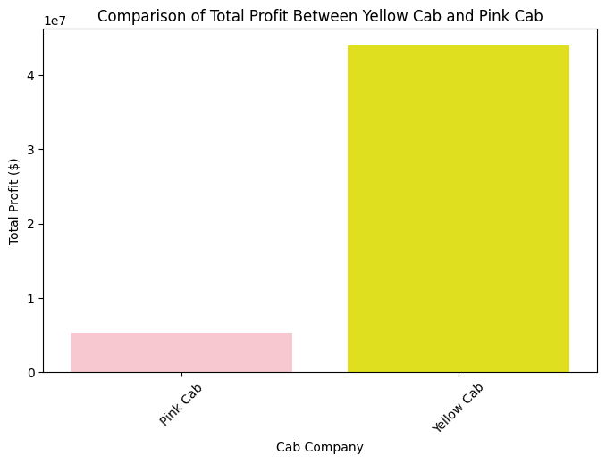
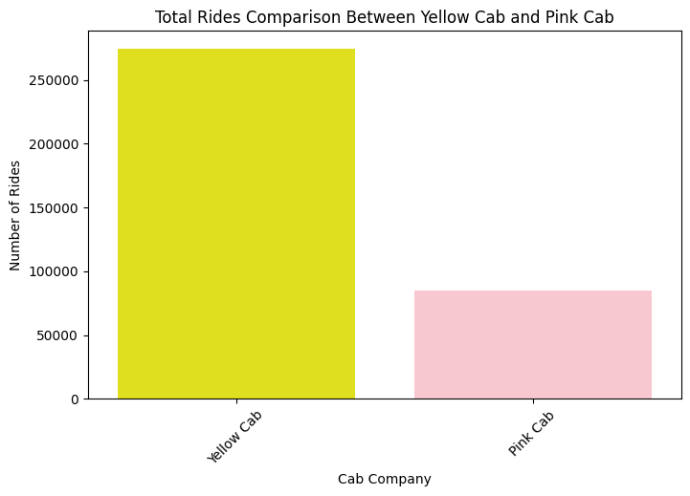
Total Profit and Total Rides
The Yellow Cab company is superior in both Total Profit generated in recent years and the Total number of Rides they have gotten.
However, this begs the question, would Yellow Cab continue to be a good choice for our firm XYZ to invest in in the future.
We have to understand what makes the difference between Yellow Cab and Pink Cab (pure fluke or business strategy)

Slide 7
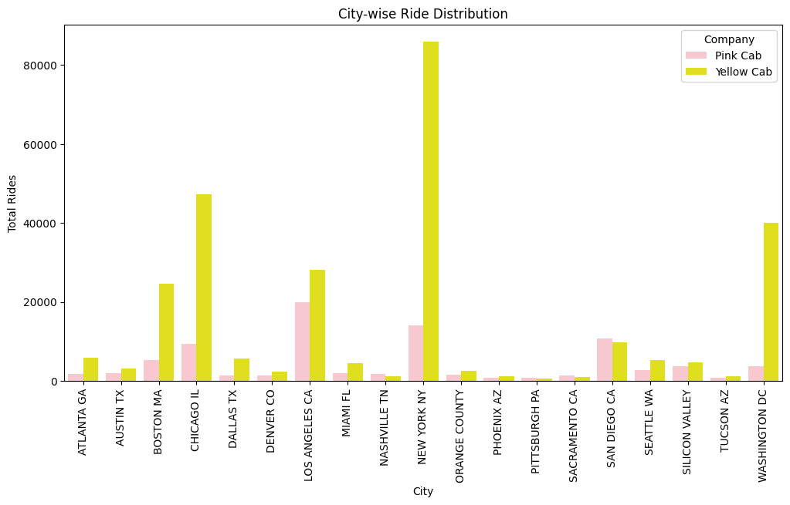
Stratified profit analysis of Customer Reach
Though both firms are present in most cities in the dataset, Yellow Cab company dominates most of the city in the total number of rides, especially busy cities like Boston, Chicago, New York and Washington DC.
This means that Yellow Cab does a better job at bringing in customers to use their services than Pink Cab.

Slide 8
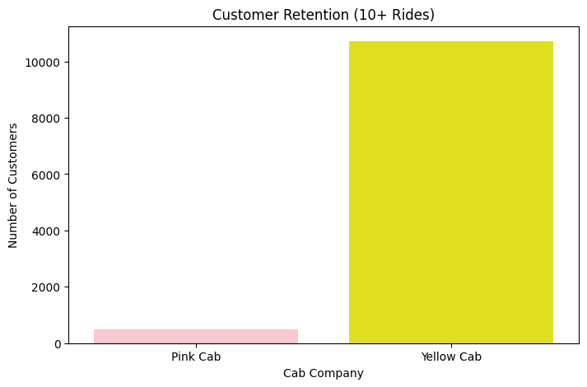
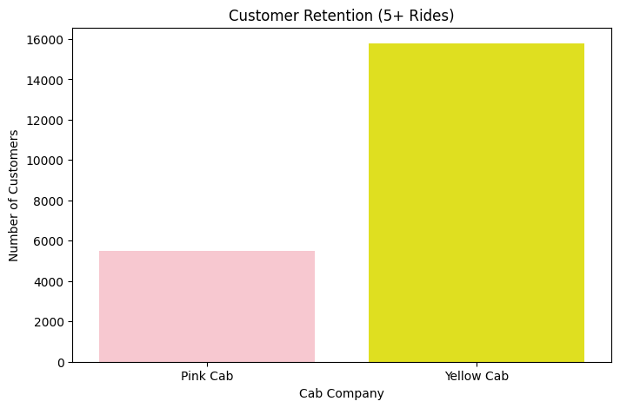
Stratified profit analysis of Customer Retention Rate
Yellow Cab is better at retaining customers compared to Pink Cab.
The number of customers who have had 5 or more rides with Yellow Cabs (15780) is 3 times the number of the same type of customers for Pink Cab (5515).
The number of customers who have had 10 or more rides with Yellow Cab is still above the 10 thousand customers, while Pink Cab's count has already dropped bellow 500 customers.

Slide 9
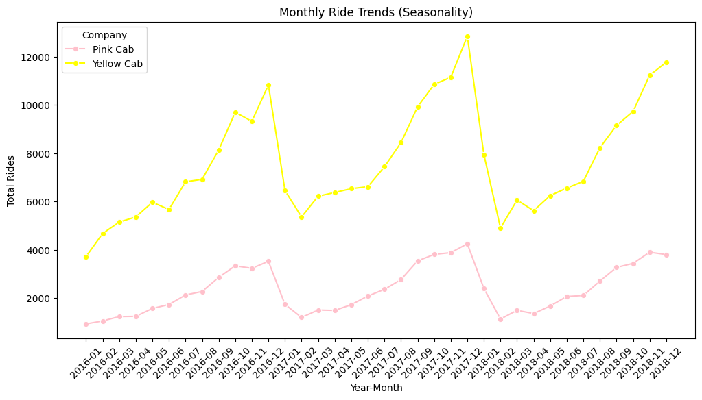
Stratified profit analysis of Seasonality
Both companies have the same patterns - peaks at the end of each year and dips at the beginning of each years.
However, Yellow Cab has a higher overall rides at every time periods when compared to Pink Cab.
In conclusion, there are seasonality in the trend of rides that equally impacts both company, but overall, Yellow Cab is better at keeping their count of customers higher than Pink Cab.

Slide 10
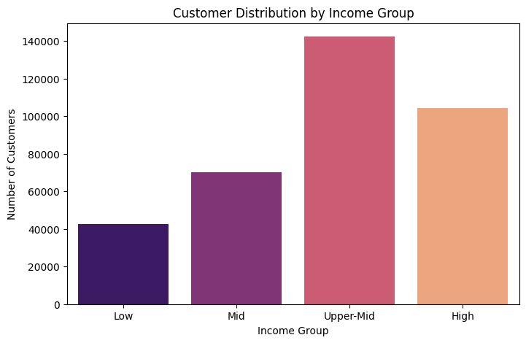
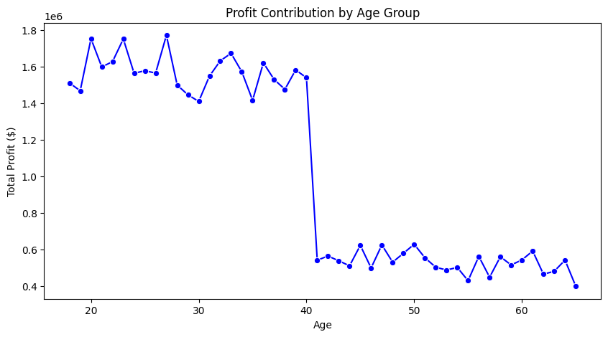
Stratified profit analysis of Customers’ Demographic
It seems like customers in the age group 18-40 contribute most to the profit of both firms.
It is possible that Yellow Cab does a better at appealing to this age group compared to Pink Cab (advertisement, deals, price), resulting in being more profitable.
Customers in upper-mid class income contribute most to the profit of both firms.
Similarly, it is possible that Yellow Cab's business strategy does a better job at appealing to this income group compared to Pink Cab.

Slide 11
Recommendations
Based on the performance of both firms' customers base and financial performance, Yellow Cab is the better investment choice for our XYZ company.
Not only does Yellow Cab has higher profit, it seems to have a better strategy targeting the groups age 18-40 and income group Upper-Mid, gaining more profit.
-> XYZ should invest in Yellow Cab because it has both the better immediate profit and growth potential when compared to Pink Cab.

Slide 12
Thank You

