Slide 1
FINAL THESIS RESEARCH TOPIC: “Covid-19 Reporting Using Azure Data Factory For Data Engineer”
SCHOOL OF ELECTRICAL AND ELECTRONIC ENGINEERING
Student: Cong Kien Duong - 20182614
Instructor: Assoc. Prof. Manh Thang Hoang
HA NOI – 8/2021

Slide 2
Outline
Problem statement
Solution architecture
Implementation
Results and discussion
Conclusion and orientation

Slide 3
Problem statement
1

Slide 4
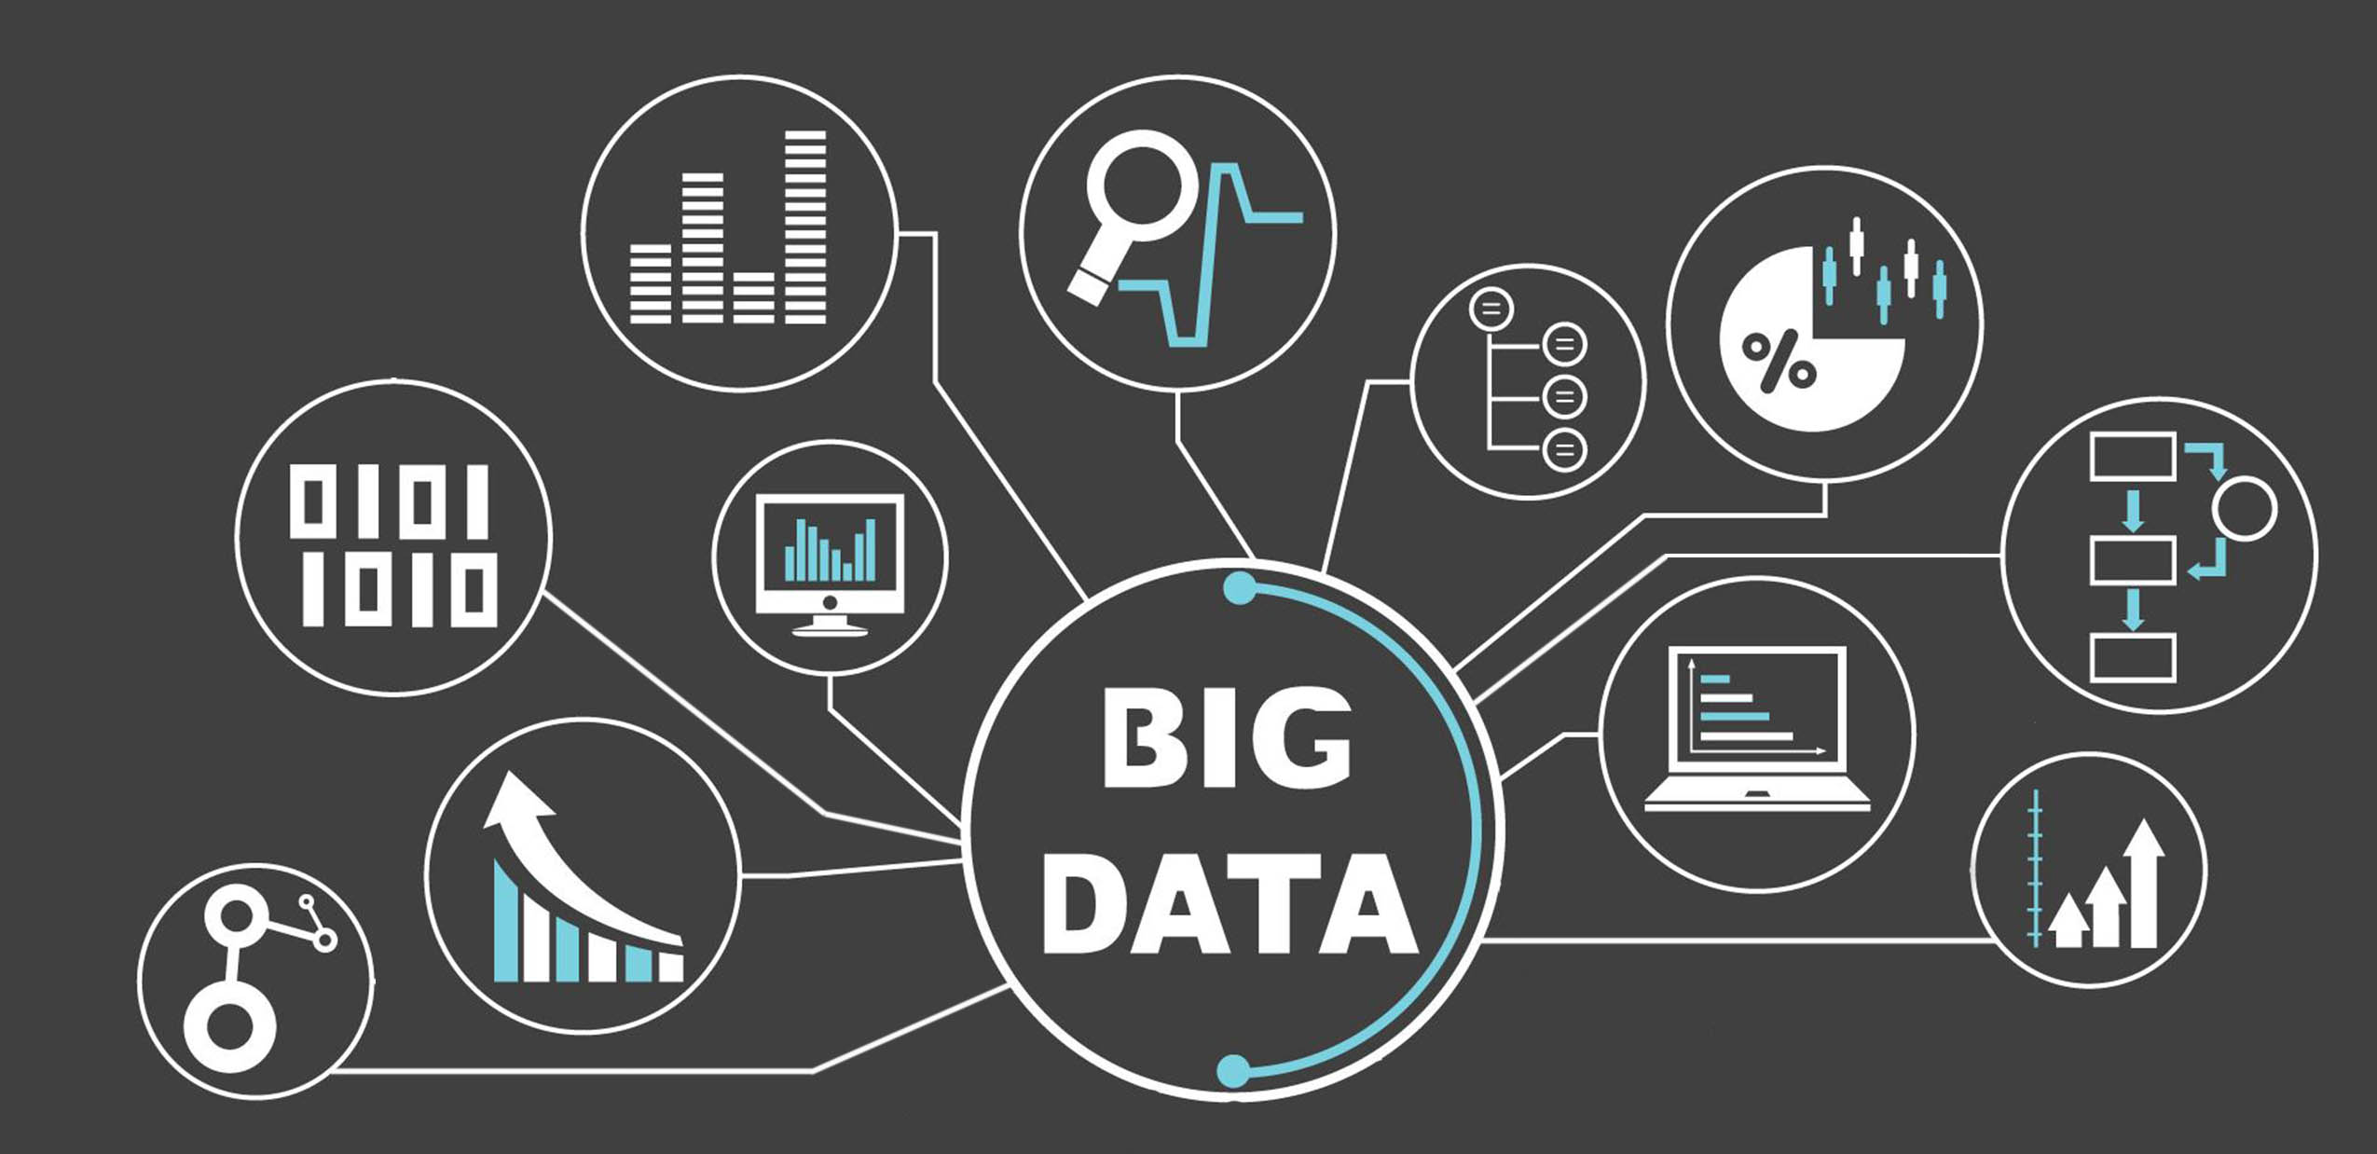








1. Problem statement
Big Data Problem
Volume
Variety
Velocity
Veracity
Value
Problem:
Industry 4.0
Digitalization
Data Explosion

Slide 5



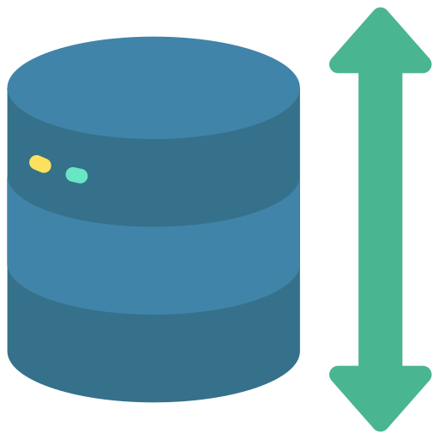



1. Problem statement
Trend Of Using Cloud Computing
Speed
Cost
Scalable
Dev-Ops
Security
Organizations/Individuals are increasingly interested in cloud computing

Slide 6
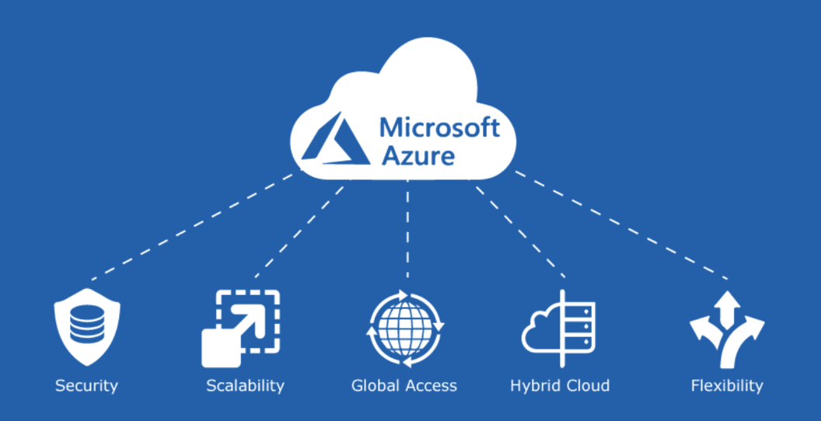







1. Problem statement
Oriented Research
Azure Storage Solutions
Azure SQL Database
Azure Blob Storage
Azure Data Lake Storage Gen 2
Azure Bigdata Solutions
Azure Databricks
Azure HDInsight
Azure Data Factory (ADF)
Visualization Tool
Microsoft Power BI

Slide 7
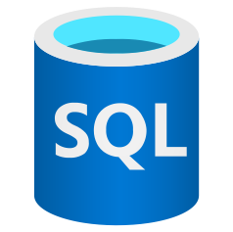


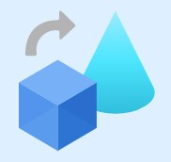







1. Problem statement
Oriented Research
Database
Data Sources
Data Transformation
Data Lake
Data Integration/ Transformation/ Management

Slide 8
Solution Architecture
2

Slide 9
2. Solution Architecture
Block diagram
Ingestion
Transformation
Copy
Visualization
3.Data Flow (1)
1.Ingestion - Blob
4.Data Flow (2)
5.Data Prep
8.Copy to SQL
9.Power BI
2.Ingestion - HTTP
6.HDInsight
7.Databricks
Management
10.Orchestration
11.Monitoring

Slide 10






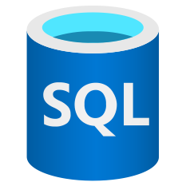




2. Solution Architecture
Transformation
ECDC COVD-19
data (HTTP Connector)
Ingestion
Transform/ Analyze
Publish
Ingest
Azure Data Lake Storage Gen2
Azure SQL Database
Population Data (Azure Blob Storage)
Azure Data Lake Storage Gen2
ML Models

Slide 11
Implementation
3

Slide 12
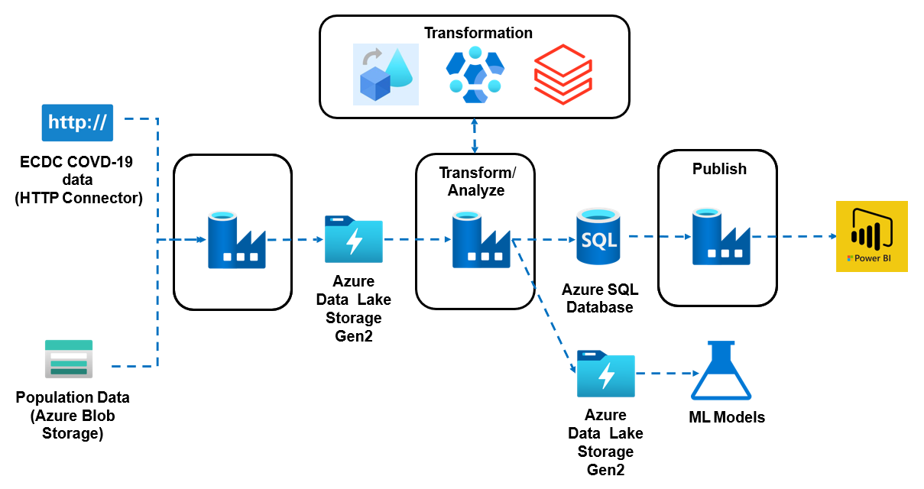
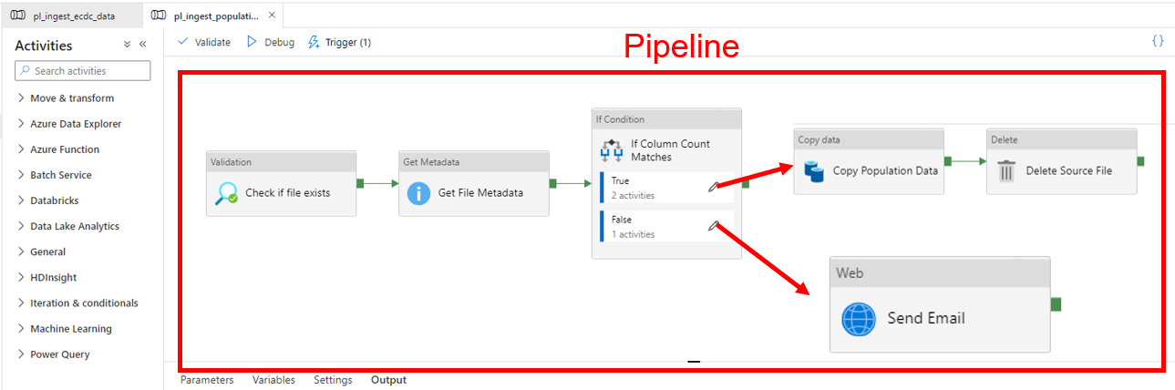
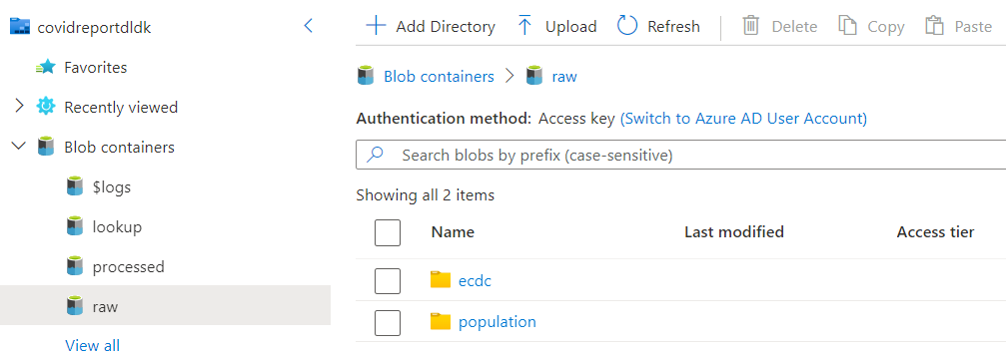
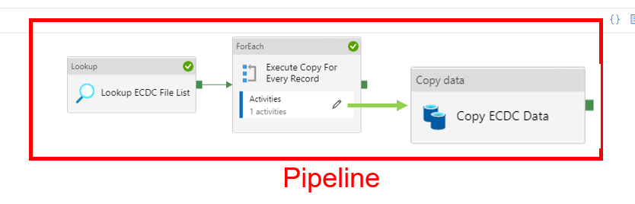
3.1. Data Ingestion
Ingest population data
Result
Ingest ECDC data

Slide 13
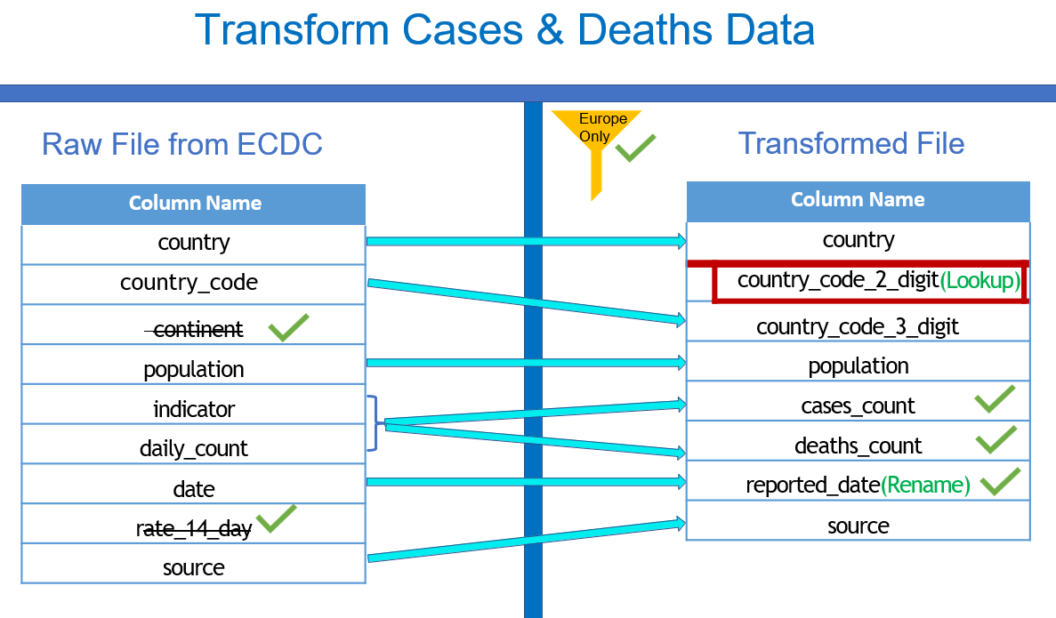
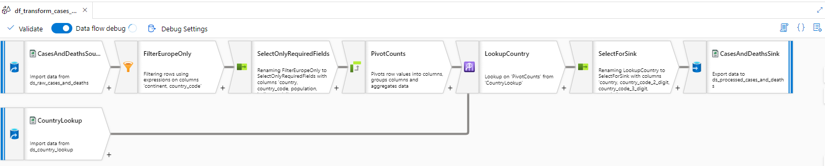
3.2. Data Transformation
Data Flow (1) – Cases & Deaths file
Select
Lookup
Pivot
Sink
Conditional Split
Derived Column
Aggregate
Sort
Join
Take some actions to transform the data
Create Pipeline

Slide 14
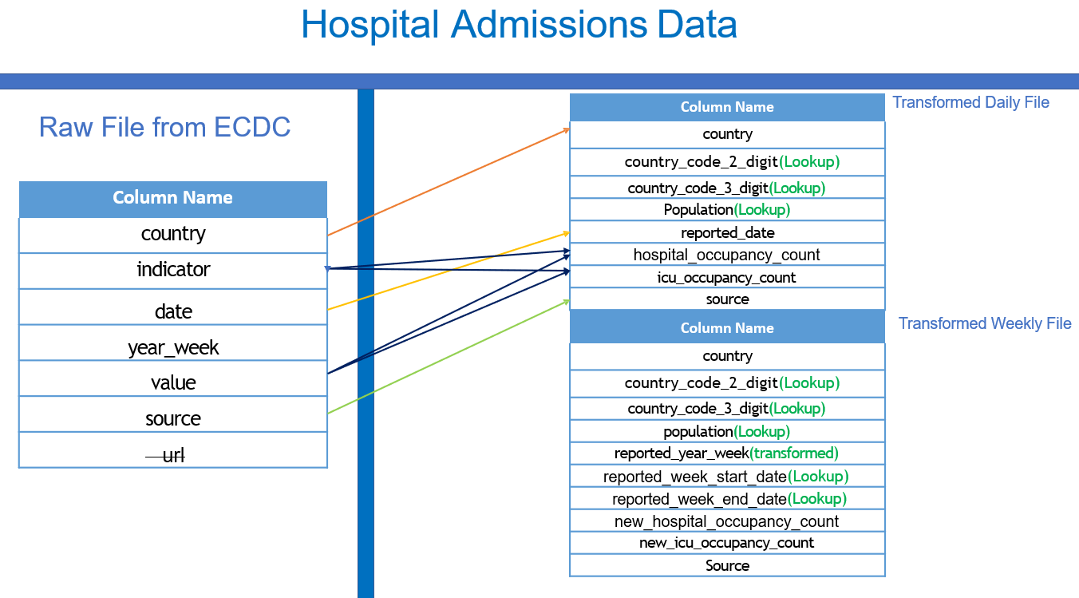
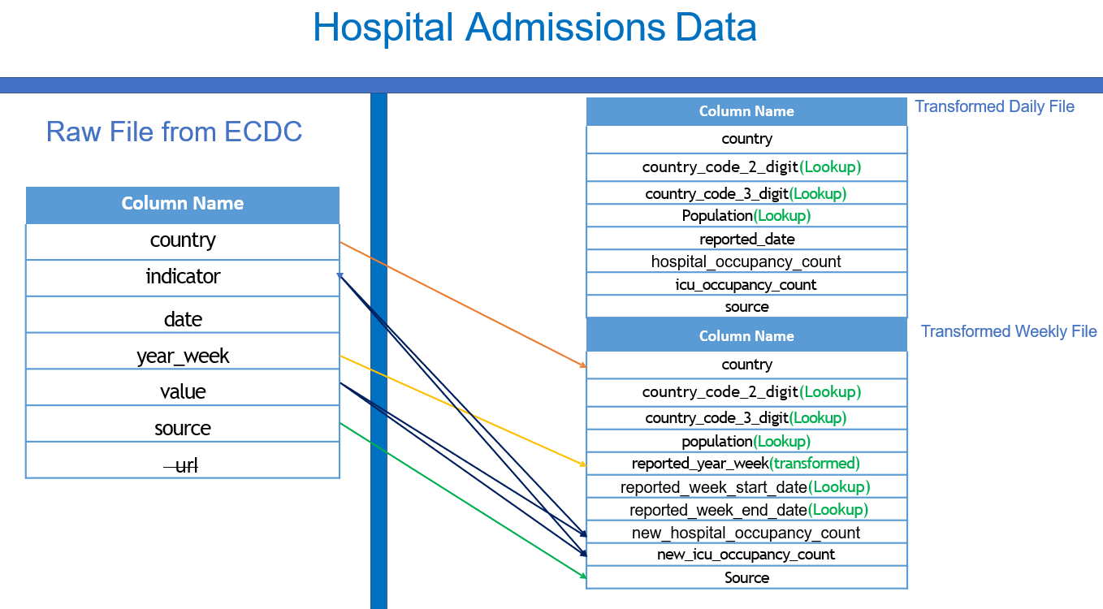
3.2. Data Transformation
Data Flow (2) – Hospital Admissions file
Transform Hospital Admissions File by Daily and Weekly

Slide 15
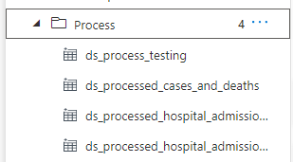
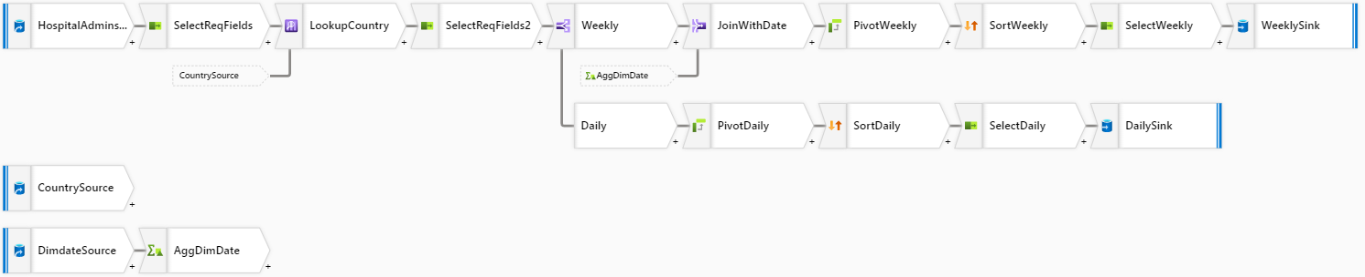
3.2. Data Transformation
Data Flow (2) – Hospotal Admissions file
Result of DF1 & DF2
4 Datasets
Pipeline

Slide 16
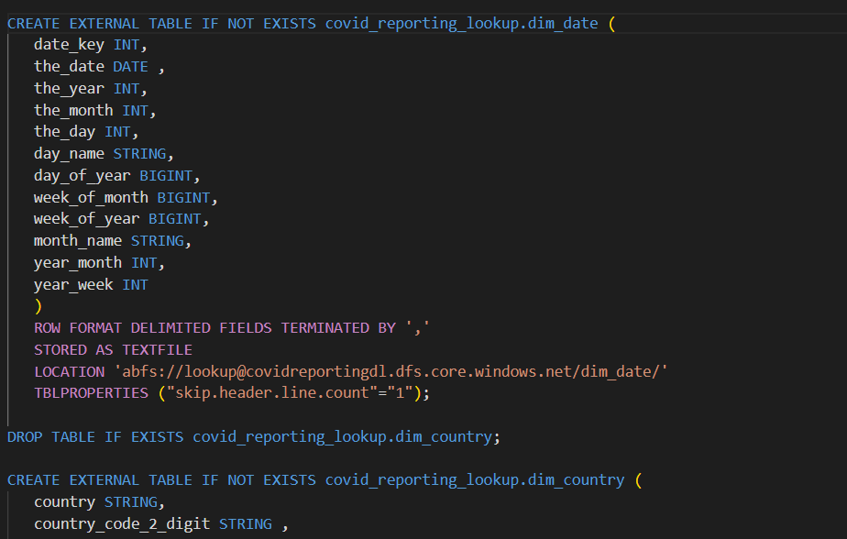
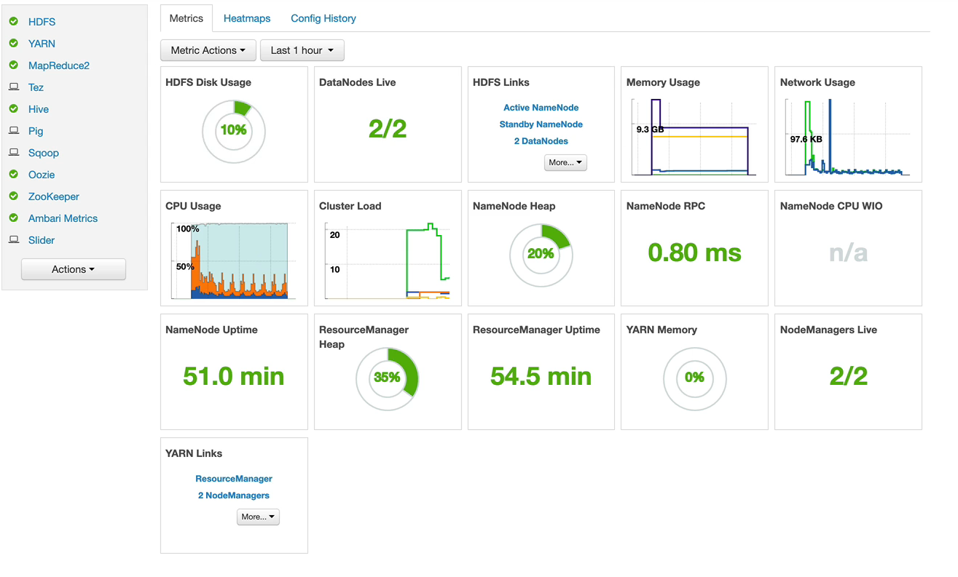
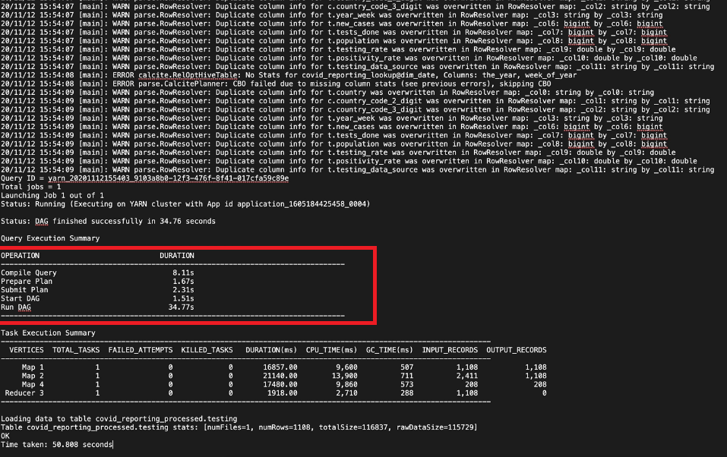
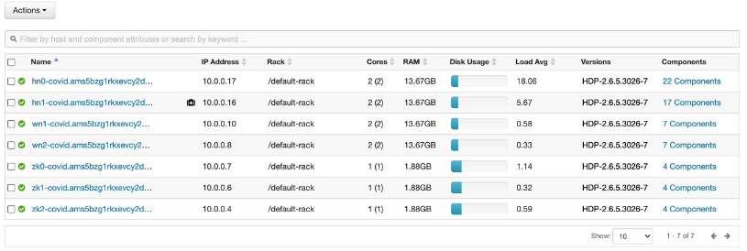
3.2. Data Transformation
HD Insight – Transform Testing Data
Create HDInsight Cluster
HD Insight UI
Transformation Requirement
Hive Script - hql
Create Pipeline

Slide 17
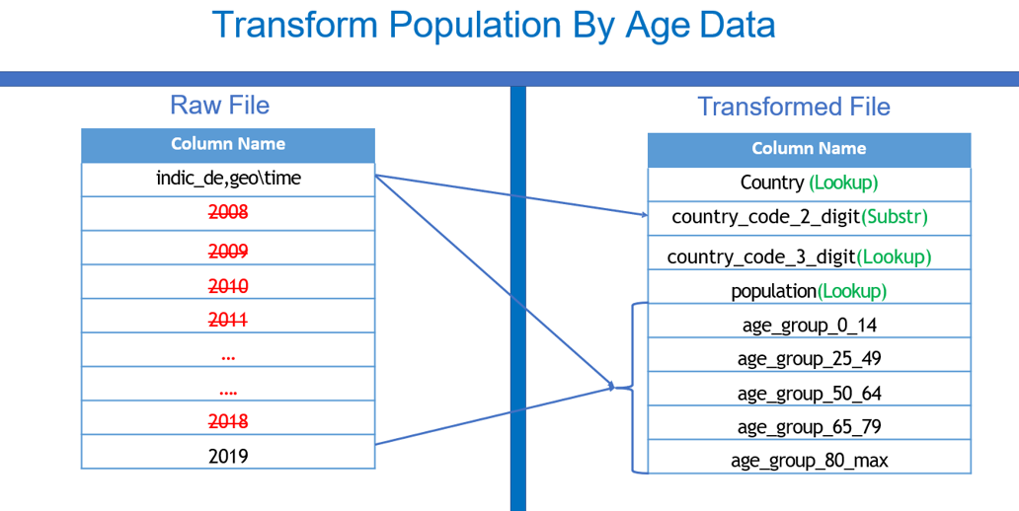
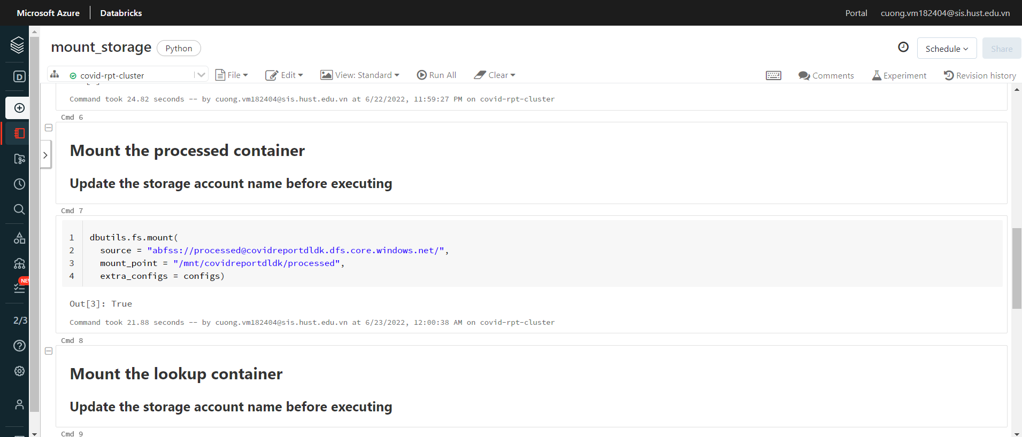
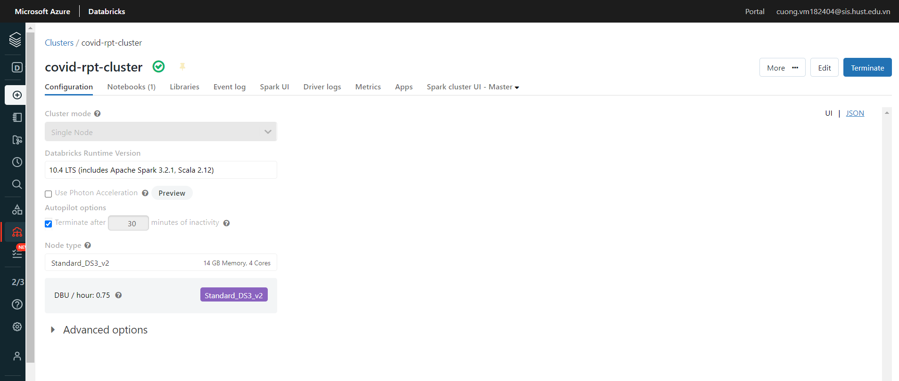
3.2. Data Transformation
Databricks – Transform Population Data
Create Databricks Service
Create Databricks Cluster
Mount Storage Accounts
Transformation Requirement
Create Pipeline

Slide 18
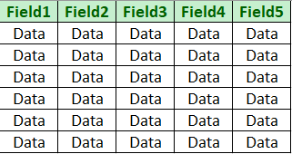
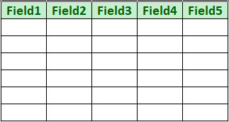
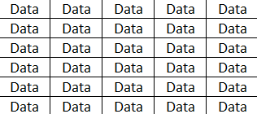
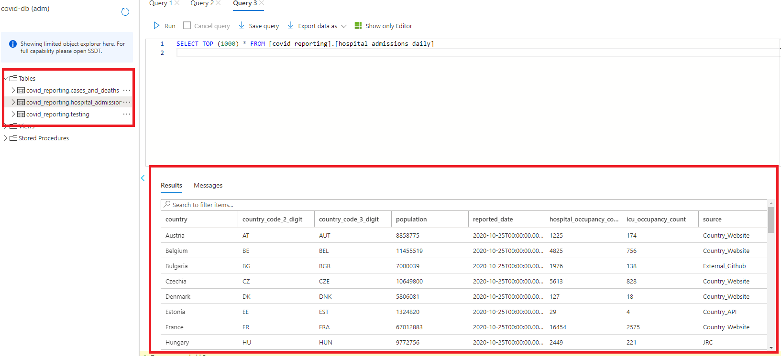
3.2. Data Transformation
Copy Data To SQL Database
Datalake Storage Gen 2
SQL Database
Copy Data
Result

Slide 19
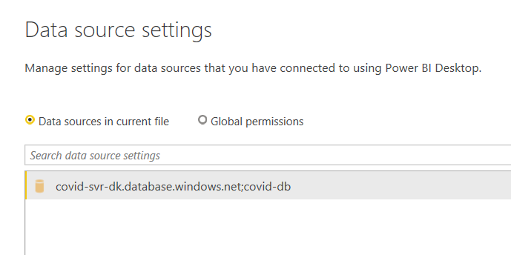
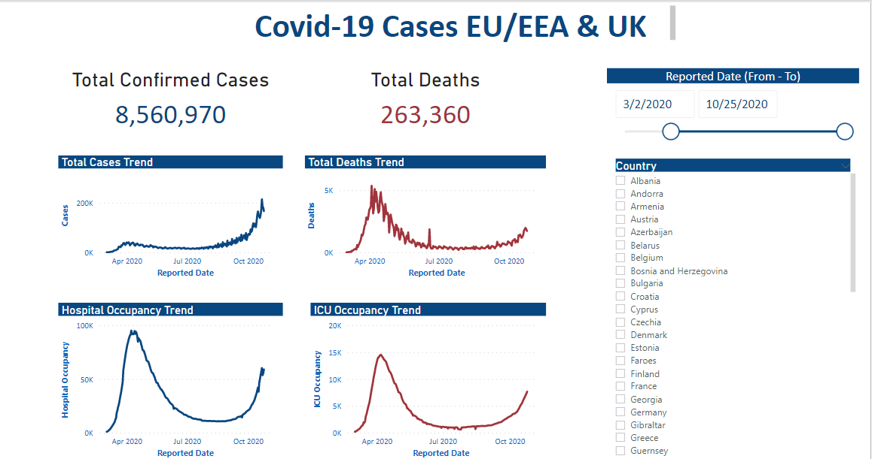
3.2. Data Transformation
Visualization Data With Power BI
Connect to SQL Database
Create Charts, Graphs,… to visualize data

Slide 20
Result
4

Slide 21
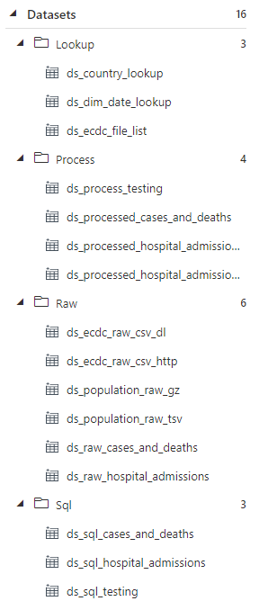
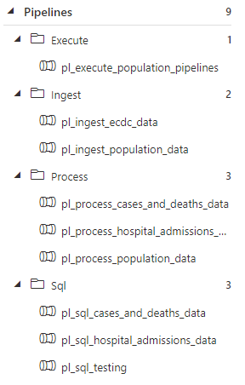
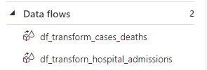
4. Result
Result on Azure Data Fatory
Data Flows
Data Pipelines
Datasets: Raw; Process; Lookup; Sql

Slide 22
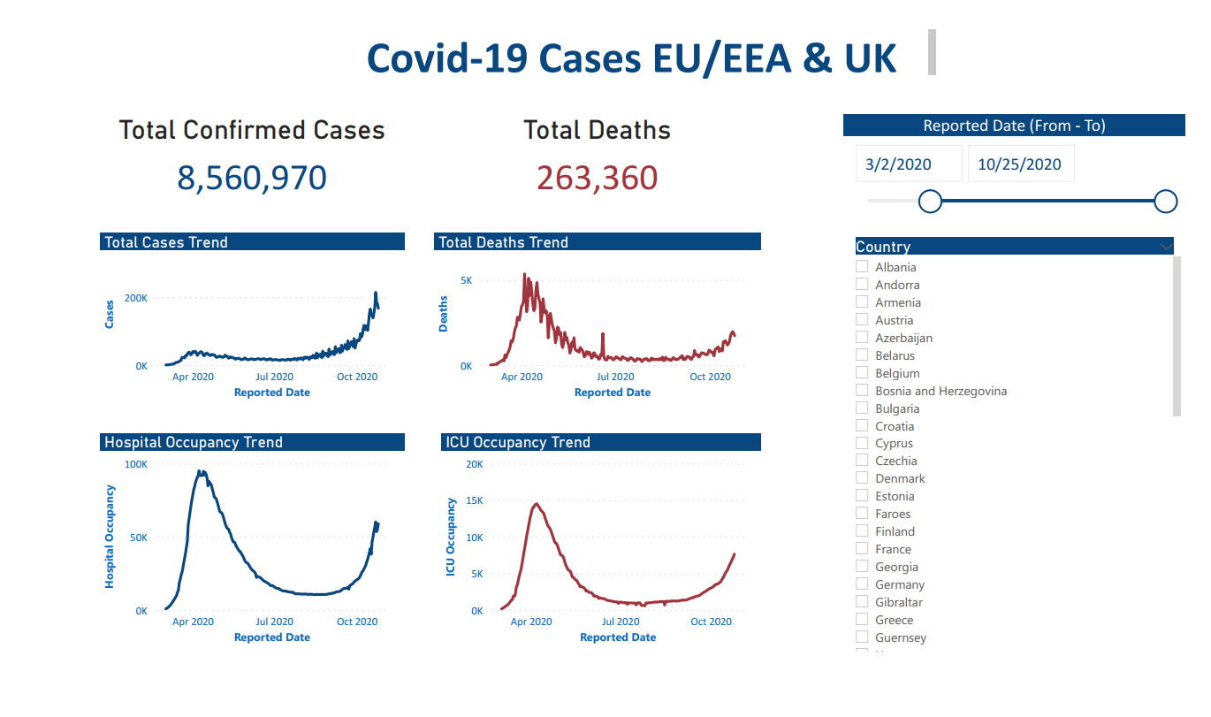
4. Result
Visualize Data

Slide 23
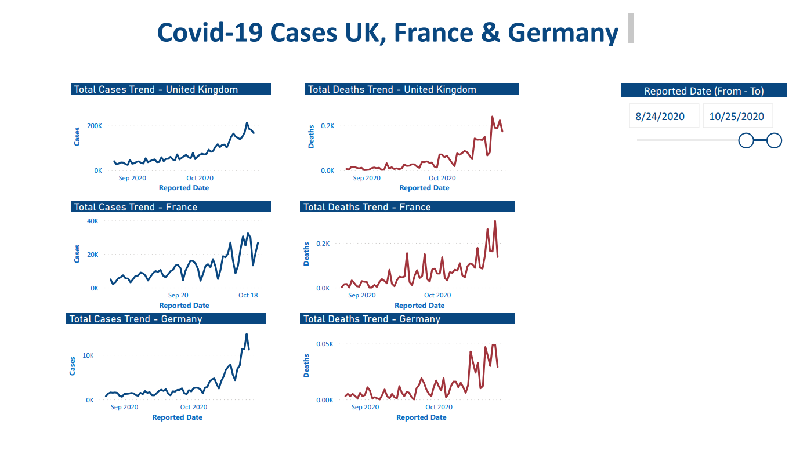
4. Result
Visualize Data

Slide 24
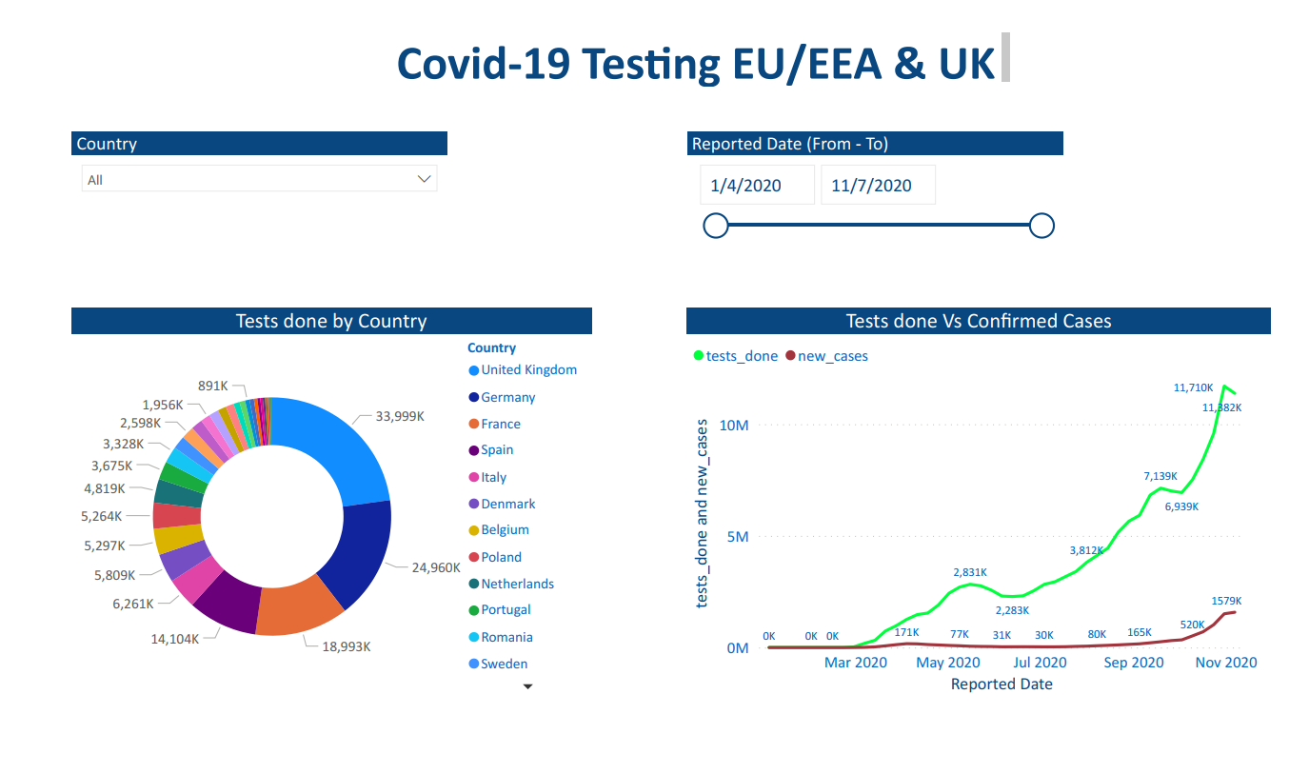
4. Result
Visualize Data

Slide 25
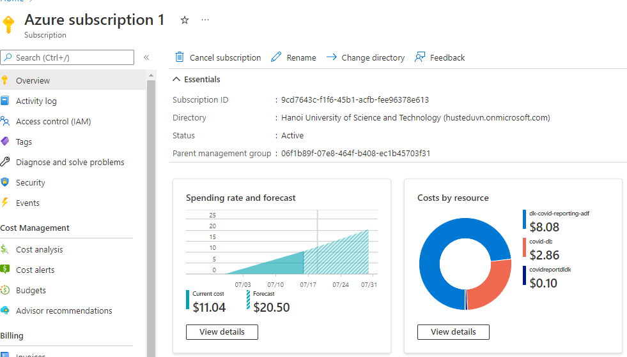
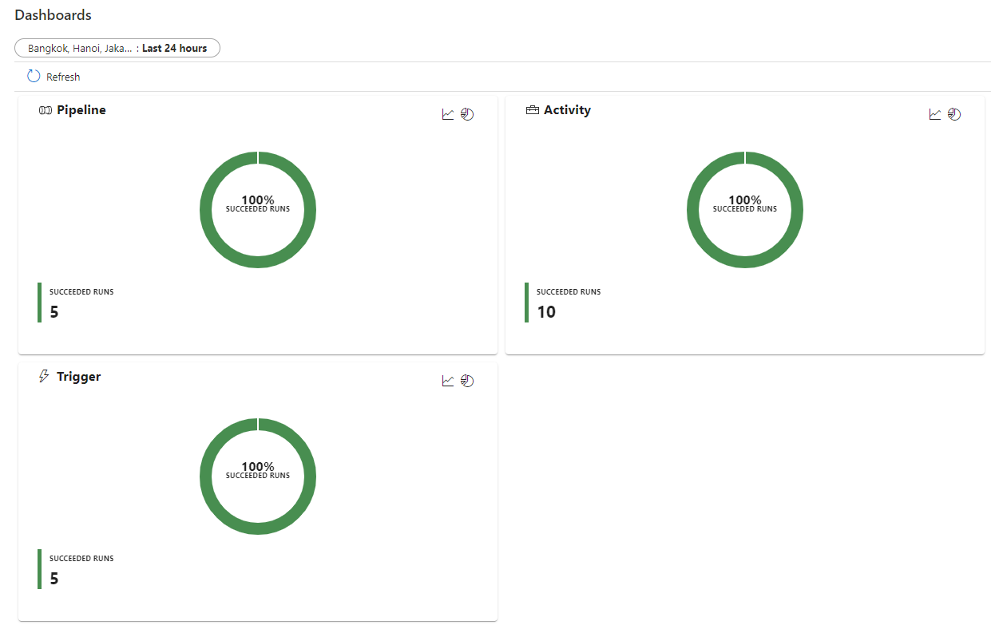
4. Result
Monitor
Account management
Azure Data Factory management

Slide 26
Conclusion & Orientation
5

Slide 27
5. Conclusion and orientation for master course
Conclusion
Completed:
Ingest, transform, visualize data
Understand and practice with Cloud service Microsoft Azure
Comment: Advantages of using Azure
Optimal
Save
Easy to use

Slide 28
5. Conclusion and orientation for master course
Orientation for master course
Upgrade with larger datasets
Use more technical for Big Data with cloud service
Build Machine Learning – AI Model with output data

Slide 29
References
[1] | Microsoft. (2019). Azure Data Factory: Data Ingtegration in the Cloud [Online]. Available: https://azure.microsoft.com/mediahandler/files/resourcefiles/azure-data-factory-data-integration-in-the-cloud/Azure_Data_Factory_Data_Integration_in_the_Cloud.pdf.
[2] | Y. Xu, S. G. Suguiyama and L. Lovosevic. (2018). Data Migration from on-premise relational Data Warehouse to Azure using Azure Data Factory [Online]. Available: https://azure.microsoft.com/mediahandler/files/resourcefiles/data-migration-from-on-premise-relational-data-warehouse-to-azure-data-lake-using-azure-data-factory/Data_migration_from_on-prem_RDW_to_ADLS_using_ADF.pdf. [Accessed 5 July 2022].
[3] | B. John and I. BA. (2019). Azure Data Factory With Azure DevOps [Online]. Available: https://azure.microsoft.com/mediahandler/files/resourcefiles/whitepaper-adf-on-azuredevops/Azure%20data%20Factory-Whitepaper-DevOps.pdf. [Accessed 5 July 2022].
[4] | B. John, I. BA, Y. Xu and Gaurav. (2019). Azure Data Factory-Passing Parameters [Online]. Available: https://azure.microsoft.com/mediahandler/files/resourcefiles/azure-data-factory-passing-parameters/Azure%20data%20Factory-Whitepaper-PassingParameters.pdf. [Accessed 5 July 2022].
[5] | S. Winarko, M. Kromer and Microsoft. (2018). Azure Data Factory: SSIS in the Cloud [Online]. Available: https://azure.microsoft.com/mediahandler/files/resourcefiles/azure-data-factory-ssis-in-the-cloud/Azure_Data_Factory_SSIS_in_the_Cloud.pdf. [Accessed 5 July 2022].
[6] | Microsoft. "Introduction to Azure Blob storage," [Online]. Available: https://docs.microsoft.com/en-us/azure/storage/blobs/storage-blobs-introduction. [Accessed 7 2022].
[7] | Microsoft, "Azure Data Lake Storage Gen 2 Introduction," [Online]. Available: https://docs.microsoft.com/en-us/azure/storage/blobs/data-lake-storage-introduction. [Accessed 7 2022].
[8] | Microsoft, "What is the Azure SQL Databases service?," [Online]. Available: https://docs.microsoft.com/en-us/azure/azure-sql/database/sql-database-paas-overview?view=azuresql. [Accessed 7 2022].
[9] | Microsoft, "Azure Databricks documentation," [Online]. Available: https://docs.microsoft.com/en-us/azure/databricks/. [Accessed 7 2022].
[10] | Microsoft, "Azure HDInsight documentation," [Online]. Available: https://docs.microsoft.com/en-us/azure/hdinsight/. [Accessed 7 2022].
[11] | I. Bill, Data Lake Architecture - Designing the Data Lake and Avoiding the Garbage Dump. Technics Publications, 2016.

Slide 30
THANK
YOU
Contact: kien.dc182614@sis.hust.edu.vn

