Slide 1
tsimages and edit logs
Secondary
NameNode
NameNode
metadata
Merged tsimages file
Client
Block Ops
Block
Information
DataNode
DataNode
DataNode
HDFS

Slide 2
Map()
Reduce()
Input
Map()
Output
Reduce()
Map()
Map Tasks
Reduce Tasks
MapReduce

Slide 3
Node
Manager
Container
App Master
Client
Resource
Manager
Node
Manager
Client
App Master
Container
MapReduce Status
Node
Manager
Job Submission
Node Status
Resource Request
Container
Container
YARN

Slide 4
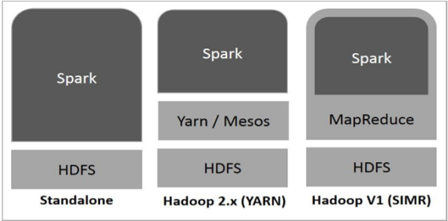
Mlib
(mechine
learning)
Spark
Streaming
GraphX
(graph)
Spark SQL
Apache Spark Core
Spark
Spark
Spark
SPARK
Yarn/Mesos
HDFS
HDFS
HDFS
Standalone
Hadoop 2.x (YARN)
Hadoop V1 (SIMR)

Slide 5













Transformation
ECDC COVD-19
data (HTTP Connector)
Ingest
Transform/ Analyze
Publish
Azure Data Lake Storage Gen2
Azure SQL Database
Population Data (Azure Blob Storage)
Azure Data Lake Storage Gen2
ML Models

Slide 6
Ingestion
Transformation
Copy
Visualization
3.Data Flow (1)
1.Ingestion - Blob
4.Data Flow (2)
5.Data Prep
8.Copy to SQL
9.Power BI
2.Ingestion - HTTP
6.HDInsight
7.Databricks
Management
10.Orchestration
11.Monitoring

Slide 7






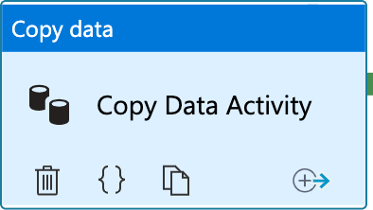



Pipeline
Sink
Source
1
Azure Blob Storage
Linked Service
Azure Data Lake
Source File (Zipped TSV)
2
4
Target File (TSV)
Source Data Set
Copy Activity
Sink Data Set
Storage Account: covidreportingsa Container: population
File: population_by_age.tsv.gz
Storage Account: covidreportingdl Container: raw
File: population/population_by_age.tsv

Slide 8


Pipeline
Source
Sink
1
HTTP
Linked Service
Linked Service
Azure Data Lake
Source File (CSV)
Source Data Set
Copy Activity
Sink Data Set
Target File (CSV)

