Slide 1
LED 失效模式分析 & 改善对策
TEMP
TEMP
人
机
法
环
现象
失效模式
改善策略

Slide 2
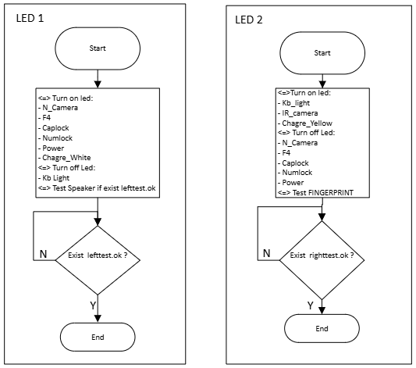
LED Testing Program Flowchart
The LED testing procedure includes two phases: LED 1 and LED 2.

