Slide 1
CZ1115 Mini project
Group 8
Benjamin Ong
Duong Ngoc Yen
Nipun Bhatia
U2021759D
U2020271G
U2023894L
Lab group: FSP3

Slide 2

Dataset:
The Movie DataBase

Slide 3
The Movie DataBase
Database split into 2 CSV files for different purposes.

Slide 4
Movies
Included important numerical statistics like budget, revenue, runtime, vote scores and vote counts.
Also includes genres of the movies and their summary.

Slide 5

2) Credits
More detailed information such as the cast members and production crew.

Slide 6
Defining our Problem
1
Using the dataset

Slide 7






Problem
Pre-elements
Elements before release
Post-elements
Elements after release
Rating
Can the producer predict the success of the movie before it is released? Does investing more money mean generating more revenue?
After releasing the film, with the response from viewers, will it help improve the prediction performance?
Notes:
When producing a movie, there are some factor that the producer can control, such as budget, casts of the movie, director, genres of the movie, etc. I call them pre-elements.
There are also other factors that are created after the movie is released, such as revenue, popularity, rating of the movie, etc. We call them post-elements. Among these post-elements, revenue is usually used to measure the success of the movie.

Slide 8
Data Preparation
2
Collection, Curation and Cleaning

Slide 9
Data Preparation
Checking for missing values: If there are NaN in the dataset, replace with some appropriate value (0 for numerical or ‘ ‘ for string)
Extract the information from json data columns:
Cast: Extract the number of cast
Crew: Extract the number of crew and director
Genres: Extract the number of genres, one-hot encoding the genres and create 20 new features. If the movie contains a genres A, then the value of column A and row of that movie will have value of 1

Slide 10
Data Preparation
Normalize the distribution of variables: The distribution of the variables are very skewed, we normalize by transform them into log scale.
Remove outliers of the model
We remove all the points that lie beyond 3 standard deviations by using the function zscore from scipy.stats.
We only keep the records that have score less than 3.

Slide 11
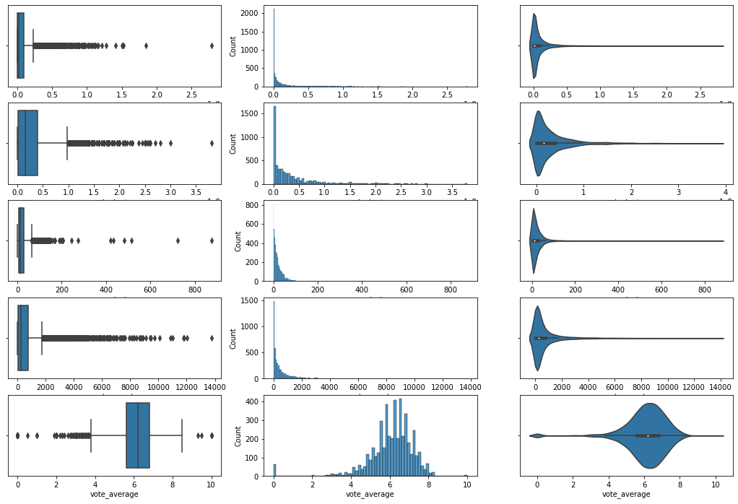
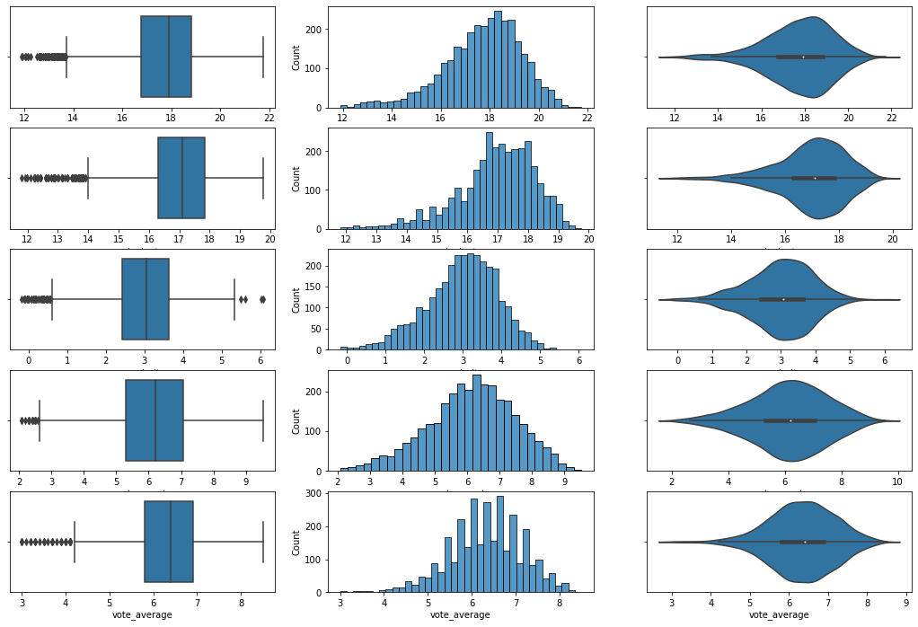
Data Preparation

Slide 12
Exploratory Data Analysis
3

Slide 14
Exploratory Data Analysis
 | budget | revenue | num_cast | num_crew | popularity | vote_count | vote_average
count | 3227.000000 | 3227.000000 | 3227.000000 | 3227.000000 | 3227.000000 | 3227.000000 | 3227.000000
mean | 16.801109 | 17.496274 | 26.038426 | 33.954447 | 2.895749 | 6.029678 | 6.313263
std | 1.665667 | 2.070263 | 21.485987 | 35.110234 | 1.100638 | 1.464709 | 0.859921
min | 0.000000 | 1.609438 | 0.000000 | 0.000000 | -3.912823 | 0.000000 | 2.300000
25% | 16.166886 | 16.651076 | 14.000000 | 12.000000 | 2.349078 | 5.181784 | 5.800000
50% | 17.034386 | 17.826442 | 19.000000 | 20.000000 | 3.016298 | 6.154858 | 6.300000
75% | 17.822844 | 18.801818 | 30.000000 | 44.000000 | 3.620220 | 7.045777 | 6.900000
max | 19.755682 | 21.748578 | 224.000000 | 435.000000 | 6.774888 | 9.528940 | 8.50000
Uni-variate
Basic Statistic

Slide 15
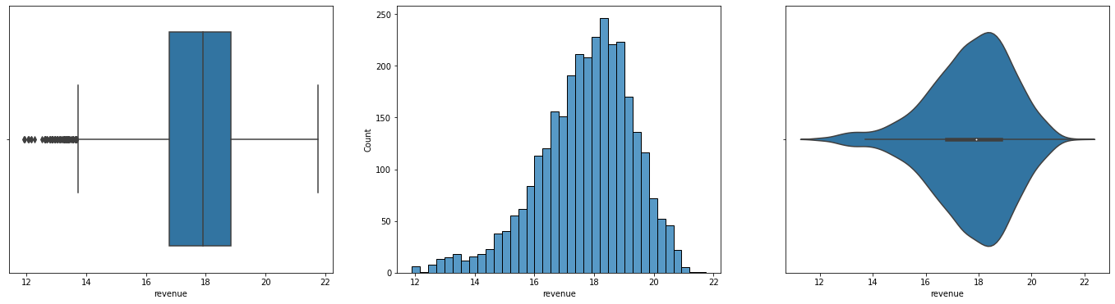
Exploratory Data Analysis
Uni-variate
Draw the distribution
Box plot, histogram plot and violin plot by using Seaborn

Slide 16
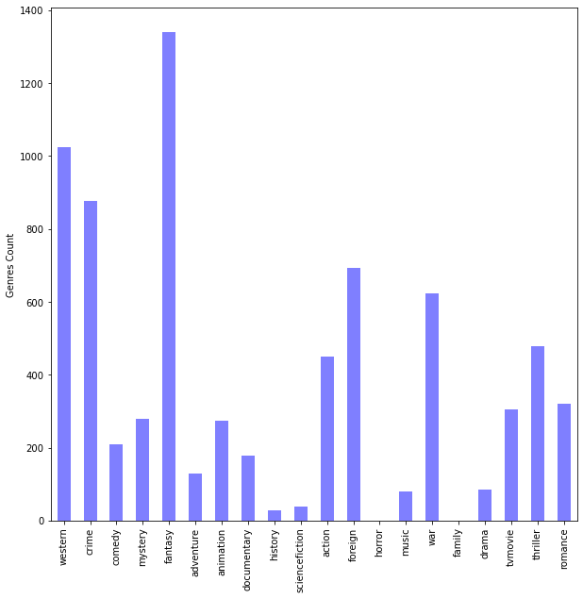
Exploratory Data Analysis
Uni-variate
Genres distribution
Fantasy, western, crime are the most popular genres

Slide 17
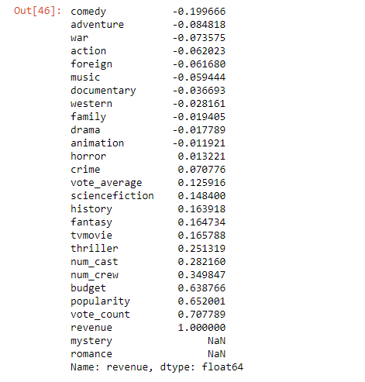
Exploratory Data Analysis
Multi-variate
Correlation to revenue

Slide 18
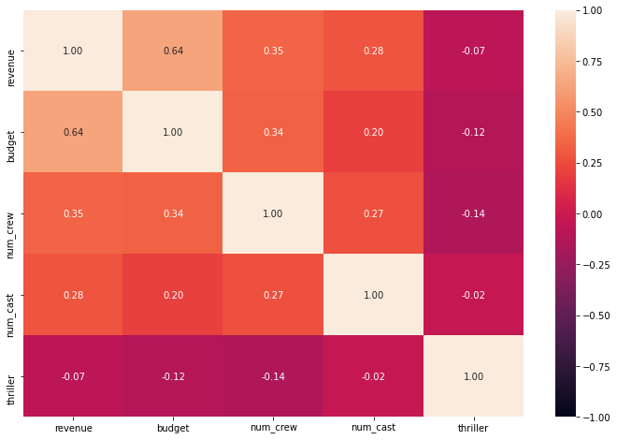
Exploratory Data Analysis
Multi-variate
Pre elements
Correlation heatmap of most correlated pre-ements:
budget, num_crew, num_cast, thriller vs revenue

Slide 19
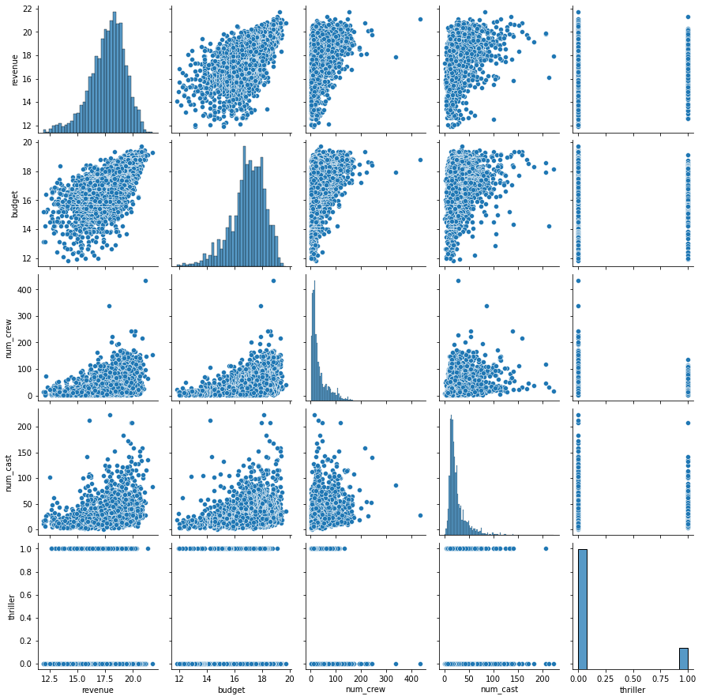
Exploratory Data Analysis
Multi-variate
Pre elements
Pair Plot

Slide 20
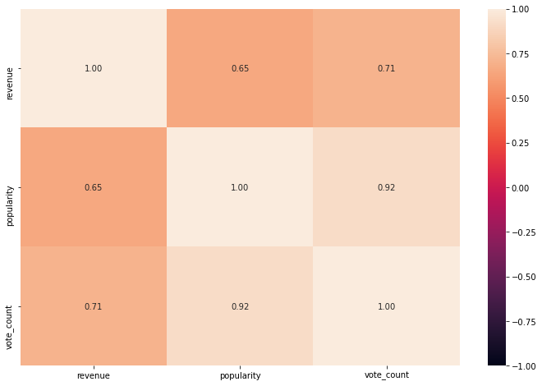
Exploratory Data Analysis
Multi-variate
Post Elements
Correlation heatmap of most correlated post-elements:
popularity, vote_count vs revenue

Slide 21
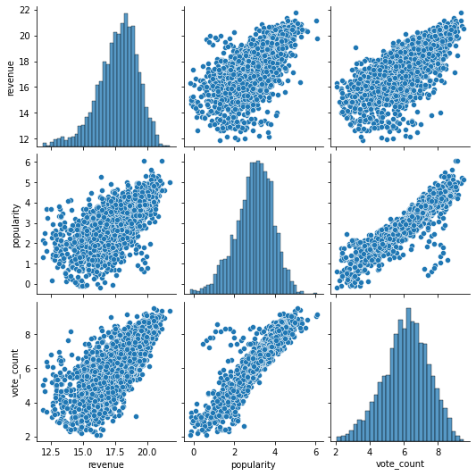
Exploratory Data Analysis
Multi-variate
Post Elements
Pair Plot

Slide 22
Machine learning model
4
Regression model

Slide 23
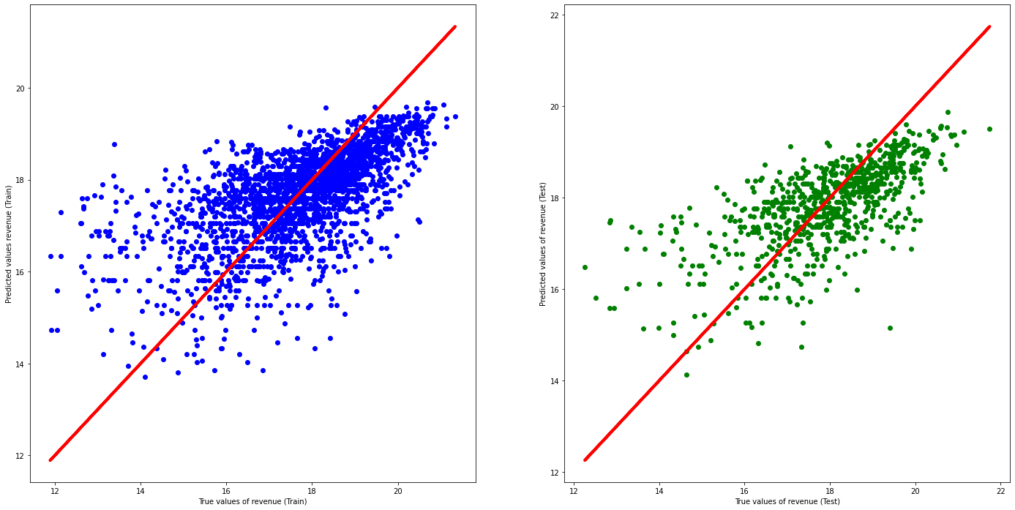
Model 1: Budget vs Revenue
Predictor feature: Budget
Response variable: Revenue
Framework: LinearRegression in Sklearn
Split the train and test data
Fit the train data to train model
Apply the model to the test set
Visualize the performance
Evaluate the model
Train set:
R^2 = 0.40
MSE = 1.53
Test set:
R^2 = 0.43
MSE = 1.31
Notes:
The budget is the money the producer give out, the revenue is the money they receive. Analyze the relationship between budget and revenue help answer the question “Does investing more money mean receiving more revenue”. If there is a relationship, what is the formular to calculate “money in” base on “money out”

Slide 24
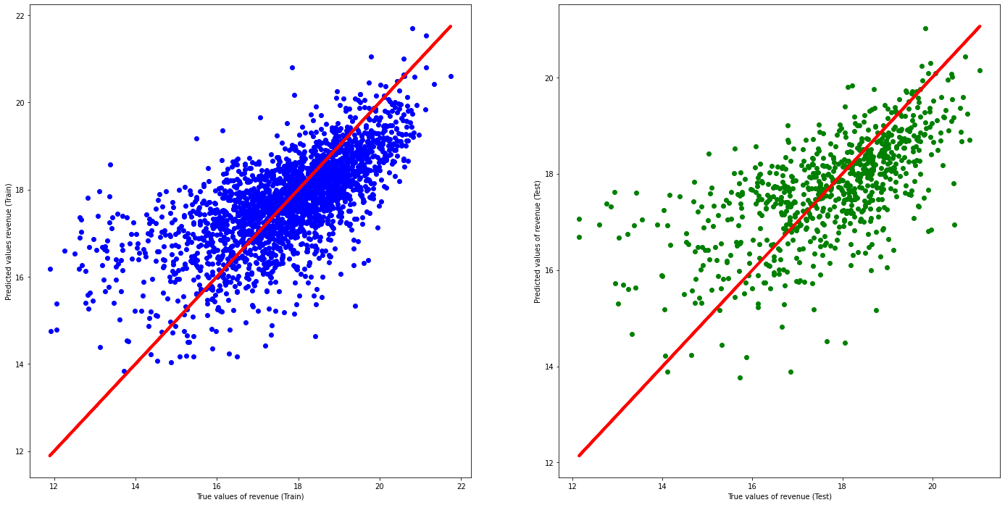
Model 2: Pre-elements vs revenue
Predictor feature: budget, num_crew, num_cast, thriller
Response variable: Revenue
Framework: LinearRegression in Sklearn
Split the train and test data
Fit the train data to train model
Apply the model to the test set
Visualize the performance
Evaluate the model
Train set:
R^2 = 0.45
MSE = 1.44
Test set:
R^2 = 0.46
MSE = 1.18
Notes:
From model 1, we can see that using only the budget to predict revenue is hard. Maybe the money that we receive can not only be determined by money we give out. There should be other factors as well. By these factors, can we predict the revenue before we release the movie. The model seem to perform better on the training set, but it seems to be overfitting.

Slide 25
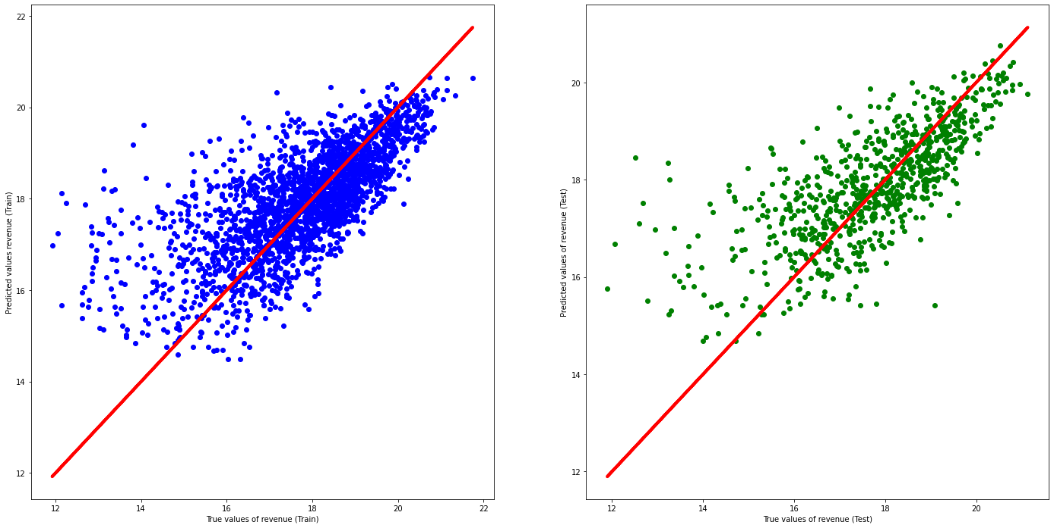
Model 3: Post-elements vs revenue
Predictor feature: popularity, vote_count
Response variable: Revenue
Framework: LinearSVR from SKlearn
Split the train and test data
Make a pipeline with StandardScaler and linearSVR
Fit the train data to train model
Apply the model to the test set
Visualize the performance
Evaluate the result
Train set:
R^2 = 0.47
MSE = 1.32
Test set:
R^2 = 0.54
MSE = 1.16
Notes:
From model 1, we can see that using only the budget to predict revenue is hard. Maybe the money that we receive can not only be determined by money we give out. There should be other factors as well. By these factors, can we predict the revenue before we release the movie. The model seem to perform better on the training set, but it seems to be overfitting.

Slide 26
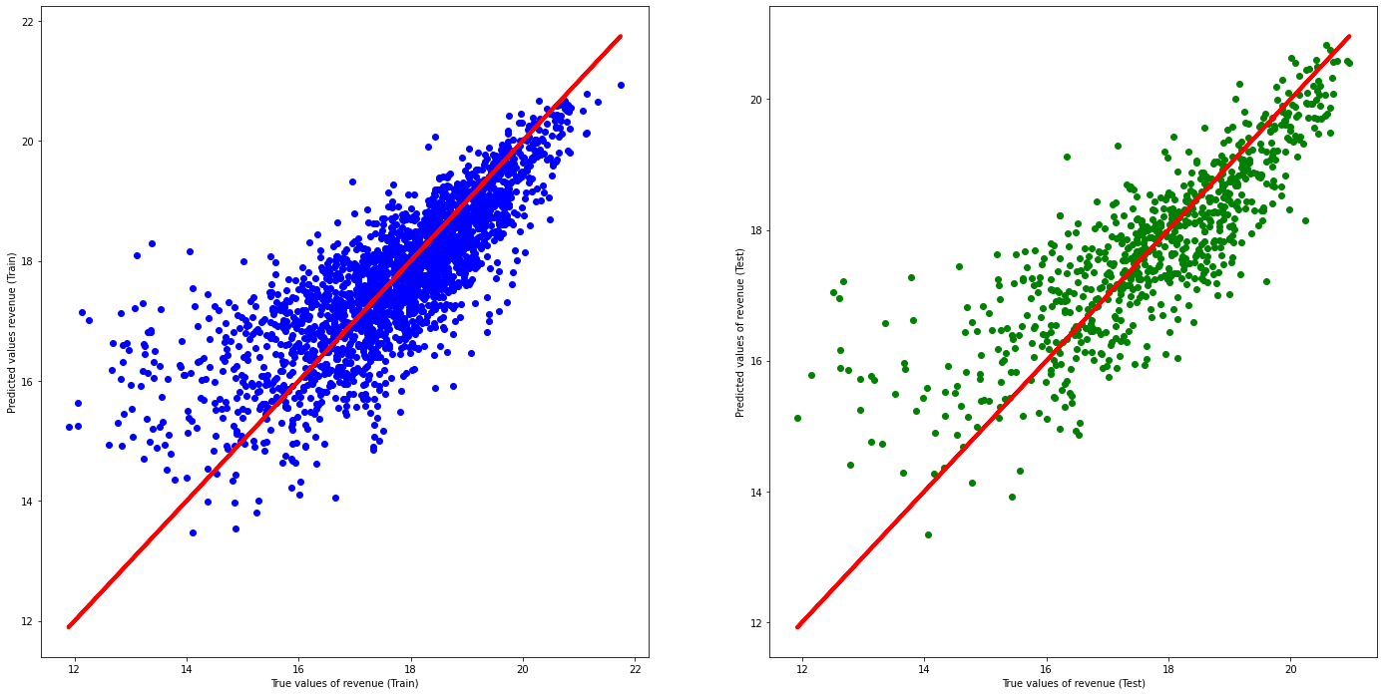
Model 4: Combined elements vs revenue
Predictor feature: pre-elements and post-elements
Response variable: Revenue
Framework: RidgeCV from SKlearn
Split the train and test data
Fit the train data to train model
Apply the model to the test set
Visualize the performance
Evaluate the model
Train set:
R^2 = 0.64
MSE = 0.87
Test set:
R^2 = 0.69
MSE = 0.88
Notes:
From model 1, we can see that using only the budget to predict revenue is hard. Maybe the money that we receive can not only be determined by money we give out. There should be other factors as well. By these factors, can we predict the revenue before we release the movie. The model seem to perform better on the training set, but it seems to be overfitting.

Slide 27
Data-driven Insights
5

Slide 28
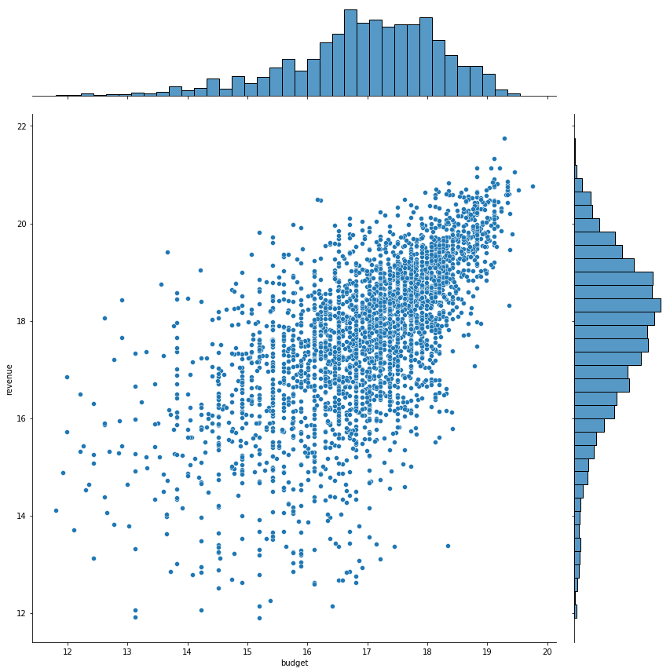
Data-driven insights from the model
Before release - Pre elements
Budget is the most relevant element to predict revenue.
There is a positive correlation between budget and revenue.
On the other hand, the genres of the movie have weak correlation.
However, the producer should use all pre-elements, as performance is higher compared to the model with only budget.
Notes:
Films with more money invested seem to receive more revenue

Slide 29
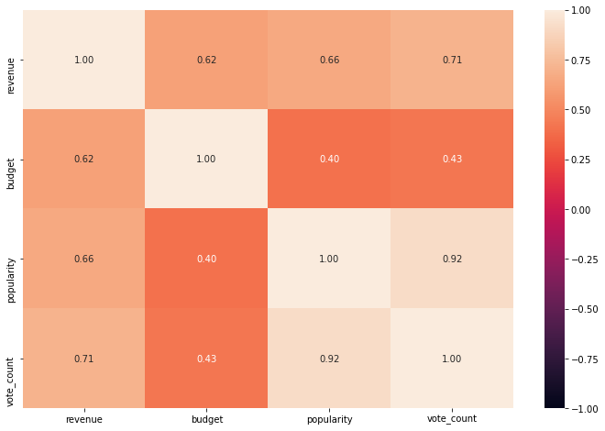
Data-driven insights from the model
After release - Post elements
The response from viewers is a better predictor of revenue as it has a stronger correlation.
Combined elements model has the best performance.
The main indicators to determine revenue are budget, popularity and vote counts.
Notes:
They contribute to the fact that a movie that are more popular and attract more people to interact is more likely to receive more revenue.

Slide 30
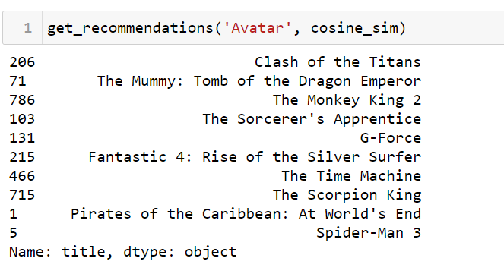
Recommendation system
Bonus
Predictor features: Name of director, cast, list of key words, genres
Response variable: name of 10 most relevant movies
Framework: CountVectorizer and cosine_similarity in Sklearn
Extract the names of directors, first 3 casts, first 3 keywords and first 3 genres
Lower case all the characters and remove spaces
Combine all these string variables to one combined variable
Apply the CountVectorize model and fit the train data.
Get the first 10 movies with the highest cosine similarity score

Slide 31
Work contribution
Benjamin Ong: | Problem formulation + Exploratory data analysis + regression model
Duong Ngoc Yen: | Data preparation + regression model + recommendation system + data-driven insights
Nipun Bhatia: | Recommendation system + Data-driven insights

Slide 32
Reference
Brownlee, Jason. “How to Remove Outliers for Machine Learning.” Machine Learning Mastery, 18 Aug. 2020, machinelearningmastery.com/how-to-use-statistics-to-identify-outliers-in-data/.
WillKoehrsen. “WillKoehrsen/Data-Analysis.” GitHub, github.com/WillKoehrsen/Data-Analysis/tree/master/random_forest_explained.
Sangeetha, Jame. “Json Parsing & Linear Regression Analysis.” Kaggle, Kaggle, 28 Mar. 2018, www.kaggle.com/sanjames/json-parsing-linear-regression-analysis.
F.koglu, et al. “How Can I Increase the Accuracy of My Linear Regression Model?(Machine Learning with Python).” Stack Overflow, 1 Sept. 1966, stackoverflow.com/questions/47577168/how-can-i-increase-the-accuracy-of-my-linear-regression-modelmachine-learning.
“Sklearn.linear_model.RidgeCV¶.” Scikit, scikit-learn.org/stable/modules/generated/sklearn.linear_model.RidgeCV.html.
“Sklearn.linear_model.RidgeCV¶.” Scikit, scikit-learn.org/stable/modules/generated/sklearn.linear_model.RidgeCV.html.
“Sklearn.svm.LinearSVR¶.” Scikit, scikit-learn.org/stable/modules/generated/sklearn.svm.LinearSVR.html.

Slide 33
Reference
Kushbhatnagar. “Movie Recommendation System.” Kaggle, Kaggle, 6 Apr. 2021, www.kaggle.com/kushbhatnagar/movie-recommendation-system.
Thomaskonstantin. “Predicting Revenue Linear Regression And Tfidf.” Kaggle, Kaggle, 24 Oct. 2020, www.kaggle.com/thomaskonstantin/predicting-revenue-linear-regression-and-tfidf.
Wade, Corey. “Transforming Skewed Data.” Medium, Towards Data Science, 16 Nov. 2020, towardsdatascience.com/transforming-skewed-data-73da4c2d0d16.
Radečić, Dario. “Top 3 Methods for Handling Skewed Data.” Medium, Towards Data Science, 4 Jan. 2020, towardsdatascience.com/top-3-methods-for-handling-skewed-data-1334e0debf45.
Team, Towards AI. “How, When, and Why Should You Normalize / Standardize / Rescale Your Data?” Towards AI - The Best of Tech, Science, and Engineering, 29 May 2020, towardsai.net/p/data-science/how-when-and-why-should-you-normalize-standardize-rescale-your-data-3f083def38ff.
“Overfitting in Machine Learning: What It Is and How to Prevent It.” EliteDataScience, 23 May 2020, elitedatascience.com/overfitting-in-machine-learning.

