Slide 1
Monitoring Service for Distributed Servers
Presenter: Nguyễn Trần Đăng Dương

Slide 2
Content
Architectural overview
Usage
Achieved results, limitations, development directions

Slide 3
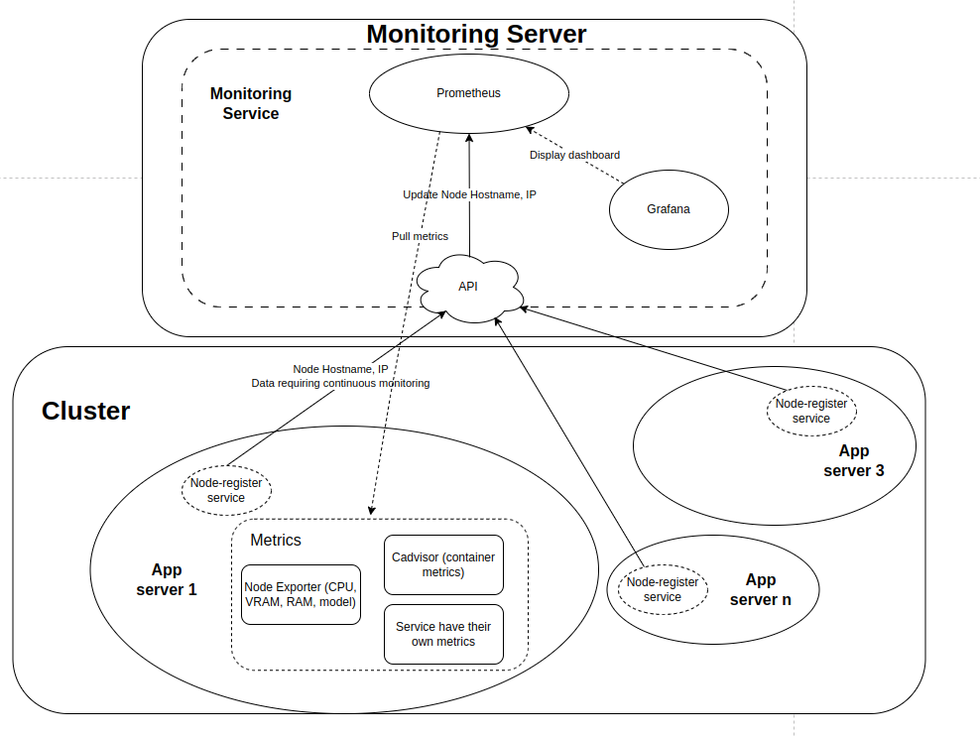
1. Architectural overview

Slide 4
2. Usage (Using Ansible)
2.1. Monitoring Server Side
The Ansible playbook consists of two plays:
Install docker: This play installs Docker and several required packages.
Run monitoring service: Run monitoring service.
Stop monitoring service: Stop monitoring service
Just execute ansible-playbook locally for successful monitoring service installation on monitoring servers.

Slide 5
2. Usage (Using Ansible)
2.2. App Servers Side
The Ansible playbook consists of two plays:
Install docker: This play installs Docker and several required packages.
Run node register service: Run node register service.
Stop node register service: Stop node register service
Just execute ansible-playbook locally for enables the monitoring server to monitor your app servers.

Slide 6
3. Achieved results, limitations, development directions
Achieved results:
All servers are monitored, new app servers added to the cluster will be updated and monitored by the monitoring server.
Limitations
Not yet automatically scale monitoring servers for an excessive number of servers to monitor.
Development directions
Deploy monitoring services in a Kubernetes cluster (k8s) to automatically scale and increase maintainability and governance.

Slide 7
DEMO

