Slide 1
UBER APPLICATION
9Meal

Slide 2
MEMBER
Phong Thanh Nhi - Leader
Nguyễn Hữu Dương
Lê Thị Cẩm Như
Nguyễn Huỳnh Vân Anh
Ngô Bỉnh Quyền

Slide 3
CONTENTS
01
02
03
04
GOOGLE S2 LIBRARY
GEOGRAPHICALLY
ETA
ARCHITECTURE

Slide 4
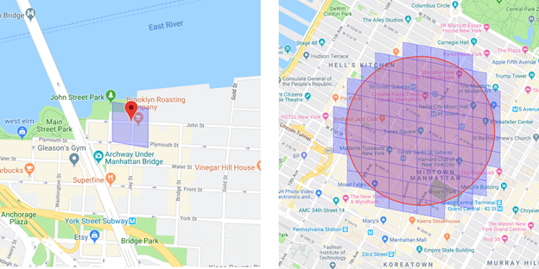
GOOGLE S2 LIBRARY

Slide 5
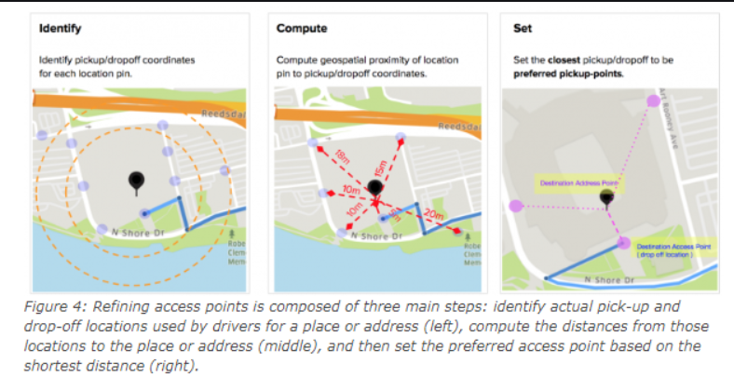
GEOGRAPHICALLY

Slide 6
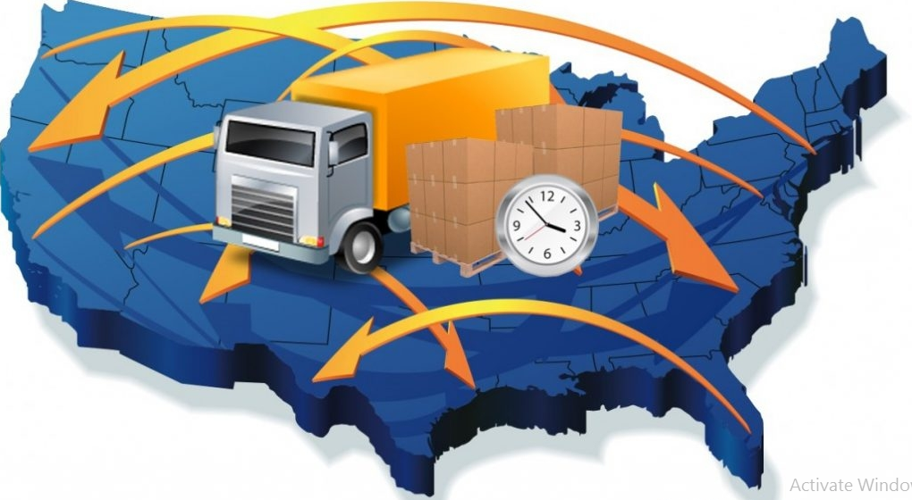
ETA

Slide 7
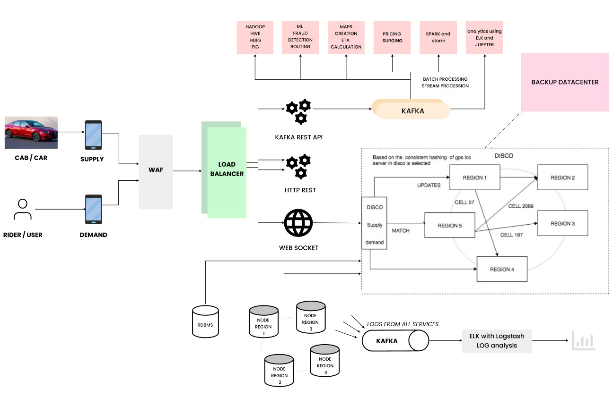
ARCHITECTURE

Slide 8
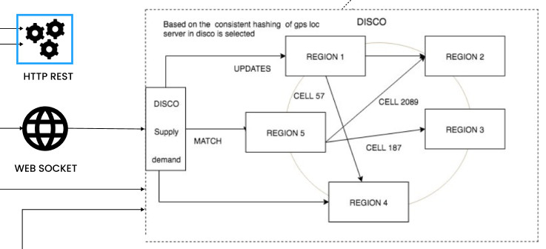

Slide 9
THANK FOR YOUR LISTENING
Do you have any questions?

