Slide 1
Chapter 6:
UNDERSTANDING FRIENDS
AND OVERLOADING OPERATORS

Slide 2
Outline
Learn what a friend is
Declare a friend function
Examine the benefits of polymorphism and overloading
Use a friend function to access data from two classes
Learn the general rules that apply to operator overloading
  Overload an arithmetic operator
  Overload operators to work with an object and a primitive type
  Chain multiple mathematical operations in an expression
  Overload the insertion operator (<<) for output
  Overload the extraction operator (>>) for input
  Overload the prefix and postfix ++ and -- operators
  Overload the == operator
  Overload the = operator
  Overload the subscript and parenthesis operators

Slide 3
WHAT ARE FRIENDS?
Encapsulation and data hiding are two primary features of object-oriented programs
Sometimes, however, it is convenient to allow an outside, nonmember function to have access to a private data member.
A friend function is a function that can access the non-public members of a class, even though the function itself is not a member of the class.
A friend function is a normal function with special access privileges.

Slide 4
WHAT ARE FRIENDS?
A friend function can access private data from a class of which it is not a member, but a friend function cannot be a friend on its own.
The C++ friend relationship is always one-sided. A class declaration must state which functions will be its friends; functions cannot declare that they are friends of a class.

Slide 5
WHAT ARE FRIENDS?
friend functions can access private data, and the data members are private for a reason, friend functions should be used only when absolutely necessary

Slide 6
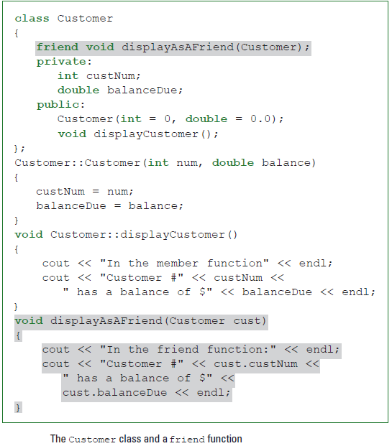
HOW TO DECLARE A FUNCTION AS A FRIEND

Slide 7
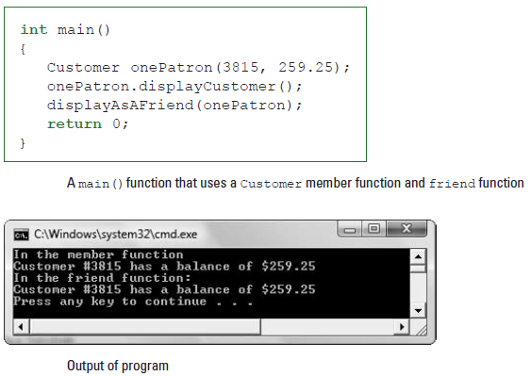

Slide 8
UNDERSTANDING THE BENEFITS
OF OVERLOADING AND POLYMORPHISM
interpret the meaning of “open” based on the context
two functions the same name, but different parameter lists
creating two or more constructors for the same class

Slide 9
USING A FRIEND FUNCTION TO ACCESS DATA FROM TWO CLASSES
class Transaction
{
private:
int transactionNum;
int custNum;
double amount;
public:
Transaction(int = 0, int = 0, double = 0.0);
};

Slide 10
USING A FRIEND FUNCTION TO ACCESS DATA FROM TWO CLASSES
» If you make both the balanceDue field in the Customer class and the amount field in the Transaction class public, then any function can use and modify them. However, this violates a basic principle of object-oriented programming.
» If you create a payment application function that is not a member of either the Customer or the Transaction class, the function will not have access to the private data fields of either class.
» If you make the payment application function a member of the Customer class, the function has access to balanceDue, but not to amount, which is private within the Transaction class.

Slide 11
USING A FRIEND FUNCTION TO ACCESS DATA FROM TWO CLASSES
» If you make the payment application function a member of the Transaction class, the function has access to amount, but not to balanceDue, which is private within the Customer class.
» If you create public get and set functions for both the Customer and Transaction classes, you can access and alter their private data fields in a controlled manner. This is the approach you almost always will want to take because it supports the object-oriented principles of data hiding and encapsulation.
» If you alter both classes to make the payment application function a friend of them, the function can use data from each class.

Slide 12
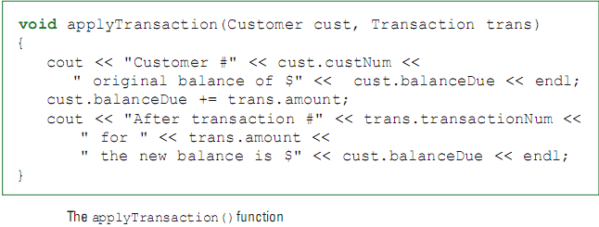
USING A FRIEND FUNCTION TO ACCESS DATA FROM TWO CLASSES

Slide 13
USING A FORWARD DECLARATION
The declaration of the applyTransaction()function is:
friend void applyTransaction(Customer, Transaction);

Slide 14
#include<iostream>
using namespace std;
class Transaction;
class Customer
{
friend void applyTransaction(Customer, Transaction);
private:
int custNum;
double balanceDue;
public:
Customer(int = 0, double = 0.0);
};
Customer::Customer(int num, double balance)
{
custNum = num;
balanceDue = balance;
}
class Transaction
{
friend void applyTransaction(Customer, Transaction);
private:
int transactionNum;
int custNum;
double amount;
public:
Transaction(int = 0, int = 0, double = 0.0);
};
Transaction::Transaction(int trans, int cust, double amt)
{
transactionNum = trans;
custNum = cust;
amount = amt;
}
void applyTransaction(Customer cust, Transaction trans)
{
cout << "Customer #" << cust.custNum <<
" original balance of $" <<
cust.balanceDue << endl;
cust.balanceDue += trans.amount;
cout << "After transaction #" <<
trans.transactionNum << " for " <<
trans.amount << " the new balance is $" <<
cust.balanceDue << endl;
}
int main()
{
Transaction oneTrans(111, 888, -150.00);
Customer oneCust(888, 200.00);
applyTransaction(oneCust, oneTrans);
return 0;
}

Slide 15
OVERLOADING OPERATORS—THE GENERAL RULES
Operator overloading is the process by which you apply operators to your own abstract data types. The +, -, *, and / symbols make it easy to work with built-in data types such as int and double
  Unary operators that can be overloaded
  Binary operators
  Precedence of operators
  Operators that cannot be overloaded

Slide 16
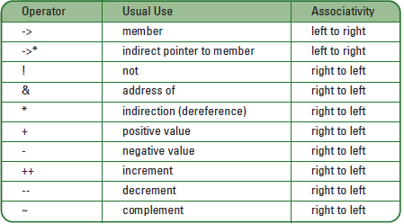
Unary operators

Slide 17
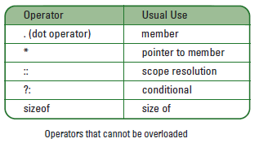
Operators that cannot be overloaded

Slide 18
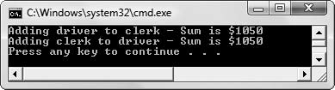
OVERLOADING AN ARITHMETIC OPERATOR
#include<iostream>
using namespace std;
class Employee
{
private:
int idNum;
double salary;
public:
Employee(int, double);
double addTwo(Employee);
};
Employee::Employee(int id, double sal)
{
idNum = id;
salary = sal;
}
double Employee::addTwo(Employee emp)
{
double total;
total = salary + emp.salary;
return total;
}
int main()
{
Employee clerk(1234, 400.00);
Employee driver(3456, 650.00);
double sum;
sum = clerk.addTwo(driver);
cout << "Adding driver to clerk - Sum is $" <<
sum << endl;
sum = driver.addTwo(clerk);
cout << "Adding clerk to driver - Sum is $" <<
sum << endl;
return 0;
}

Slide 19
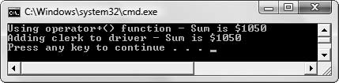
Employee class with an operator+() function
#include<iostream>
using namespace std;
class Employee
{
private:
int idNum;
double salary;
public:
Employee(int, double);
double operator+(Employee);
};
Employee::Employee(int id, double sal)
{
idNum = id;
salary = sal;
}
double Employee::operator+(Employee emp)
{
double total;
total = salary + emp.salary;
return total;
}
int main()
{
Employee clerk(1234, 400.00);
Employee driver(3456, 650.00);
double sum;
sum = clerk.operator+(driver);
cout << "Using operator+() function - Sum is $" <<
sum << endl;
sum = clerk + driver;
cout << "Adding clerk to driver - Sum is $" <<
sum << endl;
return 0;
}

Slide 20
PAYING ATTENTION TO THE ORDER OF THE OPERANDS
double Employee::operator-(Employee emp)
{
double difference;
difference = salary - emp.salary;
return difference;
}

Slide 21
OVERLOADING AN OPERATOR TO WORK WITH AN OBJECT
AND A PRIMITIVE TYPE
Employee Employee::operator+(double raise)
{
Employee temp;
temp.idNum = idNum;
temp.salary = salary + raise;
return temp;
}

Slide 22
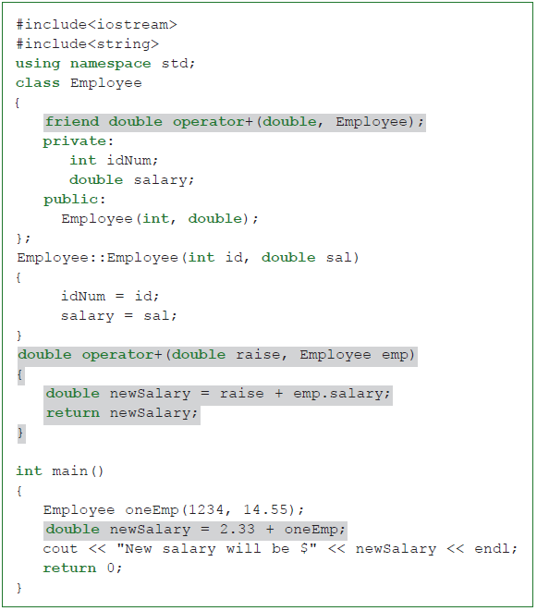

Slide 23
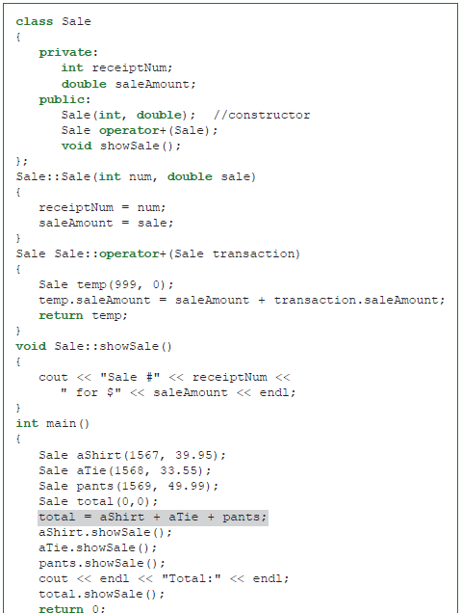

Slide 24
OVERLOADING OUTPUT
ostream& operator<<(ostream&, int);
ostream& operator<<(ostream&, double);
ostream& operator<<(ostream&, float);

Slide 25
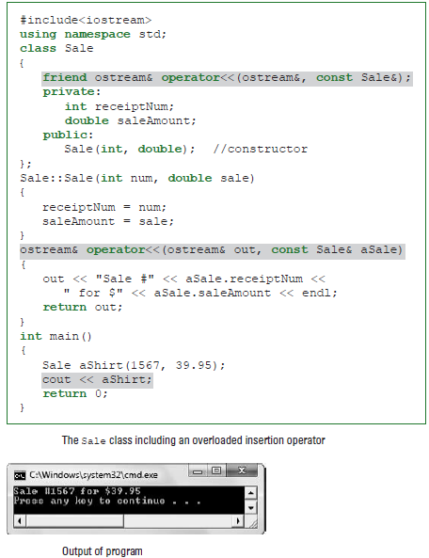

Slide 26
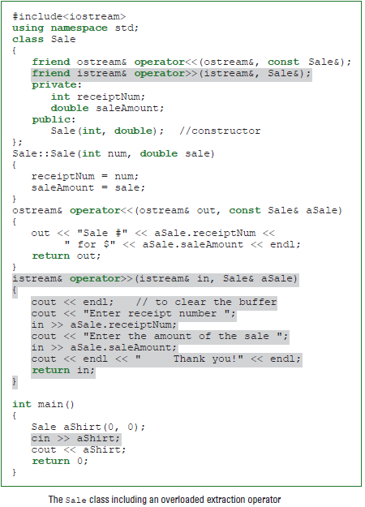

Slide 27
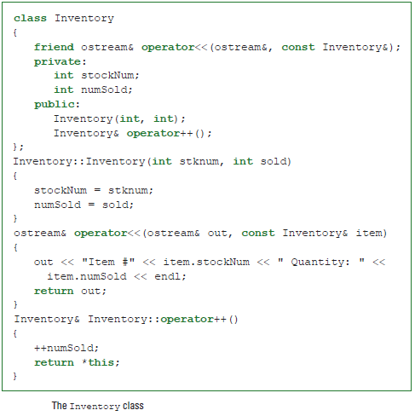
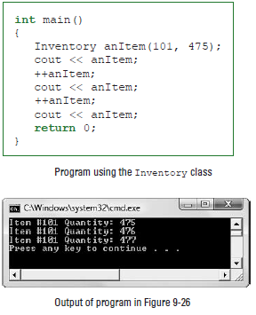
OVERLOADING THE PREFIX ++ AND – – OPERATORS

Slide 28
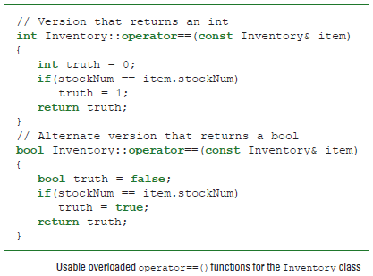
OVERLOADING THE == OPERATOR

Slide 29
OVERLOADING THE = OPERATOR
#include<iostream>
#include<string>
using namespace std;
class Classroom
{
private:
string* student;
int numStudents;
int gradeLevel;
public:
Classroom();
~Classroom();
void display();
Classroom& operator=(Classroom&);
};
Classroom::Classroom()
{
int x;
cout << "What grade level is this class? ";
cin >> gradeLevel;
cout << "How many students in this class? ";
cin >> numStudents;
student = new string[numStudents];
for(x = 0; x < numStudents; ++x)
{
cout << "Please enter the student's name ";
cin >> student[x];
}
}
Classroom::~Classroom()
{
delete [] student;
}
void Classroom::display()
{
int x;
cout << "Grade " << gradeLevel << " class list:" << endl;
for(x = 0; x < numStudents; ++x)
cout << student[x] << endl;
}
Classroom& Classroom::operator=(Classroom& aClassroom)
{
int x;
gradeLevel = aClassroom.gradeLevel;
numStudents = aClassroom.numStudents;
delete [] student;
student = new string[numStudents];
for(x = 0; x < aClassroom.numStudents; ++x)
{
student[x] = aClassroom.student[x];
}
return *this;
}

Slide 30
int main()
{
Classroom oneClass;
{
Classroom anotherClass;
cout << endl << "The original classroom before assignment:" <<endl;
oneClass.display();
cout << endl << "The second classroom ";
anotherClass.display();
oneClass = anotherClass;
cout << endl << "The original classroom after assignment:" << endl;
oneClass.display();
}
cout << endl << "After the second class has gone out of scope:" <<endl;
oneClass.display();
return 0;
}

Slide 31
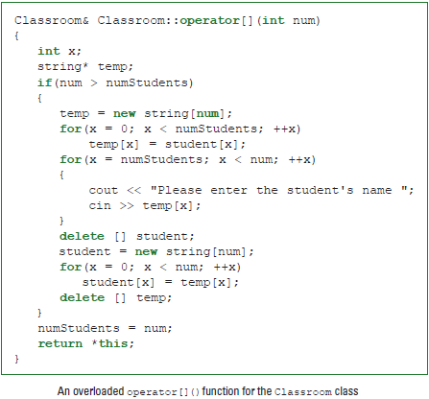
OVERLOADING [ ] AND ( )

Slide 32
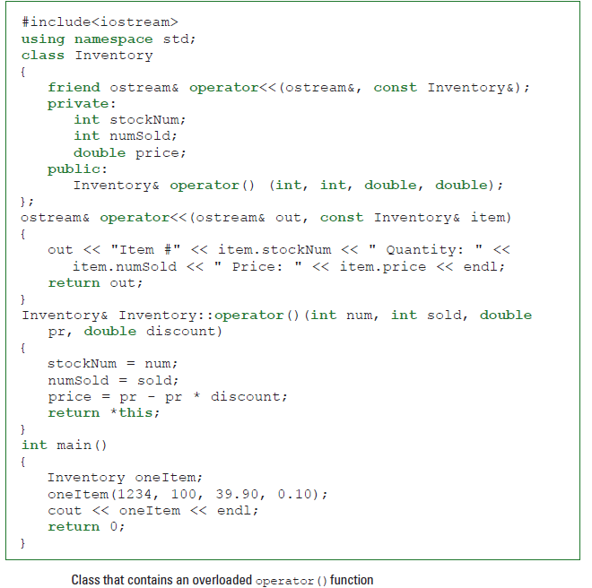

Slide 33
Summary
Use a friend function to access data from two classes
Operator overloading

