Slide 1


DUPLO: Unifying Cut-and-Choose for Garbled Circuits
Presenter: Ni Trieu
Joint work with:
Vladimir Kolesnikov, Jesper Buus Nielsen, Mike Rosulek, Roberto Trifiletti
Notes:
Hi everyone and Thanks Marcel for introduction. I am glad to be here today to present our work “DUPLO: Unifying Cut-and-Choose for Garbled Circuits”. This work focus on secure computation. It is the joint work with Vladimir Kolesnikov, Jesper Buus Nielsen, Mike Rosulek, Roberto Trifiletti

Slide 2


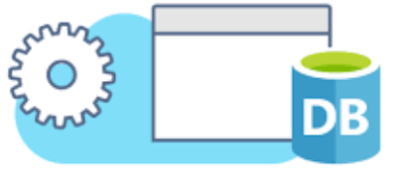




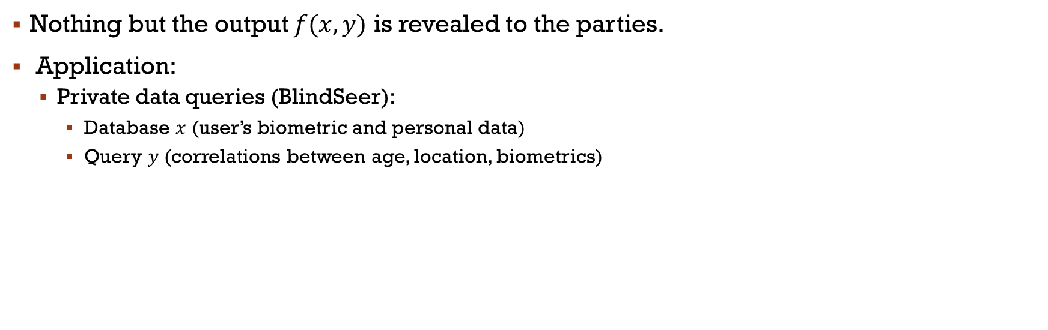

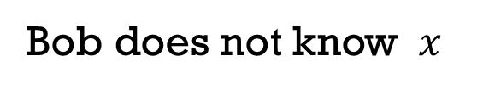
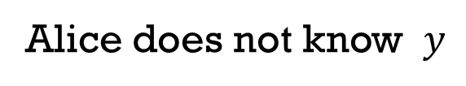

Secure Two-party Computation
$$x$$
$$y$$
$$x$$
$$y$$
2PC
$$f(x,y)$$
$$f(x,y)$$
Alice does not know $y$
Bob does not know $x$
Nothing but the output $f(x,y)$ is revealed to the parties.
Application:
Private data queries (BlindSeer):
Database $x$ (user’s biometric and personal data)
Query $y$ (correlations between age, location, biometrics)
Notes:
Let start with basic definition what Secure two-party computation is? Have 2 parties Alice and Bob with private inputs x and y. they want to compute some functions on their inputs while keeping their inputs private.
It means that Alice does not know $Bobs input$and on other hand, Bob does not know Alice’s input.
Secure two-party computation has a lot of applications:
The popular one is private data queries where Alice might has database x. for example she collects user’s biometric and personal data, there are sensitive database, so cant share
And Bob might hold the quires y. for example quires wants to mine data to find correlations between age, location, biometrics. queries must be private.
It means that Both parties want to keep their input private from the other. This one can be solved using secure 2-party computation

Slide 3

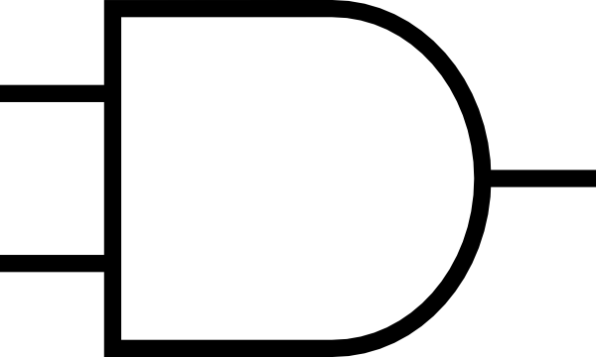






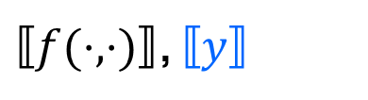








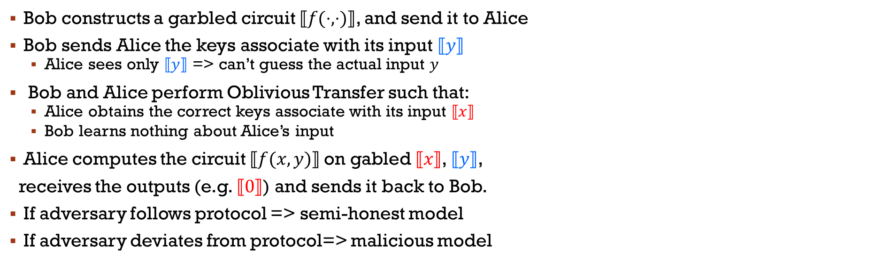
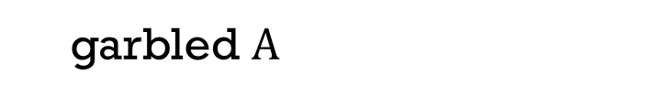


Yao’s Protocol
def
$$⟦A⟧$$
$$=$$
garbled $A$
$$x$$
$⟦f(⋅,⋅)⟧$, $⟦y⟧$
$$y$$
$$x$$
$$⟦x⟧,x∈{\left\{0,1\right\}}^{∗}$$
OT
$$⟦x⟧$$
Evaluates $⟦f(x,y)⟧$on gabled $⟦x⟧$, $⟦y⟧$
$$⟦0⟧$$
$$⟦1⟧$$
$$⟦1⟧$$
$$⟦1⟧$$
$$⟦0⟧$$
$$⟦0⟧$$
$$⟦f(⋅,⋅)⟧=$$
Bob constructs a garbled circuit $⟦f(⋅,⋅)⟧$, and send it to Alice
Bob sends Alice the keys associate with its input $⟦y⟧$
Alice sees only $⟦y⟧$ => can’t guess the actual input $y$
Bob and Alice perform Oblivious Transfer such that:
Alice obtains the correct keys associate with its input $⟦x⟧$
Bob learns nothing about Alice’s input
Alice computes the circuit $⟦f(x,y)⟧$on gabled $⟦x⟧$, $⟦y⟧$,
receives the outputs (e.g. $⟦0⟧$) and sends it back to Bob.
If adversary follows protocol => semi-honest model
If adversary deviates from protocol=> malicious model
$$⟦0⟧$$
Notes:
There are several protocols for secure computation. This work builds on Yao’s garble circuit protocol which is introduced in 1982. The ideal is to present the function to be computed by a Boolean circuit. We first will use the notation A in the box to denote its encoding. The yao’s protocol works as following:
Bob constructs a garbled circuit $⟦f(⋅,⋅)⟧$. This is essentially a circuit that can be computed without revealing anything about what's actually inside, what’s going on inside. Bob sends circuit to Alice
Bob also sends encoding [y] such that Alice cant guess the actual input $y$ even she knows its encoding
Next step is Bob and Alice perform Oblivious Transfer such that: Alice obtains the correct encoding of her input $⟦x⟧$ While Bob learns nothing about Alice’s input
Now, Alice computes the garble circuit $⟦f(x,y)⟧$on gabled encoding $⟦x⟧$, $⟦y⟧$, She receives the outputs and sends it back to Bob, who later decrypted the circuit.
By following protocols, the parties learns no more than the function to be computed. It means that Alice doesn’t know y and Bob doesn’t know x
If adversary follows protocol => we achieve a secure computation in semi-honest setting
However, a major problem of Yao’s protocol is that it is not secure against a malicious Bob who deviates from protocol. This work focus on of this problem. And we are reducing the cost of malicious Yao protocol.

Slide 4


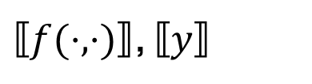





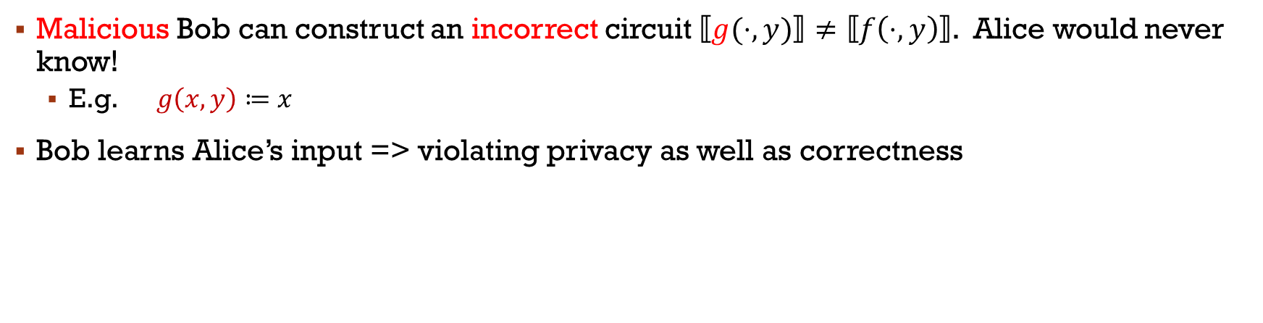
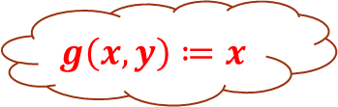
Malicious adversary
def
$$g\left(x,y\right)≔x$$
$$⟦A⟧$$
$$=$$
garbled $A$
$$⟦g(⋅,y)⟧$$
$$y$$
$$x$$
$⟦f(⋅,⋅)⟧$, $⟦y⟧$
$$x$$
$$⟦x⟧, x∈{\left\{0,1\right\}}^{∗}$$
OT
$$⟦x⟧$$
Evaluates $⟦f(x,y)⟧$on gabled $⟦x⟧$, $⟦y⟧$
$$⟦g(x,y)⟧$$
Malicious Bob can construct an incorrect circuit $⟦g(⋅,y)⟧≠⟦f\left(⋅,y\right)⟧$. Alice would never know!
E.g. $g\left(x,y\right)≔x$
Bob learns Alice’s input => violating privacy as well as correctness
Notes:
(5)Now, we are looking at more detail about malicious Bob.
A simple case is that Bob might provide the wrong function.
and Alice would never know!
Shown here, Bob garbles the function g which is output alice’s input
Clearly Bob learns Alice’s input, so Alice looses all privacy
Furthermore, correctness is definitely concern since the garble function is incorrect.

Slide 5
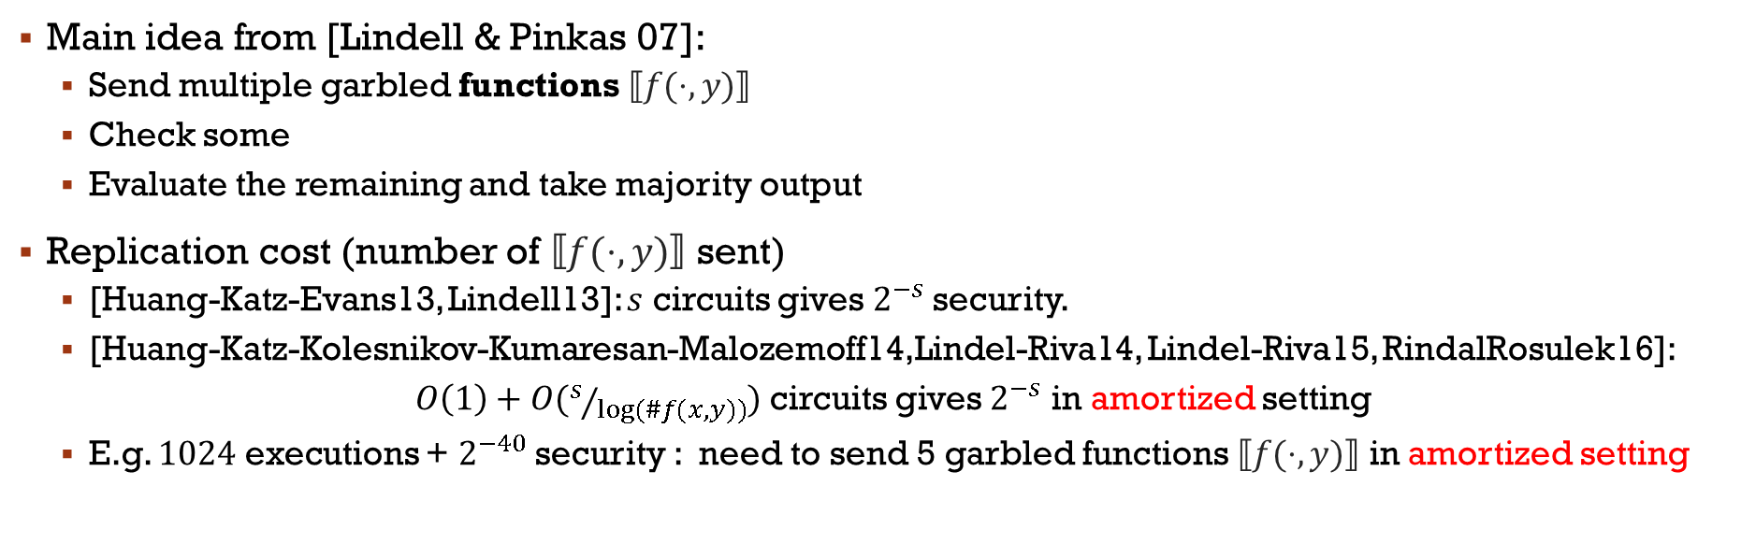











Malicious: “Standard” Cut-and-choose
$$⟦f(⋅,y)⟧$$
$$⟦f(⋅,y)⟧$$
$$x$$
$$⟦f(⋅,y)⟧$$
$$⟦f(⋅,y)⟧$$
$$y$$
$$⟦f(⋅,y)⟧$$
$$⟦f(⋅,y)⟧$$
$$…$$
$$…$$
$$⟦f(⋅,y)⟧$$
$$⟦f(⋅,y)⟧$$
Main idea from [Lindell & Pinkas 07]:
Send multiple garbled functions $⟦f(⋅,y)⟧$
Check some
Evaluate the remaining and take majority output
Replication cost (number of $⟦f(⋅,y)⟧$ sent)
[Huang-Katz-Evans13, Lindell13]: $s$ circuits gives $2^{−s}$security.
[Huang-Katz-Kolesnikov-Kumaresan-Malozemoff14,Lindel-Riva14, Lindel-Riva15, RindalRosulek16]:
$O\left(1\right)+O(s/{log⁡(\#f(x,y))})$ circuits gives $2^{−s}$ in amortized setting
E.g. $1024$ executions + $2^{−40}$security : need to send 5 garbled functions $⟦f(⋅,y)⟧$ in amortized setting
Notes:
There are several promising approaches to address malicious secure two parties computation, One of them is Cut-and-choose paradigm which is introduced by Lindell and Pinkas 2007. The main idea is that instead of Bob constructing one circuit, he actually constructs many circuits and sends them all to Alice. Alice then chooses a subset of those circuits and check with Bob that those subset that he sent is actually all correct. If those subset of circuit are correct, Alice believe Bob and continue evaluates on the rest of the circuits. Then take majority output.
The main question is how many circuits do we need to send in order to make sure that the majority are indeed correct. This is Replication cost.
There are many works try to reduce the number of circuit needed. In 2013, there are two papers: one by Huang-Katz-Evan, other by Lindell propose the protocols that 40 circuits is sufficient to achieve $2^{−40}$security.
In amortized settings when doing $1024$ executions + $2^{−40}$security : need to send 5 garbled functions $⟦f(⋅,y)⟧$

Slide 6







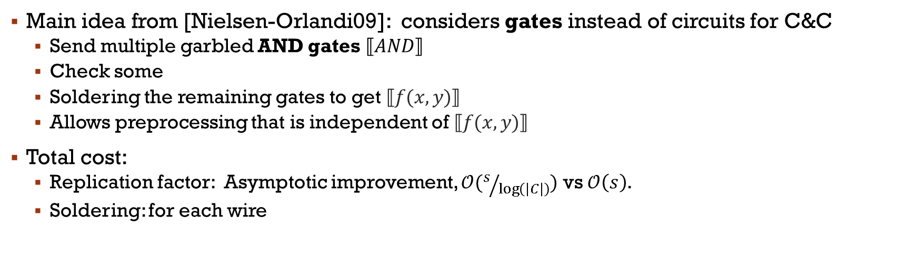




Malicious: “LEGO” Cut-and-choose
$$⟦AND⟧$$
$$⟦AND⟧$$
$$x$$
$$y$$
$$⟦AND⟧$$
$$…$$
$$⟦AND⟧$$
$$⟦AND⟧$$
$$⟦AND⟧$$
Main idea from [Nielsen-Orlandi09]: considers gates instead of circuits for C&C
Send multiple garbled AND gates $⟦AND⟧$
Check some
Soldering the remaining gates to get $⟦f(x,y)⟧$
Allows preprocessing that is independent of$⟦f(x,y)⟧$
Total cost:
Replication factor: Asymptotic improvement, $𝒪(s/{\log\left(\left|C\right|\right)})$ vs $𝒪\left(s\right)$.
Soldering: for each wire
$$⟦f(x,y)⟧=$$
$$⟦AND⟧$$
$$⟦AND⟧$$
$$⟦AND⟧$$
Notes:
(8:20p) another technique was introduced by Nielsen and Orlandi 2009. this call Lego. The main idea I sInstead of having Bob garble many circuits, he garble many gates. In particular, it will be AND gate since there are some crypto technique that can easily handle XOR gate. So just assume we only do And gate so far. Bob makes many AND gates, send it to Alice. Similar to standard C&C, Alice then chooses a subset of AND gates and check with Bob that those subset that he sent is actually all correct. If those subset of gate are correct, Alice believe that Bob is nice person and continue to play with him.
One important step in LEGO is soldering. Alice uses the remaining gates to solder them together in order to make the garbled function to be computed.
By doing this, Lego technique Allows preprocessing a ton of AND gates that is independent of$function$
Now looking at the total cost of LEGO:
For Replication factor, the LEGO technique has Asymptotic improvement compared to the standard C&C
However, they have to do soldering for each wire

Slide 7
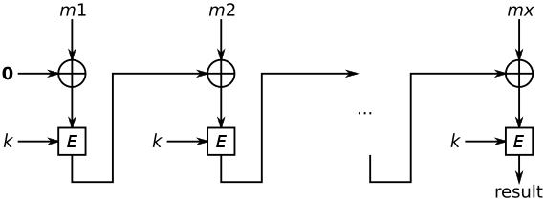











This Paper: “DUPLO” Cut-and-choose
$$x$$
$$⟦E⟧$$
$$⟦E⟧$$
$$y$$
$$⟦E⟧$$
$$⟦E⟧$$
$$…$$
$$…$$
$$⟦E⟧$$
$$⟦E⟧$$
def
$$=$$
$$⟦E⟧$$
garbled component of $f\left(x,y\right)$
Main idea:
Considers component instead of circuit or gate for C&C
E.g. AES-CBC-MAC-16 contains of 16 AES
=> AES is considered as component
Many programs consists of many identical component (e.g. loops)
Similar idea considered in [Groce-Ledger- Malozemoff- Yerukhimovich16] for semi-honest setting
Component
Notes:
Now come to our approach which is very natural, but it is powerful
Instead of bob garbling the entire circuit in standard C&C, or gate level in Lego, we consider component which contains several AND gates.
What is actual meaning of component? Consider AES-CBC-MAC-16, it contains of 16 AES inside. We can think about AES as a component. Or maybe 2 aes as the component so on so far….
Indeed, there are many programs that has many identical component, for example, loops.
Also, Similar idea considered in this paper last year. However, it is for semi-honest setting. More simple than malicious model

Slide 8























malicious Yao protocol
Standard C&C
DUPLO C&C
LEGO C&C
$$⟦f(⋅,y)⟧$$
$$⟦f(⋅,y)⟧$$
$$⟦E⟧$$
$$⟦E⟧$$
$$⟦AND⟧$$
$$⟦AND⟧$$
$$⟦f(⋅,y)⟧$$
$$⟦f(⋅,y)⟧$$
$$⟦E⟧$$
$$⟦E⟧$$
$$⟦AND⟧$$
$$…$$
$$⟦AND⟧$$
$$⟦f(⋅,y)⟧$$
$$⟦f(⋅,y)⟧$$
$$…$$
$$…$$
$$…$$
$$…$$
$$⟦E⟧$$
$$⟦E⟧$$
$$⟦AND⟧$$
$$⟦AND⟧$$
$$⟦f(⋅,y)⟧$$
$$⟦f(⋅,y)⟧$$
Two effects on the performance of malicious Yao protocol:
Replication factor: more components is better
Soldering cost: less components is better
Our main idea: balance between replication factor and soldering cost
 | Replication factor | Soldering cost
Standard C&C
Lego C&C
DUPLO
High
0
Low
High
Medium
Medium
Notes:
So looking at all 3 approaches: Standard C&C, Duplo, and Lego.
Indeed, there are two factors that effects on the performance of malicious Yao protocol:
The first one is replication factor: so more components is better. In standard C&C, the component is the whole circuit, so they have only 1 component, this approach have high Replication factor. In lego, the component is just a gate, so this approach have very low Replication factor.
The second one is Soldering cost: so less components is better . In stardr C&C, again, we don't need any soldering because the component is the whole circuit. In lego, we need to solder every wire, so this approach have high soldering cost.
Our main idea is to balance between replication factor and soldering cost. We got medium cost for both factors.

Slide 9








This Paper: “DUPLO” Cut-and-choose
$$x$$
$$⟦E⟧$$
$$⟦E⟧$$
$$y$$
$$⟦E⟧$$
$$⟦E⟧$$
$$⟦E⟧$$
$$…$$
$$…$$
$$⟦E⟧$$
$$⟦E⟧$$
def
$$⟦E⟧$$
$$⟦E⟧$$
$$⟦E⟧$$
$$=$$
$$⟦E⟧$$
garbled sub-function of $f\left(x,y\right)$
$$⟦f(x,y)⟧=$$
Main idea: Considers component for C&C
Results:
Lower replication factor due to more number components than standard C&C.
Lower soldering cost due to fewer overall input/output wires than LEGO C&C
Garble several different flavor of components in single circuit
Efficient protocol for programs comprised of many identical components (e.g. loops)
7x faster than [Wang-Malozemoff-Katz17] and 5x faster than [Rindal-Rosulek16] for certain circuits.
Notes:
When considering component for C&C: we achieve:
Low replication factor, because there are more number component than standard C&C.
Lower soldering cost than since LEGO C&C we don’t need to soldering for every wire as LEGO C&C
Moreover, DUPLO supports Garble several different flavor of components in single circuit. This is an Efficient protocol for programs which contains of many identical components (e.g. loops)
We implement our protocol and compare with other works, we found that we have 7x faster than [Wang- Malozemoff- Katz17] in single execution, and 5x faster than [RindalRosulek16]

Slide 10
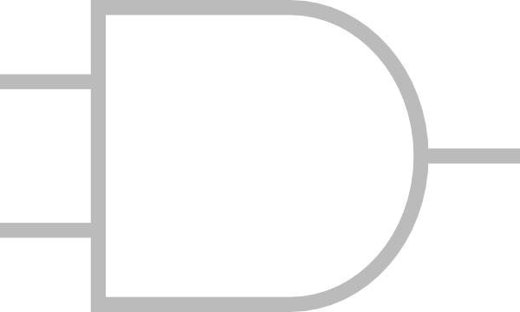
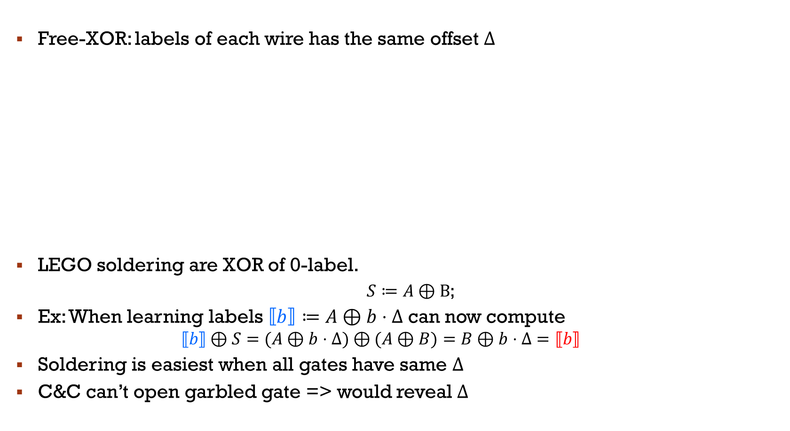
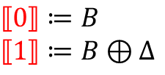
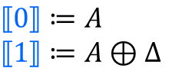

LEGO: Soldering
Free-XOR: labels of each wire has the same offset $Δ$
LEGO soldering are XOR of 0-label.
$S≔A⊕B$;
Ex: When learning labels $⟦b⟧≔A⊕b⋅Δ$ can now compute
$$⟦b⟧⊕S=(A⊕b⋅Δ)⊕(A⊕B)=B⊕b⋅Δ=⟦b⟧$$
Soldering is easiest when all gates have same $Δ$
C&C can’t open garbled gate => would reveal $Δ$
$$S≔A⊕B$$
$$⟦0⟧≔B$$
$$⟦1⟧≔B⊕Δ$$
$$⟦0⟧≔A$$
$$⟦1⟧≔A⊕Δ$$
Notes:
(15p) To make DUPLO become practical, there are several issue. In this talk, I am going to focus on the issue of soldering of circuit. The other things can be dealt with as well as in the paper. I’ll first recall the soldering technique in lego. And I want to show why Lego soldering technique does not work for DUPLO
There are a free-XOR technique that labels of each wire has the same offset $Δ$
For example, we have 2 and gates
[0] is encoding by random string A, [1] is encoding A \xor \Delta.
Similarly, we have B, and B\xor \Delta.
Now, we want to solder A and B. LEGO soldering are XOR of 0-label. It means that the soldering value is A \xor B. When learning the blue labels $⟦b⟧≔A⊕b⋅Δ$ Evaluator can compute xor of encoding of blue bit b and soldering value to get to encoding of red bit.
So, Soldering is easiest when all gates have same $Δ$. However, the important thing is that C&C can’t open garbled gate since it would reveal $Δ$

Slide 11

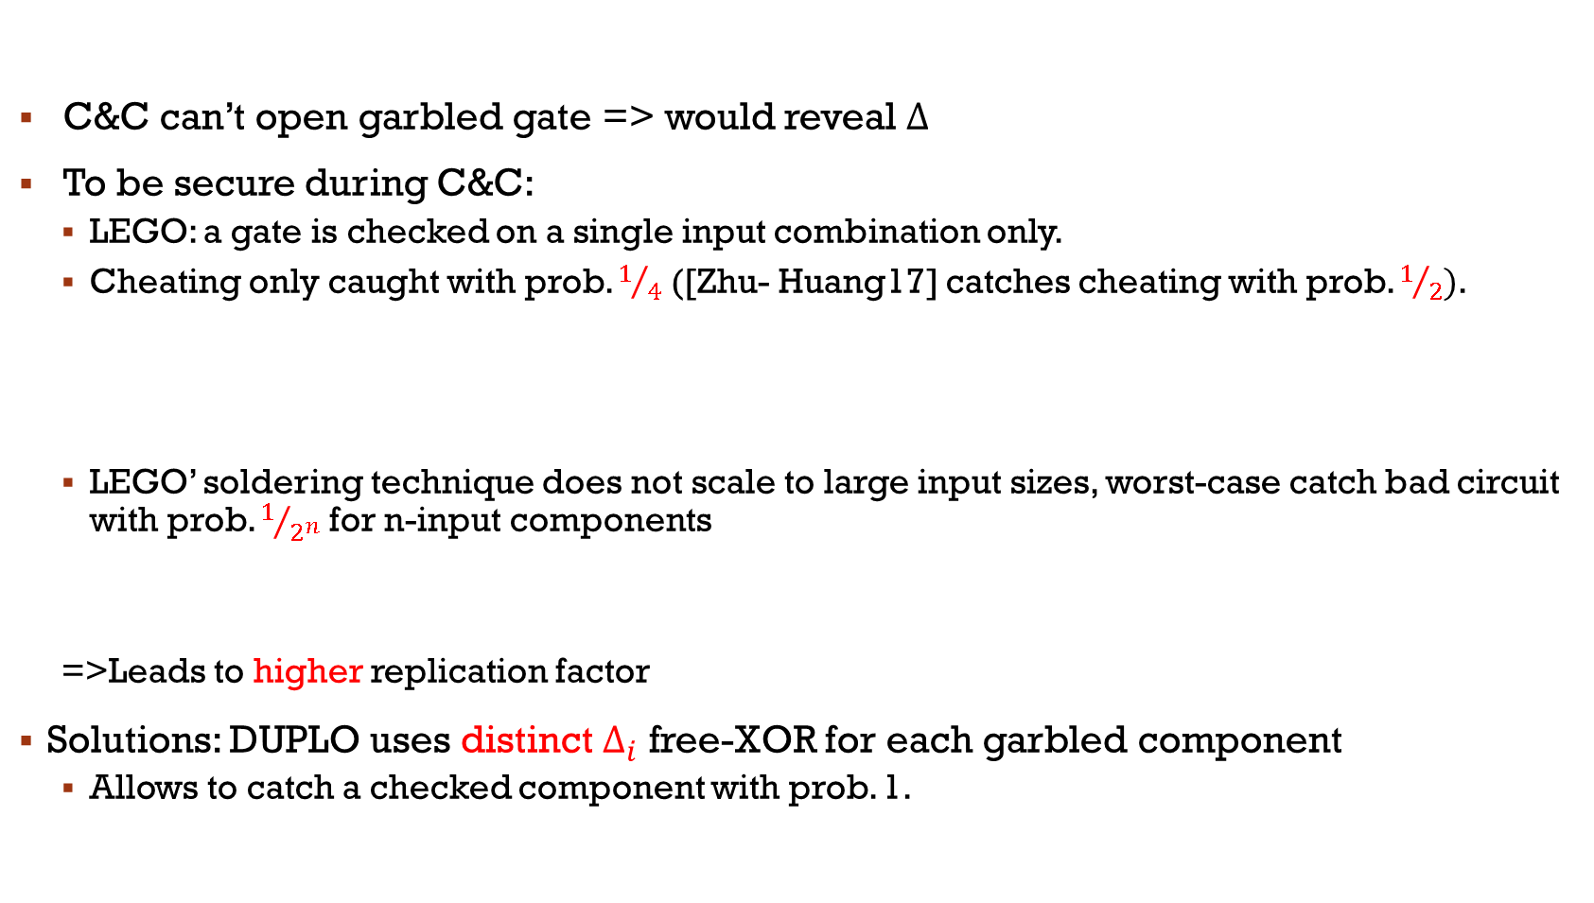



DUPLO: Soldering with distinct differences
C&C can’t open garbled gate => would reveal $Δ$
To be secure during C&C:
LEGO: a gate is checked on a single input combination only.
Cheating only caught with prob. $1/4$ ([Zhu- Huang17] catches cheating with prob. $1/2)$.
LEGO’ soldering technique does not scale to large input sizes, worst-case catch bad circuit with prob. $1/{2^{n}}$ for n-input components
=>Leads to higher replication factor
Solutions: DUPLO uses distinct $Δ_{i}$ free-XOR for each garbled component
Allows to catch a checked component with prob. 1.
$$2 inputs$$
$$⟦AND⟧$$
$$n inputs$$
$$⟦E⟧$$
Notes:
Because that the delta must be hide, to be secure during C&C:
In LEGO, we check each gate on a single input combination only. AND gates have 2 input wire, so Cheating only caught with prob. $1/4$ . Recent work of Zhu and Huang with efficient homomorphic soldering technique, they can catch cheating with prob. $1/2$
LEGO’ soldering technique does not scale to large input sizes. For example, if component has n input wires, then caught with prob. $1/{2^{n}}$
So, we need a very higher replication factor
We propose a solution to address this issue. We use distinct $Δ_{i}$ free-XOR for each garbled component. By doing it, we allow to catch a checked component with prob. 1.

Slide 12
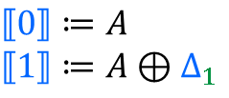
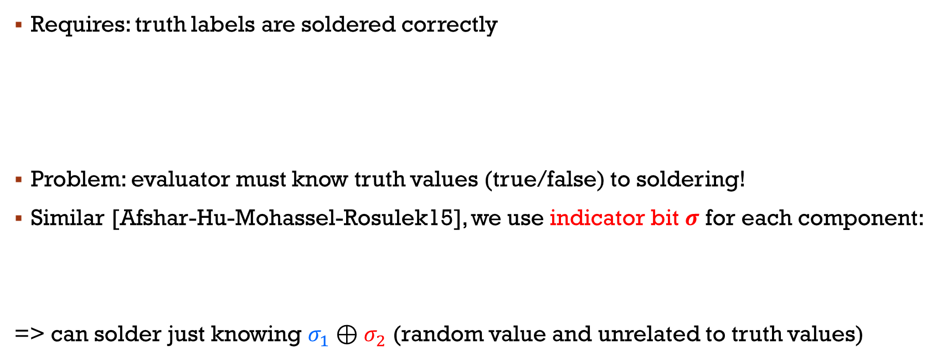

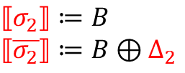


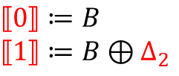
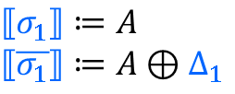


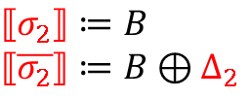
DUPLO: Soldering with distinct differences
$$⟦E⟧$$
$$⟦σ_{1}⟧≔A$$
$$⟦\overline{σ_{1}}⟧≔A⊕Δ_{1}$$
$$⟦0⟧≔B$$
$$⟦1⟧≔B⊕Δ_{2}$$
$$⟦0⟧≔A$$
$$⟦1⟧≔A⊕Δ_{1}$$
$$⟦σ_{2}⟧≔B$$
$$⟦\overline{σ_{2}}⟧≔B⊕Δ_{2}$$
$$⟦E⟧$$
Requires: truth labels are soldered correctly
Problem: evaluator must know truth values (true/false) to soldering!
Similar [Afshar-Hu-Mohassel-Rosulek15], we use indicator bit $σ$ for each component:
=> can solder just knowing $σ_{1}$ $⊕σ_{2}$ (random value and unrelated to truth values)
Sordering: $A⊕B$
False: $⟦0⟧≔A ⟦0⟧≔B$
Sordering: $A⊕B⊕Δ_{1}$ $⊕Δ_{2}$
True: $⟦1⟧≔A⊕Δ_{1} ⟦1⟧≔B⊕Δ_{2}$
$$⟦σ_{1}⟧≔A$$
$$⟦\overline{σ_{1}}⟧≔A⊕Δ_{1}$$
$$⟦σ_{2}⟧≔B$$
$$⟦\overline{σ_{2}}⟧≔B⊕Δ_{2}$$
Notes:
Now, we are looking at more detail about our soldering technique.
Shown here, we have two different components with 2 different delta free XOR. We require that truth labels are soldered correctly. It means, A will be soldered to B. If using Lego’s soldering technique, then, the soldering value must be $A⊕B$
Similarly, true label of first comp has to soldering to true label of second comp, so the soldering will be $⊕B⊕Δ_{1}$ $⊕Δ_{2}$
It raises a problem that evaluator must know truth values (true/false) to soldering. It leaks significant information
To address this problem, we use indicator bit $σ$ for each component: the value of indicator bit $σ$ is chosen randomly. For example, sigma1 has label A while sigma1 bar has label A \delta
So, soldering can be done when knowing $σ_{1}$ $⊕σ_{2}$ (random value and unrelated to truth values)

Slide 13
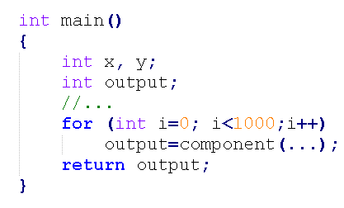
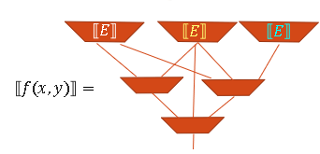




A Tool for Program Decomposition
We extend the recent Frigate compiler [Mood-Gupta-Carter-Butler-Traynor 16] to output circuits in a format suitable for DUPLO. Same input language as Frigate (C-like syntax).
Frigate
Extension
Program.cpp
$$P_{1}$$
$$P_{2}$$
$$x$$
$$y$$
DUPLO
Program(x,y)
Each function in Program.cpp is translated into a distinct boolean circuit (component). Program.GC_duplo includes “main” function describing how to solder.
Credit by Roberto Trifiletti, Aarhus University
Notes:
Here is overall view of our DUPLO program.
We extend the recent Frigate compiler to output circuits in a format suitable for DUPLO. Each function in Program.cpp is translated into a distinct boolean circuit (component). Garble Circuit includes “main” function describing how to solder.
We then use the circuit for DUPLO with input x and y. outputs f(x,y)

Slide 14

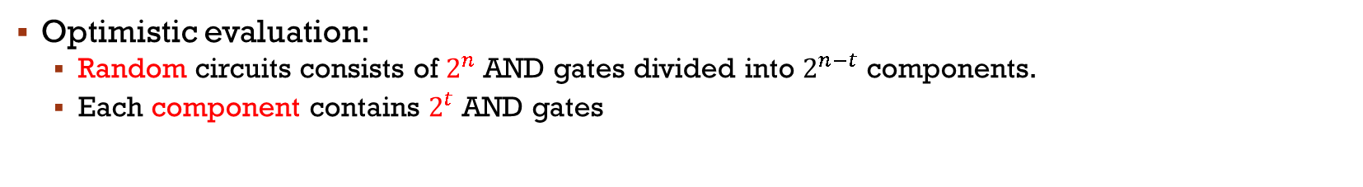








Random Circuit Decomposition
Optimistic evaluation:
Random circuits consists of $2^{n}$AND gates divided into $2^{n−t}$ components.
Each component contains $2^{t}$AND gates
Lego
Standard C&C
$2^{n}$ ANDs
$2^{n−1}$ ${ 2}^{n−1}$
ANDs ANDs
$$2^{n} ANDs$$
$${ 2}^{t}$$
$${ 2}^{n−2}$$
$${ 2}^{n−2}$$
$${ 2}^{n−2}$$
$${ 2}^{n−2}$$
component size ($2^{t}$ AND gates)
Notes:
We evaluate our protocol on a random circuit. A random circuit is consist of $2^{n}$AND gates
We divide the circuit into 2 components, each contains 2^n-1 AND dates
Or divide the circuit into 4 components, each contains 2^n-2 AND dates
So on so far, we consider the component of size 2^t
Our experiment shows that the idea number of AND gate in a component is around 2^12. Standard C&C in this side, Lego in other side
However, this is an optimistic evaluation. We are going to evaluate a real function

Slide 15
AES-CBC-MAC-16 Decomposition
AES-CBC-MAC-16 contains of 16 AES
Can naturally be split into:
16 components, each contains 1 AES (1x16)
8 components, each contains 2 AES (8x2)
4 components, each contains 4 AES (4x4)
1 components, each contains 16 AES (16x1) <= Stardard C&C
N=512
N=128
components
Component
4 AES best component
Notes:
Now, we are looking at the real function. We choose AES-CBC-MAC-16 which contains of 16 AES.
Naturally, we can be split it into:
16 components, each contains 1 AES (1x16)
8 components, each contains 2 AES (8x2)
4 components, each contains 4 AES (4x4)
1 components, each contains 16 AES (16x1) <= Stardard C&C
For Amortized settings, we found that components of 4 AES is best

Slide 16
Comparison (Same hardware, 1Gbit LAN)
N | [RR16] | [WMK17] | [NST17] | DUPLO
1 | 3,531 | 1,177 | 1,842 | 871
32 | 1,317 | - | 974 | 317
128 | 881 | - | 953 | 227
1024 | 488 | - | Out of memory | 190
N | [WMK17] | DUPLO
32 | 2,298 | 1,279
64 | 4,539 | 1,981
128 | 9,029 | 3,187
256 | 18,003 | 5,346
Credit by Roberto Trifiletti, Aarhus University
Notes:
Compared to state of the art protocol,
Ours is better. we found that we have and 5x faster than [RindalRosulek16] in Amortized setting,
In single execution, we have 7x faster than [Wang- Malozemoff- Katz17]

Slide 17
Concurrent Work
Authenticated Garbling and Efficient Maliciously Secure Two-Party Computation
Xiao Wang and Samuel Ranellucci and Jonathan Katz
CCS 2017 (next talk)
Pool: Scalable On-Demand Secure Computation Service Against Malicious Adversaries
Ruiyu Zhu, Yan Huang, Darion Cassel
CCS 2017 (afternoon talk)
Notes:
Concurrent Work

Slide 18
Thank you

