Slide 1
Efficient Batched Oblivious PRF with Applications to Private Set Intersection
Vladimir Kolesnikov (Bell Labs),
Ranjit Kumaresan (MIT),
Mike Rosulek (Oregon State University)
Ni Trieu (Oregon State University)
Notes:
Thank you for introduction. I am glad to be here today to present our paper “Efficient Batched Oblivious Pseudo Random function with Applications to Private Set Intersection”. This is the joint work with Vladimir Kolesnikov (Bell Labs), Ranjit Kumaresan (MIT), Mike Rosulek (Oregon State University)

Slide 2


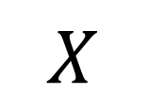
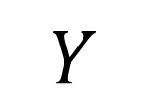



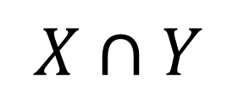
Private Set Intersection (PSI)
10-26-2016 | Efficient Batched Oblivious PRF with Applications to Private Set Intersection | Ni Trieu
Notes:
In this work, we propose an efficient protocol applied to PSI,
s a well-known problem in crypto. 1st We will go thru a simple senerios to get an idea of what PSI is.here we have 2 parties Alice and Bob, each party hold a set of items. Two parties now want to compute the intersection of their sets on the way that don’t leak any information except the intersection. It means that Alice doesn’t know the rest of Bob items, Bob also doesnot know the rest of Alice’s items.

Slide 3












PSI APP: Contact discovery
10-26-2016 | Efficient Batched Oblivious PRF with Applications to Private Set Intersection | Ni Trieu
Notes:
PSI have many applications. For example, contact discovery,
In this scenario, we has Alice with a phone and a list of her contact and she want to use Skype,
On the other side, Bob is Skype service provider. He has the list of the Skype users.
Alice want to find out which of her friends use Skype so that she can chat with them.
Obliviously, they want to compute the intersection of their database. What is privacy here? Clearly Alice doesn’t want to reveal her address book to Bob because this is her personal data. On the other hand, Bob also doesn’t want to reveal his database because of customer privacy. So, we need a PSI.

Slide 4
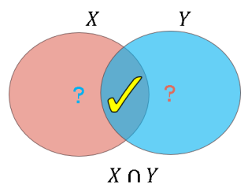

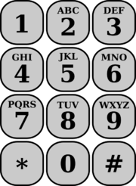
A naïve & Insecure PSI protocol
Alice
Bob
X
Y
Hash each element of X
Hash each element of Y
Bob sends H(Y) to Alice
H(X)
H(Y)
Alice compares 2 sets of hash values, output the intersection
Pro: Fast, and low communication
Con: Insecure, leak privacy of Bob's inputs
X
H(#)
10-26-2016 | Efficient Batched Oblivious PRF with Applications to Private Set Intersection | Ni Trieu
Notes:
What is solution? If we think about private intersection. We might come up with a following solution.
Here Alice has some input elements x, and Bob has some inputs elements y.
They simply hash every of their elements. Then Bob sends the hashes value to Alice, She simply compares and checks whether it is intersection.
Clearly, It is very fast [ just involve 1 hash functions call per element for each side . Bob only need to send his hash element]. Also, we use hash function, then nothing Alice can really do [ she can’t compute hash back to know the actual element due to high computation]
[ Insecure because Alice can compute all hashes values for all possible input, then know which elements Bob may have)
However, it is insecure, especially if the element are chose from small input domain, for instance telephone number (9 digits). Alice can simply computes hash of million phone numbers and compare with the hash value sent by Bob.
Note: move…

Slide 5




Current secure PSI protocol
[PinkasSchneiderSegevZohner15]
1. Special case: private equality test (PEQT), where two parties learn whether 2 strings are equal
2. [PinkasSchneiderSegevZohner15]
PEQT using Oblivious Transfer(OT) extension
Efficiently transform PEQT into PSI via hashing techniques
$$x$$
$$y$$
5
10-26-2016 | Efficient Batched Oblivious PRF with Applications to Private Set Intersection | Ni Trieu
Notes:
In order to handle this problem, several private set intersection protocols has been introduced. The current protocol was proposed last year by Pinkas, Schneider, Segev, and Zohner
Special case of PSI is private equality test protocol, where two parties learn whether their items are equal and nothing more. For example, Alice and Bob want to know whether x=y and nothing else.
The current protocol do PEQT by using OT extension fo PEQT. I will explain OT extension in next slides.
They also proposed some hashing techniques that is Efficiently transform PEQT into PSI
our main technical contribution is to improve the private equality test protocol.
First, let’s me quickly review the Pinkas, Schneider, Segev, and Zohner protocol

Slide 6

private equality test protocol
[PinkasSchneiderSegevZohner15]
?
x
y
Input: Alice has x, Bob has y. Output: x = y
Example: x = 001, y = 011, σ = 3, stat. sec. param. κ
Bob sends κ-bit string ⊕ ⊕ to Alice
Alice computes ⊕ ⊕ and compares
0
( , )
0
0
OT
0
1
(κ-bit each)
1
0
. . . . .
0
1
1
0
1
. . . . .
1
0
1
1
0
0
1
Credit by Michael Zohner, TU Darmstadt
Notes:
For example, Alice has x=001, Bob has y=011. The high level idea of their protocol is to compare bit by bit of x and y . In this case, they compare 0 and 1 as the first bit of x and y. How can they do?
They use a secure black box called Oblivious transfer.
In this scenarios , Bob simple chooses k bit string for 0 and 1 (k is security parameter) and they run OT when Alice input is her first bit 0. Afer the protocol, Alice obtain a string for 0, and Bob doesn’t know Alice’s input!
They do OT for the second bit and for the third bits. Finally, Alice receives the string mask corresponding to her input bits on that particular positions
Now, Bob takes the mask from OT corresponding to his input bit y. So he take 011 masks, XOR them and send them to Alice
Alice need XOR her masks and compare her random mask and mask from Bob.

Slide 7
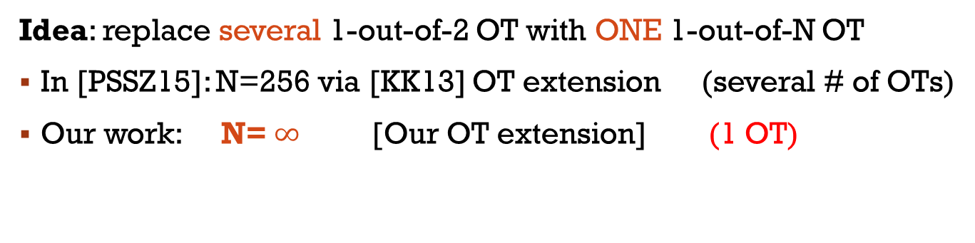
Our Idea
?
x
y
Input: Alice has x, Bob has y. Output: x = y
Example: x = 001, y = 011, σ = 3, stat. sec. param. κ
0
( , )
0
0
OT
0
1
(κ-bit each)
1
0
. . . . .
0
1
1
0
1
. . . . .
1
Idea: replace several 1-out-of-2 OT with ONE 1-out-of-N OT
In [PSSZ15]: N=256 via [KK13] OT extension (several # of OTs)
Our work: N= $∞$ [Our OT extension] (1 OT)
10-26-2016 | Efficient Batched Oblivious PRF with Applications to Private Set Intersection | Ni Trieu
Notes:
Our Idea is want to replace several 1-out-of-2 OT with only ONE 1-out-of-N OT
For the current PSI protocol. they use OT extension proposed by KK13, so they can only compare 8 bits by 8 bits of x and y. I means their N=256, \So, their private equality test still need some number of Ots,
We propose an OT extension protocol that works for any value of N. As the result, we can directly compare x and y by using only 1 OT. so, we can improve PSI protocol 3x faster

Slide 8
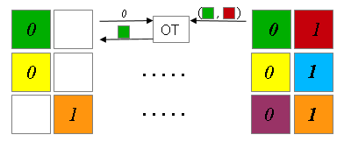



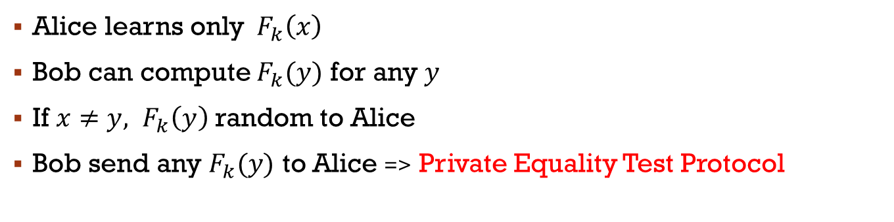

An Observation
x
k
$$F_{k}(x)$$
$$F_{k}(y)$$
Bob sends XOR values to Alice
Alice learns only${ F}_{k}\left(x\right)$
Bob can compute $F_{k}(y)$ for any $y$
If ${x≠y, F}_{k}\left(y\right)$ random to Alice
Bob send any $F_{k}(y)$ to Alice => Private Equality Test Protocol
=>Oblivious PRF[FreedmanIshaiPinkasReingold05]
10-26-2016 | Efficient Batched Oblivious PRF with Applications to Private Set Intersection | Ni Trieu
Notes:
Our observation is that If we put the previous private equality test protocol to the backbox. Briefly, We can see that Alice has x, Bob has k. After running the blackbox, Alice receives the xor of string related to her input, we consider this xor value as f(x).. It neans Alice receives f(x), similarly bob receives f(y).
There are 2 main properties of function f :
$F_{k}(.)$ is randomly uniform
If ${x=y, F}_{k}\left(x\right)=F_{k}\left(y\right)$
This is exactly Oblivious PRF!
Moreover, Bob can send his function value to Alice. She can do private equality test by comparing $F_{k}\left(x\right)$ and $F_{s}\left(y\right)$. Another important thing is that If Alice doesn’t have the same input that Bob has. F(y) looks random to Alice. she CANOT learn anything from the Bob’s input. And, This is exactly Private Equality Test Protocol
NOTE: OPRF,

Slide 9
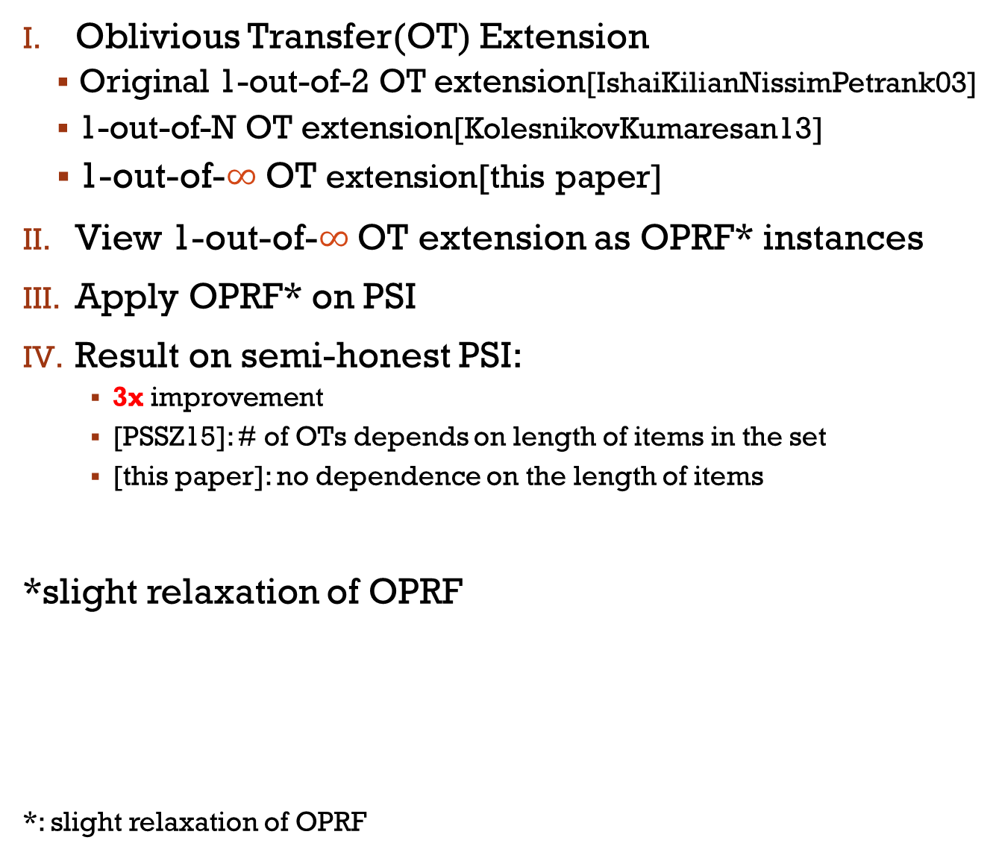
Our outline
Oblivious Transfer(OT) Extension
Original 1-out-of-2 OT extension[IshaiKilianNissimPetrank03]
1-out-of-N OT extension[KolesnikovKumaresan13]
1-out-of-$∞$ OT extension[this paper]
View 1-out-of-$∞$ OT extension as OPRF* instances
Apply OPRF* on PSI
Result on semi-honest PSI:
3x improvement
[PSSZ15]: # of OTs depends on length of items in the set
[this paper]: no dependence on the length of items
*slight relaxation of OPRF
*: slight relaxation of OPRF
10-26-2016 | Efficient Batched Oblivious PRF with Applications to Private Set Intersection | Ni Trieu
Notes:
Here is Our Achievement
1. We propose a protocol that can generate batch of OPRF (BaRK-OPRF) instances from OT extension. Our protocol doesn’t depend on the length of PRF input
2. We apply it on PSI, we improve PSI protocol by a factor 3, and we efficiently remove the gap btw our protocol and naïve one.
Before going to our approach, we first review the OT extension technique to get the flow to our high level idea
I will describe exactly what kind of relaxation we achive

Slide 10

Oblivious Transfer Extension
[Beaver 1996]
OT (using PK) is very expensive
Few OTs+ symmetric keys => many OTs
Public
Keys
Symmetric keys
vs
Public Keys
$$+$$
10-26-2016 | Efficient Batched Oblivious PRF with Applications to Private Set Intersection | Ni Trieu
Notes:
OT extension is first prosped by Beaver decade ago
OT is ex[ersiove since they use PK
His main idea of Beaver 1996 is that doing few OT and then using sysm keys to get manyOTs

Slide 11










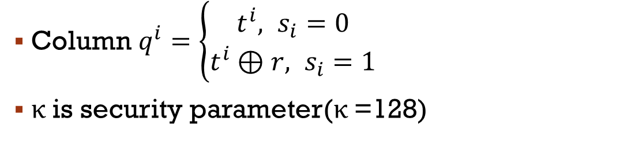

Oblivious Transfer Extension
[IshaiKilianNissimPetrank03]
$$\text{t}\text{1}$$
t²
⊕
r
$$\text{t}\text{1}$$
t¹
⊕
r
$$\text{t}\text{2}$$
$$\text{t}\text{K}$$
t^{K}
⊕
r
t¹
⊕
r
$${ s}_{1}$$
...
$$0$$
$$1$$
$${ s}_{1}$$
$${ s}_{2}$$
$${ s}_{κ}$$
...
BaseOT
Each of length κ
q¹
q²
q^{K}
...
Column $q^{i}=\left\{\begin{aligned}t^{i}, s_{i}=0 \\ &t^{i}⊕r, s_{i}=1\end{aligned}\right.$
κ is security parameter(κ =128)
Column $q^{1}=\left\{\begin{aligned}t^{1}, s_{1}=0 \\ &t^{1}⊕r, s_{1}=1\end{aligned}\right.$
10-26-2016 | Efficient Batched Oblivious PRF with Applications to Private Set Intersection | Ni Trieu
Notes:
I want to review the graphic description of OT ext. Base OT is that Sender, here is Alice, choose a random string t1, and compute other column by xor t1 and r. On the other hand, we hve Receiver, here is Bob, with a 1 bit choice s1, s1=0, or 1. After running OT, Bob gets the column t1 if s1=0, and gets the second column if s1=1. I means that Bob receive the column q1 which vaule depends on his bit choice s1. This steps is done based on OT.
They simply repeat the above step for kappa times, where kappa is the security parameter, and r is the same

Slide 12
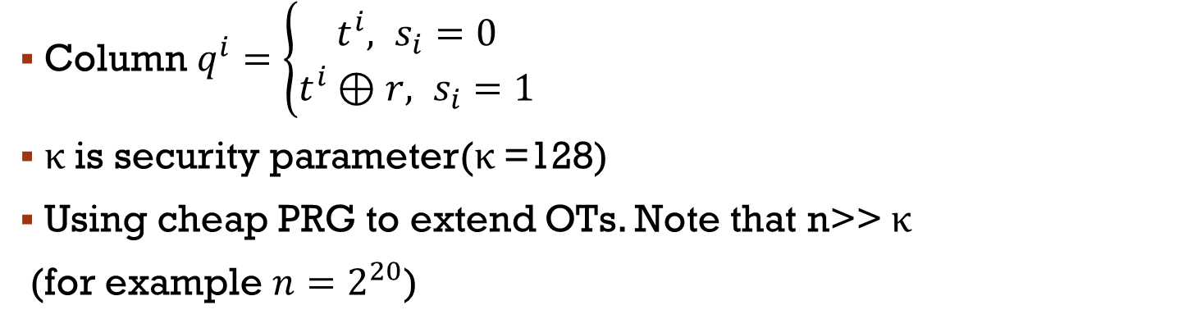




Oblivious Transfer Extension
[IshaiKilianNissimPetrank03]
$$\text{t}\text{1}$$
t¹
⊕
r
t²
⊕
r
$$\text{t}\text{1}$$
t¹
⊕
r
$$\text{t}\text{2}$$
t²
⊕
r
$$\text{t}\text{2}$$
$$\text{t}\text{K}$$
t^{K}
⊕
r
$$\text{t}\text{K}$$
t^{K}
⊕
r
$${ s}_{1}$$
$${ s}_{2}$$
...
$${ s}_{κ}$$
...
...
...
OT
Ext
BaseOT
Each of length κ
q¹
q²
q^{K}
q¹
q²
q^{K}
Each of length n
...
Column $q^{i}=\left\{\begin{aligned}t^{i}, s_{i}=0 \\ &t^{i}⊕r, s_{i}=1\end{aligned}\right.$
κ is security parameter(κ =128)
Using cheap PRG to extend OTs. Note that n>> κ
(for example $n=2^{20}$)
10-26-2016 | Efficient Batched Oblivious PRF with Applications to Private Set Intersection | Ni Trieu
Notes:
Using cheap PRF to extend Ots column to n, note that n>>k

Slide 13





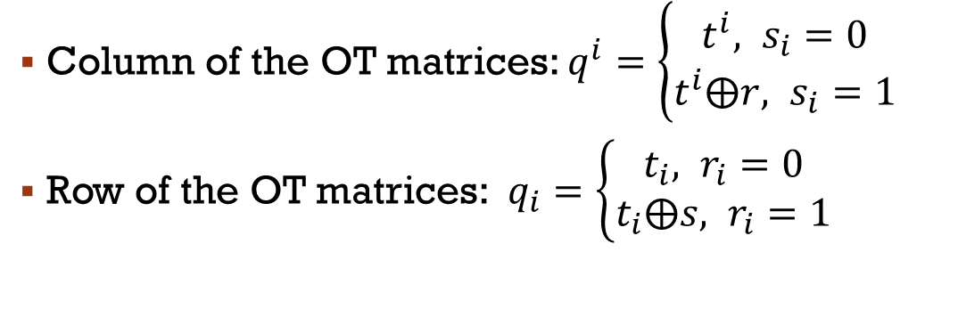










Oblivious Transfer Extension
[IshaiKilianNissimPetrank03]
$$\text{t}\text{1}$$
$$\text{t}\text{2}$$
$$\text{t}\text{k}$$
t¹
⊕
r
t²
⊕
r
t^{K}
⊕
r
$$r_{i}∈\{0,1\}$$
$$t_{i}⊕1^{κ}$$
...
$$r_{i}=0$$
$$t_{i}⊕{{(r}_{i})}^{κ}$$
$$r_{i}=1$$
$${ t}_{i}$$
$$t_{i}$$
$${ s}_{1}$$
$${ s}_{2}$$
$${ s}_{κ}$$
repetition
encoding r
...
...
OT
Ext
Bit-wise AND
q¹
q²
q^{K}
$$q_{i}=t_{i}⊕s$$
$$q_{i}=t_{i}⊕{(r_{i})}^{κ}⨀s$$
$$q_{i}=t_{i}$$
...
Column of the OT matrices: $q^{i}=\left\{\begin{aligned}t^{i}, s_{i}=0 \\ &t^{i}⨁r, s_{i}=1\end{aligned}\right.$
Row of the OT matrices: $q_{i}=\left\{\begin{aligned}t_{i}, r_{i}=0 \\ &t_{i}⨁s, r_{i}=1\end{aligned}\right.$
10-26-2016 | Efficient Batched Oblivious PRF with Applications to Private Set Intersection | Ni Trieu
Notes:
If we see the OT matrices by row,
Denote ti is the ith row of 1st matrix, ri is a ith bit of r. so the ith row of second matix is equal to ti xor the repetition encoding ri. After OT, we have qi=…
Particularly, if ri=0…
If ri=1
we can get a very good property: qi=ti if ri=0, ….
Example 1st

Slide 14

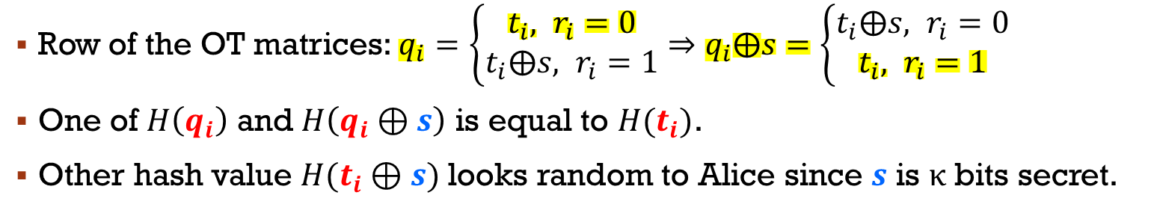






Oblivious Transfer Extension
[IshaiKilianNissimPetrank03]
$$r_{i}$$
$$s$$
$$\text{t}\text{1}$$
$$\text{t}\text{2}$$
$$\text{t}\text{k}$$
t¹
⊕
r
t²
⊕
r
t^{K}
⊕
r
$$r_{i}∈\{0,1\}$$
$${ t}_{i}$$
$t_{i}⊕$ ${(r_{i})}^{κ}$
$${ s}_{1}$$
$${ s}_{2}$$
...
$${ s}_{κ}$$
repetition
encoding r
...
...
OT
Ext
q¹
q²
q^{K}
$$q_{i}=t_{i}⊕{(r_{i})}^{κ}⨀s$$
...
$$H(t_{i})$$
$$H(q_{i})$$
$$H(q_{i}⊕s)$$
Row of the OT matrices: $q_{i}=\left\{\begin{aligned}t_{i}, r_{i}=0 \\ &t_{i}⨁s, r_{i}=1\end{aligned}\right.⇒q_{i}⨁s=\left\{\begin{aligned}t_{i}⨁s, r_{i}=0 \\ &t_{i}, r_{i}=1\end{aligned}\right.$
One of $H\left(q_{i}\right)$ and $H\left(q_{i}⊕s\right)$ is equal to $H(t_{i})$.
Other hash value $H(t_{i}⊕s)$ looks random to Alice since $s$ is κ bits secret.
10-26-2016 | Efficient Batched Oblivious PRF with Applications to Private Set Intersection | Ni Trieu
Notes:
Here is the whole picture of OT extension protocol. Now we focus on the row of all these matriecs. We can see that
Alice input ri, Bob input s, After the OT extenstion, Alice knows ti and computes H(ti), and Bob gets qi. He compute H(qi), H(qi+s).
depends on a bit ri, one of two bOb has value is equal to Alice hash value. Thus, if bob sends 2 hash values $H\left(q_{i}\right)$ and $H\left(q_{i}⊕s\right)$ to Alice. She knows one of them. Other hash value $H(t_{i}⊕s)$ looks random on the Alice’s side since $s$ is secret
This is OT, where…Alcie know 1 value, Bob knows 2 values, other value looks random. And each row of matrix gives 1 OT…so we have a million OT now

Slide 15

















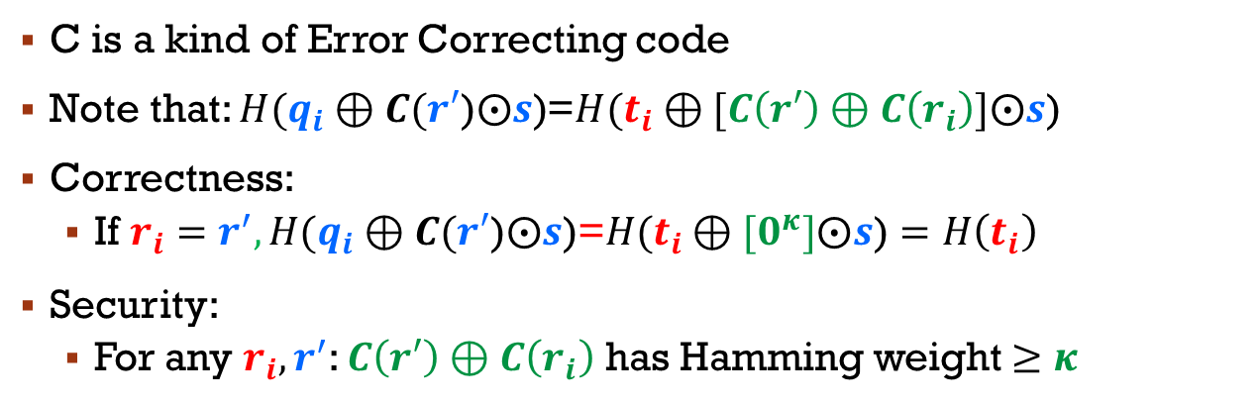


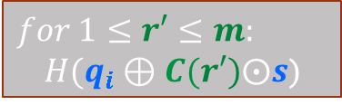
1-out-of-N oblivious transfer
[KolesnikovKumaresan13]
$$r_{i}$$
$$s$$
$$r_{i}∈\{0,1\}$$
$t_{i}⊕$ ${(r_{i})}^{κ}$
$$t_{i}⊕{C(r}_{i})$$
$$r_{i}∈[m]$$
$$t_{i}⊕{C(r}_{i})$$
$$r_{i}∈[2^{3}]$$
$${ t}_{i}$$
$$s$$
repetition
encoding $r_{i}$
Error Correcting code
$$C:[m]→{\{0,1\}}^{\text{κ}}$$
$$C:\{0,1\}→{\{0,1\}}^{\text{κ}}$$
$$C{ :\{0,1\}}^{3}→{\{0,1\}}^{\text{κ}}$$
OT
Ext
$$q_{i}=t_{i}⊕{C(r}_{i})⨀s$$
$$q_{i}=t_{i}⊕{(r_{i})}^{κ}⨀s$$
$$H(t_{i})$$
$$H(q_{i})$$
$$for 1≤r′≤m:$$
$$H(q_{i}⊕C(r′)⨀s\text{)}$$
$$H(q_{i}⊕C(000)⨀s\text{)}$$
$$H(q_{i}⊕C(0)⨀s)$$
C is a kind of Error Correcting code
Note that: $H(q_{i}⊕C(r′\text{)}⨀s\text{)}$=$H(t_{i}⊕[C\left(r′\right)⊕C\left(r_{i}\right)]⨀s\text{)}$
Correctness:
If $r_{i}{=r}^{′},H(q_{i}⊕C(r′\text{)}⨀s\text{)}\text{=}H(t_{i}⊕[0^{κ}]⨀s\text{)}=H\left(t_{i}\right)$
Security:
For any $r_{i}{, r}^{′}$: $C\left(r′\right)⊕C\left(r_{i}\right)$ has Hamming weight$≥$ $κ$
$$H(q_{i}⊕s)$$
$$H(q_{i}⊕C(001)⨀s\text{)}$$
$$H(q_{i}⊕C(1)⨀s)$$
...
$$H(q_{i}⊕C(111)⨀s\text{)}$$
10-26-2016 | Efficient Batched Oblivious PRF with Applications to Private Set Intersection | Ni Trieu
Notes:
In 2013, KK found that r is presented as the repetition code in IKNP protocol.
Instead of 1 bit ri, their protocol can works for ri <m. They replaced the repetition code of ri by C(ri), where C is a kind of Error Correcting code.,
Alice view:
By doing this, qi are updated. For example, m=8, he has 8 hash values on the slides.
Alice still has 1 hash value while Bob have m hash values,
Important property is that hash value that Bob computes is equal to ….
So, if r=ri, Alice hash value is equal to one of Bob hash values.
Their protocol is called 1-out-out N OT
color

Slide 16
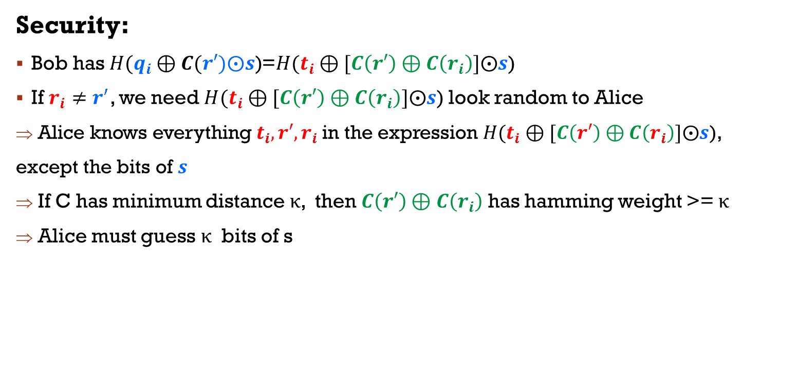
1-out-of-N oblivious transfer
[KolesnikovKumaresan13]
Security:
Bob has$H(q_{i}⊕C(r′)⨀s\text{)}$=$H(t_{i}⊕[C\left(r′\right)⊕C\left(r_{i}\right)]⨀s\text{)}$
If $r_{i}{≠r}^{′}$, we need $H(t_{i}⊕[C\left(r′\right)⊕C\left(r_{i}\right)]⨀s\text{)}$ look random to Alice
Alice knows everything$t_{i},r′,r_{i}$ in the expression $H(t_{i}⊕[C\left(r′\right)⊕C\left(r_{i}\right)]⨀s\text{), }$
except the bits of $s$
If C has minimum distance $\text{κ}$, then $C\left(r′\right)⊕C\left(r_{i}\right)$ has hamming weight >= $\text{κ}$
Alice must guess $\text{κ}$ bits of s
10-26-2016 | Efficient Batched Oblivious PRF with Applications to Private Set Intersection | Ni Trieu
Notes:
So For Security & Privacy: we need the Hamming distance btw C(x) and C(y) is larger enough
Lets look the high level of the protocol. If Bob sends Alice all his hash functions. Actually, Alice got $H(t_{i}⊕[C\left(x\right)⊕C\left(y\right)]⨀s\text{)}$
Now, if Alice tries to learn y. She knows everything$t_{i}, y, x$in this expression, except the bits of $s$.
Therefore, For security, we need: $C\left(x\right)⊕C\left(y\right)$ has Hamming weight at least κ, where κ is security parameter
We compute the output length of C, and we get that this length is 3x more than the security parameter
KK13 S&P
Pr[]
Table

Slide 17

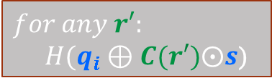




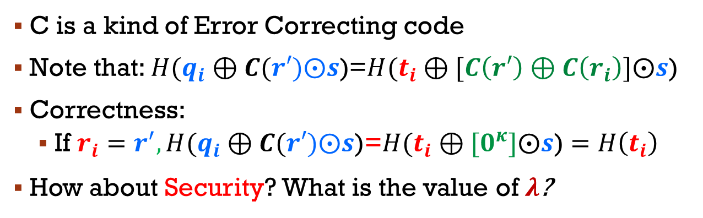

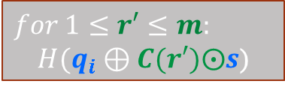
our Observation
1-out-of-$∞$ Oblivious transfer extension
$$r_{i}$$
$$s$$
$$r_{i}∈[m]$$
$$t_{i}⊕{C(r}_{i})$$
$$r_{i}∈{\{0,1\}}^{∗}$$
$${ t}_{i}$$
$$s$$
Error Correcting code
Random function
$$C:[m]→{\{0,1\}}^{\text{κ}}$$
$$C:{\{0,1\}}^{∗}→{\{0,1\}}^{λ}$$
OT
Ext
$$q_{i}=t_{i}⊕{C(r}_{i})⨀s$$
$$H(t_{i})$$
$$for any r′:$$
$$H(q_{i}⊕C(r′)⨀s\text{)}$$
$$for 1≤r′≤m:$$
$$H(q_{i}⊕C(r′)⨀s\text{)}$$
C is a kind of Error Correcting code
Note that: $H(q_{i}⊕C(r′)⨀s\text{)}$=$H(t_{i}⊕[C\left(r′\right)⊕C\left(r_{i}\right)]⨀s\text{)}$
Correctness:
If $r_{i}{=r}^{′},H(q_{i}⊕C(r′)⨀s\text{)}\text{=}H(t_{i}⊕[0^{κ}]⨀s\text{)}=H\left(t_{i}\right)$
How about Security? What is the value of $λ$?
no need decoding
Random function
10-26-2016 | Efficient Batched Oblivious PRF with Applications to Private Set Intersection | Ni Trieu
Notes:
We realize that C function doestnt need decoding in KK protocol. So We can replace C as any random function. Moreover, if Alice input is r with any length of string, so all formular are updated. And Now, for any r’, Bob computes $H(q_{i}⊕C(r′)⨀s\text{)}$ finally, the hash values of bob is equal to …
And if ri==r’, we have ..
The question now is how about Security & Privacy?
Simple change, but very powerfull

Slide 18
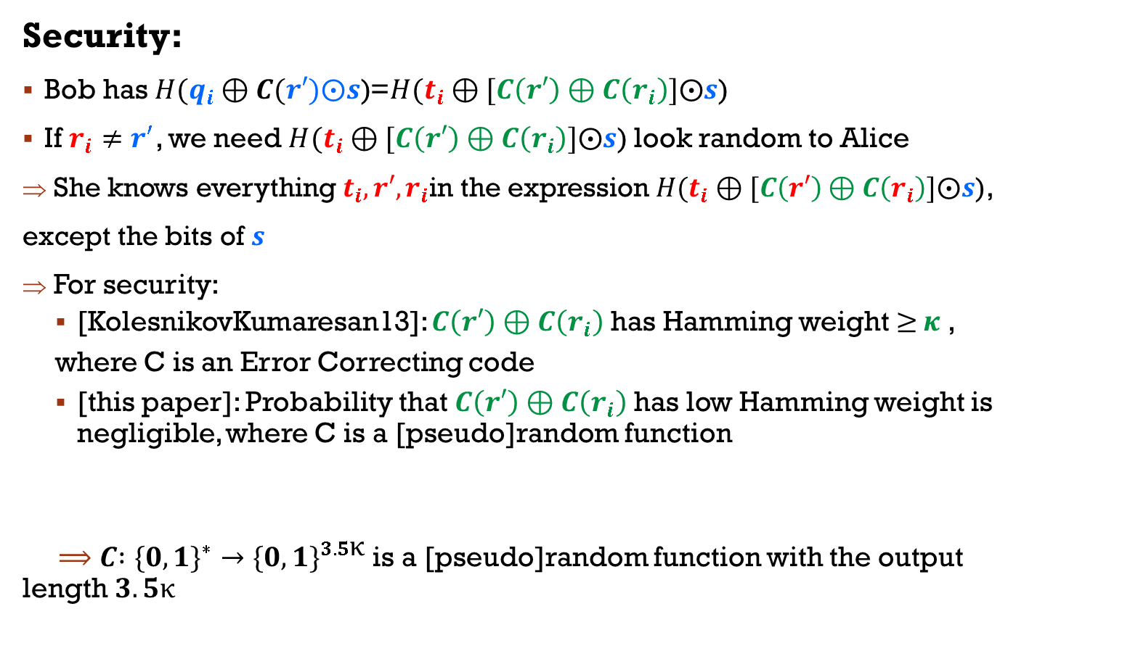
Our Contribution
Security:
Bob has$H(q_{i}⊕C(r′)⨀s\text{)}$=$H(t_{i}⊕[C\left(r′\right)⊕C\left(r_{i}\right)]⨀s\text{)}$
If $r_{i}{≠r}^{′}$, we need $H(t_{i}⊕[C\left(r′\right)⊕C\left(r_{i}\right)]⨀s\text{)}$ look random to Alice
She knows everything$t_{i},r′,r_{i}$in the expression $H(t_{i}⊕[C\left(r′\right)⊕C\left(r_{i}\right)]⨀s\text{), }$
except the bits of $s$
For security:
[KolesnikovKumaresan13]: $C\left(r′\right)⊕C\left(r_{i}\right)$ has Hamming weight$≥$ $κ$ ,
where C is an Error Correcting code
[this paper]: Probability that $C\left(r′\right)⊕C\left(r_{i}\right)$ has low Hamming weight is negligible, where C is a [pseudo]random function
$⟹C{ :\{0,1\}}^{∗}→{\{0,1\}}^{3.5\text{κ}}$ is a [pseudo]random function with the output length$3.5\text{κ}$
$$Pr\left[C\left(r^{′}\right)⊕C\left(r_{i}\right) has low Hamming weight\right]≤2^{−\text{κ}}$$
10-26-2016 | Efficient Batched Oblivious PRF with Applications to Private Set Intersection | Ni Trieu
Notes:
So For Security & Privacy: we need the Hamming distance btw C(x) and C(y) is larger enough
Lets look the high level of the protocol. If Bob sends Alice all his hash functions. Actually, Alice got $H(t_{i}⊕[C\left(x\right)⊕C\left(y\right)]⨀s\text{)}$
Now, if Alice tries to learn y. She knows everything$t_{i}, y, x$in this expression, except the bits of $s$.
Therefore, For security, we need: $C\left(x\right)⊕C\left(y\right)$ has Hamming weight at least κ, where κ is security parameter
We compute the output length of C, and we get that this length is 3x more than the security parameter
KK13 S&P
Pr[]
Table

Slide 19

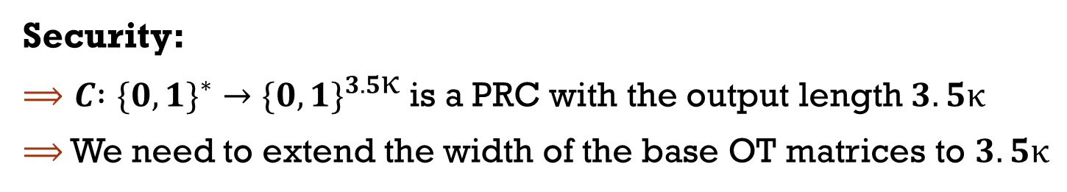





Our Contribution
$$Pr\left[C\left(r^{′}\right)⊕C\left(r_{i}\right) has low Hamming weight\right]≤2^{−\text{κ}}$$
Security:
$⟹C{ :\{0,1\}}^{∗}→{\{0,1\}}^{3.5\text{κ}}$ is a PRC with the output length $3.5\text{κ}$
$⟹$ We need to extend the width of the base OT matrices to $3.5\text{κ}$
OT Ext Transpose
$$\text{κ}$$
$$\text{κ}$$
$$\text{3.5}\text{κ}$$
BaseOT
PRG
OT
Ext
Matrix transpose
$$\text{κ}$$
$$\text{κ}$$
$$\text{3.5}\text{κ}$$
10-26-2016 | Efficient Batched Oblivious PRF with Applications to Private Set Intersection | Ni Trieu
Notes:
We use C as a PRC. From the previous slide, we need increase the width of the OT extension matrices by factor 3 so we can have a code with enough min distance
We again use Matrix transpose & PRG: extend the width of the base OT matrices to$3\text{κ}$. This step use a cheap crypto tool.
(draw …))

Slide 20









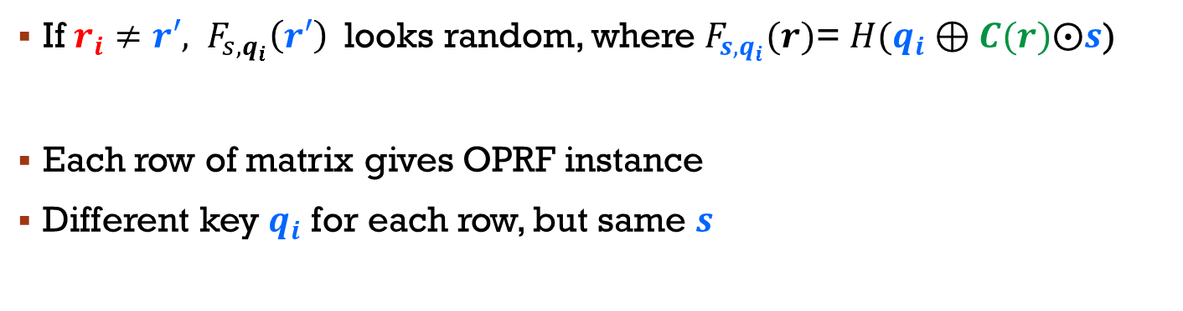
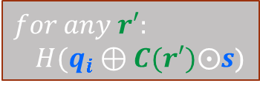




Our Batched OPRF (BaRK-OPRF)
$$r_{i}$$
$$s$$
$$r_{i}$$
Batched,
Related-key
OPRF
$${ t}_{i}$$
$$t_{i}⊕{C(r}_{i})$$
$${ t}_{i}$$
$$s$$
$$s$$
3.5k
OT
Ext
$$q_{i}=t_{i}⊕{C(r}_{i})⨀s$$
$$H(t_{i})$$
$$for any r′:$$
$$H(q_{i}⊕C(r′)⨀s\text{)}$$
$$F_{s,q_{i}}(r_{i})$$
$$for any r′:F_{s,q_{i}}(r′)$$
If ${r_{i}≠r′, F}_{s,q_{i}}\left(r′\right)$looks random, where $F_{s,q_{i}}(r)$= $H(q_{i}⊕C(r)⨀s\text{)}$
Each row of matrix gives OPRF instance
Different key $q_{i}$ for each row, but same $s$
=> Oblivious PRF of $F_{s,q_{i}}(r)$
=> Batched OPRF
=> Batched Related-key OPRF
10-26-2016 | Efficient Batched Oblivious PRF with Applications to Private Set Intersection | Ni Trieu
Notes:
Look at the overview of our protocol. We can replace all hash function as ….
We have very nice properties:
$F_{s,q_{i}}(.)$ is randomly uniform
If ${x=y, F}_{s,q_{i}}\left(x\right)=F_{s,q_{i}}\left(y\right)$
This is Oblivious PRF!
Each row of OT extension is corresponding to each value x. we can get a big matrix OT extension very cheap => Batched OPRF
Our protocol has Different key $q_{i}$ for each row but same $s$=> Batched Related-key OPRF
That is the reason we call our protocol as Batched Related-key OPRF

Slide 21
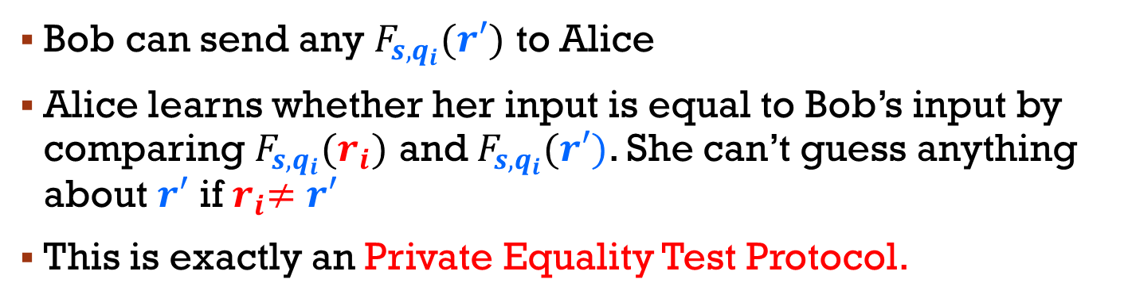

Our PSI based on OPRF
$$r_{i}$$
$$s$$
$$r_{i}$$
Batched,
Related-key
OPRF
$${ t}_{i}$$
$$t_{i}⊕{C(r}_{i})$$
$${ t}_{i}$$
$$s$$
$$s$$
3.5k
OT
Ext
$$q_{i}=t_{i}⊕{C(r}_{i})⨀s$$
Bob sends F values to Alice
$$H(t_{i})$$
$$for any r′:F_{s,q_{i}}(r′)$$
$$F_{s,q_{i}}(r_{i})$$
Bob can send any $F_{s,q_{i}}(r′)$ to Alice
Alice learns whether her input is equal to Bob’s input by comparing $F_{s,q_{i}}(r_{i})$ and $F_{s,q_{i}}(r′)$. She can’t guess anything about $r′$ if${ r}_{i}≠r′$
This is exactly an Private Equality Test Protocol.
10-26-2016 | Efficient Batched Oblivious PRF with Applications to Private Set Intersection | Ni Trieu
Notes:
Morover, We apply bark-oprf on PSI, and This is exactly an Private Equality Test Protocol.
Bob can send any $F_{s}(y)$ to Alice
Alice learns whether her input is equal to Bob’s input by comparing $F_{s}(x)$ and $F_{s}(y)$. She can’t guess anything about$y$ if $x≠y$

Slide 22
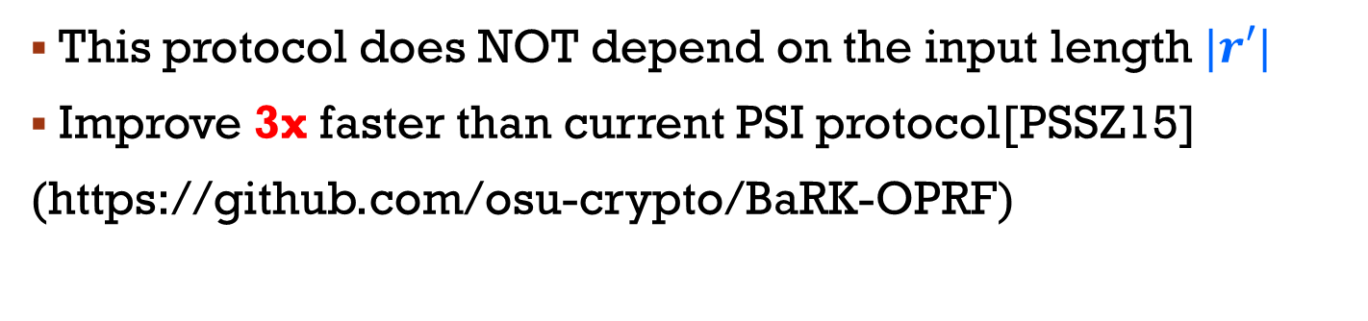
Our PSI based on OPRF
$$r_{i}$$
$$s$$
$$r_{i}$$
Batched,
Related-key
OPRF
$${ t}_{i}$$
$$t_{i}⊕{C(r}_{i})$$
$${ t}_{i}$$
$$s$$
$$s$$
3.5k
OT
Ext
$$q_{i}=t_{i}⊕{C(r}_{i})⨀s$$
Bob sends F values to Alice
$$H(t_{i})$$
$$for any r′:F_{s,q_{i}}(r′)$$
$$F_{s,q_{i}}(r_{i})$$
This protocol does NOT depend on the input length $|r′|$
Improve 3x faster than current PSI protocol[PSSZ15]
(https://github.com/osu-crypto/BaRK-OPRF)
10-26-2016 | Efficient Batched Oblivious PRF with Applications to Private Set Intersection | Ni Trieu
Notes:
Finally, we get
This protocol does NOT depend on the input length
Improve 3x faster than current PSI protocol[PSSZ15]

Slide 23
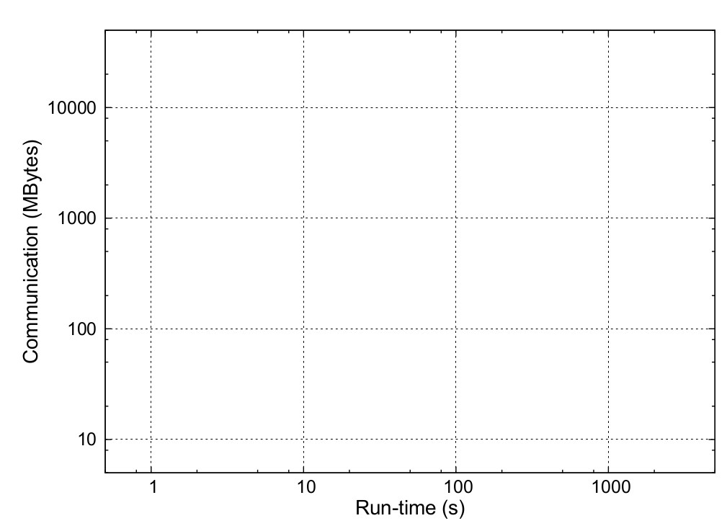
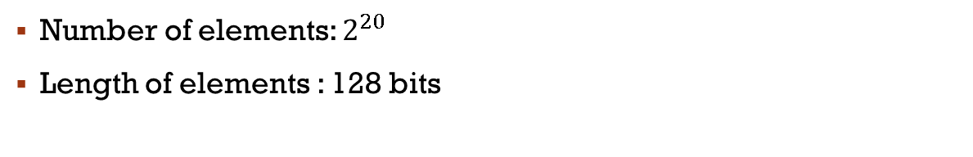
Comparison of Semi-Honest PSI
Number of elements: $2^{20}$
Length of elements : 128 bits
Circuit-Based:
+: general
-: high run-time
Public-key-Based:
+: best communication
-: high run-time
OT-Based:
+: best run-time
+: good communication
Circuit-based
OT+Hash'14
OT+Phasing'15
BaRK-OPRF
Public-key-based
Na
ï
ve
10-26-2016 | Efficient Batched Oblivious PRF with Applications to Private Set Intersection | Ni Trieu
Notes:
Here is the comparison of our protocol to other research. For the Number of elements: 2^20
Length of elements : 128 bits. As we can see from the graph, we improve the current PSI protocol by 3x. And get close to naïve protocol.
Choose the best method.

Slide 24
Another independent PSI work Improve [KK13] using error-correcting code
2016/930 ( PDF )
Scalable Private Set Intersection Based on OT Extension
Benny Pinkas and Thomas Schneider and Michael Zohner
2016/933 ( PDF )
Actively Secure 1-out-of-N OT Extension with Application to Private Set Intersection
Michele Orrù and Emmanuela Orsini and Peter Scholl
10-26-2016 | Efficient Batched Oblivious PRF with Applications to Private Set Intersection | Ni Trieu

Slide 25
Thank you
10-26-2016 | Efficient Batched Oblivious PRF with Applications to Private Set Intersection | Ni Trieu

