Slide 1

new tools and techniques for practical private set intersection
Student: Ni Trieu
Advisor: Mike Rosulek
Joint work with: Vladimir Kolesnikov, Ranjit Kumaresan, Naor Matania, Benny Pinkas
Notes:
my work is on PSI, so today I want to introduct it to your guys. This is the joint work with …

Slide 2


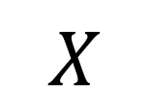
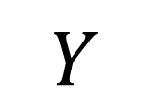



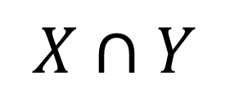
Private Set Intersection (PSI)
June-2016 | New Tools and Techniques for Practical Private Set Intersection | Ni Trieu
Notes:
In this work, we propose an efficient protocol applied to PSI,
s a well-known problem in crypto. 1st We will go thru a simple senerios to get an idea of what PSI is.here we have 2 parties Alice and Bob, each party hold a set of items. Two parties now want to compute the intersection of their sets on the way that don’t leak any information except the intersection. It means that Alice doesn’t know the rest of Bob items, Bob also doesnot know the rest of Alice’s items.

Slide 3












PSI APP: Contact discovery
June-2016 | New Tools and Techniques for Practical Private Set Intersection | Ni Trieu
Notes:
PSI have many applications. For example, contact discovery,
In this scenario, we has Alice with a phone and a list of her contact and she want to use Skype,
On the other side, Bob is Skype service provider. He has the list of the Skype users.
Alice want to find out which of her friends use Skype so that she can chat with them.
Obliviously, they want to compute the intersection of their database. What is privacy here? Clearly Alice doesn’t want to reveal her address book to Bob because this is her personal data. On the other hand, Bob also doesn’t want to reveal his database because of customer privacy. So, we need a PSI.

Slide 4
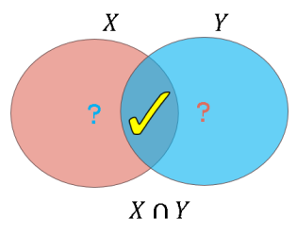

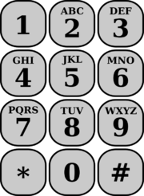
A naïve & Insecure PSI protocol
Alice
Bob
X
Y
Hash each element of X
Hash each element of Y
Bob sends H(Y) to Alice
H(X)
H(Y)
Alice compares 2 sets of hash values, output the intersection
X
Pro: Fast, and low communication
Con: Insecure, leak privacy of Bob's inputs
H(#)
June-2016 | New Tools and Techniques for Practical Private Set Intersection | Ni Trieu
Notes:
What is solution? If we think about private intersection. We might come up with a following solution.
Here Alice has some input elements x, and Bob has some inputs elements y.
They simply hash every of their elements. Then Bob sends the hashes value to Alice, She simply compares and checks whether it is intersection.
Clearly, It is very fast [ just involve 1 hash functions call per element for each side . Bob only need to send his hash element]. Also, we use hash function, then nothing Alice can really do [ she can’t compute hash back to know the actual element due to high computation]
[ Insecure because Alice can compute all hashes values for all possible input, then know which elements Bob may have)
However, it is insecure, especially if the element are chose from small input domain, for instance telephone number (9 digits). Alice can simply computes hash of million phone numbers and compare with the hash value sent by Bob.
Note: move…

Slide 5
Our outline
PSI and Its application
Naïve and Insecure PSI protocol
Previous 2-party PSI protocols
Our 2-party PSI protocol
New term: Oblivious Programmable PRF (O[P]PRF)
OPPRF application to Multi-party PSI
Further works
*: This talk is on Semi-honest setting
June-2016 | New Tools and Techniques for Practical Private Set Intersection | Ni Trieu
Notes:
Here is Our Achievement
1. We propose a protocol that can generate batch of OPRF (BaRK-OPRF) instances from OT extension. Our protocol doesn’t depend on the length of PRF input
2. We apply it on PSI, we improve PSI protocol by a factor 3, and we efficiently remove the gap btw our protocol and naïve one.
Before going to our approach, we first review the OT extension technique to get the flow to our high level idea

Slide 6
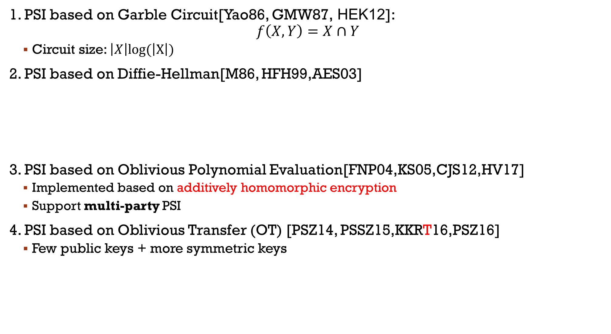






secure PSI protocol
1. PSI based on Garble Circuit[Yao86, GMW87, HEK12]:
$$f\left(X,Y\right)=X∩Y$$
Circuit size: $\left|X\right|log(\left|X\right|)$
2. PSI based on Diffie-Hellman[M86, HFH99,AES03]
3. PSI based on Oblivious Polynomial Evaluation[FNP04,KS05,CJS12,HV17]
Implemented based on additively homomorphic encryption
Support multi-party PSI
4. PSI based on Oblivious Transfer (OT) [PSZ14, PSSZ15,KKRT16,PSZ16]
Few public keys + more symmetric keys
$${{H(x_{1})}^{α},…, H(x_{n})}^{α}$$
$$β$$
$$α$$
$${H(y_{1})}^{β}, …,{H(y_{n})}^{β }$$
# Public keys ~ Set size
$${({H(y_{1})}^{β})}^{α}, …,{({H(y_{n})}^{β})}^{α }$$
Plain
Intersection
$${({H(x_{1})}^{α})}^{β}, …,{({H(x_{n})}^{α})}^{β }$$
June-2016 | New Tools and Techniques for Practical Private Set Intersection | Ni Trieu
Notes:
In order to handle this problem, several private set intersection protocols has been introduced. The current protocol was proposed last year by Pinkas, Schneider, Segev, and Zohner
Special case of PSI is private equality test protocol, where two parties learn whether their items are equal and nothing more. For example, Alice and Bob want to know whether x=y and nothing else.
The current protocol do PEQT by using OT extension fo PEQT. I will explain OT extension in next slides.
They also proposed some hashing techniques that is Efficiently transform PEQT into PSI
our main technical contribution is to improve the private equality test protocol.
First, let’s me quickly review the Pinkas, Schneider, Segev, and Zohner protocol

Slide 7

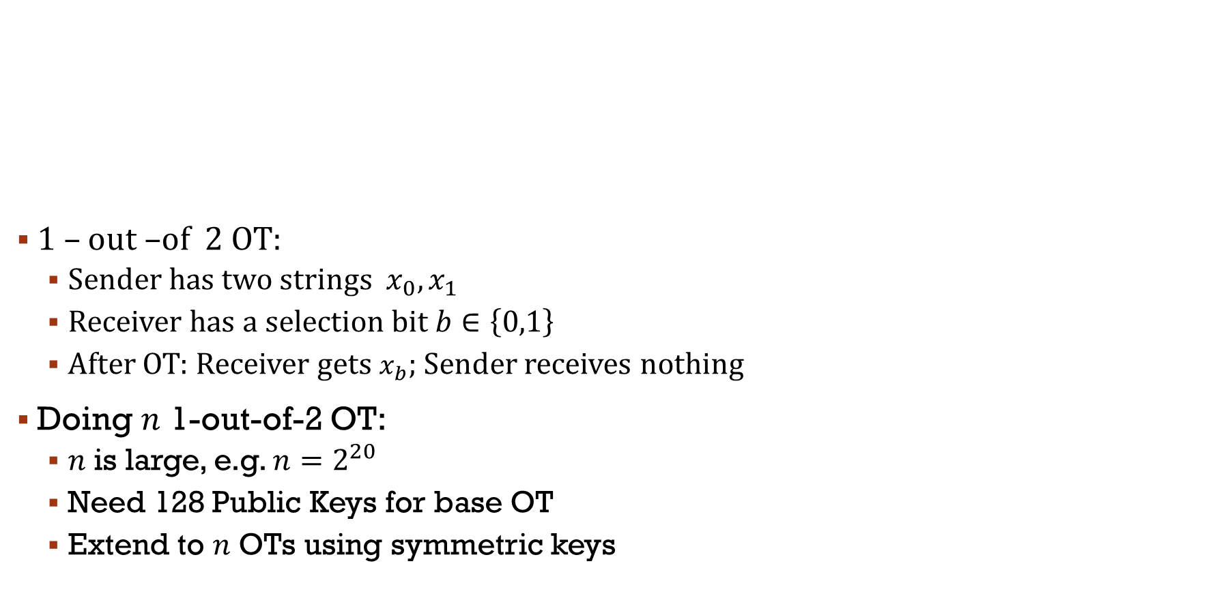



Oblivious Transfer Extension[IKNP03]
1 – out –of 2 OT:
Sender has two strings ${ x}_{0},x_{1}$
Receiver has a selection bit $b∈\left\{0,1\right\}$
After OT: Receiver gets $x_{b}$; Sender receives nothing
Doing $n$ 1-out-of-2 OT:
$n$ is large, e.g. $n=2^{20}$
Need 128 Public Keys for base OT
Extend to $n$ OTs using symmetric keys
$$b∈\{0,1\}$$
Oblivious Transfer
$$x_{0},x_{1}$$
$$x_{b}$$
Few Public keys + more symmetric keys
June-2016 | New Tools and Techniques for Practical Private Set Intersection | Ni Trieu
Notes:
In order to handle this problem, several private set intersection protocols has been introduced. The current protocol was proposed last year by Pinkas, Schneider, Segev, and Zohner
Special case of PSI is private equality test protocol, where two parties learn whether their items are equal and nothing more. For example, Alice and Bob want to know whether x=y and nothing else.
The current protocol do PEQT by using OT extension fo PEQT. I will explain OT extension in next slides.
They also proposed some hashing techniques that is Efficiently transform PEQT into PSI
our main technical contribution is to improve the private equality test protocol.
First, let’s me quickly review the Pinkas, Schneider, Segev, and Zohner protocol

Slide 8



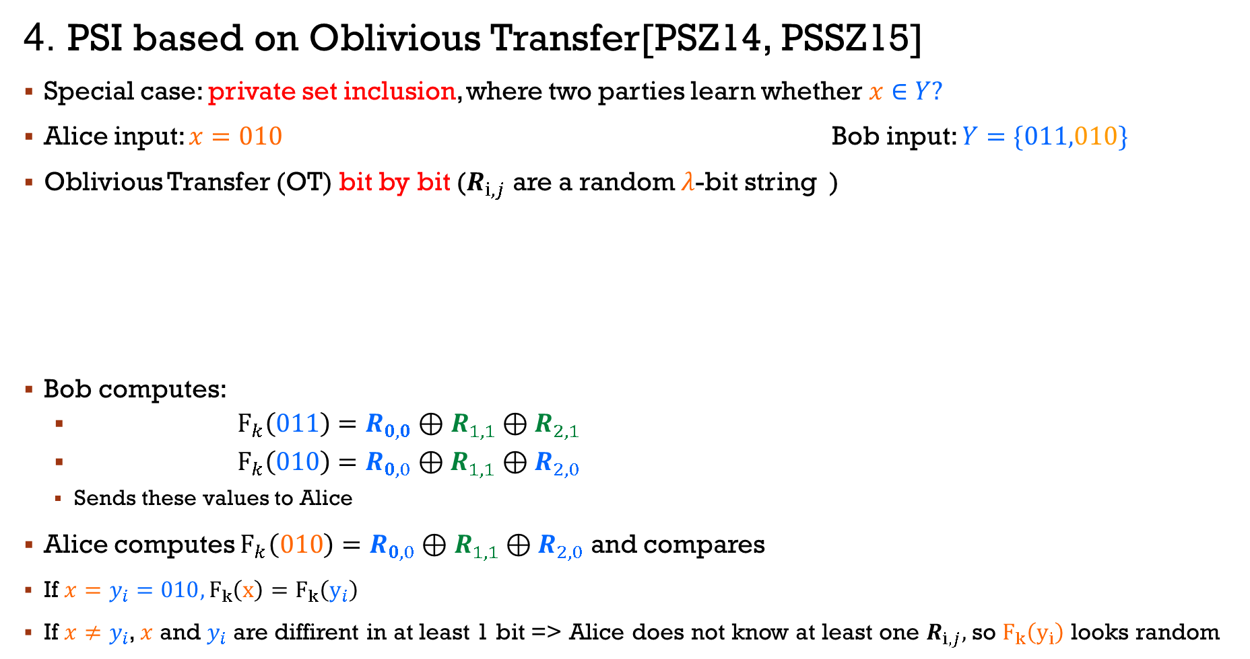










secure PSI protocol
4. PSI based on Oblivious Transfer[PSZ14, PSSZ15]
Special case: private set inclusion, where two parties learn whether$x∈Y?$
Alice input: $x=010$ Bob input: $Y=\{011,010\}$
Oblivious Transfer (OT) bit by bit ($R_{i,j}$ are a random $λ$-bit string )
Bob computes:
${{ F}_{k}\left(011\right)=R}_{0,0}⊕R_{1,1}⊕R_{2,1}$
${ F}_{k}\left(010\right)=R_{0,0}⊕R_{1,1}⊕R_{2,0}$
Sends these values to Alice
Alice computes $F_{k}\left(010\right)=R_{0,0}⊕R_{1,1}⊕R_{2,0}$ and compares
If $x=y_{i}=010, F_{k}\left(x\right)=F_{k}\left(y_{i}\right)$
If $x≠y_{i}$, $x$ and $y_{i}$ are diffirent in at least 1 bit => Alice does not know at least one $R_{i,j},$so $F_{k}\left(y_{i}\right)$ looks random
$$R_{0,0}$$
$$0$$
OT
$$R_{0,0}$$
$$R_{0,1}$$
$$R_{1,1}$$
$$1$$
$$R_{1,0}$$
$$R_{1,1}$$
$$R_{2,0}$$
$$0$$
$$R_{2,0}$$
$$R_{2,1}$$
8
June-2016 | New Tools and Techniques for Practical Private Set Intersection | Ni Trieu
Notes:
In order to handle this problem, several private set intersection protocols has been introduced. The current protocol was proposed last year by Pinkas, Schneider, Segev, and Zohner
Special case of PSI is private equality test protocol, where two parties learn whether their items are equal and nothing more. For example, Alice and Bob want to know whether x=y and nothing else.
The current protocol do PEQT by using OT extension fo PEQT. I will explain OT extension in next slides.
They also proposed some hashing techniques that is Efficiently transform PEQT into PSI
our main technical contribution is to improve the private equality test protocol.
First, let’s me quickly review the Pinkas, Schneider, Segev, and Zohner protocol

Slide 9
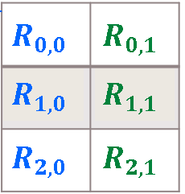
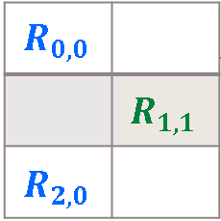




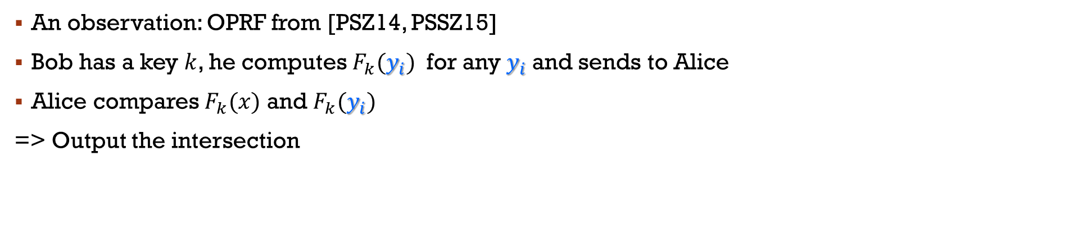
An observation [PSZ14, PSSZ15]
OPRF
$$x$$
$$F_{k}(x)$$
$$k$$
$$F_{k}(y_{i})$$
Compares the two lists
An observation: OPRF from [PSZ14, PSSZ15]
Bob has a key $k$, he computes $F_{k}(y_{i})$ for any$y_{i}$ and sends to Alice
Alice compares $F_{k}(x)$ and $F_{k}(y_{i})$
=> Output the intersection
June-2016 | New Tools and Techniques for Practical Private Set Intersection | Ni Trieu
Notes:
We construct the back box that give sender a key, and r

Slide 10
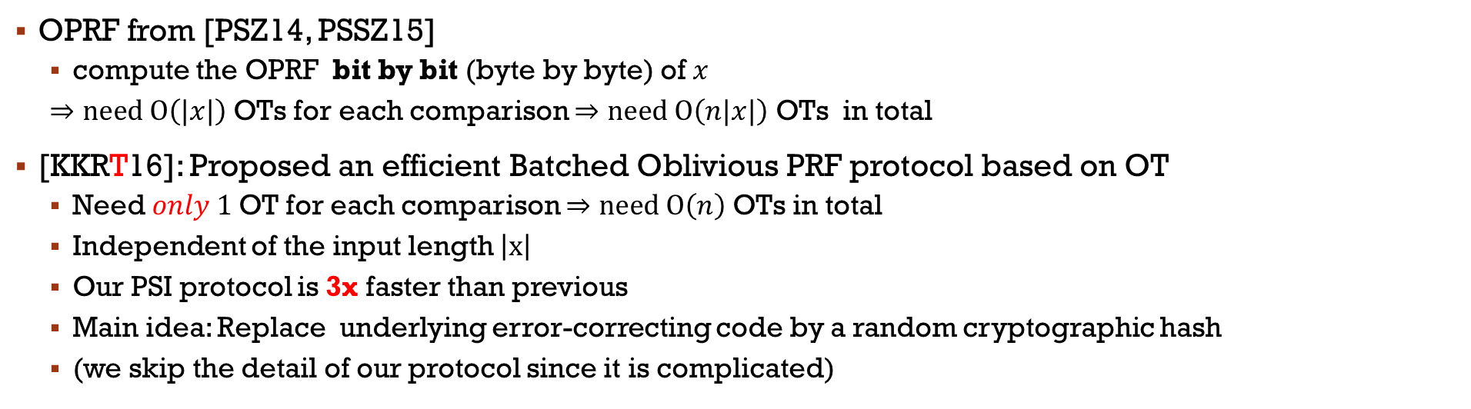
OUR 2-party PSI[KKRT16]
OPRF
$$x$$
$$F_{k}(x)$$
$$k$$
OPRF from [PSZ14, PSSZ15]
compute the OPRF bit by bit (byte by byte) of $x$
$⇒need O\left(|x|\right)$ OTs for each comparison $⇒need O\left(n|x|\right)$ OTs in total
[KKRT16]: Proposed an efficient Batched Oblivious PRF protocol based on OT
Need$only 1$ OT for each comparison $⇒need O\left(n\right)$ OTs in total
Independent of the input length $\left|x\right|$
Our PSI protocol is 3x faster than previous
Main idea: Replace underlying error-correcting code by a random cryptographic hash
(we skip the detail of our protocol since it is complicated)
June-2016 | New Tools and Techniques for Practical Private Set Intersection | Ni Trieu
Notes:
We construct the back box that give sender a key, and r

Slide 11
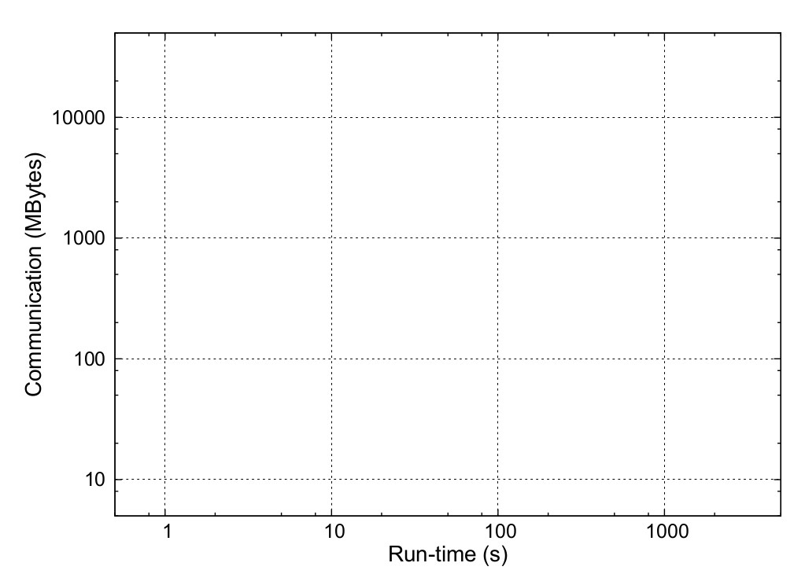
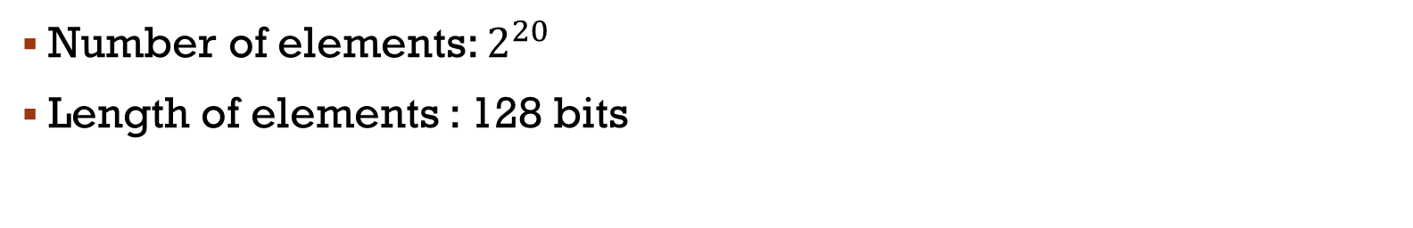
Comparison of Semi-Honest 2-PSI
Number of elements: $2^{20}$
Length of elements : 128 bits
Circuit-Based:
+: general
-: high run-time
Public-key-Based:
+: best communication
-: high run-time
OT-Based:
+: best run-time
+: good communication
Circuit-based
OT+Hash'14
OT+Phasing'15
Ours
Public-key-Based
ï
Na
ve
June-2016 | New Tools and Techniques for Practical Private Set Intersection | Ni Trieu
Notes:
Here is the comparison of our protocol to other research. For the Number of elements: 2^20
Length of elements : 128 bits. As we can see from the graph, we improve the current PSI protocol by 3x. And get close to naïve protocol.
Choose the best method.

Slide 12
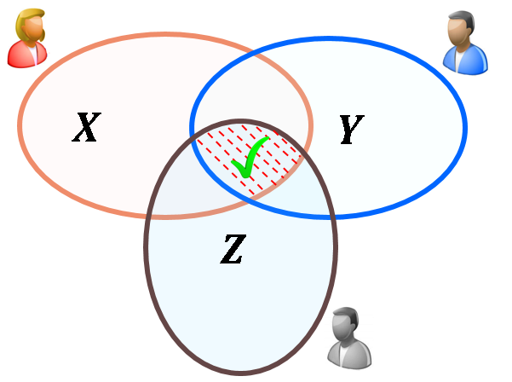
MuLTI-PARTY PSI
Practical Multi-party Private Set Intersection from Symmetric-Key Techniques (Submitted)
Joint work with:
Vladimir Kolesnikov
Naor Matania
Benny Pinkas
Mike Rosulek
June-2016 | New Tools and Techniques for Practical Private Set Intersection | Ni Trieu

Slide 13








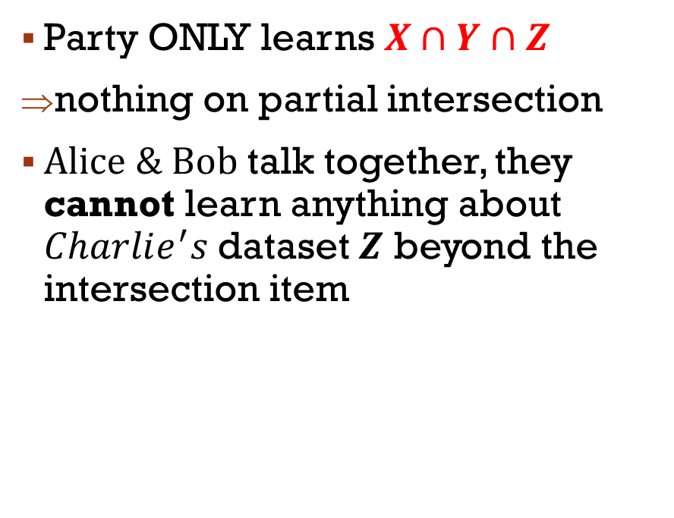


MuLTI-PARTY PSI
m
m
$$X$$
$$Y$$
$$Alice$$
$$Bob$$
$$Z$$
Party ONLY learns $X∩Y∩Z$
nothing on partial intersection
$Alice \& Bob$talk together, they cannot learn anything about $Charlie^{′}s$dataset $Z$ beyond the intersection item
$$Charlie$$
June-2016 | New Tools and Techniques for Practical Private Set Intersection | Ni Trieu
Notes:
In this work, we propose an efficient protocol applied to PSI,
s a well-known problem in crypto. 1st We will go thru a simple senerios to get an idea of what PSI is.here we have 2 parties Alice and Bob, each party hold a set of items. Two parties now want to compute the intersection of their sets on the way that don’t leak any information except the intersection. It means that Alice doesn’t know the rest of Bob items, Bob also doesnot know the rest of Alice’s items.

Slide 14

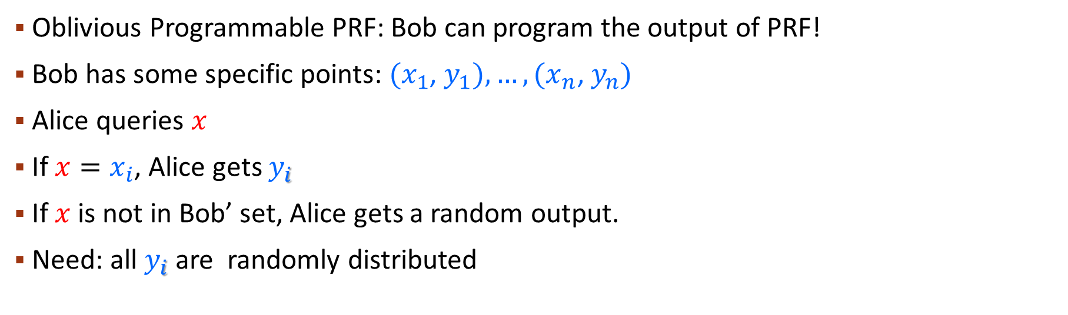



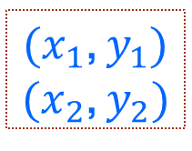


OUR Oblivious programmable PRF(OPPRF)
$$x∉\left\{x_{1},x_{2}\right\}$$
Programmable
OPRF
$(x_{1}$, $y_{1})$
$(x_{2}$, $y_{2})$
$$x$$
$$x_{i}$$
$$y=\left\{\begin{aligned}y_{i} if x=x_{i} \\ \$ otherwise\end{aligned}\right.$$
$$\$$$
$$y_{i}$$
Oblivious Programmable PRF: Bob can program the output of PRF!
Bob has some specific points: $(x_{1}$, $y_{1}),…, (x_{n}\text{,} y_{n})$
Alice queries $x$
If $x=x_{i}$, Alice gets $y_{i}$
If $x$ is not in Bob’ set, Alice gets a random output.
Need: all $y_{i}$ are randomly distributed
June-2016 | New Tools and Techniques for Practical Private Set Intersection | Ni Trieu

Slide 15



OUR Oblivious programmable PRF construction
Idea:
Parties invoke a regular OPRF
Sender sends some “correction values” (hints)
Receiver applies hints to the plain OPRF output
Main challenge: hints should hide which set of points are programmed
We proposed 3 different constructions of OP[P]RF with diﬀerent tradeoﬀs in computation, communication, number of points, number of queries.
𝑥
OPRF
$$k$$
$$F_{k}(x)$$
$$hints(k,(x_{i}, y_{i}))$$
June-2016 | New Tools and Techniques for Practical Private Set Intersection | Ni Trieu

Slide 16








OUR Polynomial based-OPPRF
$$x$$
$$\{x_{i}, y_{i}\}$$
OPPRF
$$y=\left\{\begin{aligned}y_{i} if x=x_{i} \\ r otherwise\end{aligned}\right.$$
$$r$$
Simplest protocol: Polynomial based-OPPRF with best communication
Correctness: If $x=x_{i}$ $⇒$ $P\left(x\right)⊕F_{k}\left(x\right)=y_{i}⊕F_{k}\left(x_{i}\right)⊕F_{k}\left(x\right)=y_{i}$. Otherwirse, $P\left(x\right)$ is random
Security: $y_{i}⊕F_{k}\left(x_{i}\right)$ are random => don’t leak anything on $x_{i}$ or $y_{i}$
Cost: the interpolation of the polynomial takes time $O\left(n^{2}\right)$. Communication takes $O\left(n\right)$
In the paper we show another OPPRF protocol with linear time and linear communication
Run OPRF[KKRT16] as receiver
=> Input $x$, Output: $F_{k}(x$)
Output: $P\left(x\right)⊕F_{k}\left(x\right)$
Run OPRF[KKRT16] as sender.
=> Output: key $k$
Compute: $F_{k}\left(x_{1}\right), …,F_{k}\left(x_{n}\right)$
Chooses the polynomial $P\left(x\right)$of degree n-1 such that:
Sends coefficients of $P\left(x\right)$
$$P\left(x_{i}\right)=y_{i}⊕F_{k}\left(x_{i}\right)$$

Slide 17






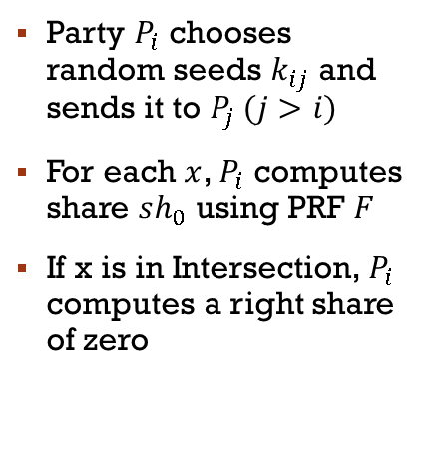




















Unconditional Zero sharing
$$x∈intersection$$
$$x$$
$$P_{0}(X_{0})$$
$$k_{01}$$
$$F(k_{01},x)$$
$sh_{0}(x)=F\left(k_{01},x\right)⊕$ $F\left(k_{02},x\right)⊕ F\left(k_{03},x\right)$
$$k_{02}$$
$$F(k_{02},x)$$
$sh_{0}(x)=F\left(k_{01},x\right)⊕$ $F\left(k_{02},x\right)⊕ F\left(k_{03},x\right)$
$$k_{03}$$
$$F(k_{03},x)$$
$sh_{1}(x)=F\left(k_{01},x\right)⊕$ $F\left(k_{12},x\right)⊕ F\left(k_{13},x\right)$
$sh_{1}(x)=F\left(k_{01},x\right)⊕$ $F\left(k_{12},x\right)⊕ F\left(k_{13},x\right)$
$sh_{3}(x)=F\left(k_{03},x\right)⊕$ $F\left(k_{13},x\right)⊕ F\left(k_{23},x\right)$
$sh_{3}(x)=F\left(k_{03},x\right)⊕$ $F\left(k_{13},x\right)⊕ F\left(k_{23},x\right)$
$$x$$
$$k_{01}$$
$$k_{03}$$
$$k_{12}$$
$$x$$
$$P_{1}\left(X_{1}\right)$$
$$⊕_{i}sh_{i }(x)$$
$$k_{13}$$
$$k_{13}$$
$$=0$$
$$P_{3}\left(X_{3}\right)$$
$$k_{23}$$
Party $P_{i}$chooses random seeds $k_{ij}$and sends it to $P_{j }(j>i)$
For each $x$, $P_{i}$computes share $sh_{0}$ using PRF $F$
If x is in Intersection, $P_{i}$ computes a right share of zero
Purpose: parties agree on a share of zero if they have common x
$$k_{02}$$
$$k_{12}$$
$$k_{23}$$
$sh_{2}(x)=F\left(k_{02},x\right)⊕$ $F\left(k_{12},x\right)⊕ F\left(k_{23},x\right)$
$sh_{2}(x)=F\left(k_{02},x\right)⊕$ $F\left(k_{12},x\right)⊕ F\left(k_{23},x\right)$
$$x$$
$$P_{2}(X_{2})$$
June-2016 | New Tools and Techniques for Practical Private Set Intersection | Ni Trieu

Slide 18

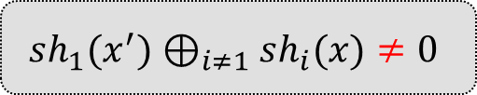
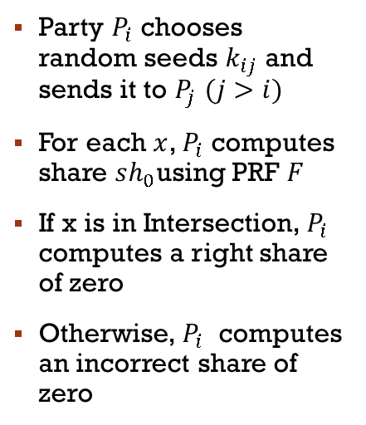





Unconditional Zero sharing
$$x∉intersection$$
$$x$$
$$x∈intersection$$
$$P_{0}(X_{0})$$
$$k_{01}$$
$$F(x,k_{01})$$
$$k_{02}$$
$$F(x,k_{02})$$
$sh_{0}(x)=F\left(k_{01},x\right)⊕$ $F\left(k_{02},x\right)⊕ F\left(k_{03},x\right)$
$$k_{03}$$
$$F(x,k_{03})$$
$sh_{1}(x′)=F\left(k_{01},x′\right)⊕$ $F\left(k_{12},x′\right)⊕ F\left(k_{13},x′\right)$
$sh_{1}(x)=F\left(k_{01},x\right)⊕$ $F\left(k_{12},x\right)⊕ F\left(k_{13},x\right)$
$sh_{3}(x)=F\left(k_{03},x\right)⊕$ $F\left(k_{13},x\right)⊕ F\left(k_{23},x\right)$
$$x′$$
$$k_{01}$$
$$x$$
$$k_{03}$$
$$x$$
$$k_{12}$$
$$sh_{1}(x^{′})⊕_{i≠1}sh_{i}(x)≠0$$
$$P_{1}\left(X_{1}\right)$$
$$⊕_{i}sh_{i}(x)=0$$
$$k_{13}$$
$$P_{3}\left(X_{3}\right)$$
$$k_{13}$$
$$k_{23}$$
Party $P_{i}$chooses random seeds $k_{ij}$and sends it to $P_{j}$ $(j>i)$
For each $x$, $P_{i}$computes share $sh_{0}$using PRF $F$
If x is in Intersection, $P_{i}$ computes a right share of zero
Otherwise, $P_{i}$ computes an incorrect share of zero
Purpose: parties agree on a share of zero if they have common x
Sending keys in an one time
An unlimited number of zero-sharings
However, set of corrupted parties can image what the correct zero share of honest party would be
In the paper, we show another protocol with interactive way to address this problem.
$$k_{02}$$
$$k_{12}$$
$$k_{23}$$
$sh_{2}(x)=F\left(k_{02},x\right)⊕$ $F\left(k_{12},x\right)⊕ F\left(k_{23},x\right)$
$$x$$
$$P_{2}(X_{2})$$

Slide 19












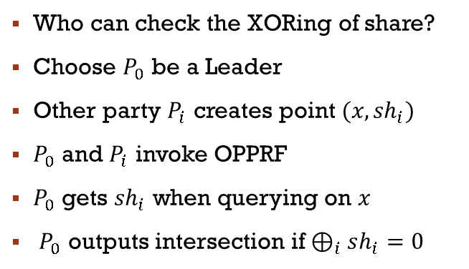
OPPRF application: MULTi-PARTY PSI
$$Leader$$
$$x∈intersection$$
$$x$$
$$P_{0}(X_{0})$$
$${check ⊕}_{i}sh_{i}=^{?}0$$
$$⊕_{i}sh_{i}(x)=0$$
$$sh_{1}$$
$$sh_{2}$$
$$sh_{3}$$
$$x$$
OPPRF
OPPRF
$$x$$
$$x$$
$$P_{1}\left(X_{1}\right)$$
$${(x,sh}_{3}(x))$$
$${(x,sh}_{1}(x))$$
$$P_{3}\left(X_{3}\right)$$
$$x$$
Who can check the XORing of share?
Choose $P_{0}$ be a Leader
Other party $P_{i}$ creates point ${(x,sh}_{i})$
$P_{0}$ and $P_{i}$ invoke OPPRF
$P_{0}$ gets ${sh}_{i}$ when querying on $x$
$P_{0}$ outputs intersection if $⊕_{i}sh_{i}=0$
OPPRF
$${(x,sh}_{2}(x))$$
$$x$$
$$P_{2}(X_{2})$$
June-2016 | New Tools and Techniques for Practical Private Set Intersection | Ni Trieu

Slide 20










OPPRF application: MULTi-PARTY PSI
$$Leader$$
$$x≠intersection$$
$$x$$
$$P_{0}(X_{0})$$
$${check ⊕}_{i}sh_{i}=^{?}0$$
$$⊕_{i}sh_{i}=0$$
$${sh_{1}\left(x^{′}\right)⊕}_{i}sh_{i}(x)≠0$$
$$sh_{1}$$
$$sh_{2}$$
$$sh_{3}$$
$$\$$$
$$x$$
OPPRF
OPPRF
$$x′$$
$$x$$
$$x$$
$$P_{1}\left(X_{1}\right)$$
$${(x,sh}_{3}(x))$$
$${(x′,sh}_{1}(x^{′}))$$
$${(x,sh}_{1}(x))$$
$$P_{3}\left(X_{3}\right)$$
$$x$$
Who can check the XORing of share?
Choose $P_{0}$ be a Leader
Other party $P_{i}$ creates point ${(x,sh}_{i})$
$P_{0}$ and $P_{i}$ invoke OPPRF
$P_{0}$ gets ${sh}_{i}$ when querying on $x$
$P_{0}$ outputs intersection if $⊕_{i}sh_{i}=0$
OPPRF
Security:
if $x′$ is NOT in intersection, OPPRF receiver gets random output
leak no information on $x′$
$${(x,sh}_{2}(x))$$
$$x$$
$$P_{2}(X_{2})$$
June-2016 | New Tools and Techniques for Practical Private Set Intersection | Ni Trieu

Slide 21
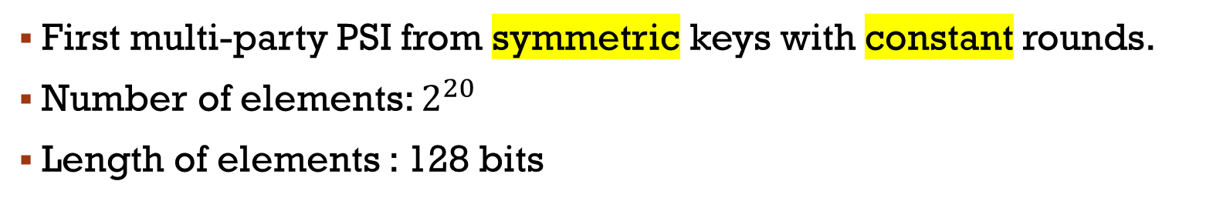
OUR Multi-PARTY psi PERFORMANCE
First multi-party PSI from symmetric keys with constant rounds.
Number of elements: $2^{20}$
Length of elements : 128 bits
Notes:
Here is the comparison of our protocol to other research. For the Number of elements: 2^20
Length of elements : 128 bits. As we can see from the graph, we improve the current PSI protocol by 3x. And get close to naïve protocol.
Choose the best method.

Slide 22
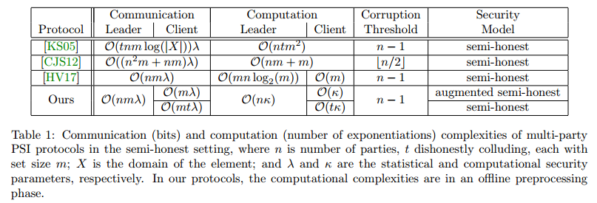
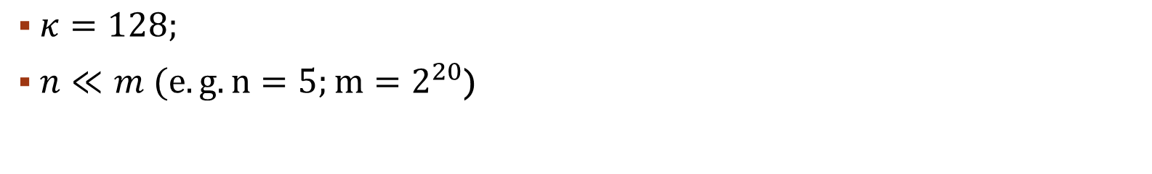
OUR Multi-PARTY psi PERFORMANCE
$κ=128;$
$n≪m (e.g. n=5;m=2^{20}$)
June-2016 | New Tools and Techniques for Practical Private Set Intersection | Ni Trieu
Notes:
Here is the comparison of our protocol to other research. For the Number of elements: 2^20
Length of elements : 128 bits. As we can see from the graph, we improve the current PSI protocol by 3x. And get close to naïve protocol.
Choose the best method.

Slide 23
The End!
Thank you
June-2016 | New Tools and Techniques for Practical Private Set Intersection | Ni Trieu

Slide 24
Reference
KKRT16. Vladimir Kolesnikov, Ranjit Kumaresan, Mike Rosulek, and Ni Trieu. Efficient batched oblivious PRF with applications to private set intersection. In ACM Computer and Communications Security (CCS’16), pages 818–829. ACM, 2016
PSZ14. Benny Pinkas, Thomas Schneider, and Michael Zohner. Faster private set intersection based on OT extension. In USENIX Security Symposium’14, pages 797–812. USENIX, 2014.
PSSZ15. Benny Pinkas, Thomas Schneider, Gil Segev, and Michael Zohner. Phasing: Private set intersection using permutation-based hashing. In USENIX Security Symposium’15, pages 515–530. USENIX, 2015.
FNP04. Michael J. Freedman, Kobbi Nissim, and Benny Pinkas. Efficient private matching and set intersection. In Advances in Cryptology – EUROCRYPT’04, volume 3027 of LNCS, pages 1–19. Springer, 2004
CJS12. Jung Hee Cheon, Stanislaw Jarecki, and Jae Hong Seo. Multi-party privacy-preserving set intersection with quasi-linear complexity. IEICE Transactions, 95-A(8):1366–1378, 2012.
HV17. Carmit Hazay and Muthuramakrishnan Venkitasubramaniam. Scalable multi-party private setintersection. Cryptology ePrint Archive, Report 2017/027, 2017. http://eprint.iacr.org/ 2017/027

Slide 25



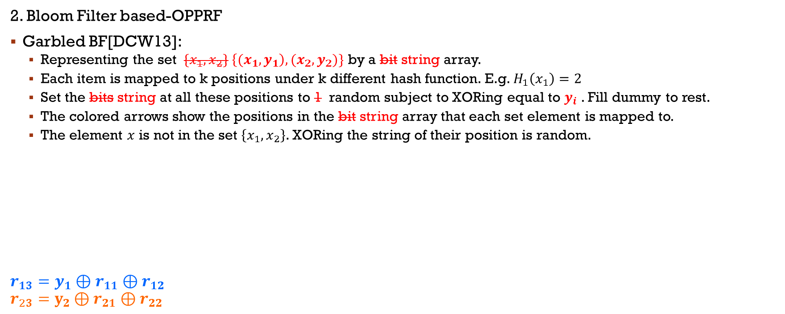














OUR programmable OPRF
$$x$$
$$\{x_{i}, y_{i}\}$$
OPPRF
$$y=\left\{\begin{aligned}y_{i} if x=x_{i} \\ r otherwise\end{aligned}\right.$$
$$r$$
2. Bloom Filter based-OPPRF
Garbled BF[DCW13]:
Representing the set $\{x_{1},x_{2}\}$ $\left\{{(x}_{1},y_{1}\right),(x_{2},y_{2})\}$ by a bit string array.
Each item is mapped to k positions under k different hash function. E.g. $H_{1}\left(x_{1}\right)=2$
Set the bits string at all these positions to 1 random subject to XORing equal to $y_{i}$ . Fill dummy to rest.
The colored arrows show the positions in the bit string array that each set element is mapped to.
The element $x$ is not in the set $\left\{x_{1},x_{2}\right\}$. XORing the string of their position is random.
$$r_{13}=y_{1}⊕r_{11}⊕r_{12}$$
$$r_{23}=y_{2}⊕r_{21}⊕r_{22}$$
$$\left\{{(x}_{1},y_{1}\right),(x_{2},y_{2})\}$$
0 | $$1$$ | 0 | 0 | $$1$$ | 0 | $$1$$ | 0 | $$1$$ | 0 | $$1$$ | 0 | $$1$$ | 0 | 0
$$\$$$
$$r_{11}$$
$$\$$$
$$\$$$
$$r_{22}$$
$$\$$$
$$r_{23}$$
$$\$$$
$$r_{12}$$
$$\$$$
$$r_{13}$$
$$\$$$
$$r_{21}$$
$$\$$$
$$\$$$
$$x$$

Slide 26



OUR programmable OPRF
$$x$$
$$\{x_{i}, y_{i}\}$$
OPPRF
$$y=\left\{\begin{aligned}y_{i} if x=x_{i} \\ r otherwise\end{aligned}\right.$$
$$r$$
2. Bloom Filter based-OPPRF
Cost: Insertion algorithm runs in time $O\left(n\right).$
Communication is still $O\left(n\right)$ but the constant coefficient is high ($60n$ items)
Allows to do many queries on diffirent $x$
Run OPRF[KKRT16] as receiver
=> Input $x$, Output: $F_{k}\left(x\right)$
Compute: $BF\left(x\right)⊕F_{k}\left(x\right)$
If $x=x_{i}$ $⇒$ $BF\left(x\right)⊕F_{k}\left(x\right)$
$$=y_{i}⊕F_{k}\left(x_{i}\right)⊕F_{k}\left(x\right)=y_{i}$$
Otherwise, $BF\left(x\right)$ is random
Run OPRF[KKRT16] as sender.
=> Output: key $k$
Compute: $F_{k}\left(x_{1}\right), …,F_{k}\left(x_{n}\right)$
Generates the Garbled Bloom Filter $BF\left(x\right)$over $\left\{x_{i}, y_{i}⊕F_{k}\left(x_{i}\right)\right\}$ by:
$y_{i}⊕F_{k}\left(x_{i}\right)=⊕H_{j}\left(x_{i}\right)$
Sends $BF\left(x\right)$

Slide 27


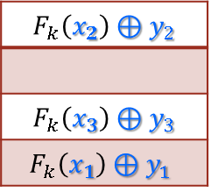

OUR programmable OPRF
$$x$$
$$\{x_{i}, y_{i}\}$$
OPPRF
$$y=\left\{\begin{aligned}y_{i} if x=x_{i} \\ r otherwise\end{aligned}\right.$$
$$r$$
3. Table based-OPPRF
$F_{k}\left(x\right)$ is in random distribution, 128-bit string $⇒$ finding $v$ with high prob. $⇒$ efficient for small $n$
Run OPRF[KKRT16] as receiver
=> Input $x$, Output: $F_{k}\left(x\right)$
Run OPRF[KKRT16] as sender.
=> Output: key $k$
Compute: $F_{k}\left(x_{1}\right), …,F_{k}\left(x_{n}\right)$
Generates the Table $T$of size by $2^{\left\lceil log⁡(n)\right\rceil }$:
Sample vector $v←{\left\{0,1\right\}}^{κ}$ such that ${∀i, h_{i}=H(F}_{k}\left(x_{i}\right)|\left|v\right)$are all distinct
Insert $F_{k}\left(x_{i}\right)⊕y_{i}$into $T_{h_{i}}$
$$F_{k}\left(x_{2}\right)=100100…0101→Proj\left(F_{k}\left(x_{2}\right)\right)=00$$
$$F_{k}\left(x_{2}\right)⊕y_{2}$$
$$F_{k}\left(x_{3}\right)⊕y_{3}$$
$$F_{k}\left(x_{1}\right)⊕y_{1}$$
$$F_{k}\left(x_{3}\right)=11010…11101→Proj\left(F_{k}\left(x_{3}\right)\right)=10$$
$$F_{k}\left(x_{1}\right)=01110…00111→Proj\left(F_{k}\left(x_{1}\right)\right)=11$$

Slide 28


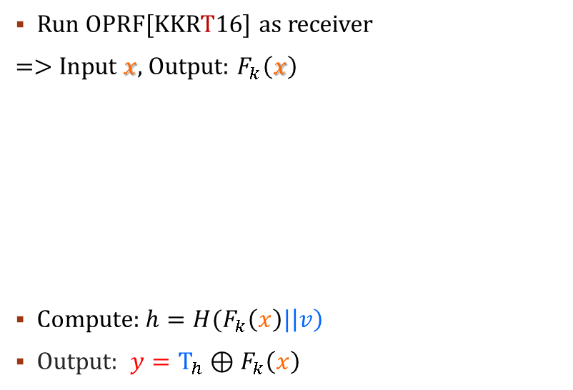
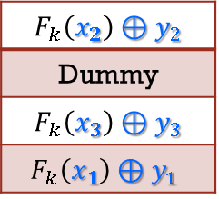
OUR programmable OPRF
$$x$$
$$\{x_{i}, y_{i}\}$$
OPPRF
$$y=\left\{\begin{aligned}y_{i} if x=x_{i} \\ r otherwise\end{aligned}\right.$$
$$r$$
3. Table based-OPPRF
$F_{k}\left(x\right)$ is in random distribution, 128-bit string $⇒$ finding $v$ with high prob. $⇒$ efficient for small $n$
Allows one query because of one time pad: $F_{k}\left(x_{i}\right)⊕y_{i}$
Run OPRF[KKRT16] as receiver
=> Input $x$, Output: $F_{k}\left(x\right)$
Compute:${ h=H(F}_{k}\left(x\right)|\left|v\right)$
Output: ${y=T}_{h}⊕F_{k}\left(x\right)$
Run OPRF[KKRT16] as sender.
=> Output: key $k$
Compute: $F_{k}\left(x_{1}\right), …,F_{k}\left(x_{n}\right)$
Generates the Table $T$of size by $2^{\left\lceil log⁡(n)\right\rceil }$:
Sample vector $v←{\left\{0,1\right\}}^{κ}$ such that ${∀i, h_{i}=H(F}_{k}\left(x_{i}\right)|\left|v\right)$are all distinct
Insert $F_{k}\left(x_{i}\right)⊕y_{i}$into $T_{h_{i}}$
Fill out other empty rows by dummy
Sends $v \& T$
$$F_{k}\left(x_{2}\right)⊕y_{2}$$
Dummy
$$F_{k}\left(x_{3}\right)⊕y_{3}$$
$$F_{k}\left(x_{1}\right)⊕y_{1}$$

