Slide 1



Practical Multi-party Private Set Intersection from Symmetric-Key Techniques
Presenter: Ni Trieu
Joint work with:
Vladimir Kolesnikov, Naor Matania, Benny Pinkas, Mike Rosulek
Notes:
Hi everyone, I am happy….This is Practical Multi-party Private Set Intersection from Symmetric-Key Techniques
Different from two previous presentation,s our work focus on multi-parties setting. Our protocol is the first protocol from Symmetric-Key operations which is every efficient
This is a joint work with …

Slide 2











Multi-party Private Set Intersection
$$X$$
$$Y$$
$$Alice$$
$$Bob$$
$$Z$$
$$Charlie$$
Notes:
Let start with simple scenario. Here, we have 3 parties Alice , Bob, and Charlie. each party holds a set of items. Now parties now want to compute the intersection of their sets on the way that don’t leak any information except the intersection.

Slide 3


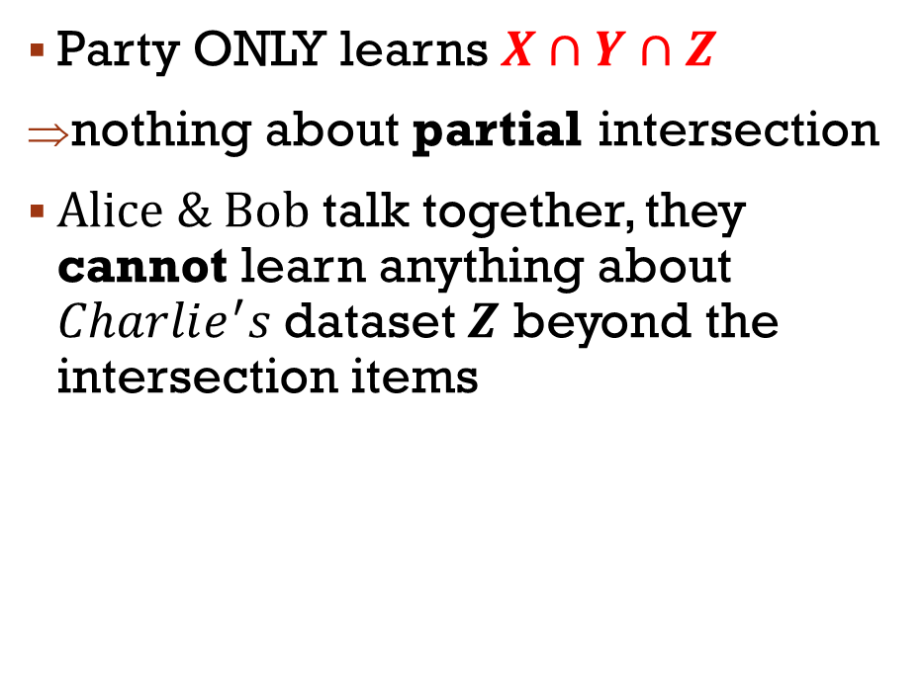





Multi-party Private Set Intersection
m
m
$$X$$
$$Y$$
$$Alice$$
$$Bob$$
$$Z$$
Party ONLY learns $X∩Y∩Z$
nothing about partial intersection
$Alice \& Bob$talk together, they cannot learn anything about $Charlie^{′}s$dataset $Z$ beyond the intersection items
$$Charlie$$
Notes:
Different from 2 party PSI. there are several security requirements for multi party PSI?
The first one that, party ONLY learns $X∩Y∩Z$, and nothing else on partial intersection. It means this part should be hiden from the protocol output.
The second one is about corruption. Let think about $Alice \& Bob migght$talk together, they don’t allow to learn anything about $Charlie^{′}s$dataset $Z$ beyond the intersection item

Slide 4










Multi-party PSI APP: Decentralized social network
Notes:
PSI have many applications. My favorized one is Decentralized social network
In this scenario, we has facebook’s users. They has a list of friends. For some reason, they want to see common friend of them. while keeping their friend list private from each other.
This problem can be solved by running Multi-party PSI

Slide 5
Previous works on multi-party psi
[Kissner-Song05, Sang-Shen08, Cheon-Jarecki-Seo12, Hazay-Venkitasubramaniam17]
Based on Oblivious Polynomial Evaluation
Implemented by using additively homomorphic encryption
Problems:
Heavy on public key operations
Homomorphic encryption for each item
inefficient when the set size is large.
Ours:
PSI from symmetric key operations
=> scalable for larger sets
5
Notes:
Unlike 2 party PSI, there are very few work focusing on multi setting. All of them are based on Oblivious Polynomial Evaluation which Implemented by using homomorphic encryption. Thess protocols are Heavy on public key operation and requires Homomorphic encryption for each item. Therefore, it is inefficient when the set size is large.
Our protocol is from symmetric key operation => therefore, it is scalable for large set

Slide 6
Our outline
PSI and Its application
Previous Work
Our PSI Approach
Oblivious Programmable PRF (new tool)
Zero Sharing
Putting it together => our PSI construction
Results
*: This talk is on Semi-honest setting
Notes:
For the rest of my talk. I will present our PSI approach. We first introduce a new term which call Oblivious Programmable PRF, and next we describe Zero Sharing protocol, then putting it together to get PSI construction.
This talk is on Semi-honest setting where we assume that the parties follow the protocol

Slide 7
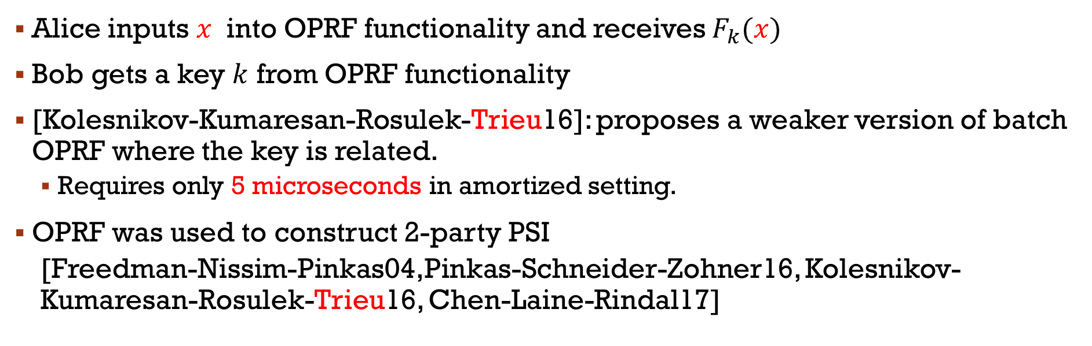


Oblivious PRF Functionality
Oblivious
PRF
𝑥
$$F_{k}(x)$$
$$k$$
Alice inputs $x$ into OPRF functionality and receives $F_{k}(x)$
Bob gets a key $k$ from OPRF functionality
[Kolesnikov-Kumaresan-Rosulek-Trieu16]: proposes a weaker version of batch OPRF where the key is related.
Requires only 5 microseconds in amortized setting.
OPRF was used to construct 2-party PSI
[Freedman-Nissim-Pinkas04,Pinkas-Schneider-Zohner16, Kolesnikov-Kumaresan-Rosulek-Trieu16, Chen-Laine-Rindal17]
Notes:
(4p)Before going to our Oblivious Programmabl PRF, I would like to revise the Oblivious PRF Functionality
So, in OPRF, Alice inputs $x$ into the functionality and receives $F_{k}\left(x\right)$while Bob gets a key $k$ from OPRF functionality
Last year, we proposes proposes a weaker version of OPRF where the key are related.
As you ‘ve seen before, OPRF used in 2party PSI

Slide 8

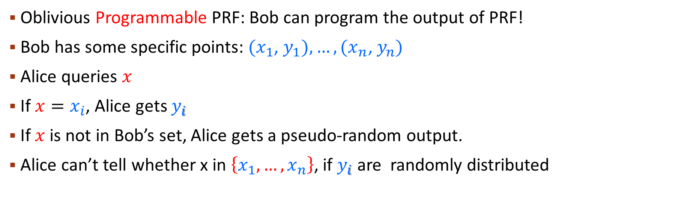



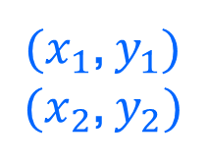


OUR Oblivious programmable PRF (OPPRF)
$$x$$
$(x_{1}$, $y_{1})$
$(x_{2}$, $y_{2})$
$$x∉\left\{x_{1},x_{2}\right\}$$
$${x=x}_{i}$$
Programmable
OPRF
$$y=\left\{\begin{aligned}y_{i} if x=x_{i} \\ \$ otherwise\end{aligned}\right.$$
$$y_{i}$$
$$\$$$
Oblivious Programmable PRF: Bob can program the output of PRF!
Bob has some specific points: $(x_{1}$, $y_{1}),…, (x_{n}\text{,} y_{n})$
Alice queries $x$
If $x=x_{i}$, Alice gets $y_{i}$
If $x$ is not in Bob’s set, Alice gets a pseudo-random output.
Alice can’t tell whether x in $\left\{x_{1},…,x_{n}\right\}$, if $y_{i}$ are randomly distributed
Notes:
What does Oblivious Programmable PRF mean? Well, it allows Bob can program the output of PRF!
Let looking at more detail about the functionality of OPPRF, we have Bob with some specific points: $(x_{1}$, $y_{1}),…, (x_{1}\text{,} y_{n})$. On the other side, we have Alice who hold a query $x$
OPRF box gives Alice yi if she have x=xi
And if If $x$ is not in Bob’ set, Alice gets a random output.
In odert to Alice can’t tell whether x inBob’ set$we require that y_{i}$ are randomly distributed

Slide 9

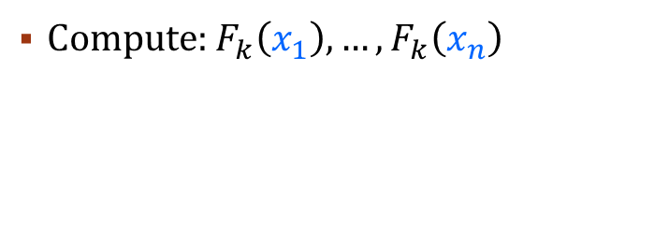






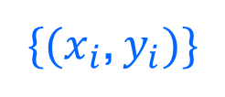


OUR Polynomial based-OPPRF
𝑥
$\{(x_{i}$, $y_{i})\}$
𝑥
Oblivious
PRF
$$F_{k}(x)$$
$$k$$
Compute: $F_{k}\left(x_{1}\right), …,F_{k}\left(x_{n}\right)$
$(x_{3}$, $y_{3})$
$(x_{1}$, $y_{1})$
$(x_{1}$, $y_{1})$
$(x_{2}$, $y_{2})$
$(x′$, $\$)$
$(x_{4}$, $y_{4})$
Notes:
I am going to present a Simplest protocol which is Polynomial based-OPPRF. It has best communication.
Parties perform OPRF, Alice input x and receives F_k(x)
Bob gets a key k from the OPRF, he can compute any OPRF values F_k(x_i) on his set X, then he builds a polynomial $P\left(x\right)$of degree n-1 that satisfies this formular, and sends its coefficients to Alice
Alice evaluate x on the received polynomial to get P(x) and outputs XOR of $it with F_{k}\left(x\right)$
For the Correctness: If $x=x_{i}$ $⇒$ $P\left(x\right)=y_{i}⊕F_{k}\left(x_{i}\right)$ . Therefore, Alice receives y_i. Otherwirse, $P\left(x\right)$ is random => Alice receives random value
For the Security: $y_{i}⊕F_{k}\left(x_{i}\right)$ are random => don’t leak anything on $x_{i}$ or $y_{i}$
So now, Cost: the interpolation of the polynomial takes time $O\left(n^{2}\right)$. Communication takes $O\left(n\right)$
In the paper we show another OPPRF protocol with linear time and linear communication

Slide 10



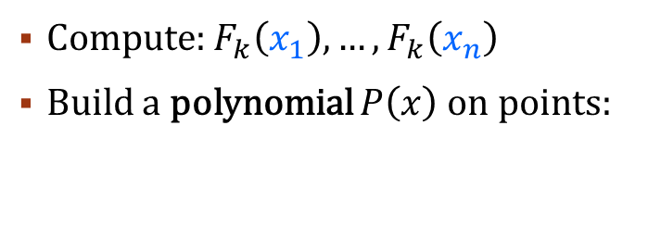
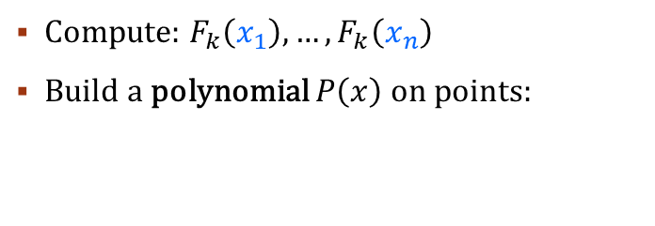
OUR Polynomial based-OPPRF
𝑥
$\{(x_{i}$, $y_{i})\}$
𝑥
Oblivious
PRF
$$F_{k}(x)$$
$$k$$
Compute: $F_{k}\left(x_{1}\right), …,F_{k}\left(x_{n}\right)$
Build a polynomial $P\left(x\right)$on points:
$$\{x_{i},y_{i}⊕F_{k}\left(x_{i}\right)\}$$
$(x_{1}$, $y_{1})$
$(x_{1}$, $y_{1})$
$(x′$, $\$)$
$(x_{1}$, $y_{1}⊕F_{k}(x_{1}))$
Notes:
I am going to present a Simplest protocol which is Polynomial based-OPPRF. It has best communication.
Parties perform OPRF, Alice input x and receives F_k(x)
Bob gets a key k from the OPRF, he can compute any OPRF values F_k(x_i) on his set X, then he builds a polynomial $P\left(x\right)$of degree n-1 that satisfies this formular, and sends its coefficients to Alice
Alice evaluate x on the received polynomial to get P(x) and outputs XOR of $it with F_{k}\left(x\right)$
For the Correctness: If $x=x_{i}$ $⇒$ $P\left(x\right)=y_{i}⊕F_{k}\left(x_{i}\right)$ . Therefore, Alice receives y_i. Otherwirse, $P\left(x\right)$ is random => Alice receives random value
For the Security: $y_{i}⊕F_{k}\left(x_{i}\right)$ are random => don’t leak anything on $x_{i}$ or $y_{i}$
So now, Cost: the interpolation of the polynomial takes time $O\left(n^{2}\right)$. Communication takes $O\left(n\right)$
In the paper we show another OPPRF protocol with linear time and linear communication

Slide 11

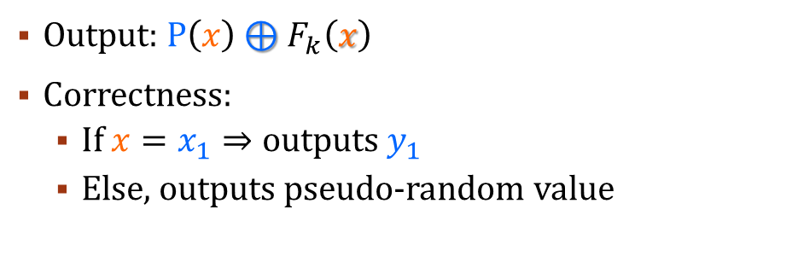


OUR Polynomial based-OPPRF
𝑥
$\{(x_{i}$, $y_{i})\}$
𝑥
Oblivious
PRF
$$F_{k}(x)$$
$$k$$
Output: $P\left(x\right)⊕F_{k}\left(x\right)$
Correctness:
If $x=x_{1}⇒$ outputs $y_{1}$
Else, outputs pseudo-random value
Compute: $F_{k}\left(x_{1}\right), …,F_{k}\left(x_{n}\right)$
Build a polynomial $P\left(x\right)$on points:
Send coefficients of $P\left(x\right)$
$$\{x_{i},y_{i}⊕F_{k}\left(x_{i}\right)\}$$
$(x_{1}$, $y_{1})$
$(x_{1}$, $y_{1})$
$(x_{1}$, $y_{1}⊕F_{k}(x_{1}))$
$(x_{1}$, $y_{1}⊕F_{k}(x_{1}))$
Notes:
I am going to present a Simplest protocol which is Polynomial based-OPPRF. It has best communication.
Parties perform OPRF, Alice input x and receives F_k(x)
Bob gets a key k from the OPRF, he can compute any OPRF values F_k(x_i) on his set X, then he builds a polynomial $P\left(x\right)$of degree n-1 that satisfies this formular, and sends its coefficients to Alice
Alice evaluate x on the received polynomial to get P(x) and outputs XOR of $it with F_{k}\left(x\right)$
For the Correctness: If $x=x_{i}$ $⇒$ $P\left(x\right)=y_{i}⊕F_{k}\left(x_{i}\right)$ . Therefore, Alice receives y_i. Otherwirse, $P\left(x\right)$ is random => Alice receives random value
For the Security: $y_{i}⊕F_{k}\left(x_{i}\right)$ are random => don’t leak anything on $x_{i}$ or $y_{i}$
So now, Cost: the interpolation of the polynomial takes time $O\left(n^{2}\right)$. Communication takes $O\left(n\right)$
In the paper we show another OPPRF protocol with linear time and linear communication

Slide 12

OUR Polynomial based-OPPRF
𝑥
$\{(x_{i}$, $y_{i})\}$
𝑥
Oblivious
PRF
$$F_{k}(x)$$
$$k$$
Output: $P\left(x\right)⊕F_{k}\left(x\right)$
Correctness:
If $x=x_{1}⇒$ outputs $y_{1}$
Else, outputs pseudo-random value
Compute: $F_{k}\left(x_{1}\right), …,F_{k}\left(x_{n}\right)$
Build a polynomial $P\left(x\right)$on points:
Send coefficients of $P\left(x\right)$
$$\{x_{i},y_{i}⊕F_{k}\left(x_{i}\right)\}$$
$(x_{1}$, $y_{1})$
$(x′$, $\$)$
$(x_{1}$, $y_{1}⊕F_{k}(x_{1}))$
$(x_{1}$, $y_{1}⊕F_{k}(x_{1}))$
Notes:
I am going to present a Simplest protocol which is Polynomial based-OPPRF. It has best communication.
Parties perform OPRF, Alice input x and receives F_k(x)
Bob gets a key k from the OPRF, he can compute any OPRF values F_k(x_i) on his set X, then he builds a polynomial $P\left(x\right)$of degree n-1 that satisfies this formular, and sends its coefficients to Alice
Alice evaluate x on the received polynomial to get P(x) and outputs XOR of $it with F_{k}\left(x\right)$
For the Correctness: If $x=x_{i}$ $⇒$ $P\left(x\right)=y_{i}⊕F_{k}\left(x_{i}\right)$ . Therefore, Alice receives y_i. Otherwirse, $P\left(x\right)$ is random => Alice receives random value
For the Security: $y_{i}⊕F_{k}\left(x_{i}\right)$ are random => don’t leak anything on $x_{i}$ or $y_{i}$
So now, Cost: the interpolation of the polynomial takes time $O\left(n^{2}\right)$. Communication takes $O\left(n\right)$
In the paper we show another OPPRF protocol with linear time and linear communication

Slide 13
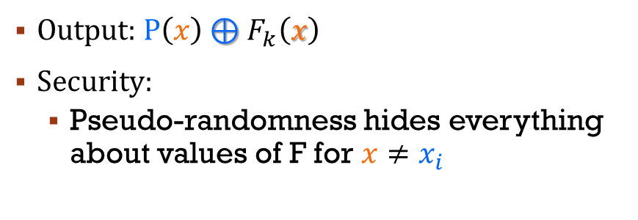
OUR Polynomial based-OPPRF
𝑥
$\{(x_{i}$, $y_{i})\}$
𝑥
Oblivious
PRF
$$F_{k}(x)$$
$$k$$
Output: $P\left(x\right)⊕F_{k}\left(x\right)$
Security:
Pseudo-randomness hides everything about values of F for $x≠x_{i}$
Compute: $F_{k}\left(x_{1}\right), …,F_{k}\left(x_{n}\right)$
Build a polynomial $P\left(x\right)$on points:
Send coefficients of $P\left(x\right)$
$$\{x_{i},y_{i}⊕F_{k}\left(x_{i}\right)\}$$
$(x_{1}$, $y_{1})$
$(x_{1}$, $y_{1})$
$(x′$, $\$)$
$(x_{1}$, $y_{1}⊕F_{k}(x_{1}))$
$(x_{1}$, $y_{1}⊕F_{k}(x_{1}))$
Notes:
I am going to present a Simplest protocol which is Polynomial based-OPPRF. It has best communication.
Parties perform OPRF, Alice input x and receives F_k(x)
Bob gets a key k from the OPRF, he can compute any OPRF values F_k(x_i) on his set X, then he builds a polynomial $P\left(x\right)$of degree n-1 that satisfies this formular, and sends its coefficients to Alice
Alice evaluate x on the received polynomial to get P(x) and outputs XOR of $it with F_{k}\left(x\right)$
For the Correctness: If $x=x_{i}$ $⇒$ $P\left(x\right)=y_{i}⊕F_{k}\left(x_{i}\right)$ . Therefore, Alice receives y_i. Otherwirse, $P\left(x\right)$ is random => Alice receives random value
For the Security: $y_{i}⊕F_{k}\left(x_{i}\right)$ are random => don’t leak anything on $x_{i}$ or $y_{i}$
So now, Cost: the interpolation of the polynomial takes time $O\left(n^{2}\right)$. Communication takes $O\left(n\right)$
In the paper we show another OPPRF protocol with linear time and linear communication

Slide 14
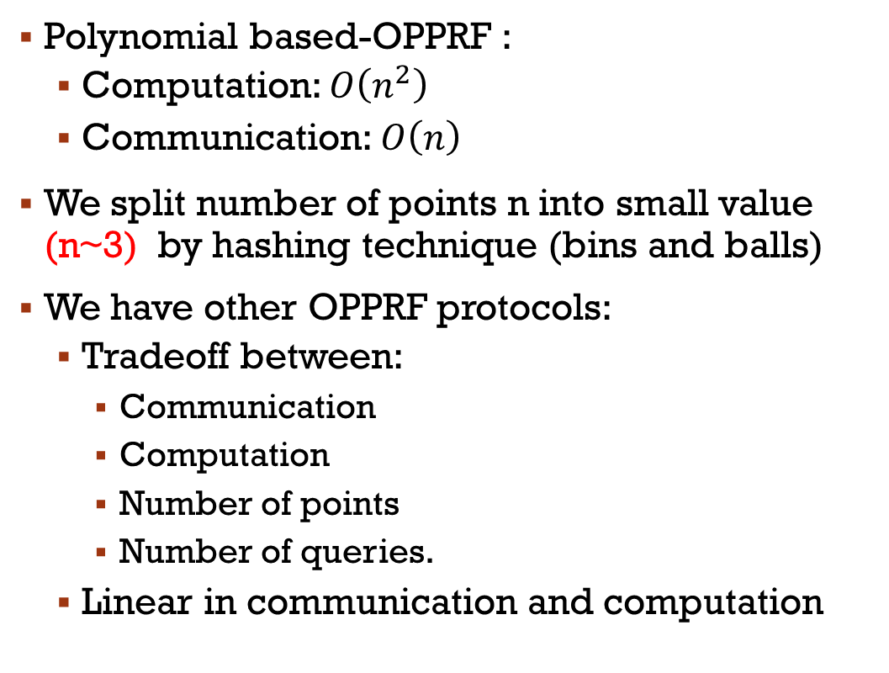






OUR Polynomial based-OPPRF
$$x$$
$$\{x_{i}, y_{i}\}$$
OPPRF
$$y=\left\{\begin{aligned}y_{i} if x=x_{i} \\ r otherwise\end{aligned}\right.$$
$$r$$
Polynomial based-OPPRF :
Computation: $O\left(n^{2}\right)$
Communication: $O\left(n\right)$
We split number of points n into small value (n~3) by hashing technique (bins and balls)
We have other OPPRF protocols:
Tradeoff between:
Communication
Computation
Number of points
Number of queries.
Linear in communication and computation
$(x_{1}$, $y_{1})$
Check paper
$(x_{1}$, $y_{1}⊕F_{k}(x_{1}))$
14
Notes:
I am going to present a Simplest protocol which is Polynomial based-OPPRF. It has best communication.
Parties perform OPRF, Alice input x and receives F_k(x)
Bob gets a key k from the OPRF, he can compute any OPRF values F_k(x_i) on his set X, then he builds a polynomial $P\left(x\right)$of degree n-1 that satisfies this formular, and sends its coefficients to Alice
Alice evaluate x on the received polynomial to get P(x) and outputs XOR of $it with F_{k}\left(x\right)$
For the Correctness: If $x=x_{i}$ $⇒$ $P\left(x\right)=y_{i}⊕F_{k}\left(x_{i}\right)$ . Therefore, Alice receives y_i. Otherwirse, $P\left(x\right)$ is random => Alice receives random value
For the Security: $y_{i}⊕F_{k}\left(x_{i}\right)$ are random => don’t leak anything on $x_{i}$ or $y_{i}$
So now, Cost: the interpolation of the polynomial takes time $O\left(n^{2}\right)$. Communication takes $O\left(n\right)$
In the paper we show another OPPRF protocol with linear time and linear communication

Slide 15
Our outline
PSI and Its application
Previous Work
Our PSI Approach
Oblivious Programmable PRF (new tool)
Zero Sharing
Putting it together => our PSI construction
Results
*: This talk is on Semi-honest setting
Notes:
Ok. we are done with OPPRF construction. Now, we move to zero sharing protocol

Slide 16



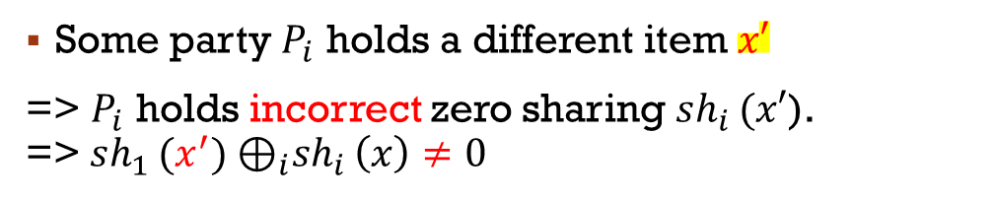






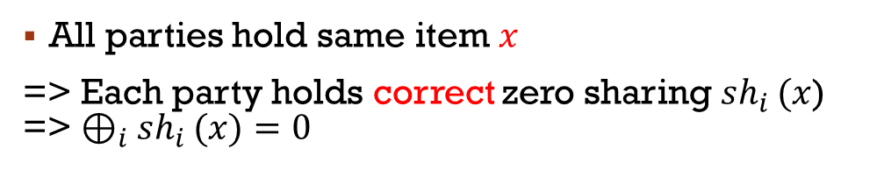

















Zero sharing
All parties hold same item $x$
=> Each party holds correct zero sharing $sh_{i }(x$) => $⊕_{i}sh_{i }(x)=0$
Some party $P_{i}$ holds a different item $x′$
=> $P_{i}$ holds incorrect zero sharing $sh_{i }(x′$). =>${ sh_{1 }(x^{′})⊕}_{i}sh_{i }\left(x\right)≠0$
$$sh_{0 }(x)$$
$$sh_{0 }(x)$$
$$x$$
$$x$$
$$P_{0}(X_{0})$$
$$P_{0}(X_{0})$$
$$sh_{1 }(x)$$
$$sh_{3 }(x)$$
$$sh_{1 }(x′)$$
$$sh_{3 }(x)$$
$$x$$
$$x$$
$$x′$$
$${sh_{1 }(x^{′})⊕}_{i}sh_{i }\left(x\right)≠0$$
$$x$$
$$P_{1}\left(X_{1}\right)$$
$$⊕_{i}sh_{i }(x)=0$$
$$P_{3}\left(X_{3}\right)$$
$$P_{1}\left(X_{1}\right)$$
$$P_{3}\left(X_{3}\right)$$
$$sh_{2 }(x)$$
$$sh_{2 }(x)$$
$$x$$
$$x$$
$$P_{2}(X_{2})$$
$$P_{2}(X_{2})$$
Notes:
(10p)The purpose of zero sharing is that if all parties think about the same value x, then they have a correct zero sharing which is xor of the share equals to zero.
and if one party hold a different item x’, in this scenarios, P1 has x’. then this party have an incorrect zero sharing. it means that xor of the share now equals to one thing else (not zero).

Slide 17















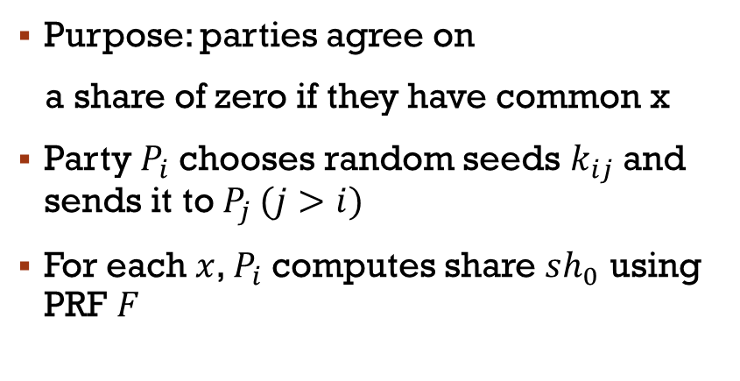











Non-interactive Zero sharing
$$x∈intersection$$
$$x$$
$$P_{0}(X_{0})$$
$$k_{01}$$
$$F(k_{01},x)$$
$$k_{02}$$
$$F(k_{02},x)$$
$sh_{0}(x)=F\left(k_{01},x\right)⊕$ $F\left(k_{02},x\right)⊕ F\left(k_{03},x\right)$
$$k_{03}$$
$$F(k_{03},x)$$
$sh_{1}(x)=F\left(k_{01},x\right)⊕$ $F\left(k_{12},x\right)⊕ F\left(k_{13},x\right)$
$sh_{3}(x)=F\left(k_{03},x\right)⊕$ $F\left(k_{13},x\right)⊕ F\left(k_{23},x\right)$
$$x$$
$$k_{01}$$
$$k_{03}$$
$$k_{12}$$
$$x$$
$$P_{1}\left(X_{1}\right)$$
$$⊕_{i}sh_{i }(x)$$
$$k_{13}$$
$$k_{13}$$
$$=0$$
$$P_{3}\left(X_{3}\right)$$
$$k_{23}$$
Purpose: parties agree on
a share of zero if they have common x
Party $P_{i}$chooses random seeds $k_{ij}$and sends it to $P_{j }(j>i)$
For each $x$, $P_{i}$computes share $sh_{0}$ using PRF $F$
$$k_{02}$$
$$k_{12}$$
$$k_{23}$$
$sh_{2}(x)=F\left(k_{02},x\right)⊕$ $F\left(k_{12},x\right)⊕ F\left(k_{23},x\right)$
$$x$$
17
$$P_{2}(X_{2})$$
Notes:
Now, I am going to present one of our zero sharing protocol. This is non-interactive version. We have an interactive one which we can deal with as well as in the paper.

Slide 18


Non-interactive Zero sharing
$$x∉intersection$$
$$x$$
$$P_{0}(X_{0})$$
$$k_{01}$$
$$F(k_{01},x)$$
$$k_{02}$$
$$F(k_{02},x)$$
$sh_{0}(x)=F\left(k_{01},x\right)⊕$ $F\left(k_{02},x\right)⊕ F\left(k_{03},x\right)$
$$k_{03}$$
$$F(k_{03},x)$$
$sh_{1}(x)=F\left(k_{01},x\right)⊕$ $F\left(k_{12},x\right)⊕ F\left(k_{13},x\right)$
$sh_{3}(x)=F\left(k_{03},x\right)⊕$ $F\left(k_{13},x\right)⊕ F\left(k_{23},x\right)$
$sh_{3}(x)=F\left(k_{03},x\right)⊕$ $F\left(k_{13},x\right)⊕ F\left(k_{23},x\right)$
$$x′$$
$$k_{01}$$
$$x$$
$$k_{03}$$
$$x$$
$$P_{1}\left(X_{1}\right)$$
$$k_{12}$$
$$k_{13}$$
$$k_{13}$$
$$P_{3}\left(X_{3}\right)$$
$$k_{23}$$
Purpose: parties agree on
a share of zero if they have common x
Party $P_{i}$chooses random seeds $k_{ij}$and sends it to $P_{j }(j>i)$
For each $x$, $P_{i}$computes share $sh_{0}$ using PRF $F$
$$k_{02}$$
$$k_{12}$$
$$k_{23}$$
$sh_{2}(x)=F\left(k_{02},x\right)⊕$ $F\left(k_{12},x\right)⊕ F\left(k_{23},x\right)$
$sh_{2}(x)=F\left(k_{02},x\right)⊕$ $F\left(k_{12},x\right)⊕ F\left(k_{23},x\right)$
$$x$$
18
$$P_{2}(X_{2})$$
Notes:
And if x is not common. For example, P1 has x'. Therefore, share of p1 will be F k01 of x' which appears only 1 time in xor of shares. Thus xor of share is not equal to zero
For Non-interactive Zero sharing, Sending keys in an one time
We can generate An unlimited number of zero-sharings

Slide 19


Non-interactive Zero sharing
$$x∉intersection$$
$$x$$
$$P_{0}(X_{0})$$
$$k_{01}$$
$$F(k_{01},x)$$
$$k_{02}$$
$$F(k_{02},x)$$
$sh_{0}(x)=F\left(k_{01},x\right)⊕$ $F\left(k_{02},x\right)⊕ F\left(k_{03},x\right)$
$$k_{03}$$
$$F(k_{03},x)$$
$sh_{1}(x′)=F\left(k_{01},x′\right)⊕$ $F\left(k_{12},x′\right)⊕ F\left(k_{13},x′\right)$
$sh_{3}(x)=F\left(k_{03},x\right)⊕$ $F\left(k_{13},x\right)⊕ F\left(k_{23},x\right)$
$sh_{3}(x)=F\left(k_{03},x\right)⊕$ $F\left(k_{13},x\right)⊕ F\left(k_{23},x\right)$
$$x′$$
$$k_{01}$$
$$k_{03}$$
$$k_{12}$$
$${sh_{1 }(x′)⊕}_{i}sh_{i }(x)$$
$$x$$
$$P_{1}\left(X_{1}\right)$$
$$k_{13}$$
$$P_{3}\left(X_{3}\right)$$
$$k_{13}$$
$$k_{23}$$
Purpose: parties agree on
a share of zero if they have common x
Party $P_{i}$chooses random seeds $k_{ij}$and sends it to $P_{j }(j>i)$
For each $x$, $P_{i}$computes share $sh_{0}$ using PRF $F$
$$k_{02}$$
$$k_{12}$$
$$k_{23}$$
$sh_{2}(x)=F\left(k_{02},x\right)⊕$ $F\left(k_{12},x\right)⊕ F\left(k_{23},x\right)$
$sh_{2}(x)=F\left(k_{02},x\right)⊕$ $F\left(k_{12},x\right)⊕ F\left(k_{23},x\right)$
$$x$$
19
$$P_{2}(X_{2})$$
Notes:
And if x is not common. For example, P1 has x'. Therefore, share of p1 will be F k01 of x' which appears only 1 time in xor of shares. Thus xor of share is not equal to zero
For Non-interactive Zero sharing, Sending keys in an one time
We can generate An unlimited number of zero-sharings

Slide 20
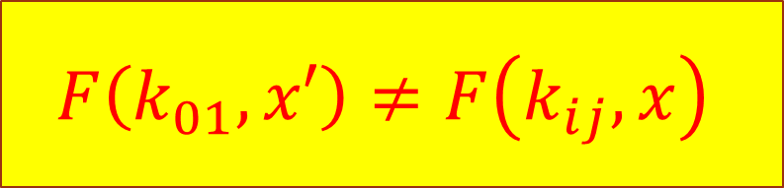
Non-interactive Zero sharing
$$x∉intersection$$
$$x$$
$$P_{0}(X_{0})$$
$$k_{01}$$
$$F(k_{01},x)$$
$$F\left(k_{01},x′\right)≠F\left(k_{ij},x\right)$$
$sh_{0}(x)=F\left(k_{01},x\right)⊕$ $F\left(k_{02},x\right)⊕ F\left(k_{03},x\right)$
$$k_{02}$$
$$F(k_{02},x)$$
$$k_{03}$$
$$F(k_{03},x)$$
$sh_{1}(x′)=F\left(k_{01},x′\right)⊕$ $F\left(k_{12},x′\right)⊕ F\left(k_{13},x′\right)$
$sh_{3}(x)=F\left(k_{03},x\right)⊕$ $F\left(k_{13},x\right)⊕ F\left(k_{23},x\right)$
$sh_{3}(x)=F\left(k_{03},x\right)⊕$ $F\left(k_{13},x\right)⊕ F\left(k_{23},x\right)$
$$x′$$
$$k_{01}$$
$$k_{03}$$
$$k_{12}$$
$${sh_{1 }(x′)⊕}_{i}sh_{i }(x)$$
$$x$$
$$P_{1}\left(X_{1}\right)$$
$$k_{13}$$
$$P_{3}\left(X_{3}\right)$$
$$k_{13}$$
$$k_{23}$$
Purpose: parties agree on
a share of zero if they have common x
Party $P_{i}$chooses random seeds $k_{ij}$and sends it to $P_{j }(j>i)$
For each $x$, $P_{i}$computes share $sh_{0}$ using PRF $F$
$$k_{02}$$
$$k_{12}$$
$$k_{23}$$
$sh_{2}(x)=F\left(k_{02},x\right)⊕$ $F\left(k_{12},x\right)⊕ F\left(k_{23},x\right)$
$sh_{2}(x)=F\left(k_{02},x\right)⊕$ $F\left(k_{12},x\right)⊕ F\left(k_{23},x\right)$
$$x$$
20
$$P_{2}(X_{2})$$
Notes:
And if x is not common. For example, P1 has x'. Therefore, share of p1 will be F k01 of x' which appears only 1 time in xor of shares. Thus xor of share is not equal to zero
For Non-interactive Zero sharing, Sending keys in an one time
We can generate An unlimited number of zero-sharings

Slide 21

Non-interactive Zero sharing
$$x∉intersection$$
$$x$$
$$P_{0}(X_{0})$$
$$k_{01}$$
$$F(k_{01},x)$$
$$k_{02}$$
$$F(k_{02},x)$$
$sh_{0}(x)=F\left(k_{01},x\right)⊕$ $F\left(k_{02},x\right)⊕ F\left(k_{03},x\right)$
$$k_{03}$$
$$F(k_{03},x)$$
$sh_{1}(x′)=F\left(k_{01},x′\right)⊕$ $F\left(k_{12},x′\right)⊕ F\left(k_{13},x′\right)$
$sh_{3}(x)=F\left(k_{03},x\right)⊕$ $F\left(k_{13},x\right)⊕ F\left(k_{23},x\right)$
$sh_{3}(x)=F\left(k_{03},x\right)⊕$ $F\left(k_{13},x\right)⊕ F\left(k_{23},x\right)$
$$x′$$
$$k_{01}$$
$$k_{03}$$
$$k_{12}$$
$${sh_{1 }(x′)⊕}_{i}sh_{i }(x)$$
$$x$$
$$P_{1}\left(X_{1}\right)$$
$$≠0$$
$$k_{13}$$
$$k_{13}$$
$$P_{3}\left(X_{3}\right)$$
$$k_{23}$$
Purpose: parties agree on
a share of zero if they have common x
Party $P_{i}$chooses random seeds $k_{ij}$and sends it to $P_{j }(j>i)$
For each $x$, $P_{i}$computes share $sh_{0}$ using PRF $F$
$$k_{02}$$
$$k_{12}$$
$$k_{23}$$
$sh_{2}(x)=F\left(k_{02},x\right)⊕$ $F\left(k_{12},x\right)⊕ F\left(k_{23},x\right)$
$sh_{2}(x)=F\left(k_{02},x\right)⊕$ $F\left(k_{12},x\right)⊕ F\left(k_{23},x\right)$
$$x$$
21
$$P_{2}(X_{2})$$
Notes:
And if x is not common. For example, P1 has x'. Therefore, share of p1 will be F k01 of x' which appears only 1 time in xor of shares. Thus xor of share is not equal to zero
For Non-interactive Zero sharing, Sending keys in an one time
We can generate An unlimited number of zero-sharings

Slide 22
Non-interactive Zero sharing
$$x∉intersection$$
$$x$$
$$P_{0}(X_{0})$$
$$k_{01}$$
$$F(k_{01},x)$$
Sending keys is one-time event
An unlimited number of zero-sharings
$sh_{0}(x)=F\left(k_{01},x\right)⊕$ $F\left(k_{02},x\right)⊕ F\left(k_{03},x\right)$
$$k_{02}$$
$$F(k_{02},x)$$
$$k_{03}$$
$$F(k_{03},x)$$
$sh_{1}(x′)=F\left(k_{01},x′\right)⊕$ $F\left(k_{12},x′\right)⊕ F\left(k_{13},x′\right)$
$sh_{3}(x)=F\left(k_{03},x\right)⊕$ $F\left(k_{13},x\right)⊕ F\left(k_{23},x\right)$
$sh_{3}(x)=F\left(k_{03},x\right)⊕$ $F\left(k_{13},x\right)⊕ F\left(k_{23},x\right)$
$$x′$$
$$k_{01}$$
$$k_{03}$$
$$k_{12}$$
$${sh_{1 }(x′)⊕}_{i}sh_{i }(x)$$
$$x$$
$$P_{1}\left(X_{1}\right)$$
$$≠0$$
$$k_{13}$$
$$k_{13}$$
$$P_{3}\left(X_{3}\right)$$
$$k_{23}$$
Purpose: parties agree on
a share of zero if they have common x
Party $P_{i}$chooses random seeds $k_{ij}$and sends it to $P_{j }(j>i)$
For each $x$, $P_{i}$computes share $sh_{0}$ using PRF $F$
$$k_{02}$$
$$k_{12}$$
$$k_{23}$$
$sh_{2}(x)=F\left(k_{02},x\right)⊕$ $F\left(k_{12},x\right)⊕ F\left(k_{23},x\right)$
$sh_{2}(x)=F\left(k_{02},x\right)⊕$ $F\left(k_{12},x\right)⊕ F\left(k_{23},x\right)$
$$x$$
22
$$P_{2}(X_{2})$$
Notes:
And if x is not common. For example, P1 has x'. Therefore, share of p1 will be F k01 of x' which appears only 1 time in xor of shares. Thus xor of share is not equal to zero
For Non-interactive Zero sharing, Sending keys in an one time
We can generate An unlimited number of zero-sharings

Slide 23
Our outline
PSI and Its application
Previous Work
Our PSI Approach
Oblivious Programmable PRF (new tool)
Zero Sharing
Putting it together => our PSI construction
Results
*: This talk is on Semi-honest setting
Notes:
Ok. we are done with zero sharing construction. Now, we put OPPRF and zero sharing together to achieve PSI construction

Slide 24
Our PSI construction
Simple case: PSI of 1 item each
Idea:
If all parties have same item x => XOR of parties’ shares equals 0
Otherwise: XOR of shares is random
Question: who can check the XOR of shares?
Choose one party be a Leader
How to send the share?
Send directly? => insecure
Subset of corrupt parties compute correct share of honest party
Share can leak the honest party’s item to Adversary
Use our new tool OPPRF
Leader receives a correct share if he has common item with sender,
else he learns nothing
Zero Sharing
OPPRF
Notes:
(15p)Consider a simple case where each party has only 1 item.
Our idea is that if all parties have same item x => XOR of party’s share equals to 0. Otherwise, this XOR equals to random value. This is indeed our zeroshare functionality.
The question now is how to check shares? and who can do it? we first Choose one party be a Leader. Now, how to send the share to the leader? Broadcast? it is insecure since share can leak your item to Adversary.
Our solution is to use our new term OPPRF. It can allow Leader receives a correct share if he has common item with sender, else he learn nothing

Slide 25














OUR MULTi-PARTY PSI
$${(x,sh}_{0}(x))$$
$$x∈intersection$$
$$x$$
$$P_{0}(X_{0})$$
$$⊕_{i}sh_{i}(x)=0$$
Zero Sharing
$$x$$
$$x$$
$$P_{1}\left(X_{1}\right)$$
$${(x,sh}_{3}(x))$$
$${(x,sh}_{1}(x))$$
$$P_{3}\left(X_{3}\right)$$
$${(x,sh}_{2}(x))$$
$$x$$
$$P_{2}(X_{2})$$
Notes:
In this senerio, we choose P0 be a leader.
From ZeroShare, each party has a share. they create a point (x, share). Now party Pi and leader invoke OPPRF. If both parties has x, then leader receives a correct share. After runing 3 OPPRFs, leader computes XOR of the OPPRF outputs and check whether the xor equals to zero. if yes, x is intersection item

Slide 26
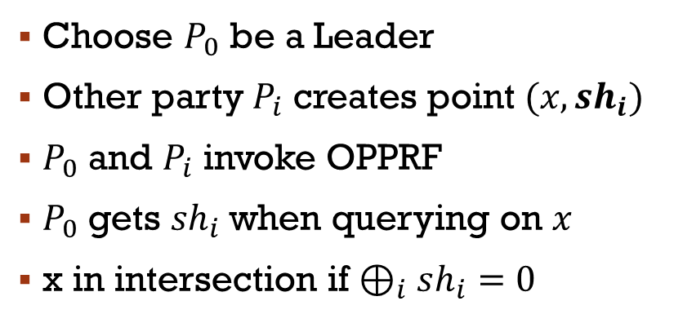








OUR MULTi-PARTY PSI
$$Leader$$
$${(x,sh}_{0}(x))$$
$$x∈intersection$$
$$x$$
$${ ⊕}_{i}sh_{i}{ =}^{?} 0$$
$$P_{0}(X_{0})$$
$$=$$
$$⊕_{i}sh_{i}(x)=0$$
$$sh_{1}$$
$$sh_{2}$$
$$sh_{3}$$
$$x$$
OPPRF
OPPRF
$$x$$
$$x$$
$$P_{1}\left(X_{1}\right)$$
$${(x,sh}_{3}(x))$$
$${(x,sh}_{1}(x))$$
$$P_{3}\left(X_{3}\right)$$
$$x$$
Choose $P_{0}$ be a Leader
Other party $P_{i}$ creates point ${(x,sh}_{i})$
$P_{0}$ and $P_{i}$ invoke OPPRF
$P_{0}$ gets ${sh}_{i}$ when querying on $x$
x in intersection if $⊕_{i}sh_{i}=0$
OPPRF
$${(x,sh}_{2}(x))$$
$$x$$
$$P_{2}(X_{2})$$
Notes:
In this senerio, we choose P0 be a leader.
From ZeroShare, each party has a share. they create a point (x, share). Now party Pi and leader invoke OPPRF. If both parties has x, then leader receives a correct share. After runing 3 OPPRFs, leader computes XOR of the OPPRF outputs and check whether the xor equals to zero. if yes, x is intersection item

Slide 27




















OUR MULTi-PARTY PSI
$$Leader$$
$${(x,sh}_{0}(x))$$
$$x∉intersection$$
$$x$$
$${ ⊕}_{i}sh_{i}{ =}^{?} 0$$
$$P_{0}(X_{0})$$
$$≠$$
$$⊕_{i}sh_{i}=0$$
$${sh_{1}\left(x^{′}\right)⊕}_{i}sh_{i}(x)≠0$$
$$sh_{1}$$
$$sh_{2}$$
$$sh_{3}$$
$$\$$$
$$x$$
OPPRF
OPPRF
$$x′$$
$$x$$
$$x$$
$$P_{1}\left(X_{1}\right)$$
$${(x,sh}_{3}(x))$$
$${(x,sh}_{1}(x))$$
$$P_{3}\left(X_{3}\right)$$
$${(x′,sh}_{1}(x^{′}))$$
$$x$$
Choose $P_{0}$ be a Leader
Other party $P_{i}$ creates point ${(x,sh}_{i})$
$P_{0}$ and $P_{i}$ invoke OPPRF
$P_{0}$ gets ${sh}_{i}$ when querying on $x$
x in intersection if $⊕_{i}sh_{i}=0$
OPPRF
$${(x,sh}_{2}(x))$$
$$x$$
$$P_{2}(X_{2})$$
27
Notes:
Now, look at the case that x is not in the intersection. For example, P1 has x', from zerosharing, xor of share doesnt equal to zero. Leader and P1 invoke OPRF, leader receives a random output when quering on x. The important thing is that leader doesnt know anything on x and cant recognize the diffirence. After runing 3 OPPRFs, leader computes XOR of the OPPRF outputs. Now he can see that the xor of the share doesnt equal to zero. however, he would never know who doesnt have x

Slide 28





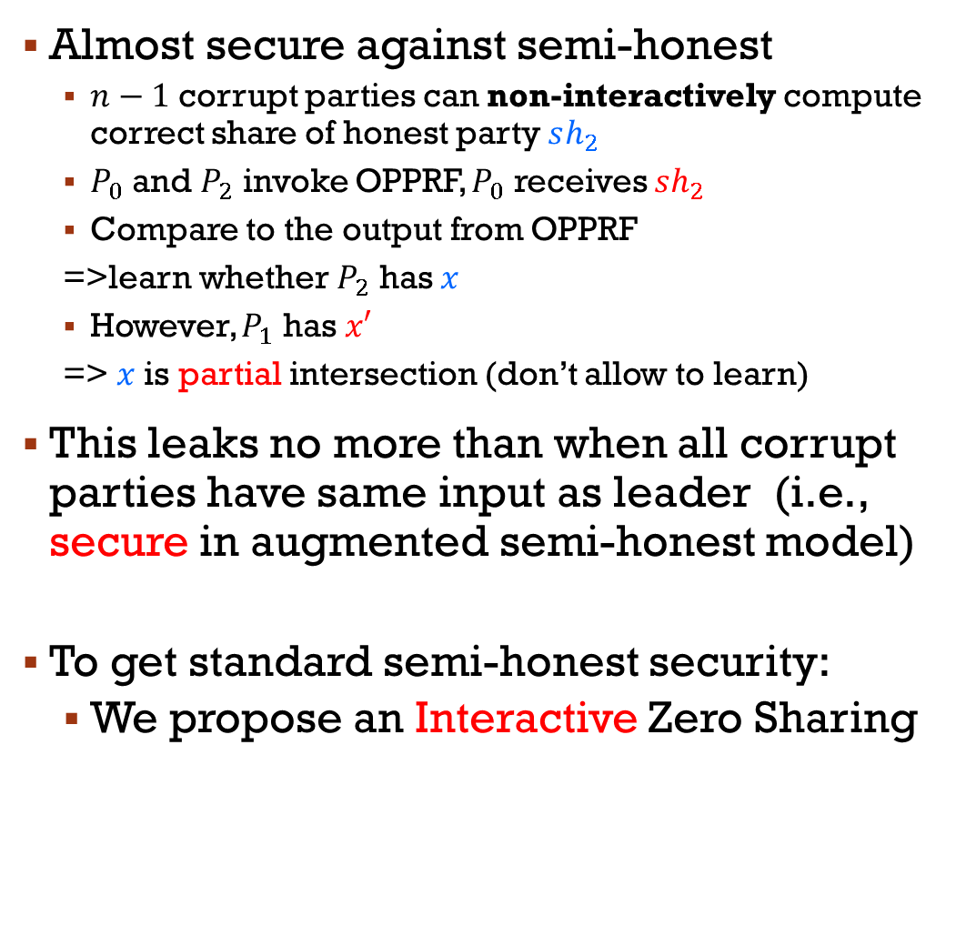



















Security
$$?$$
$$sh_{2}←k_{ij}$$
Almost secure against semi-honest
$n−1$ corrupt parties can non-interactively compute correct share of honest party $sh_{2}$
$P_{0}$ and $P_{2}$ invoke OPPRF, $P_{0}$ receives $sh_{2}$
Compare to the output from OPPRF
=>learn whether $P_{2}$ has $x$
However, $P_{1}$ has $x′$
=> $x$is partial intersection (don’t allow to learn)
This leaks no more than when all corrupt parties have same input as leader (i.e., secure in augmented semi-honest model)
To get standard semi-honest security:
We propose an Interactive Zero Sharing
$$x$$
$$k_{01}$$
$$k_{02}$$
$$P_{0}(X_{0})$$
$$k_{03}$$
$$sh_{2}$$
$$k_{01}$$
$$k_{03}$$
$$x′$$
$$k_{12}$$
$$k_{13}$$
$$x$$
$$P_{1}\left(X_{1}\right)$$
$$k_{13}$$
$$k_{23}$$
$$P_{3}\left(X_{3}\right)$$
OPPRF
$$sh_{2}$$
Check paper
$$k_{02}$$
$$k_{12}$$
$$x$$
$$k_{23}$$
$$P_{2}(X_{2})$$
Notes:
We presented Non-Interactive Zero Sharing. However, this protocol have a problem when Subset of parties corrupt. For example, leader, P1 and P3 corrupt, they have all the keys from other parties. They can compute share value of P2. In the OPPRF step, leader receives the share value from P2. he can see whether P2 has x. this information doesn't allow the adversary learn in PSI.
However, the Non-Interactive Zero Sharing can work in Augmented Semi-honest model where parties has a same input if they corrupt
In standard Semi-honest model, To address this problem, we propose an Interactive Zero Sharing
X’

Slide 29
Our outline
PSI and Its application
Previous Work
Our PSI Approach
Oblivious Programmable PRF (New tool)
Zero Sharing
Putting it together => our PSI construction
Results
*: This talk is on Semi-honest setting
Notes:
Cool. We are almost done

Slide 30
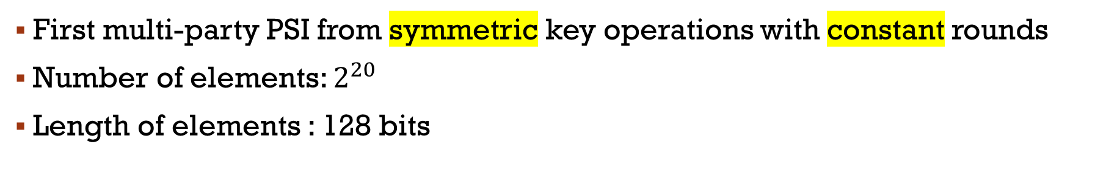
OUR Multi-PARTY psi PERFORMANCE
First multi-party PSI from symmetric key operations with constant rounds
Number of elements: $2^{20}$
Length of elements : 128 bits
Notes:
We implement our protocol and found that we take only xxx for 3 parties.
Runing time is linear in number of parties

Slide 31
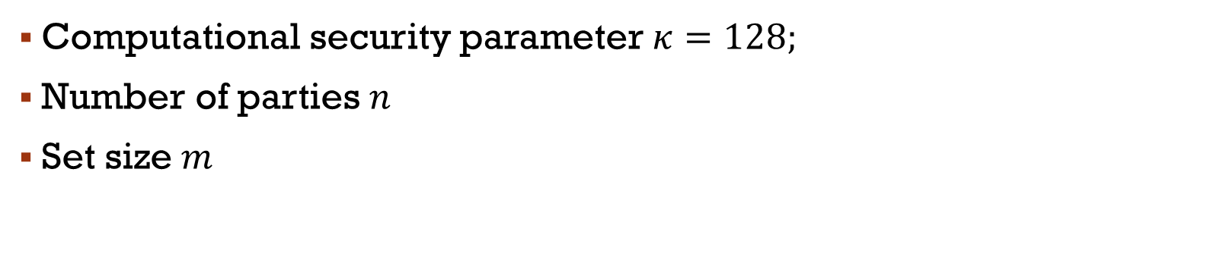
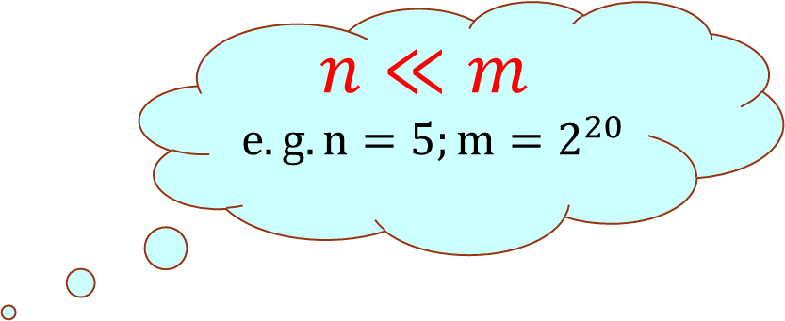
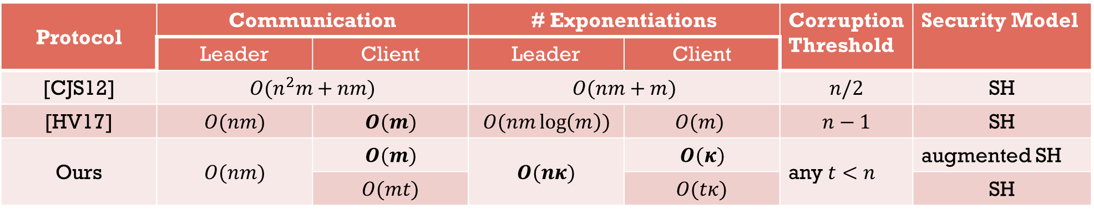
OUR Multi-PARTY psi PERFORMANCE
Computational security parameter$κ=128;$
Number of parties $n$
Set size $m$
$$n≪m$$
$$e.g. n=5;m=2^{20}$$
Protocol | Communication |  | # Exponentiations |  | Corruption Threshold | Security Model
 | Leader | Client | Leader | Client
[CJS12] | $O(n^{2}m+nm)$ |  | $O(nm+m)$ |  | $n/2$ | SH
[HV17] | $O(nm)$ | $O(m)$ | $O(nm\log\left(m\right))$ | $$O(m)$$ | $n−1$ | SH
Ours | $O(nm)$ | $O(m)$ | $O(nκ)$ | $$O(κ)$$ | any $t<n$ | augmented SH
 |  | $O(mt)$ |  | $O(tκ)$ |  | SH
Notes:
Compare to previous work

Slide 32
The End!
Thank you

Slide 33
Reference
[CJS12] Jung Hee Cheon, Stanislaw Jarecki, and Jae Hong Seo. Multi-party privacy-preserving set intersection with quasi-linear complexity. IEICE Transactions, 95-A(8):1366–1378, 2012.
[HV17] Carmit Hazay and Muthuramakrishnan Venkitasubramaniam. Scalable multi-party private setintersection. Cryptology ePrint Archive, Report 2017/027, 2017. http://eprint.iacr.org/ 2017/027
[KS05] Lea Kissner and Dawn Song. Privacy-preserving set operations. In Proceedings of the 25th Annual International Conference on Advances in Cryptology, CRYPTO’05, pages 241–257, Berlin, Heidelberg, 2005. Springer-Verlag
[KKRT16] Vladimir Kolesnikov, Ranjit Kumaresan, Mike Rosulek, and Ni Trieu. Efficient batched oblivious prf with applications to private set intersection. 2016. http://eprint.iacr.org/2016/799.
[SS08] Yingpeng Sang and Hong Shen. Privacy preserving set intersection based on bilinear groups. In Proceedings of the Thirty-first Australasian Conference on Computer Science - Volume 74, ACSC ’08, pages 47–54, Darlinghurst, Australia, Australia, 2008. Australian Computer Society, Inc.
[FNP04] Michael J. Freedman, Kobbi Nissim, and Benny Pinkas. Efficient private matching and set intersection. In Advances in Cryptology - EUROCRYPT 2004, volume 3027 of Lecture Notes in Computer Science, pages 1–19. Springer, 2004.
[PSZ16] Benny Pinkas, Thomas Schneider, and Michael Zohner. Scalable private set intersection based on ot extension. Cryptology ePrint Archive, Report 2016/930, 2016. http://eprint.iacr. org/2016/930.
[RR17] Peter Rindal and Mike Rosulek. Malicious-secure private set intersection via dual execution. Cryptology ePrint Archive, Report 2017/769, 2017. http://eprint.iacr.org/2017/769.
[CLR17] Hao Chen, Kim Laine, and Peter Rindal. Fast private set intersection from homomorphic encryption. Cryptology ePrint Archive, Report 2017/299, 2017. http://eprint.iacr.org/ 2017/299

