Slide 1
Disagreements Aggregation
Kien Duong + Hung Anh

Slide 2
Idea
This method use the disagreement as the penalty for the predicted score.
If the user's behavior is too different from other members, we lower the score of the item suggested by that user.
To be fair for all user, we calculate the disagreements pairwise.
Then:
pred_score_i = pred_score_i * 1/(Σdist_i_k)
Where i is the user, k is other users in group.

Slide 3
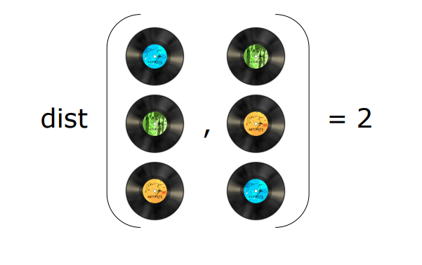
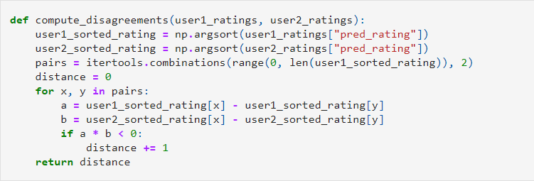
Step1: Calculate the disagreements for each pair of user

Slide 4
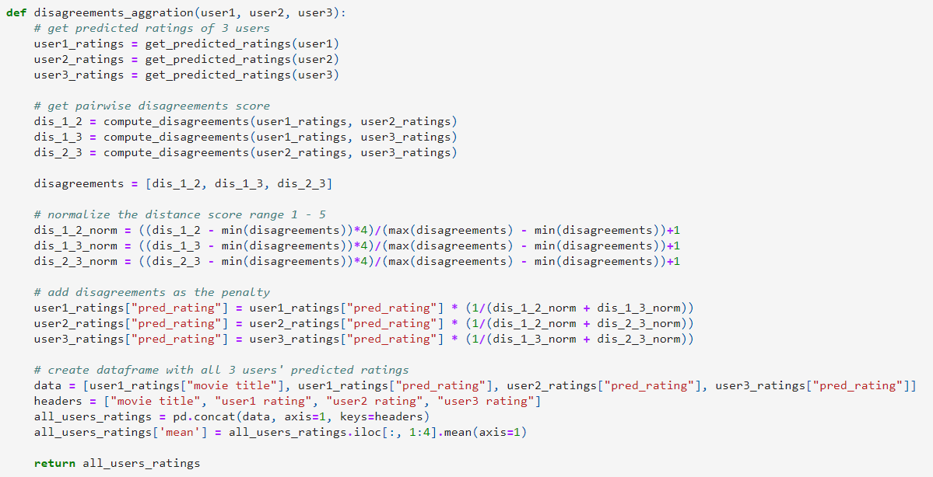
Step2: Rescale the disagreements and apply the penalty.

