Slide 1
Sequential recommender system
Kien Duong + Hung Anh

Slide 2
Idea
Inspired by satisfaction method in the paper, we implement satisfaction method based on movies genre.
Human tend to have more interest in some specific genre -> movies are grouped by genre.
We calculate the satisfaction score for each genre using the same formula in the paper.

Slide 3
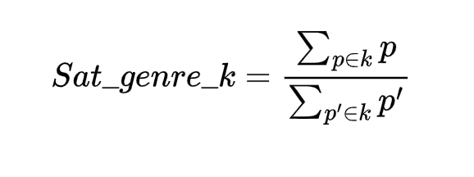
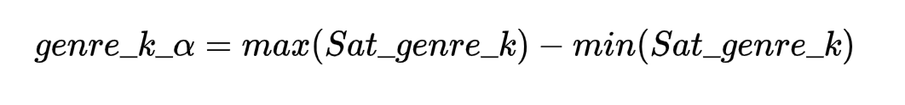
Formula
Assume:
K is the set of genre {k1, k2, k3,…,kn}
Gj is the group recommended item set after iter “j” {p1, p2,…,pm}
Ai is set of recommended item for user “i” {p’1, p’2,…,p’m}
Step1: compute the satisfaction for each genre:
Step2: compute alpha for each genre

Slide 4
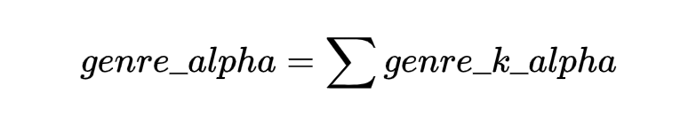
Formula
Step3: genre_alpha for a movie is the sum of all genre alpha which the movie belong to
Step4: use the same score equation in the lecture

