Slide 1
Sequential recommender system
Kien Duong + Hung Anh

Slide 2
Idea
Inspired by satisfaction method in the paper, we implement satisfaction method based on movies genre.
Human tend to have more interest in some specific genre -> movies are grouped by genre.
We calculate the satisfaction score for each genre using the same formula in the paper.
We also remove all movies which have rating less than 2. This make sure that nobody in the group don’t like the movie.

Slide 3
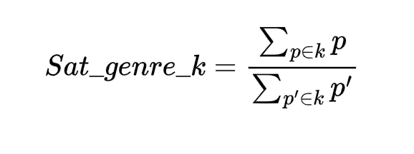
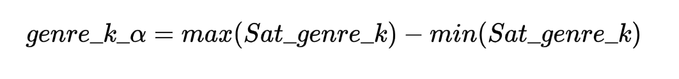
Formula
Assume:
K is the set of genre {k1, k2, k3,…,kn}
Gj is the group recommended item set after iter “j” {p1, p2,…,pm}
Ai is set of recommended item for user “i” {p’1, p’2,…,p’m}
Step1: compute the satisfaction for each genre:
Step2: compute alpha for each genre

Slide 4
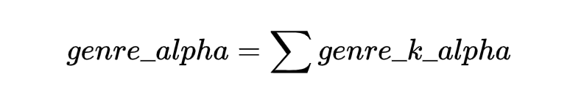
Formula
Step3: genre_alpha for a movie is the sum of all genre alpha which the movie belong to
Step4: use the same score equation in the lecture

