Slide 1
Constrained Optimization and Lagrange Multipliers
Team 2

Slide 2
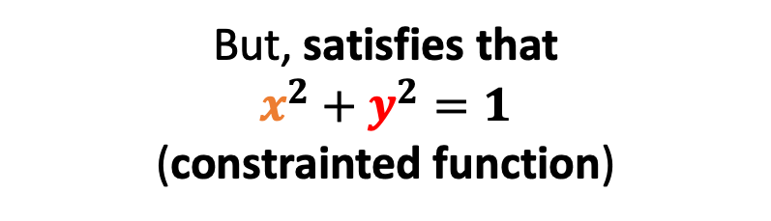
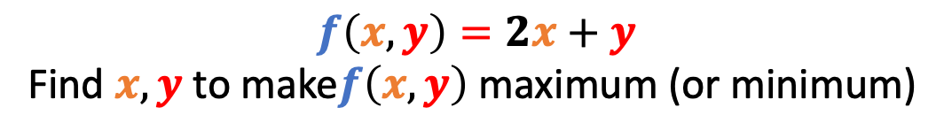
What is constrained optimization?
Constrained optimization: the process of optimizing an objective function with respect to some variables in the presence of constraints on those variables.
$$f\left(x,y\right)=2x+y$$
Find $x, y$ to make$f\left(x,y\right)$ maximum (or minimum)
But, satisfies that
$$x^{2}+y^{2}=1$$
(constrainted function)

Slide 3
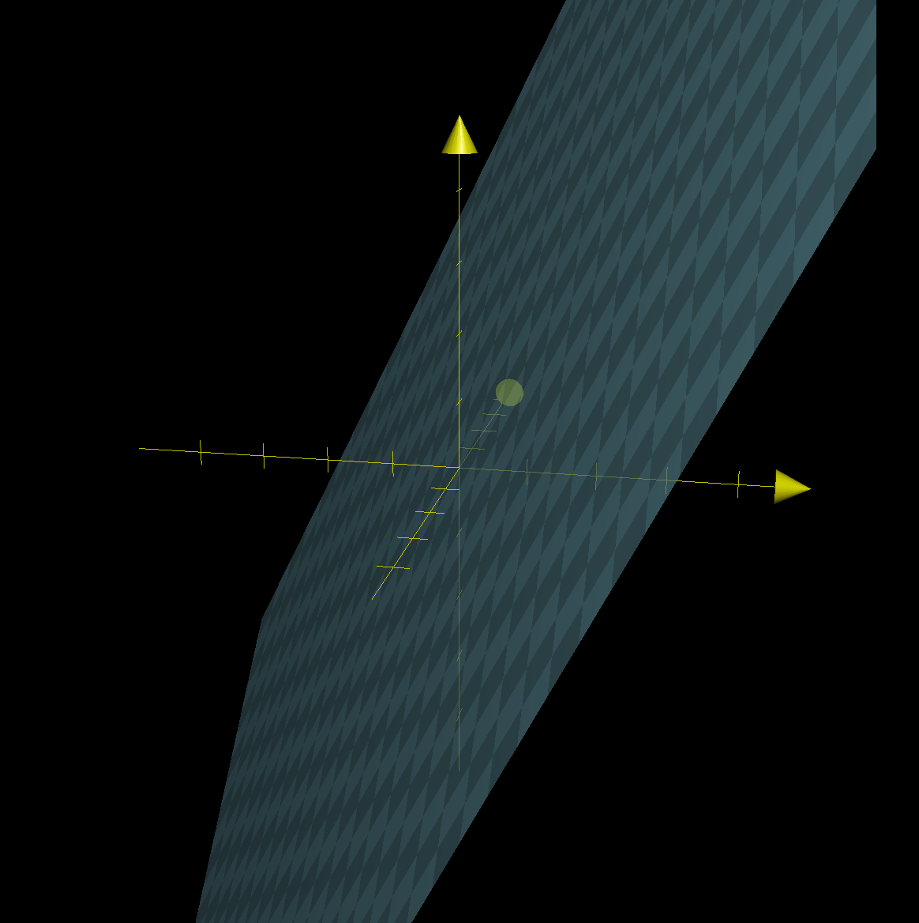



$$f\left(x,y\right)=2x+y$$
$$x^{2}+y^{2}=1$$
$$x, y?$$

Slide 4



In general,
Given $f\left(x,y\right)$ and constrained function $g\left(x,y\right)=c$, we have:
$$g\left(x,y\right)=c$$
$$∇f(x​,y​)=λ∇g(x​,y)$$
Lagrange multiplier

Slide 5



$$f\left(x,y\right)=2x+y$$
$${g\left(x,y\right)=x}^{2}+y^{2}=1$$

Slide 6

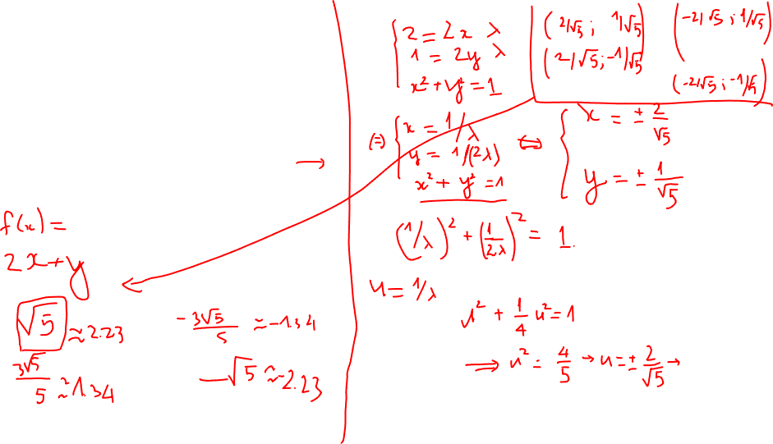

Slide 7
