Slide 1
Constrained Optimization and Lagrange Multipliers
Team 2

Slide 2
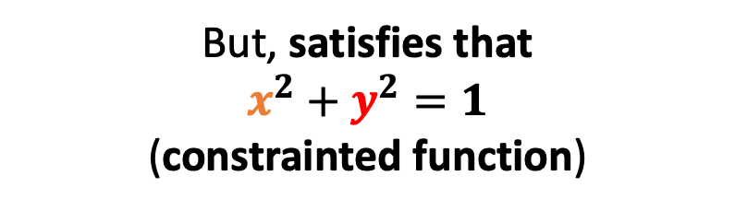
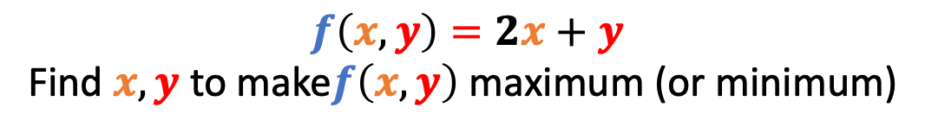
What is constrained optimization?
Constrained optimization: the process of optimizing an objective function with respect to some variables in the presence of constraints on those variables.
$$f\left(x,y\right)=2x+y$$
Find $x, y$ to make$f\left(x,y\right)$ maximum (or minimum)
But, satisfies that
$$x^{2}+y^{2}=1$$
(constrainted function)

Slide 3
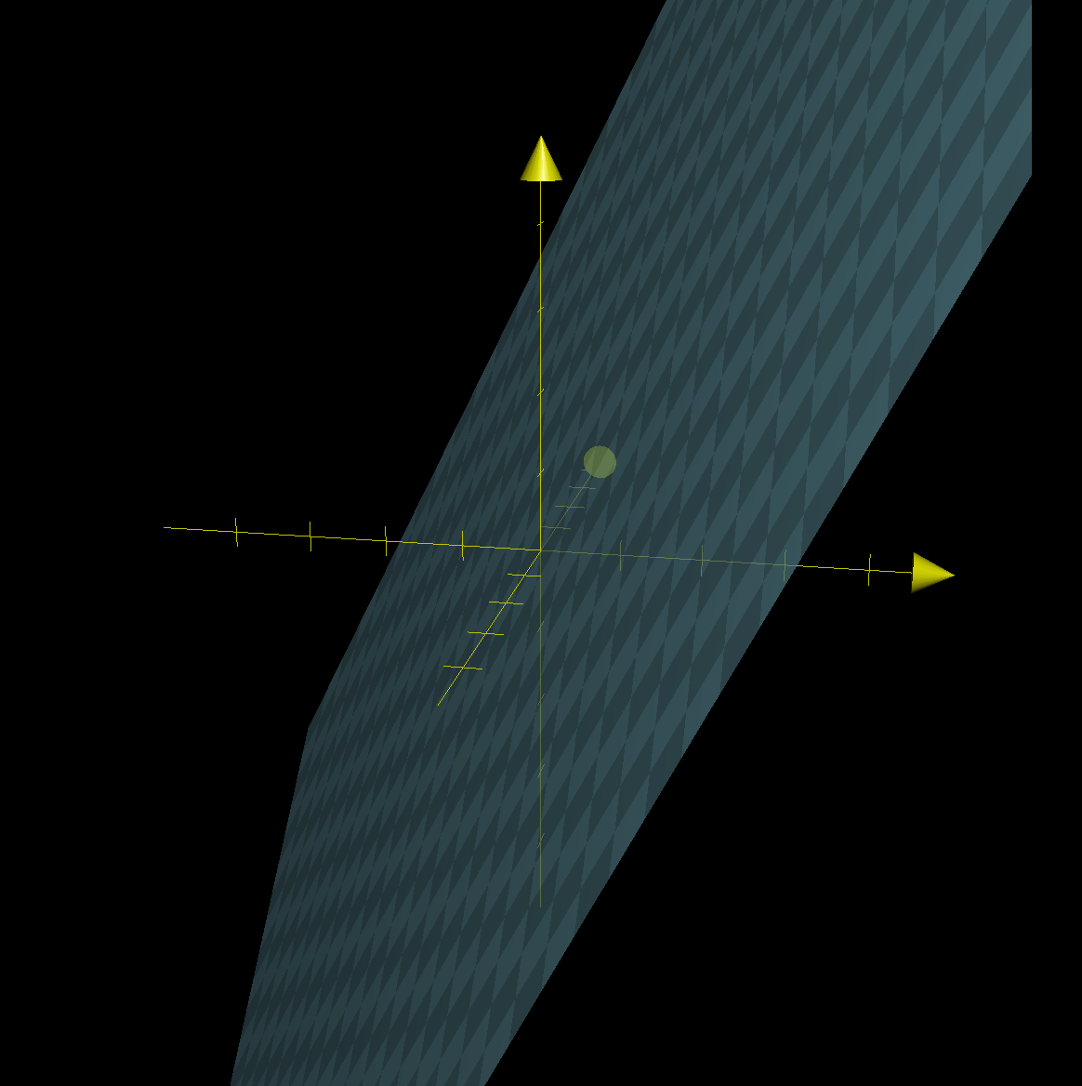



$$f\left(x,y\right)=2x+y$$
$$x^{2}+y^{2}=1$$
$$x, y?$$

Slide 4
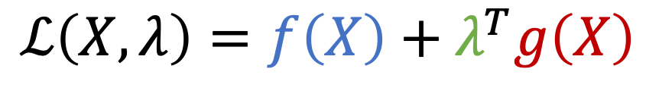
In general,
Given $f\left(X\right)$ and mutiple constrained functions $g\left(X\right)=0$, we have:
$$ℒ\left(X,λ\right)=f\left(X\right)+λ^{T}g\left(X\right)$$
Lagrangian
Lagrange multipliers

Slide 5
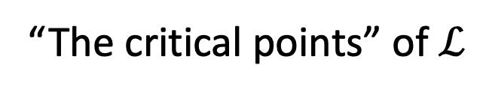
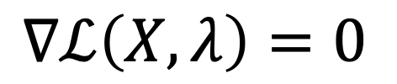
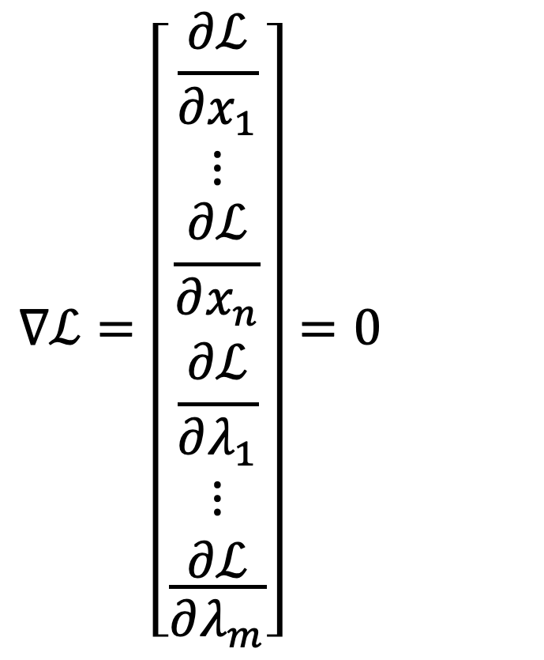
$∇ℒ\left(X,λ\right)=0$
“The critical points” of $ℒ$
$$∇ℒ=\left[\begin{aligned}\frac{∂ℒ}{∂x_{1}} \\ ⋮ \\ \frac{∂ℒ}{∂x_{n}} \\ \frac{∂ℒ}{∂λ_{1}} \\ \frac{\begin{aligned}⋮ \\ ∂ℒ\end{aligned}}{∂λ_{m}}\end{aligned}\right]=0$$

Slide 6


$$f\left(x,y\right)=2x+y$$
$${g\left(x,y\right):x}^{2}+y^{2}=1$$

Slide 7
