Slide 1
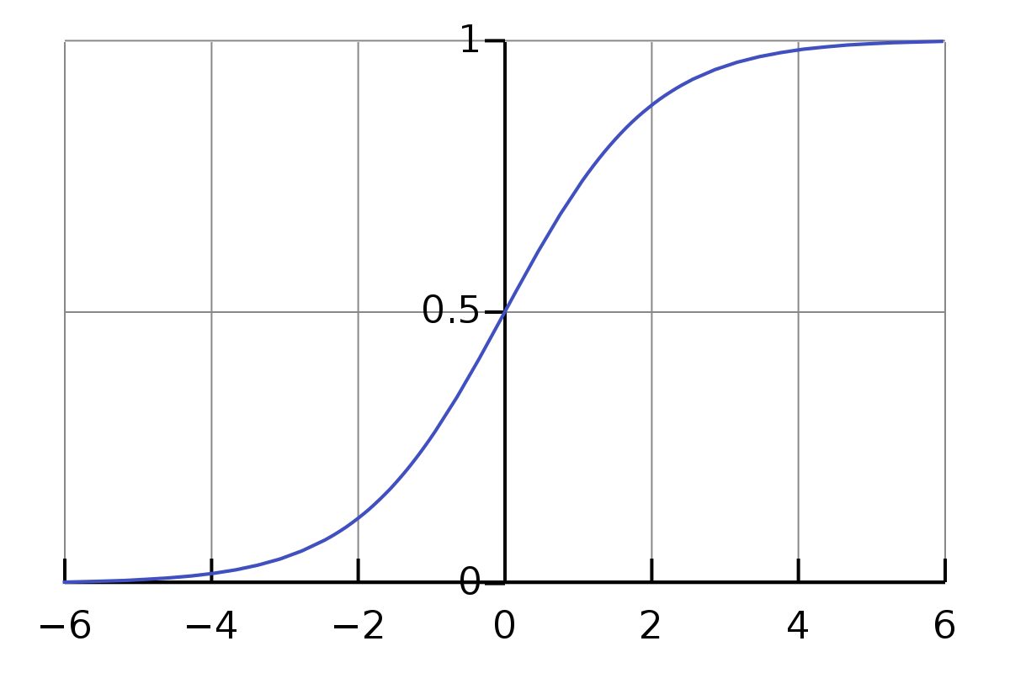
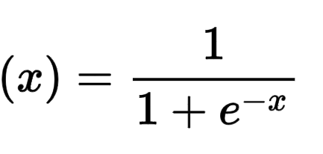

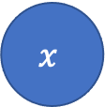


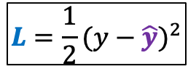


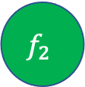


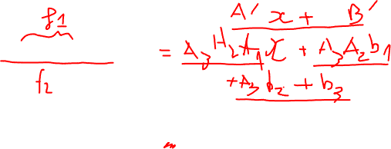
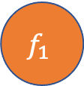


$$y=A_{3}\left(A_{2}\left(A_{1}x+b_{1}\right)+b_{2}\right)+b_{3}$$
$$L=\frac{1}{2}{(y−\hat{y})}^{2}$$
$$f_{1}={σ(z}_{1})$$
$$f_{2}={σ(z}_{2})$$
$$\hat{y}={σ(z}_{3})$$
$$x$$
$$z_{1}=A_{1}x+b_{1}$$
$$f_{1}$$
$$z_{2}=A_{2}f_{1}+b_{2}$$
$$f_{2}$$
$$z_{3}=A_{3}f_{2}+b_{3}$$
$$\hat{y}$$
$$L$$
σ

Slide 2
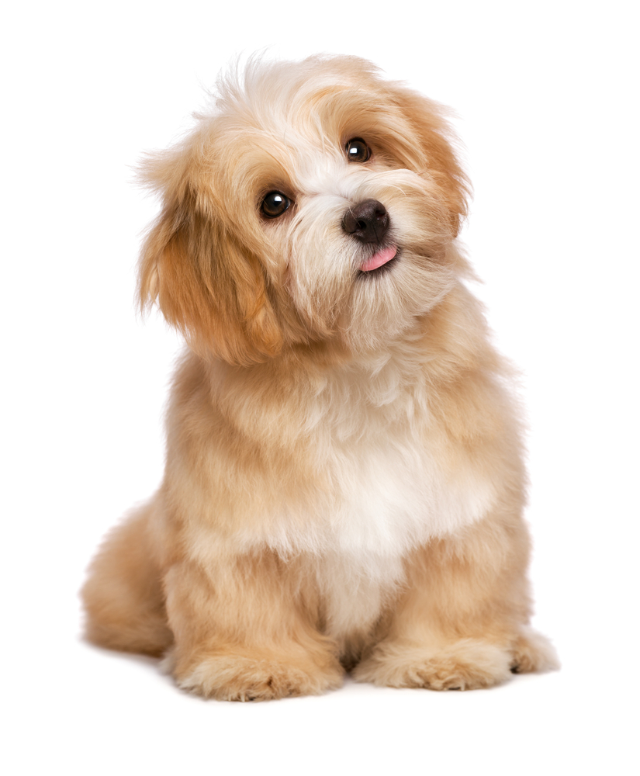
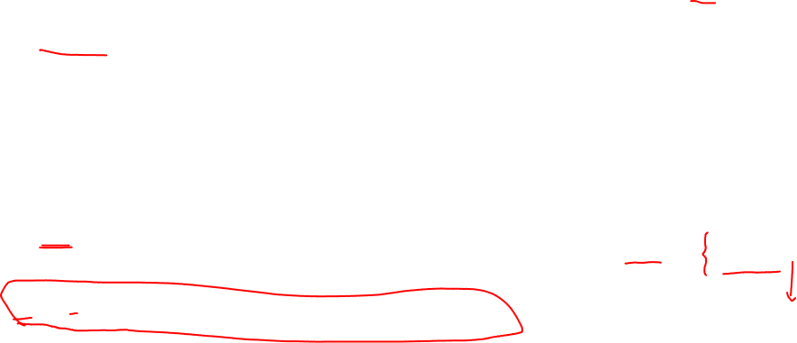

0: not dog
1: dog
$$y=1$$
$$L=\frac{1}{2}{(y−\hat{y})}^{2}$$
$$f_{1}={σ(z}_{1})$$
$$f_{2}={σ(z}_{2})$$
$$\hat{y}={σ(z}_{3})$$
$$x$$
$$z_{1}=A_{1}x+b_{1}$$
$$f_{1}$$
$$z_{2}=A_{2}f_{1}+b_{2}$$
$$f_{2}$$
$$z_{3}=A_{3}f_{2}+b_{3}$$
$$\hat{y}$$
$$L$$
x = 3
z1 = 2*3 - 3 = 3
f1 = σ(3) = 0.952
z2 = (-3)*0.952 + 1 = -1.856
f2 = σ(-1.856) = 0.135
z3 = (-1)*0.135 - 4 = -4.135
y^ = σ(-4.135) = 0.016
L = ½ (1-0.016)^2
= 0.484128
A1 = 2, b1 = -3
A2 = -3, b2 = 1
A3 = -1, b3 = -4

Slide 3
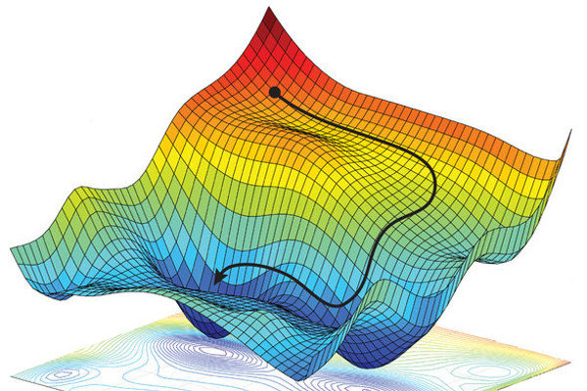
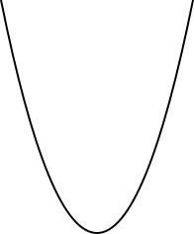
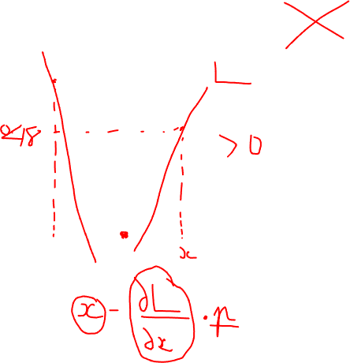

Slide 4
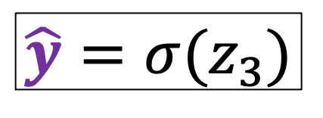
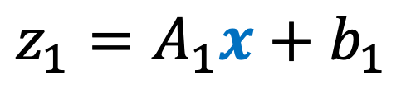
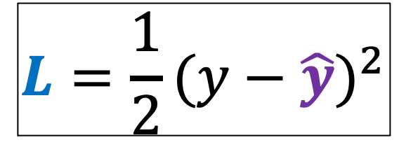
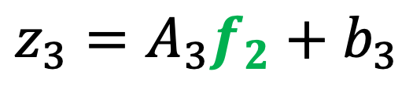
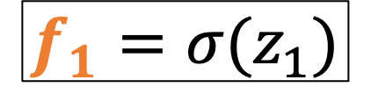
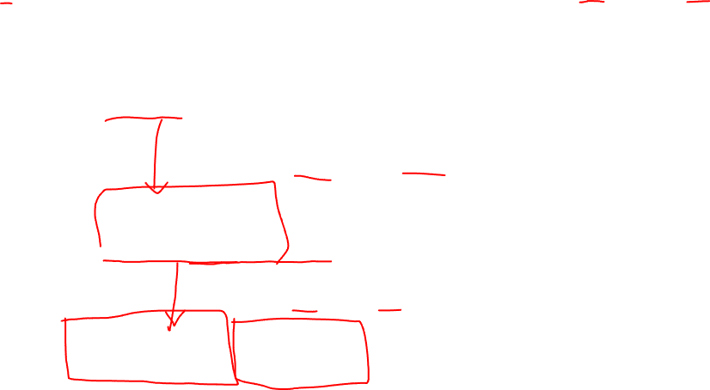
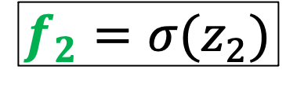
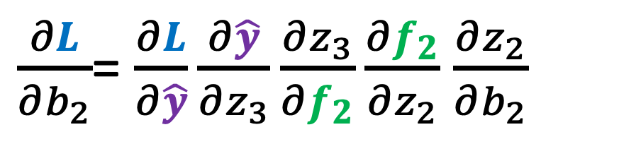
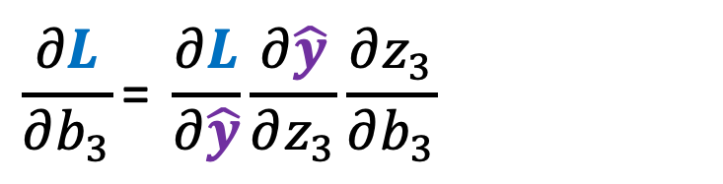
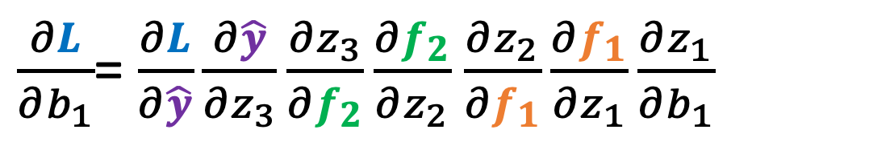
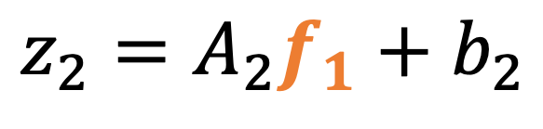
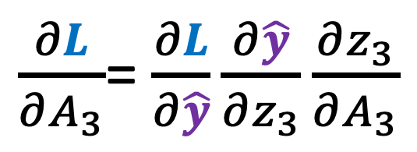
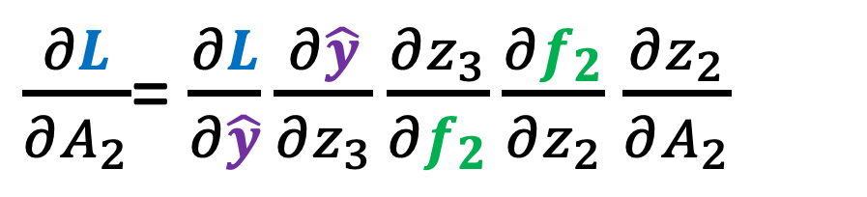

$$L=\frac{1}{2}{(y−\hat{y})}^{2}$$
$$\hat{y}={σ(z}_{3})$$
$$z_{3}=A_{3}f_{2}+b_{3}$$
$\frac{∂L}{∂A_{3}}$= $\frac{∂L}{∂\hat{y}}\frac{∂\hat{y}}{∂z_{3}}\frac{∂z_{3}}{∂A_{3}}$
$$\frac{∂L}{∂b_{3}}\text{=} \frac{∂L}{∂\hat{y}}\frac{∂\hat{y}}{∂z_{3}}\frac{∂z_{3}}{∂b_{3}}$$
$$f_{2}={σ(z}_{2})$$
$$z_{2}=A_{2}f_{1}+b_{2}$$
$\frac{∂L}{∂A_{2}}$= $\frac{∂L}{∂\hat{y}}\frac{∂\hat{y}}{∂z_{3}}\frac{∂z_{3}}{∂f_{2}}\frac{∂f_{2}}{∂z_{2}}$ $\frac{∂z_{2}}{∂A_{2}}$
$\frac{∂L}{∂b_{2}}$= $\frac{∂L}{∂\hat{y}}\frac{∂\hat{y}}{∂z_{3}}\frac{∂z_{3}}{∂f_{2}}\frac{∂f_{2}}{∂z_{2}}$ $\frac{∂z_{2}}{∂b_{2}}$
$$f_{1}={σ(z}_{1})$$
$$z_{1}=A_{1}x+b_{1}$$
$\frac{∂L}{∂A_{1}}$= $\frac{∂L}{∂\hat{y}}\frac{∂\hat{y}}{∂z_{3}}\frac{∂z_{3}}{∂f_{2}}\frac{∂f_{2}}{∂z_{2}}$ $\frac{∂z_{2}}{∂f_{1}}\frac{∂f_{1}}{∂z_{1}}\frac{∂z_{1}}{∂A_{1}}$
$\frac{∂L}{∂b_{1}}$= $\frac{∂L}{∂\hat{y}}\frac{∂\hat{y}}{∂z_{3}}\frac{∂z_{3}}{∂f_{2}}\frac{∂f_{2}}{∂z_{2}}$ $\frac{∂z_{2}}{∂f_{1}}\frac{∂f_{1}}{∂z_{1}}\frac{∂z_{1}}{∂b_{1}}$

Slide 5
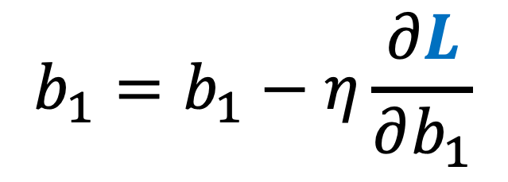
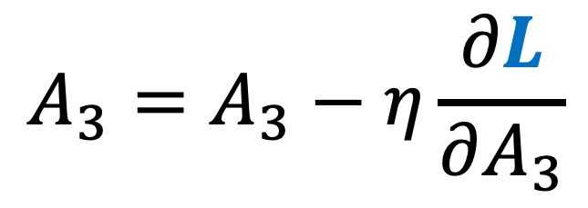
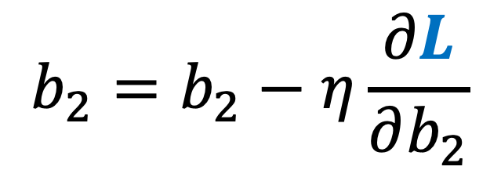

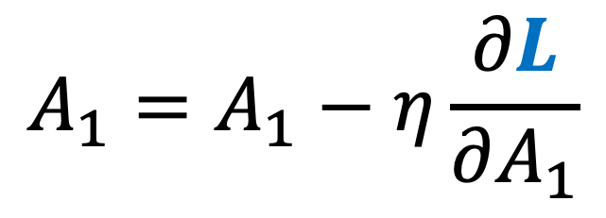

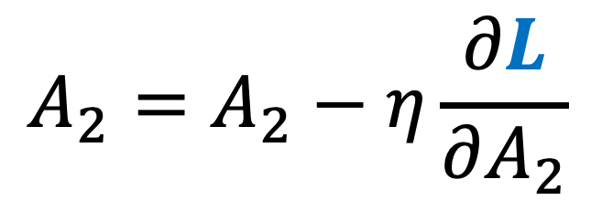
Gradient Descent
$$A_{3}=A_{3}−η\frac{∂L}{∂A_{3}}$$
$$b_{3}=b_{3}−η\frac{∂L}{∂b_{3}}$$
$$A_{2}=A_{2}−η\frac{∂L}{∂A_{2}}$$
$$b_{2}=b_{2}−η\frac{∂L}{∂b_{2}}$$
$$A_{1}=A_{1}−η\frac{∂L}{∂A_{1}}$$
$$b_{1}=b_{1}−η\frac{∂L}{∂b_{1}}$$

Slide 6
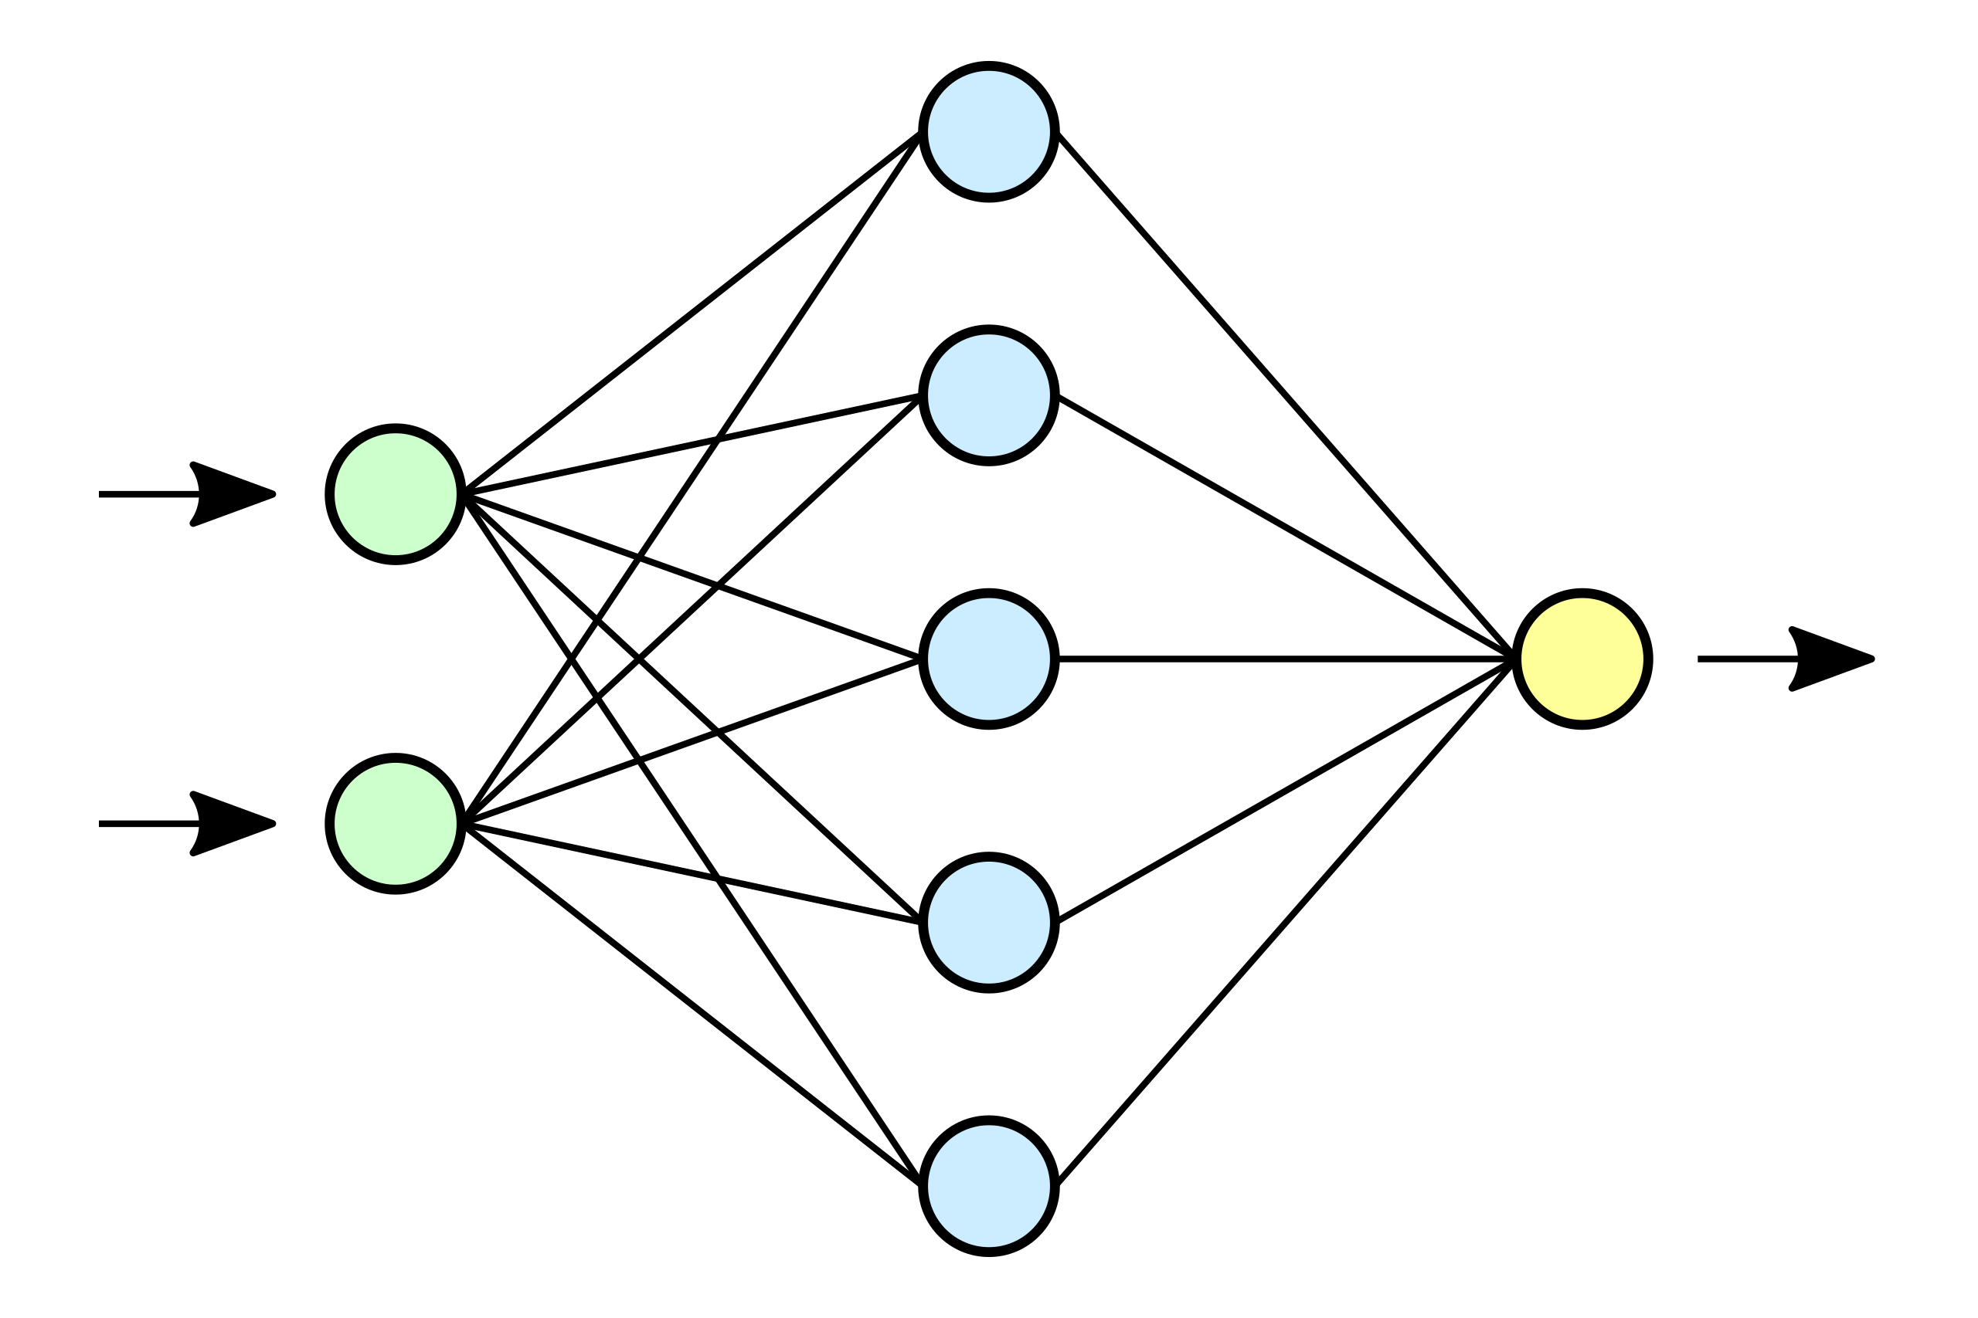

Slide 7
