Slide 1
DATA SCIENCE
SPEAKER:
TRAN THANH DUONG (SE160185)
NGUYEN TAN LOC (SE160366)

Slide 2




TABLE OF CONTENTS
01
02
04
INTRODUCTION
IMPORTANCE
HOW TO BECOME
03
STEPS
What is Data Science?
Why should we study it?
How it impacts on our life
Steps for handling data
Some requirements to become a Data Scientist

Slide 3
INTRODUCTION
01
What is Data Science?

Slide 4



Some questions
How Google suggests results based on your keywords?
How Amazon suggests item to buy?
How Gmail filters email in spam or non-spam categories?
Notes:
It depends on a base thing, which is data. If data is big enough, they can use that data to predict the results. And the core job of data science is to understand the data, extract the useful information and apply it to solve problems.

Slide 5
DATA

Slide 6
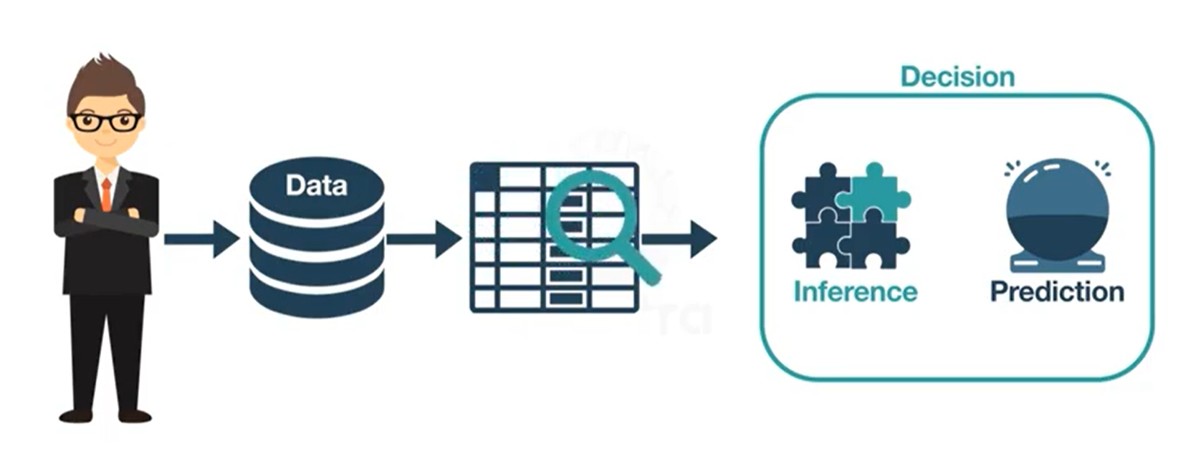

Slide 7



Héctor García-Molina
Data Science is a new term. But in the same sense as Columbus was discovered NEW Continent 1000 years ago.

Slide 8

i. What is Data Science?
A multi-disciplinary field that uses scientific methods, processes, alogorithms and systems to extract knowledge and insights from structured and unstructured data.

Slide 9
DATA SCIENCE
Machine
Learning
Computer
Science
Statistial
Mathematics
Data
Science
Software
Development
Business
Analytics
Business

Slide 10
ii. Why should we study Data Science?
Learning about data science provides an opportunity for you to recreate yourself.
We live in a digital world, everything is data-driven.
Basic data science skills are important for personal use.
Data science is also a very promising field with lots of high paying job opportunities.

Slide 11
DATA SCIENTIST’S SALARY
ENTRY-LEVEL
MID-LEVEL
EXPERIENCED
SMALL
MEDIUM
HIGH
The median salary at $95,000/year
The median salary at $130,000/year.
The median salary at $165,000/year.

Slide 12
IMPORTANCE
02
How does it impact on our life in the future?

Slide 13
i. Data Science for better marketing
Companies are using data to analyze their marketing strategies and create better advertisements.
Therefore, by studying and analyzing customer feedback, companies are able to create better advertisements.
Notes:
Companies are using Data to analyze their marketing strategies and create better advertisements. Many times, businesses spend an astronomical amount on marketing their products. This may at times not yield expected results. Therefore, by studying and analyzing customer feedback, companies are able to create better advertisements. The companies do so by carefully analyzing customer behavior online. Also, monitoring customer trends helps the company to get better market insights. Therefore, businesses need Data Scientists to assist them in making strong decisions with regards to marketing campaigns and advertisements.

Slide 14
ii. Data Science for healthcare
Healthcare industries use the data available to them to assist their customers in their everyday life.
Data Scientists in these type of industries have the purpose of analyzing the personal data, health history and create products that tackle the problems faced by customers.

Slide 15
iii. Data Science for entertainment
Nowadays, entertainment is indispensable in our life because of human’s need. So that, a lot of organizations collects users’ data for better services.
Like Netflix, every task you do, they can know exactly what you like to watch, which parts in it are boring, how they recommend that movie for other people, etc.

Slide 16
STEPS
03
Steps for handling data

Slide 17
BUSINESS REQUIREMENTS
DATA CLEANING
STEP 2
STEP 4
STEP 1
STEP 3
DATA COLLECTION
DATA EXPLORATION & ANALYSIS
DATA VALIDATION
STEP 7
STEP 5
STEP 6
DATA MODELLING
DEPLOYMENT & OPTIMAZATION

Slide 18
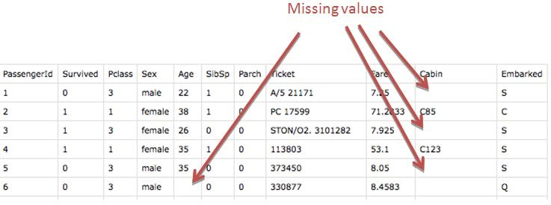
STEP 3

Slide 19
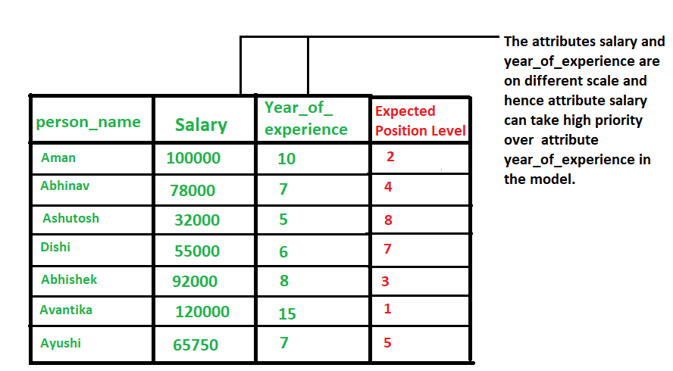
STEP 3

Slide 20
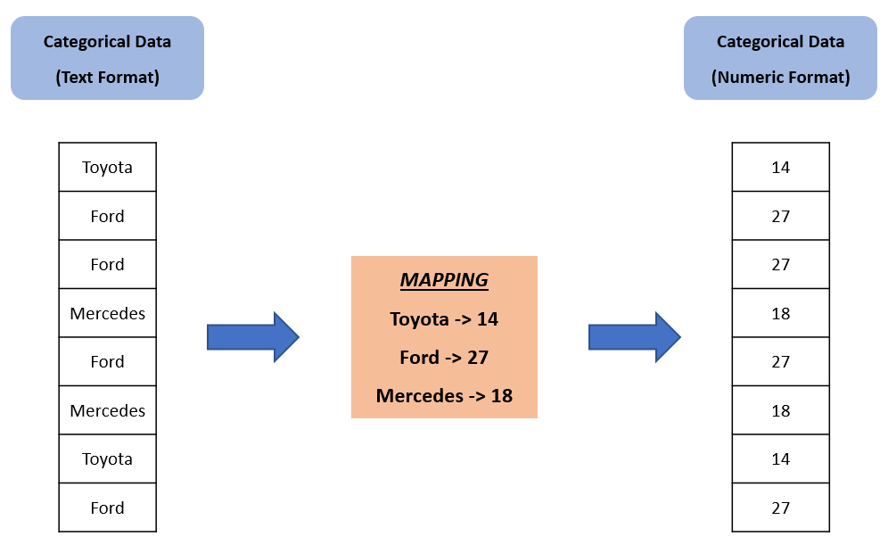
STEP 3

Slide 21
HOW TO BECOME
04
Some requirements to become Data Scientist

Slide 22





CODE
MATHEMATICS
STATISTICAL ANALYSIS
MACHINE LEARNING
SOFTWARE ENGINEERING

Slide 23
VARIOUS ROLES OFFERED TO A DATA SCIENTIST
Data Analyst
Machine Learning Engineer
Deep Learning Engineer
Data Engineer

Slide 24
THANKS FOR YOUR ATTENTION

