Slide 1


STM32 Bluetooth Car
Circuit Diagram & System Analysis
NUCLEO-F401RE · L298N Motor Driver · HC-05 Bluetooth · 4× DC Motors
mbed C++
UART 9600
PWM 1kHz
H-Bridge
Embedded Systems Assignment

Slide 2
Group 4
CS200558 - Duong Van Hoa
CE200171 - Nguyen Nhu Van Anh
CE200046 - Nguyen Gia Thuan
CE200736 - Nguyen Quoc Kiet
CE200509 - Le Hieu Dat
Mentor: Tran Ngoc Hoang

Slide 3
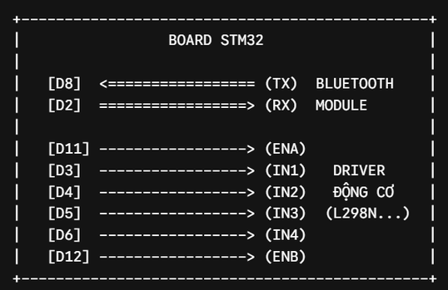
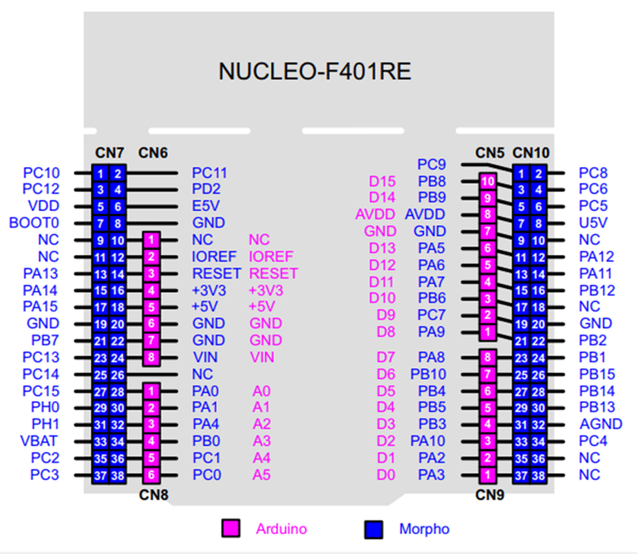
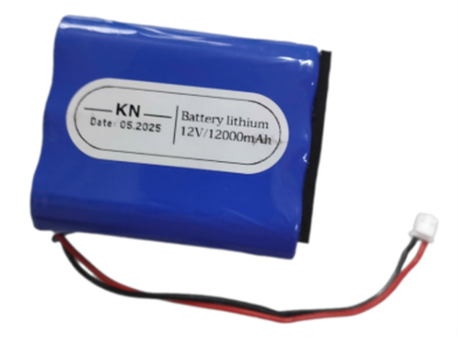
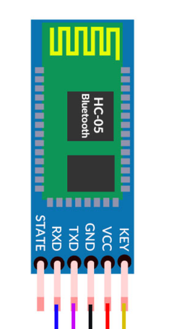
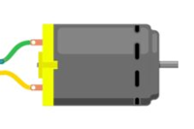
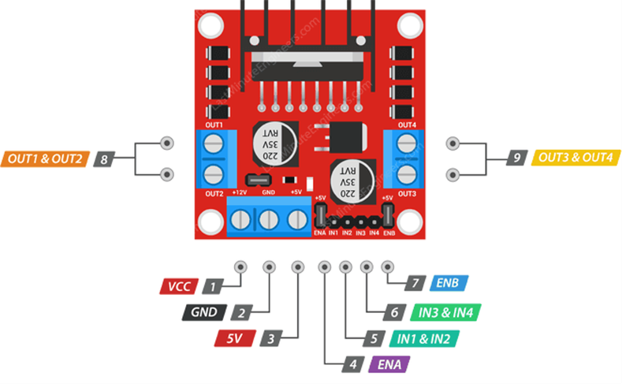
Circuit Diagram

Slide 4
System Operation — Questions & Analysis
❶ Motor Direction Control
❷ PWM Speed Control
STM32 GPIO pins D3–D6 drive L298N IN1–IN4. Setting IN1=HIGH, IN2=LOW (forward) or IN1=LOW, IN2=HIGH (backward) reverses H-bridge polarity. IN3/IN4 independently control the right-side motors.
ENA (D11) and ENB (D12) output 1 kHz PWM with 70% duty cycle by default (write(0.7)). Higher duty = more average voltage = faster spin. Speed is changed by calling ENA.write(0.0–1.0).
❸ HC-05 Bluetooth Role
❹ Shared GND Requirement
❺ External Power for Motors
All ICs need a common 0 V reference. Without shared GND between STM32, L298N, and HC-05, the logic voltages (HIGH/LOW) have no stable reference point — signals are undefined and communication fails.
DC motors draw 0.5–2 A each under load. The STM32 5V pin supplies only ~150–500 mA total — far too little for 4 motors. A 12V external supply feeds L298N's VM pin, providing the required current independently of the MCU.
HC-05 is a Bluetooth-to-UART bridge. A smartphone app sends command characters (F/B/L/R/S) wirelessly. HC-05 converts the RF signal to serial UART at 9600 baud, which STM32 reads on pin D2.
Flow:
📱 Phone
App
📡 HC-05
Bluetooth
🔌 UART
D2 / D8
🔧 STM32
F401RE
⚡ L298N
Driver
🚗 4× DC
Motors
Pin Mapping Reference
STM32 Pin | → Connected To | Function | STM32 Pin | → Connected To | Function
D2 (RX) | HC-05 TXD | BT Serial Receive | D11 (ENA~) | L298N ENA | PWM Left Speed
D8 (TX) | HC-05 RXD | BT Serial Transmit | D12 (ENB~) | L298N ENB | PWM Right Speed
D3 | L298N IN1 | Left Motor Dir A | 5V (out) | L298N VCC + HC-05 | Logic Power
D4 | L298N IN2 | Left Motor Dir B | GND | All GNDs (shared) | Common Reference 0V
D5 | L298N IN3 | Right Motor Dir A | 12V External | L298N VM | Motor Power Supply
D6 | L298N IN4 | Right Motor Dir B | OUT1–4 (L298N) | 4× DC Motors | Motor Terminals

Slide 5
Thank You
Group 4
CS200558 - Duong Van Hoa
CE200171 - Nguyen Nhu Van Anh
CE200046 - Nguyen Gia Thuan
CE200736 - Nguyen Quoc Kiet
CE200509 - Le Hieu Dat
Mentor: Tran Ngoc Hoang

