Slide 1




NetLLM: Adapting Large Language Models for Networking
Speaker: Duo Wu (Ph.D. student at Tsinghua University)
CUHK-Shenzhen
Tsinghua University
UChicago
Notes:
Good afternoon everyone. My name is duo wu. I am glad to introduce our work NetLLM. This is the work that we focus on using large language models to solve networking problems. Now let’s get started.
Hello! This is duo wu. I am glad to introduce our work NetLLM. This is the work that we focus on using large language models to solve networking problems. Now let’s get started.

Slide 2
Part 1 Why, What, How, Evaluation
Why we start this research
Notes:
The presentation will have four parts. The first part we will talk about the motivation our work. So let’s start the first part.

Slide 3


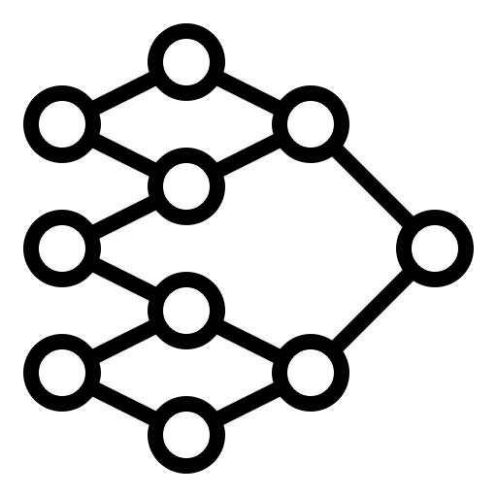
Deep Learning in Networking
Deep learning (DL) has been used to solve complex prediction and decision-making tasks in networking.
Prediction tasks
Traffic classification (WWW ’22)
Bandwidth prediction (NSDI ’20)
Viewport prediction (TPAMI ’22)
Decision-making tasks
Congestion control (SIGCOMM ’20, ’23)
Adaptive bitrate streaming (SIGCOMM ’17, ’22)
Cloud cluster job scheduling (SIGCOMM ’19)
Dataset/
Environment
Train
Deep Neural Network (DNN)
Network Service
DL in networking suffers from limits
Notes:
well deep learning has been popular in networking. It has been applied to solve prediction tasks like bandwidth prediction and decision-making tasks like adaptive bitrate streaming.
This figure shows the typically pipeline of the DL-based algorithms. First, we will design a deep neural network, represented as a policy. Then we use a dataset or networking environment to train the DNN model to automatically solve the networking problem. After that, we can deploy the DNN for network service.
However, even though there are so many DL researches in networking, they still suffer from some limits.

Slide 4


Limitation #1: Labor-intensive model engineering
The success of DL-based algorithms heavily relies on the manual design of black-box DNNs [1].
Trial-and-error design manner.
$×N$ times
Handcraft DNN
Validate DNN
Modify DNN
Dataset/
Environment
Good
DNN
Network Service
Train
I once spent three weeks to discover a good DNN! What a painful experience!
[1] Risto Miikkulainen, et al.. “Evolving deep neural networks”. In Artificial Intelligence in the Age of Neural Networks and Brain Computing (Second Edition). Academic Press, 269–287, 2024.
Notes:
The first is the success of DL algorithms heavily relies on the manual design of DNN models.
Unfortunately, due to the black-box nature of DNNs, the design process is done in a trial-and-error manner. That is, we will first handcraft a DNN, then evaluate its performance and if it doesn’t work, we will have to modify the DNN model. This process will keep going until we find a good DNN model. So the entire process can be labor intensive.

Slide 5


Limitation #1: Labor-intensive model engineering
The success of DL-based algorithms heavily relies on the manual design of black-box DNNs [1].
Trial-and-error design manner
DNN is not shareable across tasks
One model only for one task
Adaptive Bitrate Streaming (ABR)
ABR
DNN
ABR Service
Train
ABR
DNN
CJS Service
Cluster Job Scheduling (CJS)
Train
[1] Risto Miikkulainen, et al.. “Evolving deep neural networks”. In Artificial Intelligence in the Age of Neural Networks and Brain Computing (Second Edition). Academic Press, 269–287, 2024.
Notes:
To make thing worse, DNN is not shareable across different tasks. That said, if we have a well-design DNN for the bitrate streaming service. We cannot use the same DNN to do cluster job scheduling. This means one DNN only for one task, so we have to handcraft specialized DNNs for different tasks.

Slide 6

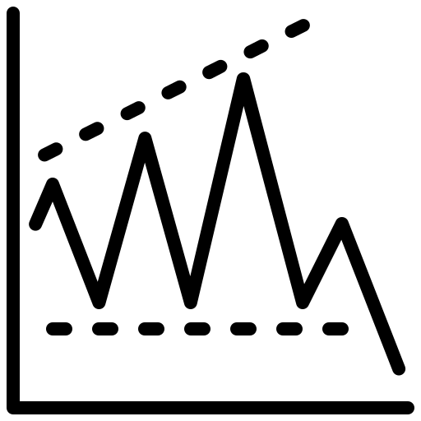


Limitation #2: Poor generalization
DL-based algorithms tend to achieve poor generalization on unseen data distributions or environments.
Stable
Network Env.
Stable
Network Env.
DNN
Train
Fluctuating
Network Env.
Can we use one model for all networking tasks with even stronger generalization?
Try large language model (LLM)!
[1] Risto Miikkulainen, et al.. “Evolving deep neural networks”. In Artificial Intelligence in the Age of Neural Networks and Brain Computing (Second Edition). Academic Press, 269–287, 2024.
Notes:
The second limit is that DL-based algorithms tend to achieve poor generalization on unseen data distributions or environments.
For example, if we train the DNN on statble network environments, it may not work well on the flucautating network environments.
So, to address these limits, we start to think that is it possible to use one model for ll networking tasks with even better generalization? Well, we think that the recent large language model could be the possible answer.

Slide 7
Part 2 Why, What, How, Evaluation
What we try to approach: Make LLM do networking!
Notes:
So let’s see what we try to approach in our research, that is make LLM do networking!

Slide 8







LLM: New Opportunities for Networking
Large language model (LLM), e.g., ChatGPT, Llama.
Large-scale pretraining to absorb extensive knowledge.
One model for all tasks with even better performance in natural language processing (NLP).
Conversations
Large-scale pretraining on massive data
LLM
(ChatGPT,
Llama, …)
Code Generation
Reasoning
Can LLM be used in other domains beyond NLP.
Of course!
Notes:
Well LLM has been popular in recent years. It is pre-trained on massive data to absorb extensive knowledge and then they can serve as the foundation model in nature language processing. In other words, with LLM, we can achieve one model for all tasks with even better performance in NLP.
Perhaps, we already know that the LLM is powerful in NLP, but it is natural to ask is LLM only useful in NLP. The answer is not.

Slide 9





LLM: New Opportunities for Networking
LLM is also a master in other domains beyond NLP.
LLM exhibits some emergent abilities.
These abilities prove to be transferable across domains.
Robotics Control
Common Abilities (Generalization, Planning, …)
LLM
(ChatGPT,
Llama, …)
Chip Design
Protein Prediction
Impressive! Is it possible to use LLM for networking?
Yes! That’s what we do!
Notes:
Researches have recently shown that LLM is not just a master in NLP. It can be successfully applied in other domains.
This is because after large-scale pre-training, LLM demonstrate some emergent abilities such as planning and generalization to unseen cases. These abilities prove to be transferable across domains. This allow the LLM to be applied in other domains, including robotics control, chip design, and protein structure prediction.
This is impressive, but is it possible to use LLM for networking? Of course, that’s exactly what we do.

Slide 10




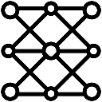

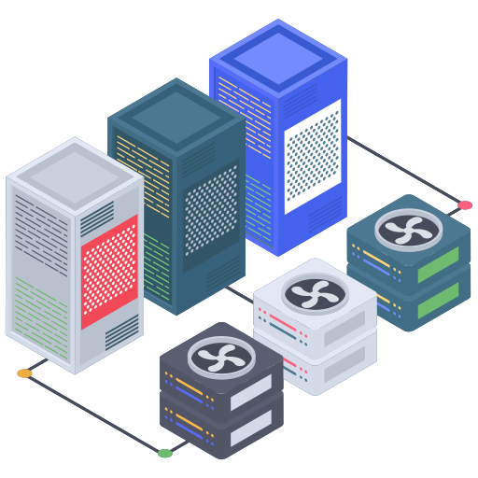
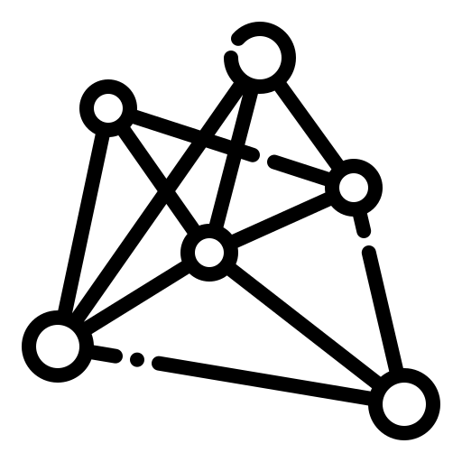
LLM: New Opportunities for Networking
Why use LLM for networking?
One LLM for various tasks.
Utilize its powerful capabilities to achieve better performance.
Bandwidth Prediction
DNN1
NetLLM
LLM
(ChatGPT,
Llama, …)
Video Streaming
DNN2
Job Scheduling
DNN3
Answer: Yes! Through our framework NetLLM!
Key question: Can we efficiently use the LLM to achieve “one model for all networking tasks” with even better performance?
Notes:
Why should we use LLM for networking? There are actually some certain beneftis.
First, we use one LLM to solve various networking tasks. In this way, we no longer need to handcraft DNNs for different tasks, so the model engineering overhead can be mimized.
What’s more, we can also utilize the powerful capabilities of the LLM to achieve better performance and generalization.
Therefore, in this paper, we try to answer the following key question: Can we efficiently harness the capabilities of LLM to achieve “one model for all networking tasks” with even better performance?
The answer is yes, through our framework NetLLM.

Slide 11
Part 3 Why, What, How, Evaluation
How we approach our goal
Notes:
Next, let’s talk how we design the NetLLM framework to approach our goal

Slide 12



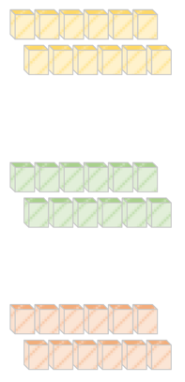



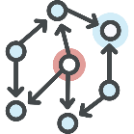
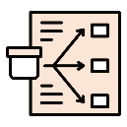
Overview of NetLLM
NetLLM: the first framework to adapt the LLM to solve networking tasks with low efforts.
Multimodal encoder (let LLM understand networking information effectively)
Networking head (let LLM generate answers for networking efficiently)
Data-driven low-rank networking adaptation (let LLM learn networking knowledge efficiently)
LLM
Low Rank Matrices
Viewport Prediction (VP)
Multimodal Encoder
Networking
Head
Adaptive Bitrate Streaming (ABR)
Cluster Job Scheduling (CJS)
…
…
Data-Driven Low-Rank Networking Adaptation
Notes:
NetLLM: the first framework to adapt the LLM to solve networking tasks with low efforts.
That said, while the LLM is originally designed for NLP, we can wrap the LLM with this framework to make it solve networking problems.
To be more specific, NetLLM consists of the following three modules to address three key challenges.
First is the multimodal encoder, which enables the LLM to understand the networking information effectively.
The second is the networking head, it enables the LLM to efficiently generate answers for networking.
Finally, we have a module called data-driven low-rank networking adaptation. It allows the LLM to efficiently learn domain knowledge for networking.
To make our discussion concrete, we will use three example cases to discuss the eidea of NetLLM.

Slide 13
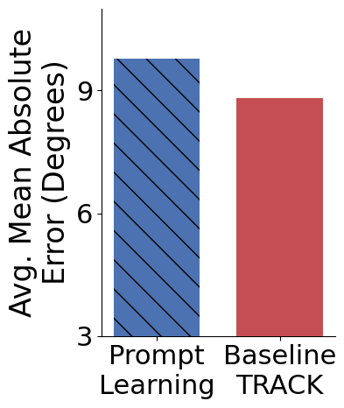

NetLLM – Multimodal Encoder
Challenge 1: How to enable the LLM to understand networking information?
Solution 1: Multimodal LLMs.
Support limited modalities so far.
Solution 2: Prompt Learning – Transform data into texts through a prompt template.
i) Only applicable to simple modalities (e.g., time-series data); ii) Suboptimal transformation.
Example case
Multimodal Information
LLM
Image in viewport prediction
11.1% worse than DL-based algorithm TRACK on viewport prediction task
Time-series data in bitrate streaming
Differ from plain text
Graph in job scheduling
Lower is better
…
Notes:
We will first talk about the multimodal encoder.
We know that networking tasks often collect various pieces of information for decisions. For instance, in bitrate streaming, we often collect network throughputs for bitrate decisions, which are represented as time-series data. Unfortunately, these pieces of information differ from plain text in terms of their modalities. Therefore, the LLM cannot directly process the networking information.

Slide 14

NetLLM – Multimodal Encoder
Challenge 1: How to enable the LLM to understand networking information?
Multimodal encoder: Project data into the same feature space as texts.
1) Feature encoder for feature extraction
2) Linear layer for feature projection
3) Normalization layer for feature fusion
Multimodal Information
Multimodal Encoder
Text-like features
LLM
Image in viewport prediction
ViT
Linear
Layer Norm
Time-series data in bitrate streaming
CNN
Linear
Layer Norm
Differ from plain text
Graph in job scheduling
GNN
Linear
Layer Norm
…
Notes:
So to address this challenge, we design the multimodal encoder. Our key idea is to project multimodal data into the same feature space as texts, so that the LLM can understand the multimodal networking information.
Specifically, for each modality, we reuse an existing feature encoder to extract features from raw data, such as vision transformer for image, and graph neural network for graph. Then, we use a linear layer to project these features to the feature space as text. Finally, we use a layer normalization layer to normalize these features to improve training stalibility. This will results in some text-like features that the LLM can effectively process.

Slide 15



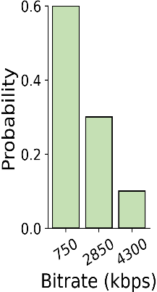


NetLLM – Networking Head
Challenge 2: How to enable the LLM to generate answers for networking efficiently?
Default: Token (i.e., sub-word) generation with a language modeling (LM) output head.
i) Multiple inferences -> high generation latency; ii) Uncertainty -> invalid answers
Networking head: a linear output layer to generate task-specific answers directly.
LLM
Language Modeling Head
“7”
download
Default mechanism
“0”
700 kbps
“0”
(Invalid)
750 kbps
<EOS>
Video chunks in different bitrates
Networking Head for Video Streaming
download
2850 kbps
Ours
750 kbps
(Valid)
4300 kbps
Notes:
After enabling the LLM to understand networking information, the next question is how to let the LLM generate answers for networking efficiently.
First of all, we need to look at the default mechanism for LLM to generate answers. By default, the LLM generates answer based on token generation using a language modeling output head. This figure demonstrates this mechanism. The output features of the LLM will be fed to the language modeling head, then the this head will predict a token. The generated token will be iteratively fed to the LLM to predict the next token. This process will keep going until we have a speicial token called end of sentence is predicted.
While this mechanism is well suited in NLP, it presents some limitation in the field of networking.
First, we can see that it takes multiple inferences for the LLM to generate a single answer, this will results in high generation latency. For example, in this figure, the LLM need 4 inferences to generate a bitrate. Besides, due to the uncertainty of token prediction, the generated answers can be invalied. For example, in this figure, the generated bitrate does not match any bitrate versions of the encoded video, so we cannot use it to download the video.
To address this challenge, our key idea is to replace the default language modeling head with our customized task-specific networking head. Each networking head is in fact a linear output layer to generate task-specific answers directly. For instance, in this figure, we design the networking head to output the probability distribution of bitrates, then we can sample a bitrate from the bitrate distribution. While this approach is simple, we can see that it can indeed generate answers in a single inference, and also guarantee the validness the generated answers.

Slide 16
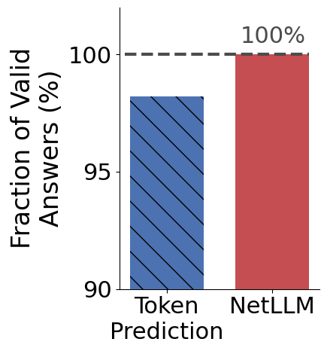
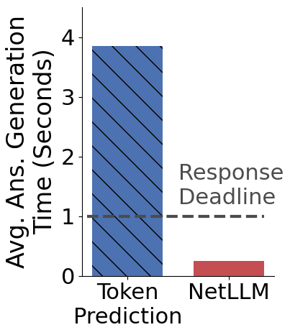
NetLLM – Networking Head
Challenge 2: How to enable the LLM to generate answers for networking efficiently?
Default: Token (i.e., sub-word) generation with a language modeling (LM) output head.
i) Multiple inferences -> high generation latency; ii) Uncertainty -> invalid answers
Networking head: a linear output layer to generate task-specific answers directly.
Compared to token prediction with LM head, NetLLM with networking head can:
Guarantee 100% validness of answers.
Reduce 93.6% generation time.
Quantitative results on viewport prediction task
Notes:
After enabling the LLM to understand networking information, the next question is how to let the LLM generate answers for networking efficiently.
First of all, we need to look at the default mechanism for LLM to generate answers. By default, the LLM generates answer based on token generation using a language modeling output head. This figure demonstrates this mechanism. The output features of the LLM will be fed to the language modeling head, then the this head will predict a token. The generated token will be iteratively fed to the LLM to predict the next token. This process will keep going until we have a speicial token called end of sentence is predicted.
While this mechanism is well suited in NLP, it presents some limitation in the field of networking.
First, we can see that it takes multiple inferences for the LLM to generate a single answer, this will results in high generation latency. For example, in this figure, the LLM need 4 inferences to generate a bitrate. Besides, due to the uncertainty of token prediction, the generated answers can be invalied. For example, in this figure, the generated bitrate does not match any bitrate versions of the encoded video, so we cannot use it to download the video.
To address this challenge, our key idea is to replace the default language modeling head with our customized task-specific networking head. Each networking head is in fact a linear output layer to generate task-specific answers directly. For instance, in this figure, we design the networking head to output the probability distribution of bitrates, then we can sample a bitrate from the bitrate distribution. While this approach is simple, we can see that it can indeed generate answers in a single inference, and also guarantee the validness the generated answers.

Slide 17
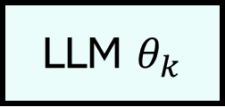


NetLLM – Data-Driven Low-Rank Networking Adaptation (DD-LRNA)
Challenge 3: How to fine-tune the LLM to learn networking knowledge efficiently?
The costs of fine-tuning the LLM are expensive because of the large parameter size.
Standard reinforcement learning (RL) requires active environment interaction.
Fully fine-tuning the LLM is expensive.
State, Reward
Experience Dataset
Network Env.
Standard RL Training
LLM $θ_{k}$
Train
LLM $θ_{k+1}$
Action
Time-consuming
$$θ_{k+1}$$
Time-consuming
Notes:
So far, we already address two key challenges, but due to the large domain gap between NLP and networking, the LLM cannot solve networking tasks very well.
Therefore, we need to fine-tune the LLM to learn domain knowledge for networking.
However, the costs of fine-tuning the LLM can be expensive becaues of the large parameter size of the LLM.
The reasons are two-fold.
First, we know that reinforcement learning has been widely used in networking. It requires to actively interact with the environments to collect experience dataset for training. So if we use the standard RL to fine-tune the LLM, we will spend a lot of time having the LLM interact with the environments. This process is time-consuming.
Second, since the parameter size of the LLM is huge, if we fully fine-tune all of its parameters, the training time will also be expensive.

Slide 18
NetLLM – Data-Driven Low-Rank Networking Adaptation (DD-LRNA)
Challenge 3: How to fine-tune the LLM to learn networking knowledge efficiently?
DD-LRNA: Significantly reduce the fine-tuning costs of LLM.
Remove interactions between LLM and environments based on data-driven RL.
Insert low-rank matrices to reduce the number of trainable parameters.
Reduce >30% training time
State, Reward
Experience Dataset
Reduce >15% training time
Network Env.
Existing non-LLM Policy
LLM $θ_{k}$
Train
LLM $θ_{k+1}$
LLM
Low-Rank Matrices
Action
+
$$θ_{k+1}$$
Notes:
Our DD-LRNA comes to the rescure. First, it remove the active interaction between the LLM and environments based on the data-driven RL technique. Instead, it use an existing non-LLM policy to collect the dataset once before training, the use the dataset to train the LLM throughput the training process. This can reduce more than 30% of training time compared to standard RL training.
Second, the DD-LRNA inserts some low-rank matrices to approximate the chaneges needed in the LLM parameters. This can constrain the parameter update to a small amount of parameters. Therefore, it can signifantly reduce the training time, with the reduction of more than 15%.

Slide 19
Part 4 Why, What, How, Evaluation
Main Evaluation Results
Notes:
Finally, Let’s discuss our main evaluation results.

Slide 20
Experiments – Setup
Tasks: Viewport Prediction (VP), Adaptive Bitrate Streaming (ABR), Cluster Job Scheduling (CJS).
Metrics: Mean absolute error (MAE) for VP, Quality of Experience (QoE) for ABR, job completion time (JCT) for CJS.
LLM: We use Llama2-7B as the default LLM.
Baselines: We compare the NetLLM-adapted Llama2 with three other state-of-the-art algorithms on each task.
Hardware: A Linux server equipped with eight Intel(R) Xeon(R) Gold 5318Y CPUs and two NVIDIA 40GB A100 GPUs.
Notes:
Now let’s talk about our experiments.
In our experiments, we evaluate NetLLM on three tasks, viewport prediction, adaptive bitrate streaming and cluster job scheduling.
We compare NetLLM with three other algorithms on each task, and we use the Llama2-7B as the default foundation model.

Slide 21
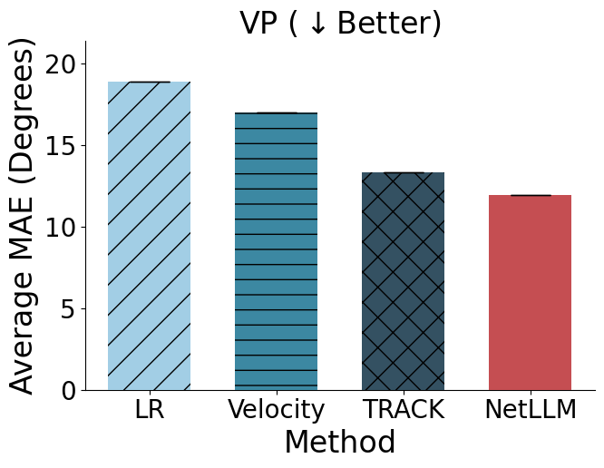
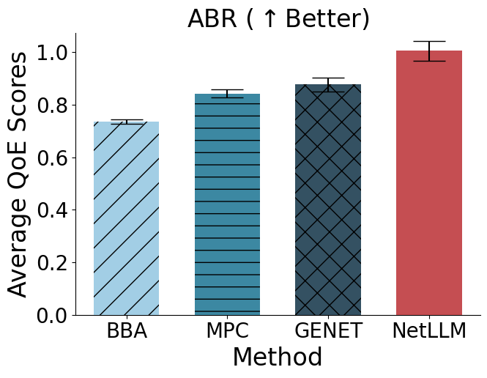
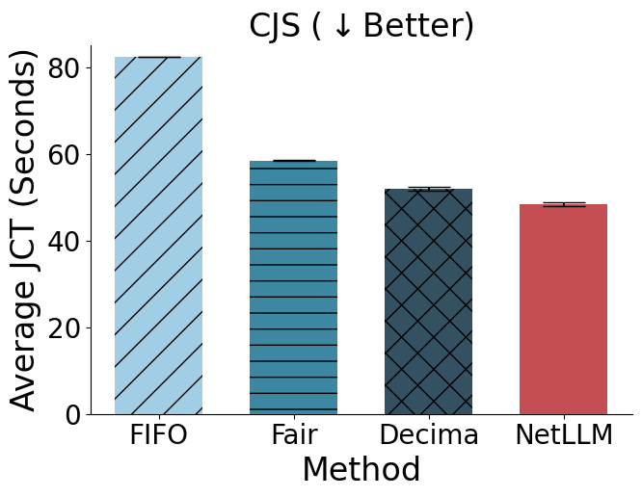

Experiments – General Evaluation Testing distributions $=$ Training Distributions
14.5-36.6% Improvement
6.8-41.3% Improvement
10.1-36.6% Improvement
Demonstrate the effectiveness of NetLLM in adapting the LLM for networking.
Showcase the potential of “one model for all tasks with better performance”!
Notes:
We first evaluate the performance of each method when the testing distributions are the same as training distributions.
The results are illustrated in the right figure.
We can see that the NetLLM-adapted Llama2 significantly outperforms baselines across all tasks! This demonstrates the effectiveness of NetLLM in networking adaptation. What’s more, the results here also showcase the potential of using a single LLM to solve different networking tasks.

Slide 22
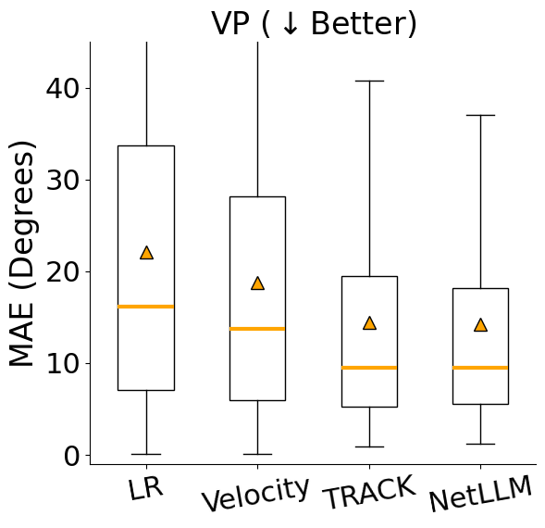
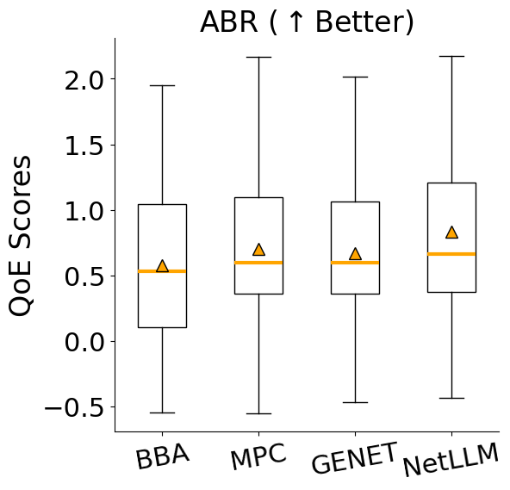
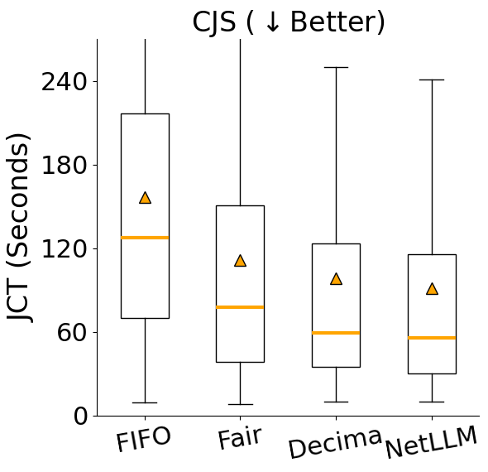

Experiments – Generalization Evaluation Testing distributions $≠$ Training Distributions
NetLLM-adapted Llama2 significantly outperforms baselines across all cases!
With NetLLM, we can indeed efficiently utilize the extensive knowledge of the LLM to achieve stronger generalization.
Notes:
Next, we evaluate the generalization performance of each method.
Still, we can see that the NetLLM-adapted Llama2 also achieve better generalization performance than others.
This indicates that with NetLLM, we can indeed utilize the extensive knowledge of LLM to achieve stronger generalization.

Slide 23
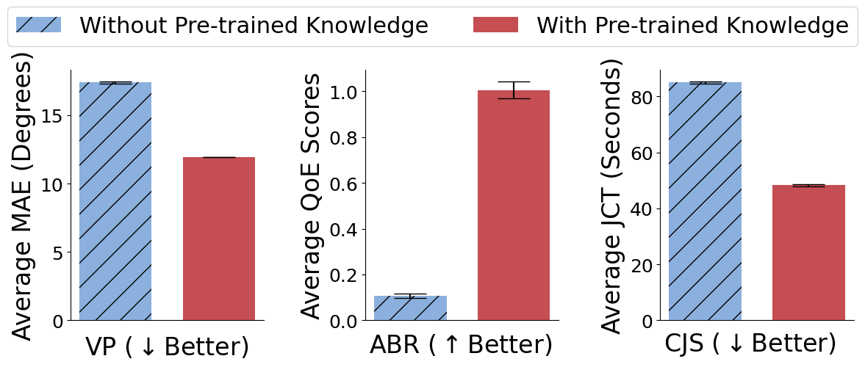
Experiments – Deep Dive Importance of Pre-trained Knowledge
Without Pre-trained Knowledge: Random initialize LLM instead of using its pre-trained parameters
Pre-trained knowledge is important, indicating that LLM indeed contains some common knowledge useful for networking.
Notes:
To understand why LLM can be used for networking, we investigate the importance of its pre-trained knowledge.
We remove the pre-trained knowledge of LLM by randomly setting its model parameters, and compare its performance with the regular case.
We can see that after removing the pre-trained knowledge, the performance of LLM significantly decreases. This show that LLM indeed contains some common knowledge and thus the pre-trained knowledge is essential for solving networking problems.

Slide 24
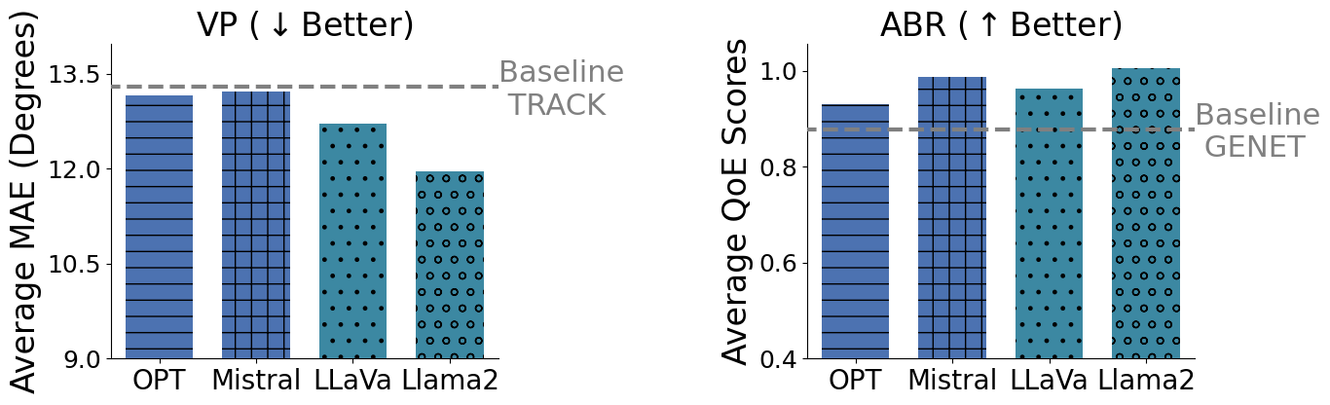
Experiments – Deep Dive Impacts of Different Types of LLMs
Improvement
Improvement
All the adapted LLMs outperform the state of the arts on both tasks.
Different LLMs can be adapted to solve networking tasks with our NetLLM framework
Notes:
Next, we investigate the whether NetLLM is applicable to various LLMs.
We find an interesting phenomenon. When the parameter size is less than 1 billion, the LLM starts to perform well on VP but poorly on ABR. That said, it is no longer able to generalize across different networking tasks. This suggests that the 1 billion could be the boarder line when using LLMs for networking problems.

Slide 25
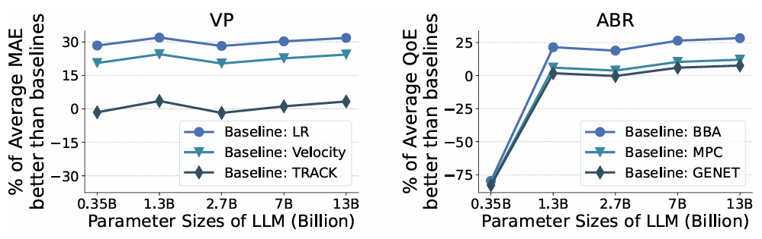
Experiments – Deep Dive Impacts of LLM Parameter Size
We use OPT as the LLM for this investigation, which offers different versions with varying parameter sizes.
The LLM of 0.35 billion parameters performs well on VP but poorly on ABR.
Indicating that 1B could be the boarder line of using LLM for networking.
Notes:
Next, we investigate the impacts of LLM parameter size.
We find an interesting phenomenon. When the parameter size is less than 1 billion, the LLM starts to perform well on VP but poorly on ABR. That said, it is no longer able to generalize across different networking tasks. This suggests that the 1 billion could be the boarder line when using LLMs for networking problems.

Slide 26
Final Note
Can we use the LLM to achieve “one model for all networking tasks” with even better performance?
Of course! NetLLM can do that for us!
Is NetLLM applicable to various LLMs?
Of course! NetLLM is compatible with different LLMs!
Is this the end story of using LLMs for networking?
No! We hope NetLLM can inspire more researches on LLMs for networking!
Notes:
Now at the end of this presentation, let’s answer some key questions.
NetLLM is the firs to systematically provide a coherent design to utilize LLMs for networking.
It showcases the promising potential of using the LLM as the single foundation model to solve various networking problems.
Although NetLLM is by no means the final solution, we hope that its can serve as the stepping stone to inspire more research on LLMs for networking.

Slide 27
Final Note
Broader Impact…
Input Processing
Multimodal Encoder of NetLLM
LLM Domain Adaptation
Output Processing
Networking Head of NetLLM
Training Method
DD-PEFT fine-tuning scheme of NetLLM
NetLLM is the first to provide a coherent design for LLM domain adaptation.
Though originally intended for networking, NetLLM provides valuable insights on LLM domain adaptation for the broader research communities.
Notes:
Now at the end of this presentation, let’s answer some key questions.
NetLLM is the firs to systematically provide a coherent design to utilize LLMs for networking.
It showcases the promising potential of using the LLM as the single foundation model to solve various networking problems.
Although NetLLM is by no means the final solution, we hope that its can serve as the stepping stone to inspire more research on LLMs for networking.

Slide 28
NetLLM: Adapting Large Language Models for Networking
Thank you for listening!
Check out our paper for more details: https://doi.org/10.1145/3651890.3672268
Check out our github repository: https://github.com/duowuyms/NetLLM
CUHK-Shenzhen
Tsinghua University
UChicago
Notes:
Good afternoon everyone. My name is duo wu. I am glad to introduce our work NetLLM. This is the work that we focus on using large language models to solve networking problems. Now let’s get started.
Hello! This is duo wu. I am glad to introduce our work NetLLM. This is the work that we focus on using large language models to solve networking problems. Now let’s get started.

